Slide 1
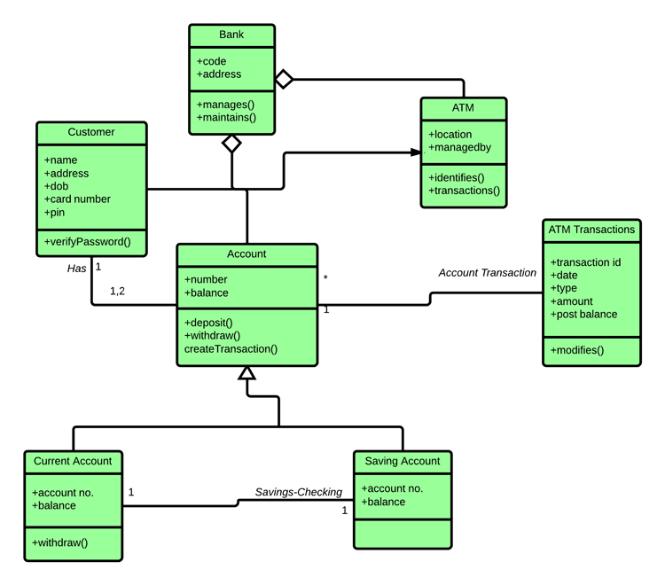
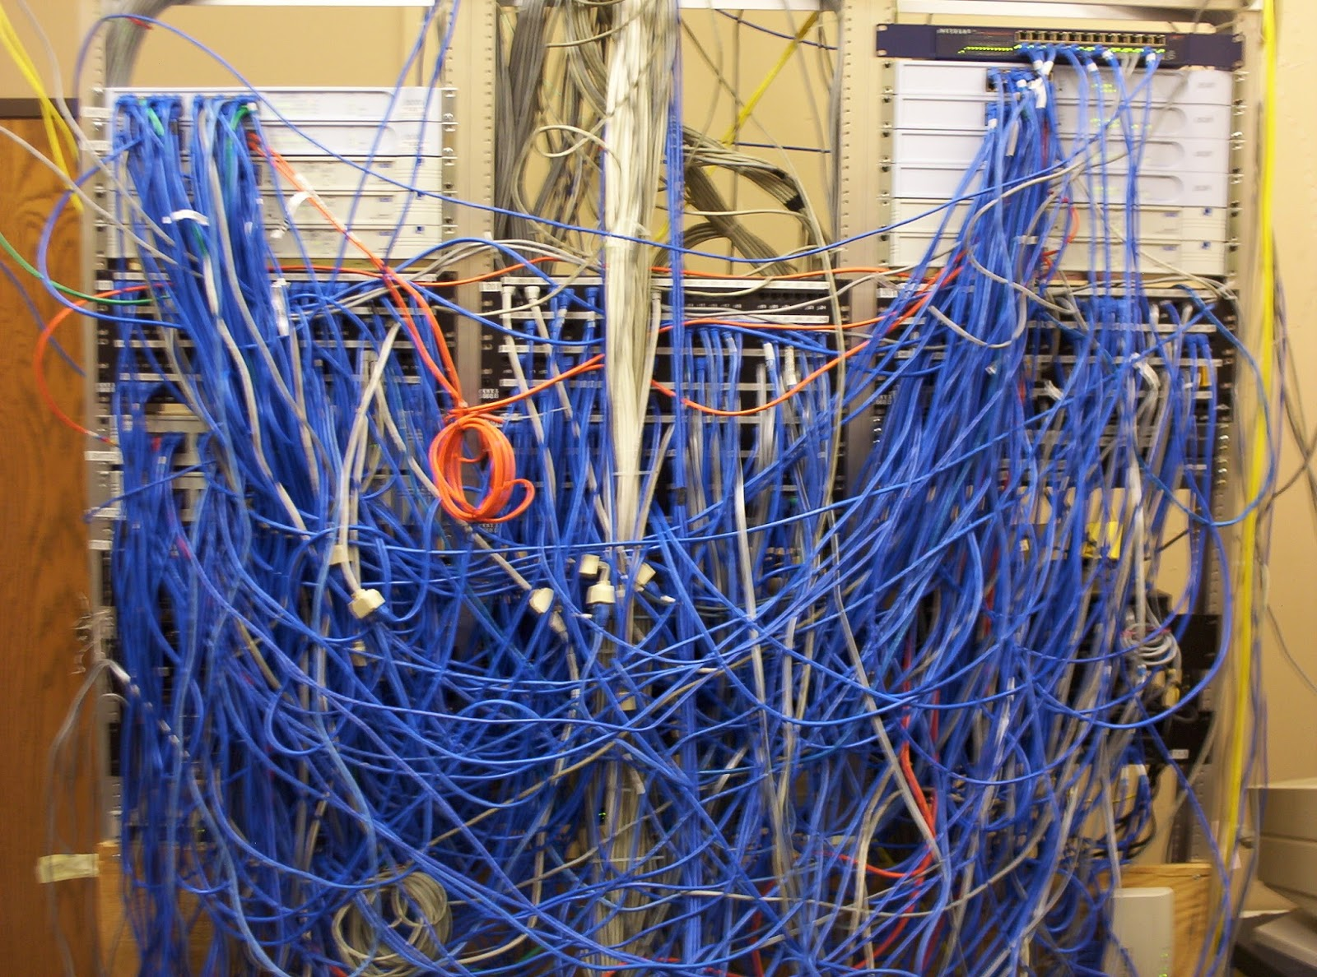
Introduction to Software Engineering
CS 6100 — Fall 2025
Tong Zhou
tzhou44@fordham.edu

Slide 2
What is Software Engineering?
“The application of a systematic, disciplined, quantifiable approach to the development, operation, and maintenance of software; that is, the application of engineering to software.”
— defined by IEEE
More than coding — involves people, processes, and tools.

Slide 3
Software vs. Program
Program: a single, stand-alone piece of code that solves a specific problem.
Software: computer programs, procedures, and possibly associated documentation and data pertaining to the operation of a computer system.
Programs (code) are part of a software.

Slide 4


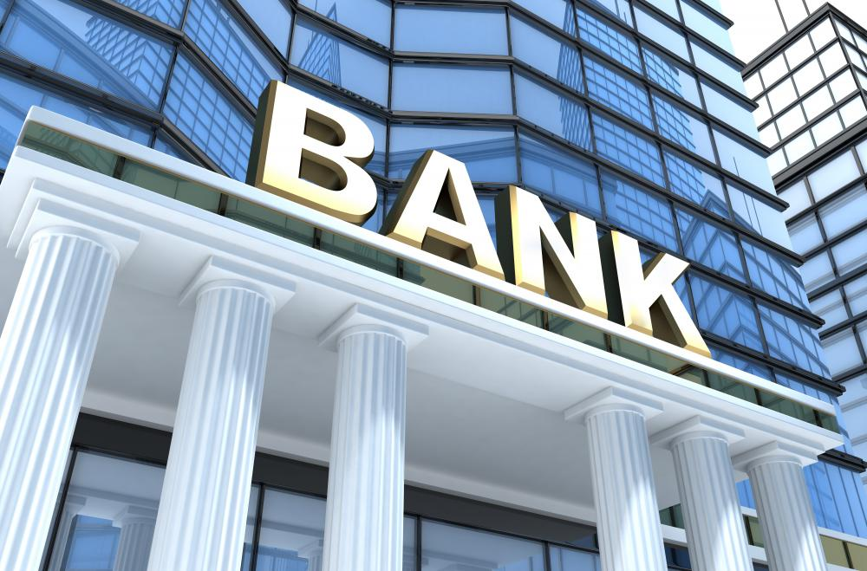
Why Software Engineering?
Software is Everywhere
Example: An MRI scanner, an airplane autopilot system, and your ride-share app — all run on complex software
Point: These systems must be safe, reliable, and maintainable

Slide 5
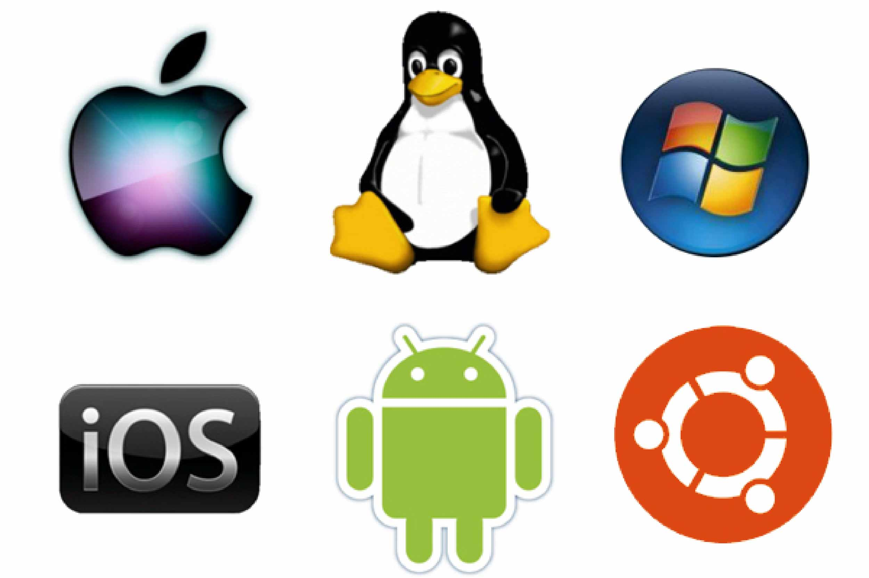




Why Software Engineering?
Software is Everywhere
Example: An MRI scanner, an airplane autopilot system, and your ride-share app — all run on complex software
Point: These systems must be safe, reliable, and maintainable

Slide 6
Why Software Engineering?
Code Is Easy to Write, Hard to Manage
Example: A prototype written in a hackathon might work once, but will break with real users, multiple developers, or scaling needs
Point: SE helps manage complexity, especially in large teams and long-term projects

Slide 7
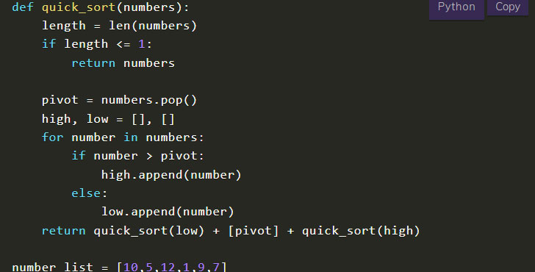
Why Software Engineering?
Code Is Easy to Write, Hard to Manage
Example: A prototype written in a hackathon might work once, but will break with real users, multiple developers, or scaling needs
Point: SE helps manage complexity, especially in large teams and long-term projects
Homework assignment
https://www.codingcreativo.it/python-quicksort/

Slide 8
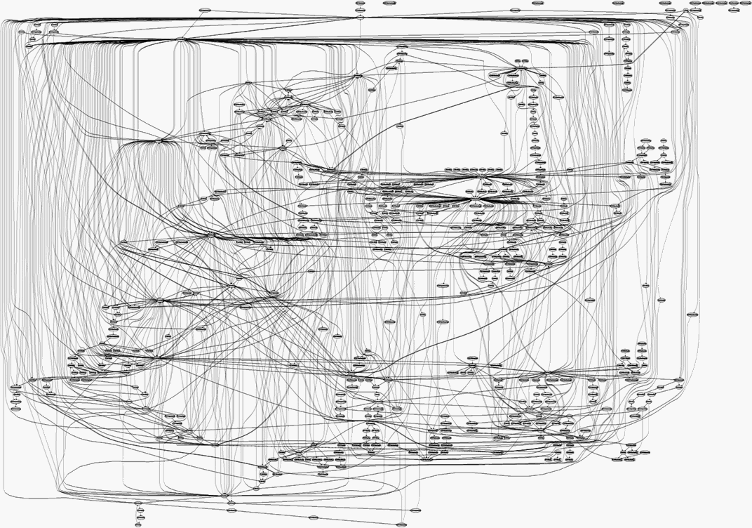
Why Software Engineering?
Code Is Easy to Write, Hard to Manage
Example: A prototype written in a hackathon might work once, but will break with real users, multiple developers, or scaling needs
Point: SE helps manage complexity, especially in large teams and long-term projects
Real large-scale software project
Homework assignment
https://www.codingcreativo.it/python-quicksort/
https://medium.freecodecamp.org/building-and-installing-the-latest-linux-kernel-from-source-6d8df5345980

Slide 9
Why Software Engineering?
Modern software = millions of lines of code
Google: 9 million source code files, 2 billion lines of source code (as of 2015)
Facebook: 9.9 million lines of open source code (as of 2014)
Linux kernel: over 15 million lines of code (as of 2013)
Used by millions, across multiple platforms
Web, desktop, mobile
Errors are costly: time, money, reputation, lives.

Slide 10
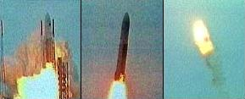
Ariane 5 Flight 501
Left/center: liftoff (June 4th, 1996)
Right: self-destruct after 39 seconds
~ 500 million US-$ damage
Image source: https://www-users.cse.umn.edu/~arnold/disasters/ariane.html

Slide 11
Ariane 5 Flight 501
Reasons: integer overflow
64-bit float velocity converted to 16-bit integer
Measurement > 32768 → overflow → uncaught exception → system crash
Software reused from Ariane 4
Old rocket was slower, overflow impossible
No overflow handler → system crash with Ariane 5

Slide 12
Famous software failure: Therac-25
(1985–87): Radiation overdoses → patient deaths.

Slide 13
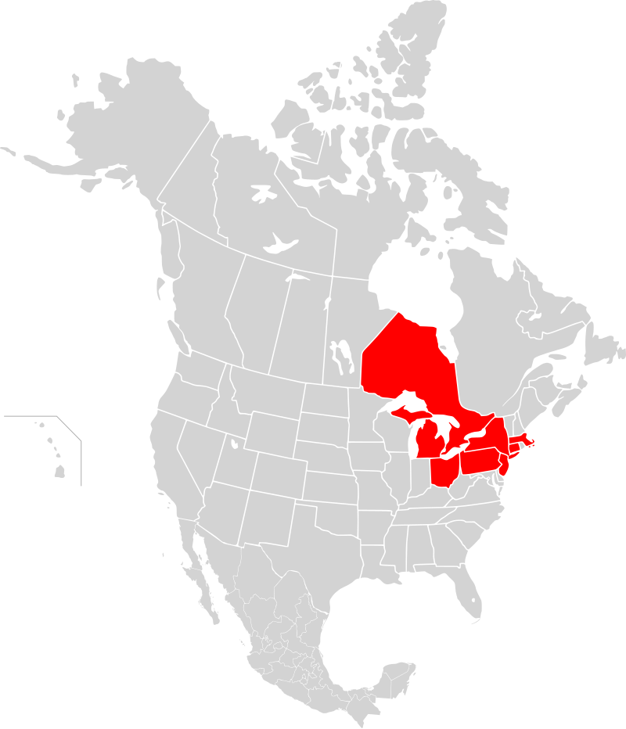
Northeast Blackout of 2003
The world’s second most widespread blackout in history at its time
Affected an estimated 55 million people (14,300,000 affected in NYC and its surroundings)
Outage map
Source: https://web.archive.org/web/20110610163731/http://www.securityfocus.com/news/8412

Slide 14
Northeast Blackout of 2003
A race condition existed in General Electric Energy's Unix-based XA/21 energy management system
Compiled from 4 million lines of C code
The triggered race condition stalled the control room’s alarm system for over an hour
Two processes both got write access to a shared data structure at the same time
That corruption led to the alarm event application getting into an infinite loop
Outage map
Source: https://web.archive.org/web/20110610163731/http://www.securityfocus.com/news/8412

Slide 15
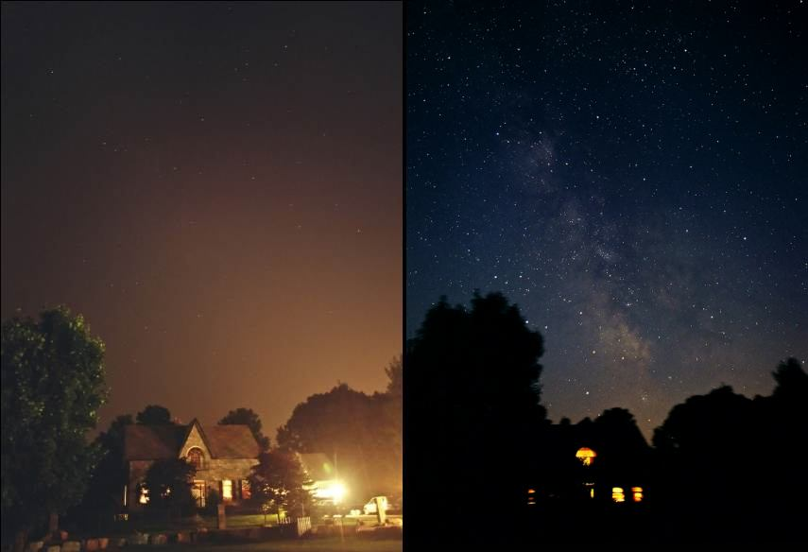
Northeast Blackout of 2003
The milky way became visible in populated areas during the power outage
Normal night
During the outage
Source: http://www.illinoislighting.org/loss.html

Slide 16
The Challenges
Growing complexity
Changing requirements
Large teams & coordination
Testing & quality assurance
Performance & scalability

Slide 17
Core Principles to Tame Complexity
Abstraction — focus on the “what” not the “how”
Modularity — divide and conquer
Encapsulation — control access to internal details
Separation of Concerns — each part handles one responsibility
Iterative Development — build, test, refine

Slide 18
Software Engineering in the Real World
~70% of cost = maintenance ¹
Good SE → reliability, maintainability, scalability
Examples: Linux kernel, SpaceX flight software
1: Software Evolution and Maintenance: A Practitioner's Approach, 2014

Slide 19
Main course topics
How to write quality code?

Slide 20
Main course topics
How to write quality code?
Usable
Less error-prone
Easier to maintain
Reusable
…

Slide 21
Main course topics
How to write quality code?
Usable
Less error-prone
Easier to maintain
Reusable
…
How to manage a software project effectively?

Slide 22
Main course topics
How to write quality code?
Usable
Less error-prone
Easier to maintain
Reusable
…
How to manage a software project effectively?
Meet the user requirements
Delivered in a timely manner
…

Slide 23
Main course topics
How to write quality code?
Object oriented programming
UML and design patterns
Testing
Code quality
How to manage a software project effectively?
Requirements engineering
Software development process
Tools: Git, CI/CD

Slide 24
Miscellaneous course topics
Web development basics
Front end/back end interaction
Concurrency
Improve scalability

Slide 25
Acknowledgements
Course materials are inspired by or adapted from previous offerings of CS 6100 by Prof. Bill Lord, and the open source teaching materials by Prof. Florian Echtler.

Slide 26
Course logistics
Textbook (reference)
Software Engineering 10th edition, by Ian Sommerville
Prerequisites
Basic programming skills
Final grade
20% homework assignments
20% midterm exam
60% software engineering project

Slide 27
Semester-Long Project – Gomoku Game
A simple game with minimal domain knowledge
Some level of complexity will be incorporated into the software

Slide 28
Gomoku Game Demo

Slide 29
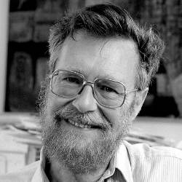
Final Thought
The computing scientist‘s main challenge is not to get confused by the complexities of his own making ----- Edsger Dijkstra
https://cacm.acm.org/news/an-interview-with-edsger-w-dijkstra/

