Slide 1
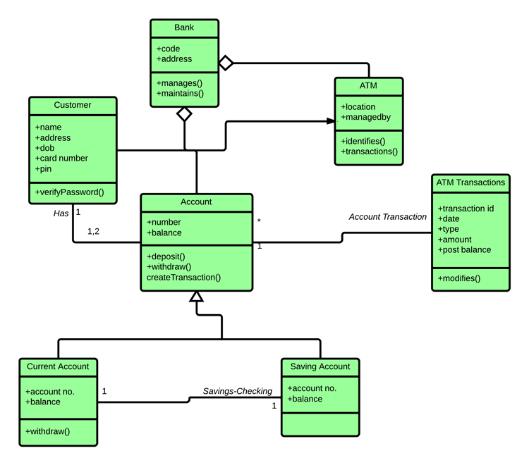
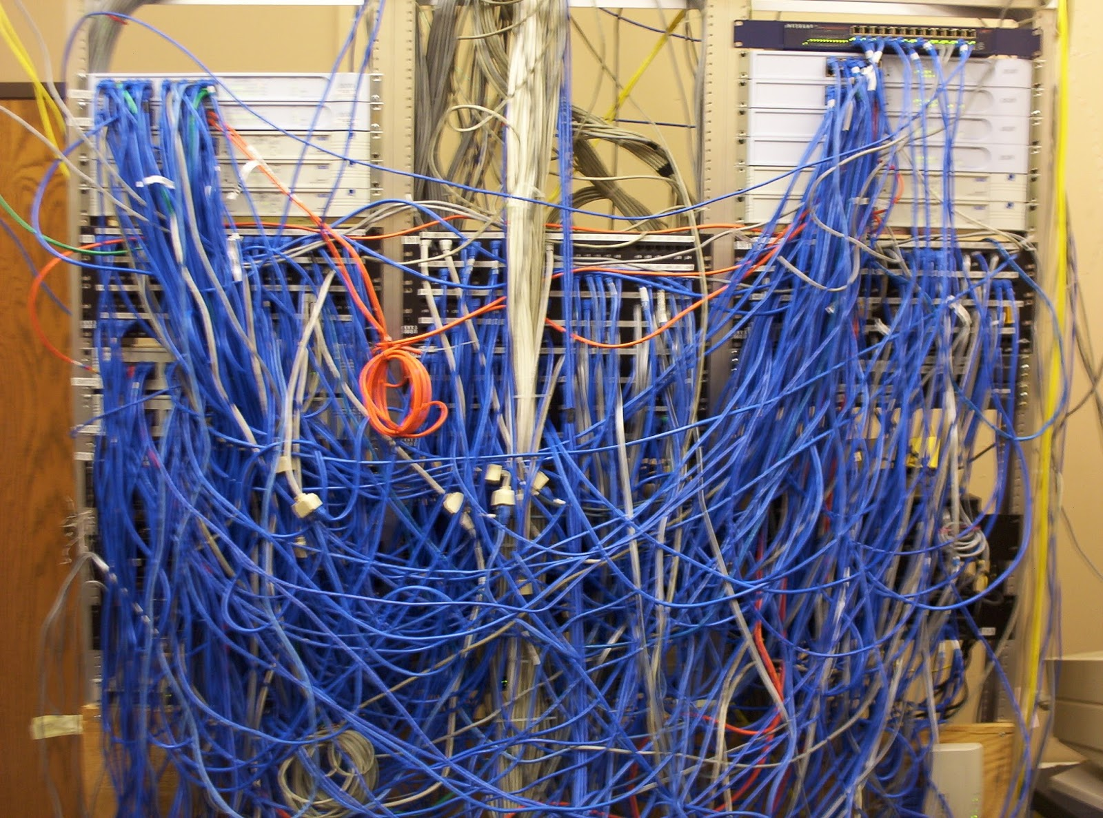
Introduction to Software Engineering
CS 6100 — Fall 2025
Tong Zhou
tzhou44@fordham.edu

Slide 2
What is Software Engineering?
“The application of a systematic, disciplined, quantifiable approach to the development, operation, and maintenance of software; that is, the application of engineering to software.”
— defined by IEEE
More than coding — involves people, processes, and tools.

Slide 3
Software vs. Program
Program: a single, stand-alone piece of code that solves a specific problem.
Software: computer programs, procedures, and possibly associated documentation and data pertaining to the operation of a computer system.
Programs (code) are part of a software.

Slide 4


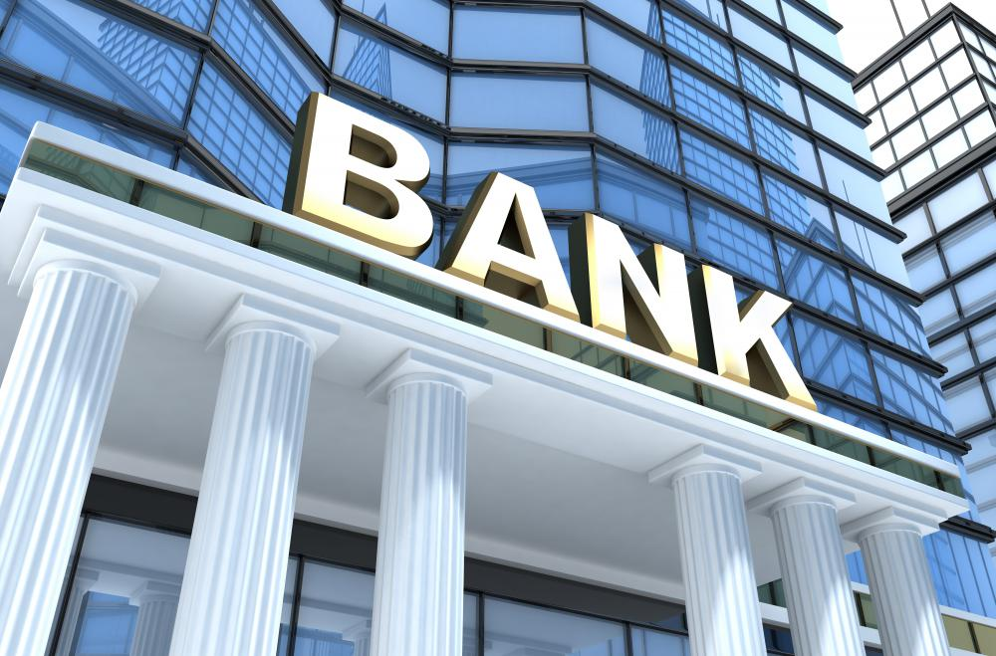
Why Software Engineering?
Software is Everywhere
Example: An MRI scanner, an airplane autopilot system, and your ride-share app — all run on complex software
Point: These systems must be safe, reliable, and maintainable

Slide 5
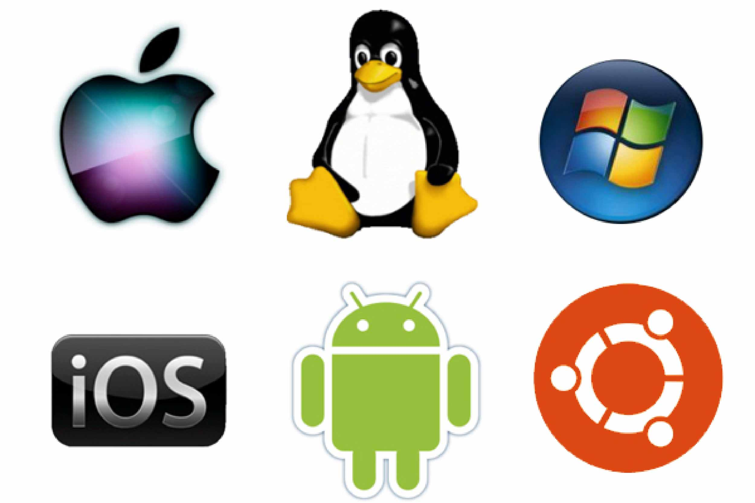




Why Software Engineering?
Software is Everywhere
Example: An MRI scanner, an airplane autopilot system, and your ride-share app — all run on complex software
Point: These systems must be safe, reliable, and maintainable

Slide 6
Why Software Engineering?
Code Is Easy to Write, Hard to Manage
Example: A prototype written in a hackathon might work once, but will break with real users, multiple developers, or scaling needs
Point: SE helps manage complexity, especially in large teams and long-term projects

Slide 7
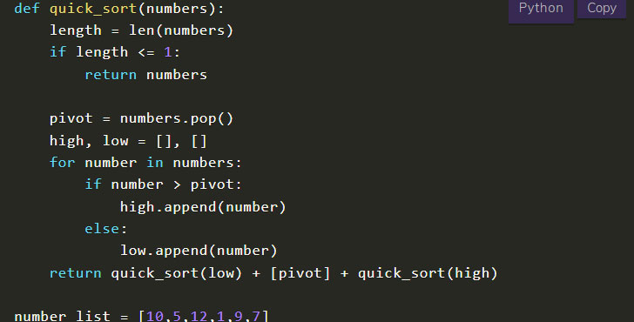
Why Software Engineering?
Code Is Easy to Write, Hard to Manage
Example: A prototype written in a hackathon might work once, but will break with real users, multiple developers, or scaling needs
Point: SE helps manage complexity, especially in large teams and long-term projects
Homework assignment
https://www.codingcreativo.it/python-quicksort/

Slide 8
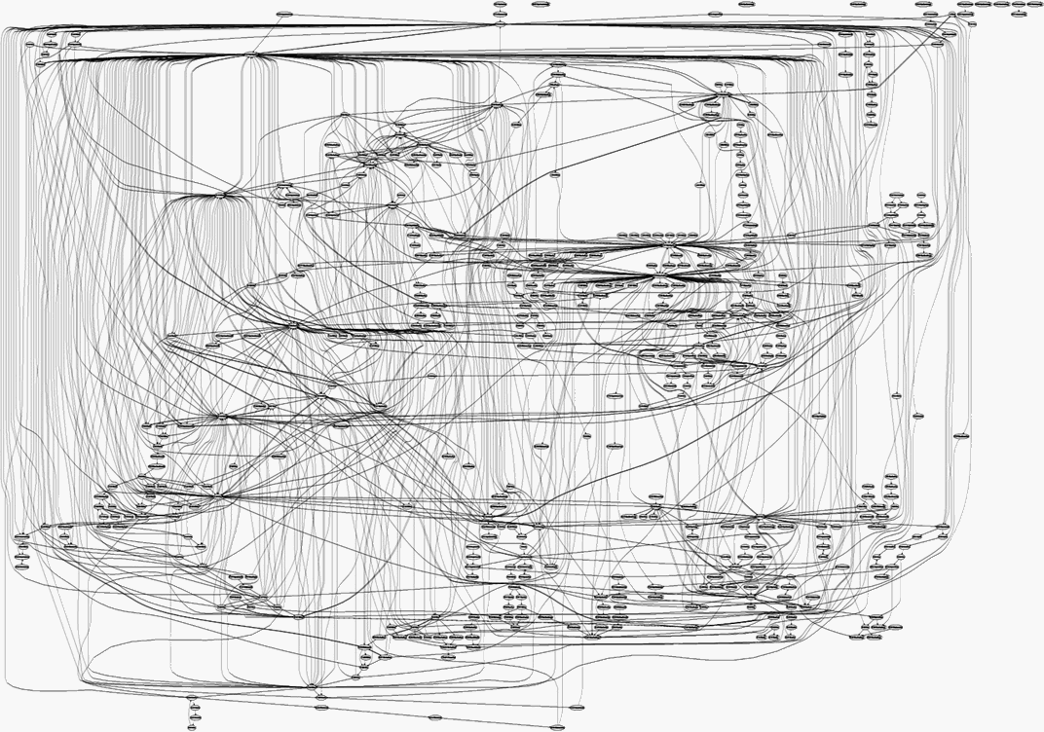
Why Software Engineering?
Code Is Easy to Write, Hard to Manage
Example: A prototype written in a hackathon might work once, but will break with real users, multiple developers, or scaling needs
Point: SE helps manage complexity, especially in large teams and long-term projects
Real large-scale software project
Homework assignment
https://www.codingcreativo.it/python-quicksort/
https://medium.freecodecamp.org/building-and-installing-the-latest-linux-kernel-from-source-6d8df5345980

Slide 9
Why Software Engineering?
Modern software = millions of lines of code
Google: 9 million source code files, 2 billion lines of source code (as of 2015)
Facebook: 9.9 million lines of open source code (as of 2014)
Linux kernel: over 15 million lines of code (as of 2013)
Used by millions, across multiple platforms
Web, desktop, mobile
Errors are costly: time, money, reputation, lives.

Slide 10

Ariane 5 Flight 501
Left/center: liftoff (June 4th, 1996)
Right: self-destruct after 39 seconds
~ 500 million US-$ damage
Image source: https://www-users.cse.umn.edu/~arnold/disasters/ariane.html

Slide 11
Ariane 5 Flight 501
Reasons: integer overflow
64-bit float velocity converted to 16-bit integer
Measurement > 32768 → overflow → uncaught exception → system crash
Software reused from Ariane 4
Old rocket was slower, overflow impossible
No overflow handler → system crash with Ariane 5

Slide 12
Famous software failure: Therac-25
(1985–87): Radiation overdoses → patient deaths.

Slide 13
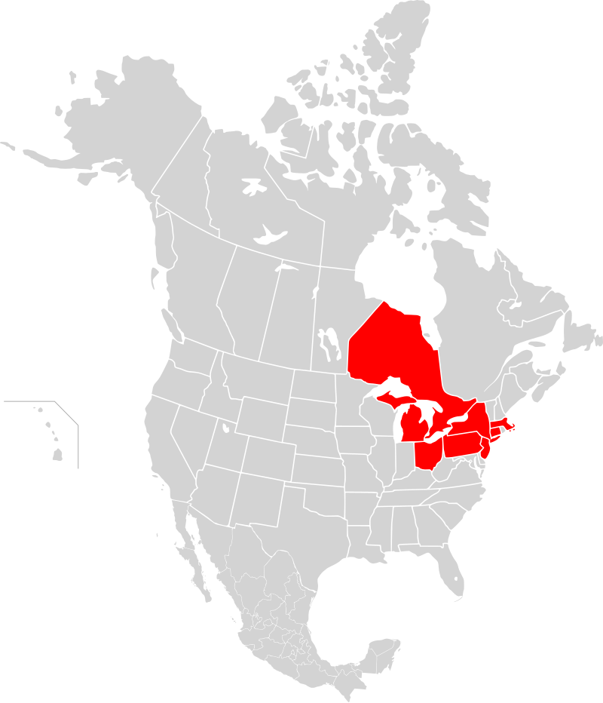
Northeast Blackout of 2003
The world’s second most widespread blackout in history at its time
Affected an estimated 55 million people (14,300,000 affected in NYC and its surroundings)
Outage map
Source: https://en.wikipedia.org/wiki/Northeast_blackout_of_2003

Slide 14
Northeast Blackout of 2003
A race condition existed in General Electric Energy's Unix-based XA/21 energy management system
Compiled from 4 million lines of C code
The triggered race condition stalled the control room’s alarm system for over an hour
Two processes both got write access to a shared data structure at the same time
Exhaustive testing did not find the bug
Outage map
Source: https://web.archive.org/web/20110610163731/http://www.securityfocus.com/news/8412

Slide 15
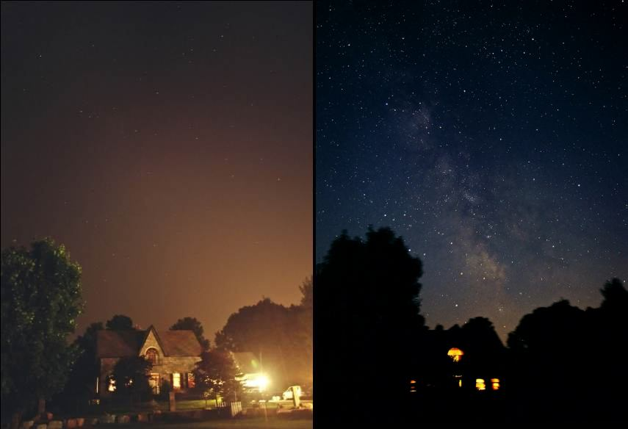
Northeast Blackout of 2003
The milky way became visible in populated areas during the power outage
Normal night
During the outage
Source: http://www.illinoislighting.org/loss.html

Slide 16
The Challenges
Growing complexity
Changing requirements
Large teams & coordination
Testing & quality assurance
Performance & scalability

Slide 17
Core Principles to Tame Complexity
Abstraction — focus on the “what” not the “how”
Modularity — divide and conquer
Encapsulation — control access to internal details
Separation of Concerns — each part handles one responsibility
Iterative Development — build, test, refine

Slide 18
Software Engineering in the Real World
~70% of cost = maintenance ¹
Good SE → reliability, maintainability, scalability
Examples: Linux kernel, SpaceX flight software
1: Software Evolution and Maintenance: A Practitioner's Approach, 2014

Slide 19
Main Topics
Building Quality Code
Usable
Less error-prone
Easier to maintain
…
Managing Software Projects
Meet the user requirements
Delivered in a timely manner
…

Slide 20
Main Topics
Building Quality Code
Object-oriented programming
UML & design patterns
Testing
Code quality
Managing Software Projects
Software development process
Requirements engineering
Tools: Git, CI/CD

Slide 21
Miscellaneous Topics
Web development basics
Front end/back end interaction
Concurrency
Improve scalability

Slide 22
Acknowledgements
Course materials are inspired by or adapted from previous offerings of CISC 6100 by Prof. Bill Lord, and open source teaching materials by Prof. Florian Echtler.

Slide 23
Course logistics
Textbook (reference)
Software Engineering 10th edition, by Ian Sommerville
Prerequisites
Basic programming skills
Final grade
20% homework assignments
20% midterm exam
60% software engineering project

Slide 24
Semester-Long Project – Gomoku Game
A simple game with minimal domain knowledge
Some level of complexity will be incorporated into the software

Slide 25
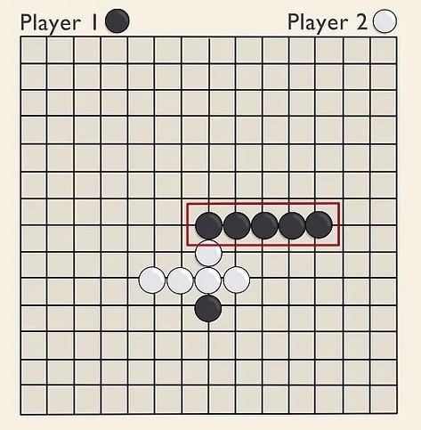
Gomoku Game Demo
Two players alternate turns.
Win: unbroken line of 5 of your stones, horizontally, vertically, or diagonally.
Image source: https://www.wikihow.com/Play-Gomoku

Slide 26
Project Goal
Build a web application where users can play Gomoku locally or online with a friend by sharing a link
Project specification specifies a list of mandatory features, while you can implement additional features you find fun
Work in teams of 3 people (form your team by Sep. xxx)

Slide 27
Or You Own Project
Send me a project proposal with specific product features, project milestones, teams members and demonstrate that it’s both manageable and related to class topics.

Slide 28
A Brief History of Software Engineering
1950s–60s: Early Days
Software was handcrafted by scientists & engineers
No standard processes; code was often treated as an accessory to hardware
1968: The "Software Crisis"
Coined at the NATO Conference on Software Engineering
Large projects over budget, late, unmaintainable, or outright failures
Highlighted lack of engineering discipline in software

Slide 29
A Brief History of Software Engineering
1970s–90s: Foundational Work
Structured programming (Dijkstra, Parnas)
Object-Oriented programming (Simula -> Smalltalk -> C++)
Waterfall model (Winston Royce)
SE education and textbooks emerge
2000s–Now: Agile & Beyond
Agile Manifesto (2001) → shift toward adaptability and people
Rise of DevOps, CI/CD, microservices
Software as infrastructure (cloud, AI, ML systems)
Notes:
During the 1970s to 1990s, software engineering began to mature as a discipline.
First, structured programming, championed by Edsger Dijkstra and David Parnas, emphasized clarity, modularity, and control flow discipline. It moved us away from chaotic 'spaghetti code' and toward code that could be reasoned about and maintained.
Around the same time, object-oriented programming (OOP) started to gain traction. The idea came from earlier languages like Simula and Smalltalk, but it wasn’t until C++ in the 1980s that OOP became mainstream in commercial software. Later, Java further cemented OOP in industry and education during the 1990s.
Another important development was the Waterfall model, proposed by Winston Royce in 1970. Though originally a cautionary example, it was widely adopted in industry as a sequential approach to software development — progressing from requirements to design, implementation, testing, and maintenance.
Finally, we began to see the formalization of software engineering education. University courses, degree programs, and textbooks started to appear, helping to professionalize the field and establish common best practices. During the 1970s to 1990s, software engineering began to mature as a discipline.
First, structured programming, championed by Edsger Dijkstra and David Parnas, emphasized clarity, modularity, and control flow discipline. It moved us away from chaotic 'spaghetti code' and toward code that could be reasoned about and maintained.
Around the same time, object-oriented programming (OOP) started to gain traction. The idea came from earlier languages like Simula and Smalltalk, but it wasn’t until C++ in the 1980s that OOP became mainstream in commercial software. Later, Java further cemented OOP in industry and education during the 1990s.
Another important development was the Waterfall model, proposed by Winston Royce in 1970. Though originally a cautionary example, it was widely adopted in industry as a sequential approach to software development — progressing from requirements to design, implementation, testing, and maintenance.
Finally, we began to see the formalization of software engineering education. University courses, degree programs, and textbooks started to appear, helping to professionalize the field and establish common best practices. The Waterfall model is often credited to Winston Royce, based on his 1970 paper. It depicts software development as a linear sequence of stages — from requirements to maintenance.
However, it’s worth noting that Royce never intended it as a strict process model. In fact, his paper warned that a purely sequential approach was risky for large software systems. He actually advocated for iterative development and prototyping.

Slide 30
No Silver Bullet
One of the most influential papers in the history of software engineering by Fred Brooks in 1986.
Slides are adapted from CSCI 5828 by Prof. Kenneth Anderson.
Notes:
To close today's lecture, I want to introduce one of the most influential essays in software engineering history: “No Silver Bullet” by Fred Brooks.
Brooks argues that there is no quick fix — no “silver bullet” — that will dramatically improve software development productivity. He explains why software is inherently complex, and reflects on what advances might help us — and which won't.

Slide 31
Backup slides

Slide 32
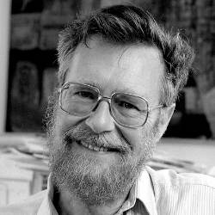
Final Thought
The computing scientist‘s main challenge is not to get confused by the complexities of his own making ----- Edsger Dijkstra
https://cacm.acm.org/news/an-interview-with-edsger-w-dijkstra/

Slide 33
Main course topics
How to write quality code?

Slide 34
Main course topics
How to write quality code?
Usable
Less error-prone
Easier to maintain
Reusable
…

Slide 35
Main course topics
How to write quality code?
Usable
Less error-prone
Easier to maintain
Reusable
…
How to manage a software project effectively?

Slide 36
Main course topics
How to write quality code?
Usable
Less error-prone
Easier to maintain
Reusable
…
How to manage a software project effectively?
Meet the user requirements
Delivered in a timely manner
…

