Slide 1
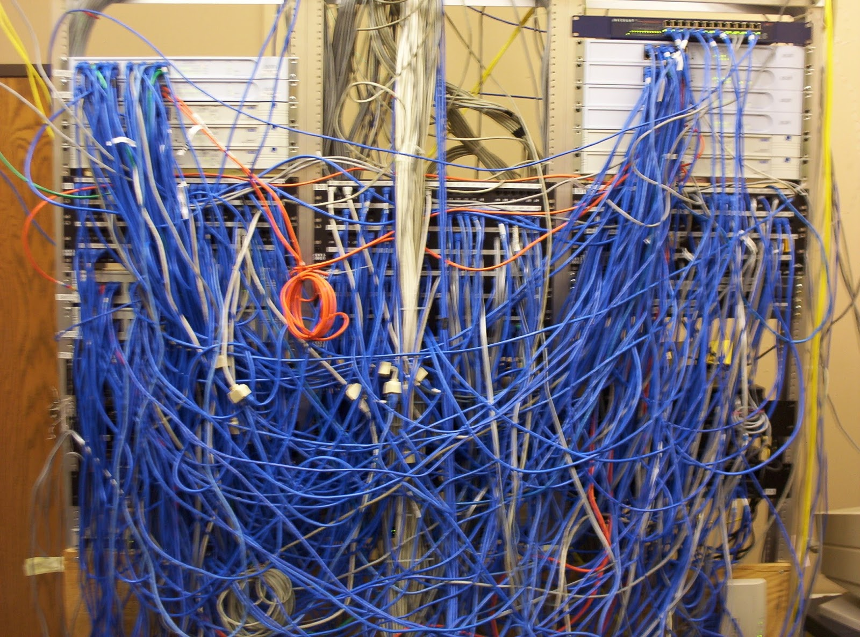
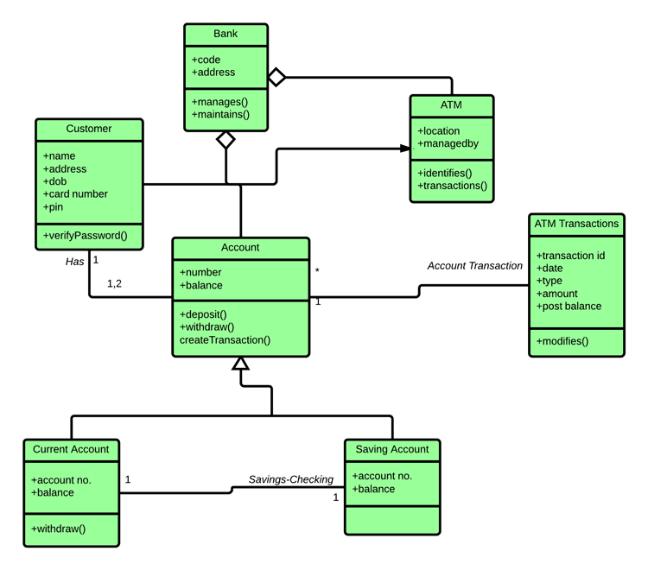
Introduction to Software Engineering
CS 6100 — Fall 2025
Tong Zhou
tzhou44@fordham.edu
This Photo by Unknown Author is licensed under CC BY

Slide 2
What is Software Engineering?
“The application of a systematic, disciplined, quantifiable approach to the development, operation, and maintenance of software; that is, the application of engineering to software.”
---- defined by IEEE
More than coding — involves people, processes, and tools.

Slide 3
Software vs. Program
Program: a single, stand-alone piece of code that solves a specific problem.
Software: a collection of programs + documentation + configuration + processes.
Program (code) is part of a software

Slide 4



Why Software Engineering?
Software is Everywhere
Example: An MRI scanner, an airplane autopilot system, and your ride-share app — all run on complex software
Point: These systems must be safe, reliable, and maintainable

Slide 5
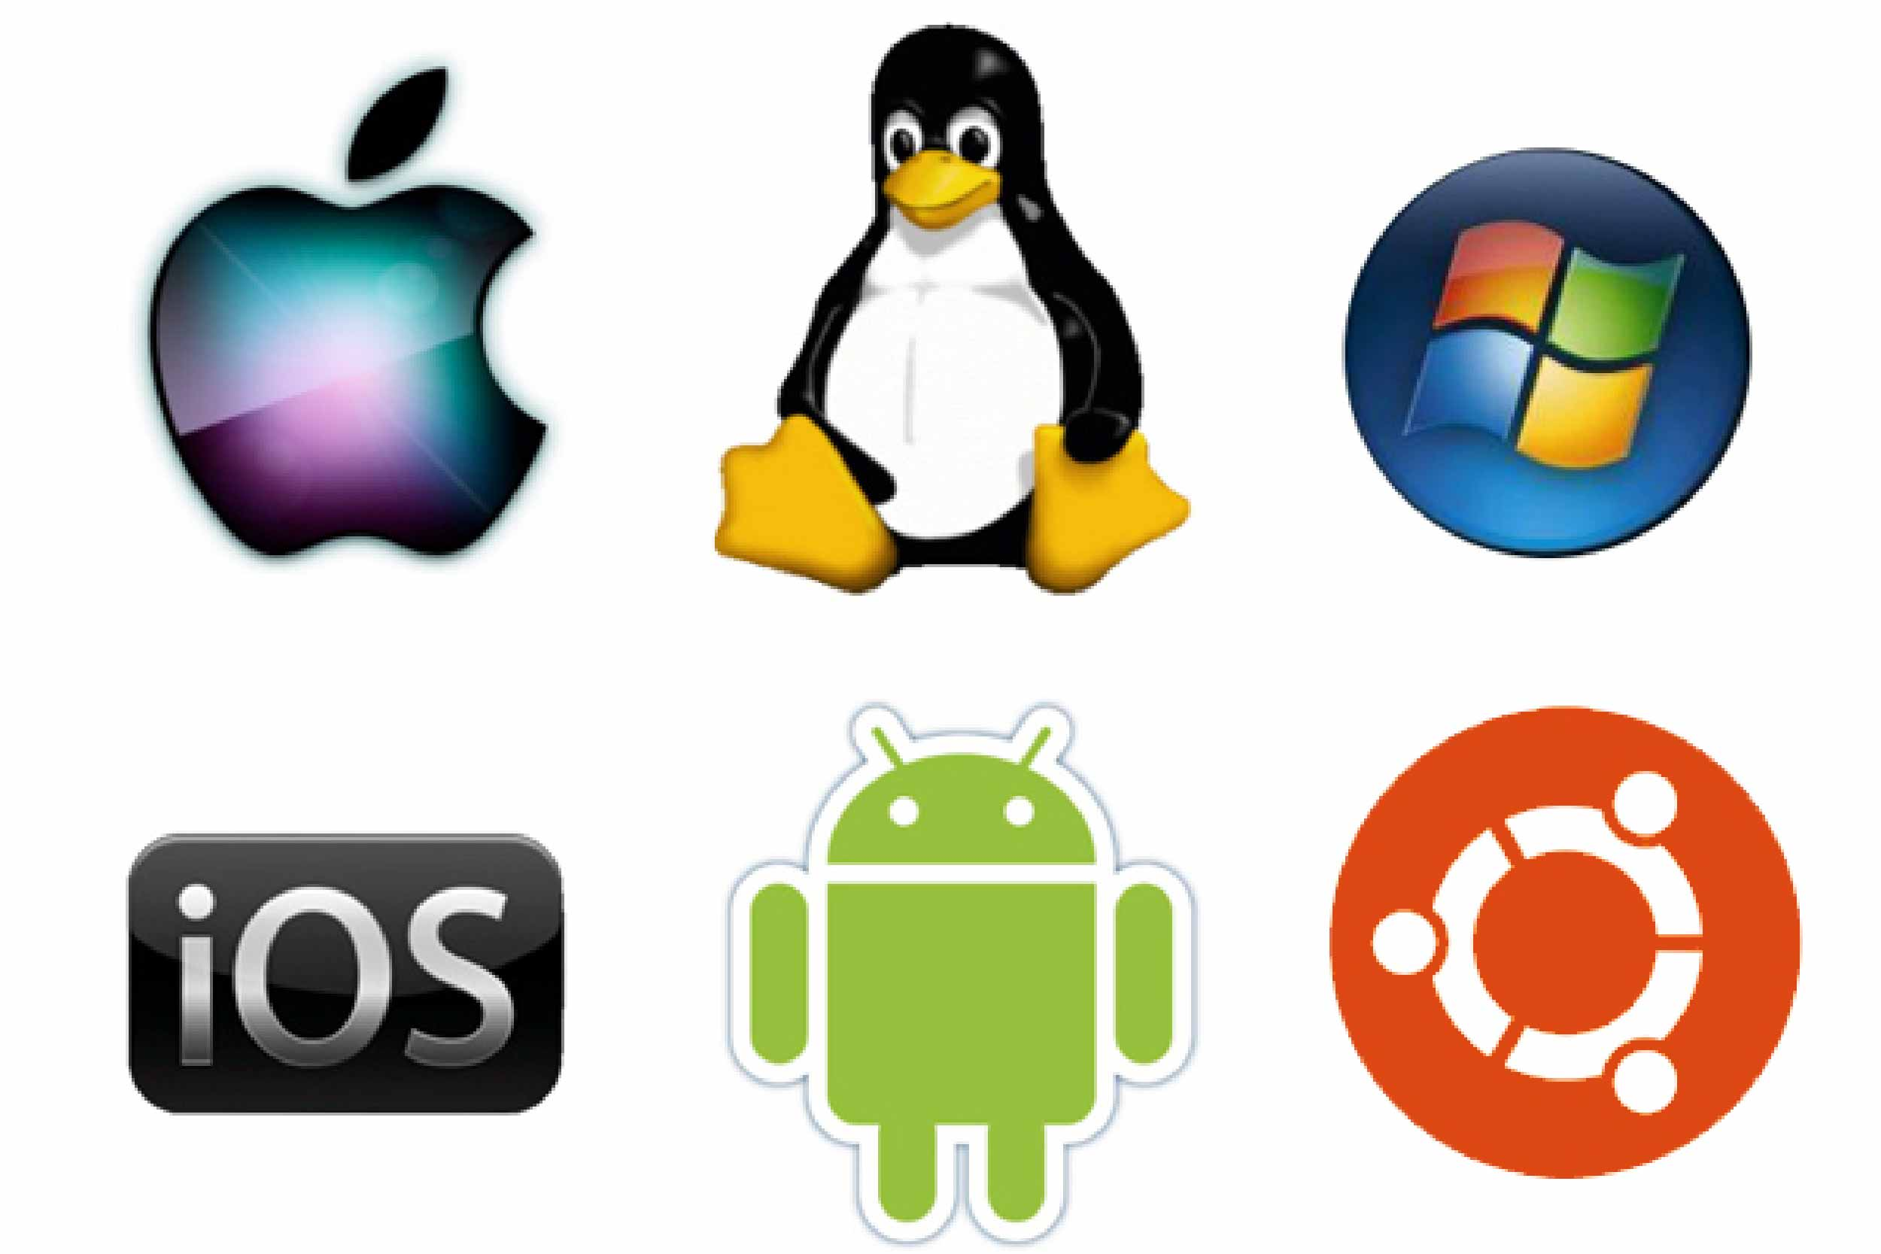




Why Software Engineering?
Software is Everywhere
Example: An MRI scanner, an airplane autopilot system, and your ride-share app — all run on complex software
Point: These systems must be safe, reliable, and maintainable

Slide 6
Why Software Engineering?
Code Is Easy to Write, Hard to Manage
Example: A prototype written in a hackathon might work once, but will break with real users, multiple developers, or scaling needs
Point: SE helps manage complexity, especially in large teams and long-term projects

Slide 7
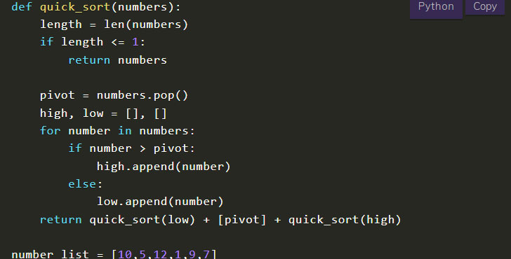
Why Software Engineering?
Code Is Easy to Write, Hard to Manage
Example: A prototype written in a hackathon might work once, but will break with real users, multiple developers, or scaling needs
Point: SE helps manage complexity, especially in large teams and long-term projects
Homework assignment
https://www.codingcreativo.it/python-quicksort/

Slide 8
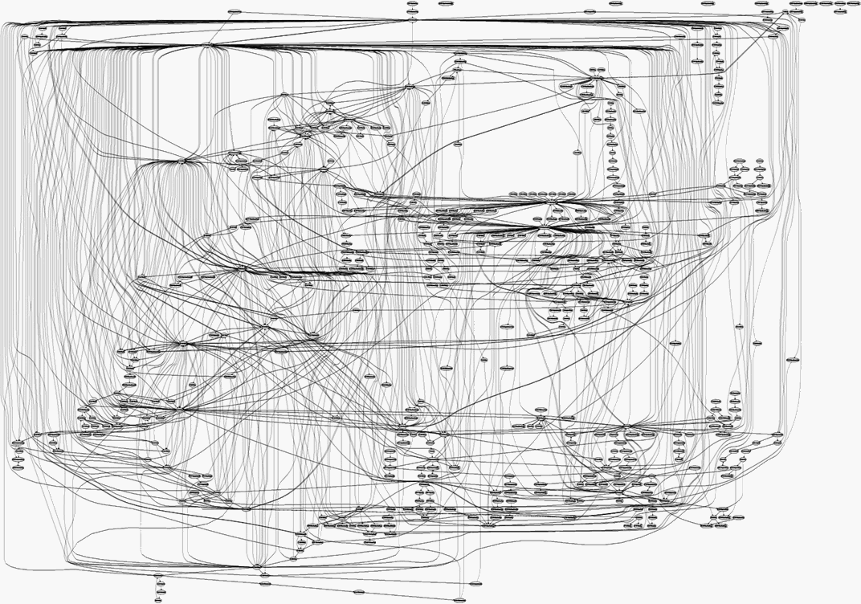
Why Software Engineering?
Code Is Easy to Write, Hard to Manage
Example: A prototype written in a hackathon might work once, but will break with real users, multiple developers, or scaling needs
Point: SE helps manage complexity, especially in large teams and long-term projects
Real large-scale software project
Homework assignment
https://www.codingcreativo.it/python-quicksort/
https://medium.freecodecamp.org/building-and-installing-the-latest-linux-kernel-from-source-6d8df5345980

Slide 9
Why Software Engineering?
Modern software = millions of lines of code
Google: 9 million source code files, 2 billion lines of source code (as of 2015)
Facebook: 9.9 million lines of open source code (as of 2014)
Linux kernel: over 15 million lines of code (as of 2013)
Used by millions, across multiple platforms
Web, desktop, mobile
Errors are costly: time, money, reputation, lives.

Slide 10

Famous software failure: Ariane 5 Flight 501
Left/center: liftoff (June 4th, 1996)
Right: self-destruct after 39 seconds
~ 500 million US-$ damage

Slide 11
Famous software failure: Ariane 5 Flight 501
Reasons: integer overflow
64-bit float velocity converted to 16-bit integer
Measurement > 32768 → overflow → uncaught exception → system crash
Software reused from Ariane 4
Old rocket was slower, overflow impossible
No overflow handler → system crash with A5

Slide 12
Famous software failure: Therac-25
(1985–87): Radiation overdoses → patient deaths.

Slide 13
Famous software failure: Knight Capital
2012
Deployment bug → $440M loss in 45 minutes.

Slide 14
The Challenges
Growing complexity
Changing requirements
Large teams & coordination
Testing & quality assurance
Performance & scalability

Slide 15
Core Principles to Tame Complexity
Abstraction — focus on the “what” not the “how”
Modularity — divide and conquer
Encapsulation — control access to internal details
Separation of Concerns — each part handles one responsibility
Iterative Development — build, test, refine

Slide 16
Software Engineering in the Real World
70% of cost = maintenance
Good SE → reliability, scalability, maintainability
Examples: Linux kernel, SpaceX flight software
Visual idea: pie chart showing maintenance vs initial development.

Slide 17
Main course topics
How to write quality code?

Slide 18
Main course topics
How to write quality code?
Usable
Less error-prone
Easier to maintain
Reusable
…

Slide 19
Main course topics
How to write quality code?
Usable
Less error-prone
Easier to maintain
Reusable
…
How to manage a software project effectively?

Slide 20
Main course topics
How to write quality code?
Usable
Less error-prone
Easier to maintain
Reusable
…
How to manage a software project effectively?
Meet the user requirements
Delivered in a timely manner
…

Slide 21
Main course topics
How to write quality code?
Object oriented programming
UML and design patterns
Testing
Code quality
How to manage a software project effectively?
Requirements engineering
Software development process
Tools: Git, CI/CD

Slide 22
Miscellaneous course topics
Web development basics
Front end/back end interaction
Concurrency
Improve scalability

Slide 23
Course logistics
Textbook (reference)
Software Engineering 10th edition, by Ian Sommerville
Prerequisites
Basic programming skills
Final grade
20% homework assignments
20% midterm exam
60% software engineering project

Slide 24
Semester-Long Project – Gomoku Game
A simple game with minimal domain knowledge
Some level of complexity will be incorporated into the software

Slide 25
Gomoku Game Demo

Slide 26
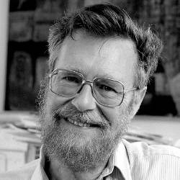
Final Thought
The computing scientist‘s main challenge is not to get confused by the complexities of his own making ----- Edsger Dijkstra
https://cacm.acm.org/news/an-interview-with-edsger-w-dijkstra/

