Slide 1
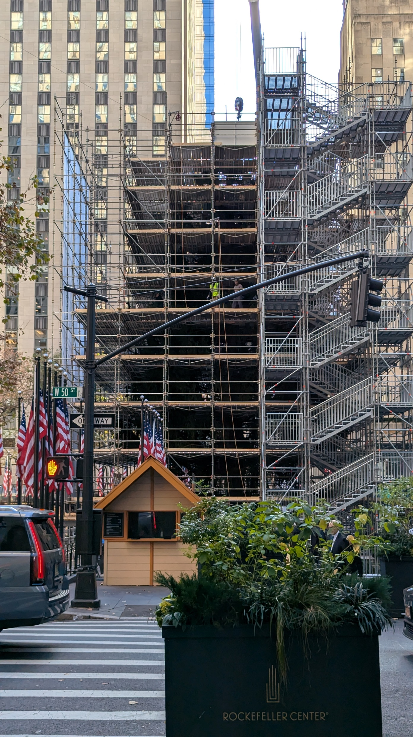
CISC-6100: Software Engineering
Design patterns
Week 11 – November 18

Slide 2
Outline for today’s class
Progress Meeting/Presentation
Testing continued
Database for project
Design exercise
Design patterns
Homework
Class project time

Slide 3
Progress / status meetings
Status reports from teams:
Azerbaijan
Bro
C
A short verbal update on how your project is going. Please include:
What you’ve worked on in the past week
Unexpected difficulties and thoughts on mitigation
What’s gone well!
Your progress versus your plan, and any changes made to the plan
Next steps

Slide 4
Testing continued
For each of the following describe how you might design the testing to be run before final release:
Azerbaijan: Video game –
Bro: Bank’s money transfer app –
C: SpaceX re-entry code –
D: Sudoku puzzle solver –
Edamame: Tax return software (e.g. TurboTax) -
F: Eye tracking eReader -

Slide 5
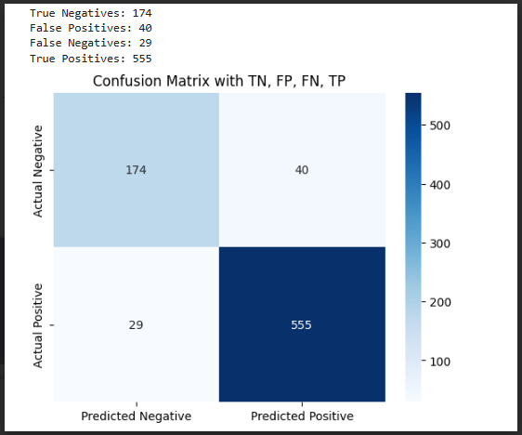
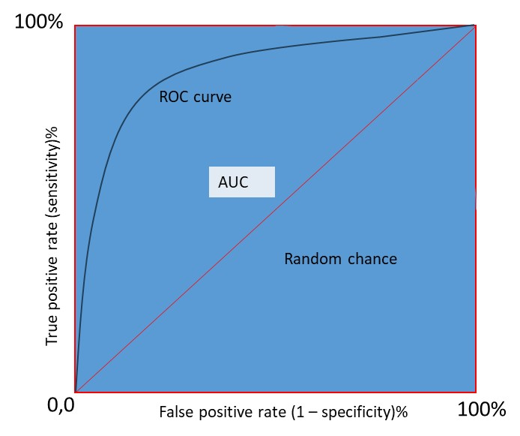
Eye tracking eReader
How would you obtain “ground truth?”
Accuracy testing: How accurate is the system tracking the user’s eye movement?
Responsiveness Testing: How quickly is responding to user’s input (their eye movement)?
Edge cases testing: Example – How would the system react if an undefined eye movement is captured?
Usability & Environment: compatibility …

Slide 6
Banking system
Some of these should be requirements from the start (that will get tested)
Shared account access: how to deal with transfers at the same time between people?
Security of transfer:
Authentication
Google
reCAPTCHA
How to deal with unsuccessful account transfer / info
Transfer from phone to bank & vice versa
Check go to right place
Insufficient funds are not transferred & vice versa
Sandbox testing

Slide 7
Video game
Impossible (almost) to define all possible user actions
Test scenario where game is played as intended
Rely on testers’ creativity for other scenarios
Large group of testers
Encourage testers to “break rules”
Think outside the box
Companies challenge to break code-esque
Exhaustive testing
Random testing
Targeted testing
Known good
Edge cases
Known bad
Edge cases

Slide 8
Tax filing
Security Testing → sensitive user data
Usability Testing → user satisfaction
Regression Testing → no new bugs after debugging
User Acceptance Testing & Final Approval
Compliance standards & security standards
Ensure Transmission of Data to IRS
Accuracy Testing
How would you obtain “ground truth?”

Slide 9
SpaceX
Test 1: Is my math right? (physics stuff)
Test 2: Performance specs
Test 3: Stress Test -> calculation volume
Edge case -> Emergency landing
Unexpected weather parameters
Incorrect trajectory
Power/Engine issues
Build a really good simulator
(SW <--> HW)
How would you obtain “ground truth?”
7. NASA’s Mars Climate Orbiter, 1998
Losing $20 from your wallet is probably enough to ruin your day — how would it feel to lose a $125 million spacecraft? NASA engineers found out back in 1998 when the Mars Climate Orbiter burned up after getting too close to the surface of Mars.
It took engineers several months to work out what went wrong. It turned out to be an embarrassingly simple mistake in converting imperial units to metric. According to the investigation report, the ground control software produced by Lockheed Martin used imperial measurements, while the software onboard, produced by NASA, was programmed with SI metric units. The overall cost of the failed mission was more than $320 million.
https://raygun.com/blog/costly-software-errors-history/

Slide 10
Sudoku
How would you obtain “ground truth?”
Deployment and Testing
Frontend
API testing
If we have users – security testing
Backend
Unit test
Solver
Board related
Logic etc.
Integration testing
Use current position to test fetching???
Exhaustive testing
Random testing
Targeted testing
How might you approach testing a heuristic algorithm versus a brute force algorithm for puzzle solving?

Slide 11
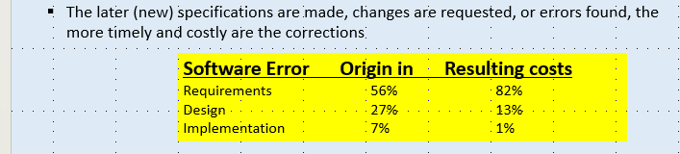
SpaceX
Test 1: Is my math right? (physics stuff)
Test 2: Performance specs
Test 3: Stress Test -> calculation volume
Edge case -> Emergency landing
Unexpected weather parameters
Incorrect trajectory
Power/Engine issues
Build a really good simulator
(SW <--> HW)
How would you obtain “ground truth?”
7. NASA’s Mars Climate Orbiter, 1998
Losing $20 from your wallet is probably enough to ruin your day — how would it feel to lose a $125 million spacecraft? NASA engineers found out back in 1998 when the Mars Climate Orbiter burned up after getting too close to the surface of Mars.
It took engineers several months to work out what went wrong. It turned out to be an embarrassingly simple mistake in converting imperial units to metric. According to the investigation report, the ground control software produced by Lockheed Martin used imperial measurements, while the software onboard, produced by NASA, was programmed with SI metric units. The overall cost of the failed mission was more than $320 million.
https://raygun.com/blog/costly-software-errors-history/

Slide 12
Example of how a simple translation from one programming language to another can cause errors
What’s going on here?
Which is right?
Python
C++
X = a % b | b = 12 | b = -12
a = 3 | 3 | -9
a = -3 | 9 | -3
X = a % b | b = 12 | b = -12
a = 3 | 3 | 3
a = -3 | -3 | -3
def IsOdd(n):
if ((n % 2) == 1): return True
else: return False
bool IsOdd(int n) {
if ((n % 2) == 1) return true;
else return false;
}

Slide 13
Design for testing (DfT) – building the software in such a way to facilitate testing
Priority queue
Next patient
Patient not found
Complete
New patient
Discharged patient
Registration
New patient
Discharged patient
Alert
Find patient
Patient found
Patient not found
Next patient
NextPt
32676-103
NewPt
John Doe
32556-983
PtFound
Subscription service
Pulse
110
Alert
32556-983
Analysis
Complete
Alert
Pulse
Respiration
Next patient
Vital sign acquisition
Pulse
Respiration
Patient found
Database
All

Slide 14
Testing: summary
Testing cannot show the absence of errors and defects; it can show only that software errors and defects are present. -- Software Engineering: A practitioner’s approach. 6.2.4 Construction principles, pg. 97
1. Testing is a process of executing a program with the intent of finding an error.
2. A good test case is one that has a high probability of finding an as-yet-undiscovered error.
3. A successful test is one that uncovers an as-yet-undiscovered error.
-- Software Engineering: A practitioner’s approach. 6.2.4 Construction principles, pg. 96, referecing Glen Myers[Mye79]

Slide 15
Testing: summary
Testing principles
All tests should be traceable to customer requirements
Tests should be planned long before testing begins
Testing should begin “in the small” and progress toward testing “in the large”
Exhaustive testing is not possible
Apply to each module in the system a testing effort commensurate with its expected fault density
Static testing techniques can yield high results (design/system documentation)
Track defects and look for patterns in defects uncovered by testing
Include test cases that demonstrate software is behaving correctly
-- Software Engineering: A practitioner’s approach. 6.2.4 Construction principles

Slide 16
How much testing
How critical is it to be “correct?”
Personal safety related issues
Economic issues
Customer dissatisfaction
How often will testing be done?

Slide 17
Database usage and design

Slide 18
Purpose of the Database
Saved puzzles:
Size
Difficulty
ID?
Given values
Solution
Saved sessions:
SessionID
Puzzle state …
History …

Slide 19
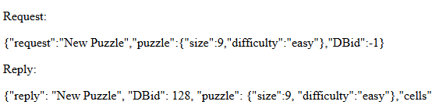
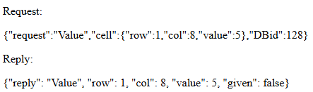
Saving puzzle session with a database
Server
Receive and parse request
Establishing and using a session ID
Get Session for ID from DB
Delete DB data for ID
Perform request
Respond to request
Save session to DB

Slide 20
Saving puzzle session with a database
Server
Receive and parse request
Establishing and using a session ID
if (requestDict["request"] == "New Puzzle"):
#remove old puzzle if it exists
if Puzzle.objects.filter(pk=DBid).exists():
Puzzle.objects.get(pk=DBid).delete()
#create the puzzle
puzzleSpec = DictToPuzzleSpecObj(requestDict["puzzle"])
engineObj.LoadNewPuzzle(puzzleSpec.size, puzzleSpec.difficulty)
#create the DB puzzle entry
puzzleDB = Puzzle(size=puzzleSpec.size, difficulty=puzzleSpec.difficulty)
puzzleDB.save()
puzzleDB.uid = puzzleDB.id
puzzleDB.save()
for i in range(puzzleSpec.size*puzzleSpec.size):
c = Cell(puzzle=puzzleDB, index=i, value=0, given=False, solution=0)
c.save()
SavePuzzleToDB(puzzleObj, puzzleDB)
jsonResponse = PuzzleToJSON(puzzleObj)
jsonResponse = jsonResponse[1:]
jsonResponse = '{"reply": "New Puzzle", "DBid": ' + str(puzzleDB.id) + ', ' + jsonResponse
If starting a new game from a previous puzzle, delete the previous game’s session
Get Session for ID from DB
Delete DB data for ID
Create a new session for the new puzzle
Perform request
Respond to request
Save the new puzzle session to the DB
Save session to DB

Slide 21
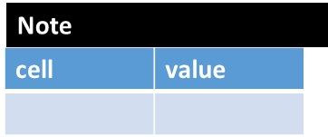
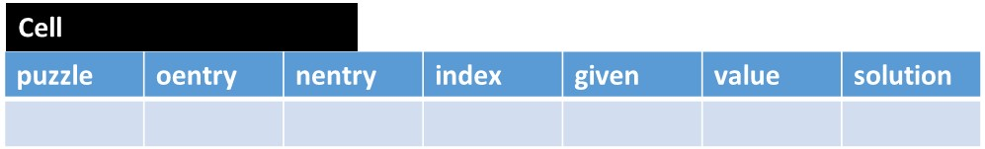
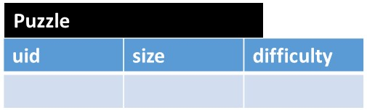
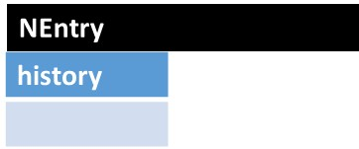
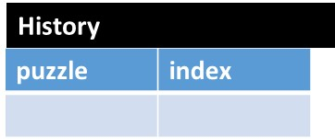
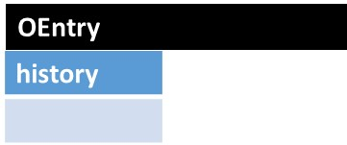
Saving puzzle session with a database
Cell
Puzzle
NEntry
History
OEntry

Slide 22
Practice design
Each team choose one project idea from the following list. Over the next few ambiguous, you will have the opportunity to further develop the project and receive feedback:
Practice for what we have learned this semester
Practice for the final which will include a design question
Midterm focused on the design process
Final will focus more on the design itself (by employing the design process!)
Practice for potentially taking the Capstone course (all but one idea below are from actual Capstone projects)
Choices are left somewhat ambiguous, so you have the flexibility to further define it like you want
Faster URL Parser
Pass the picture – n people start drawing a picture n their drawing tool, and after x minutes the pictures “rotate” to the next person. This goes on for n times.
Graphical rendering of algorithms for teaching purposes
What should I wear to a specified event
Use eye tracking on phone to move cursor on laptop
Multi-player distributed monopoly
Stock market trading simulator
Let’s meet – like a dating site, but for planning group outings
Help me budget and buy
Super easy to use tablet for nursing home residents
Job search and posting
Escape room game
First task: Give an elevator pitch for your project idea. (60 second talk)

Slide 23
Design Patterns
Material presented is in part from:
https://en.wikipedia.org/wiki/Software_design_pattern
https://cs.brown.edu/cgc/jdsl/papers/patterns.pdf
https://medium.com/@ronnieschaniel/object-oriented-design-patterns-explained-using-practical-examples-84807445b092

Slide 24
A design pattern is:
General, reusable approach to a commonly occurring problem
A description for how to solve a problem that can be used in many different situations
Formalized best practices to use for common problems
A design pattern is not:
A finished design that can be transformed directly into source code
Four general ways to group design patterns are:
Creational Patterns
Structural Patterns
Behavioral Patterns
Concurrency Patterns
However, there are many domain specific design patterns:
User interfaces
Information visualization
Secure design
Secure usability
Web design
Business model design

Slide 25
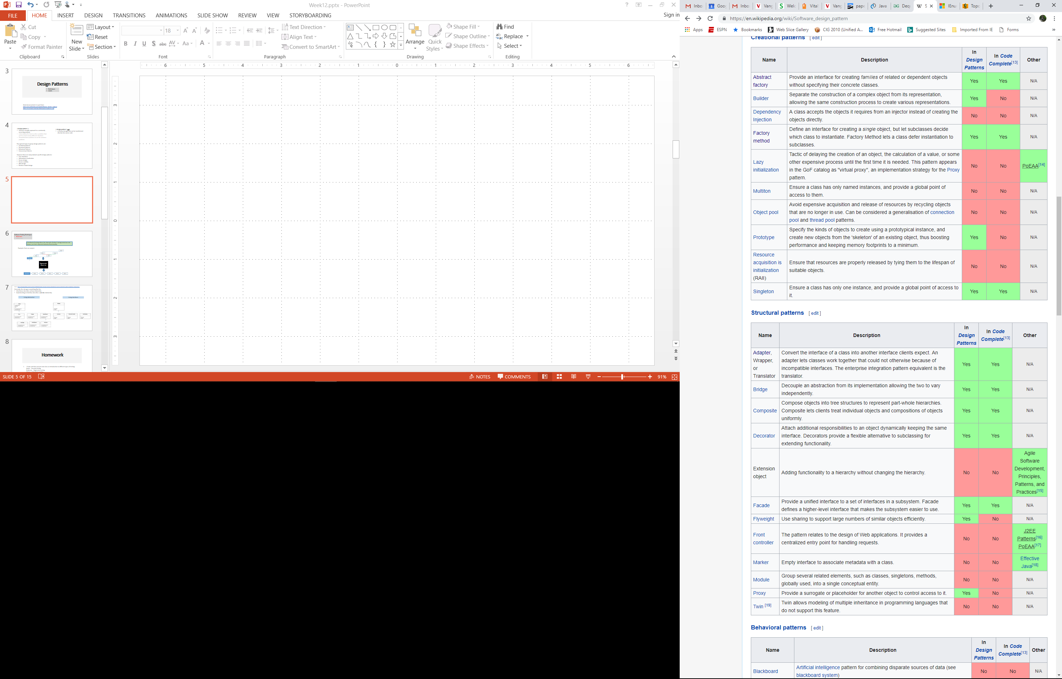
In-depth use of Wikipedia for studying design patterns reveals a weakness in its construction: following links to each design pattern shows lack of uniformity in presentation of a design pattern.

Slide 26
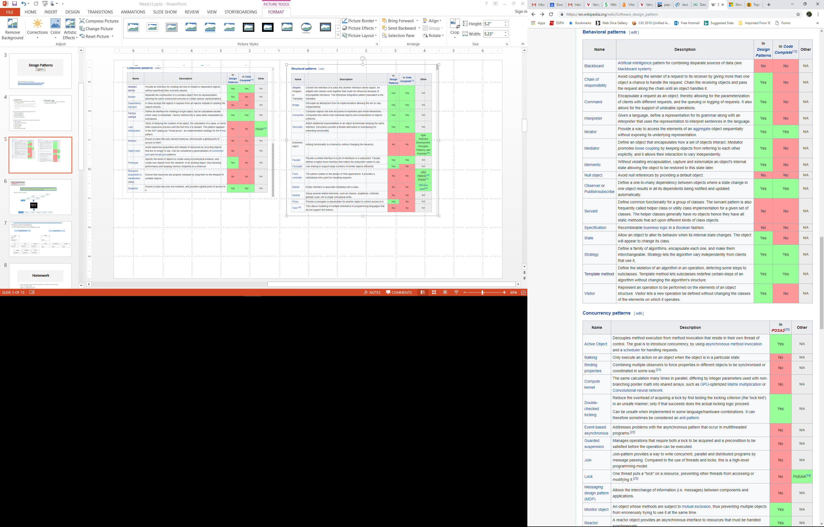

Slide 27
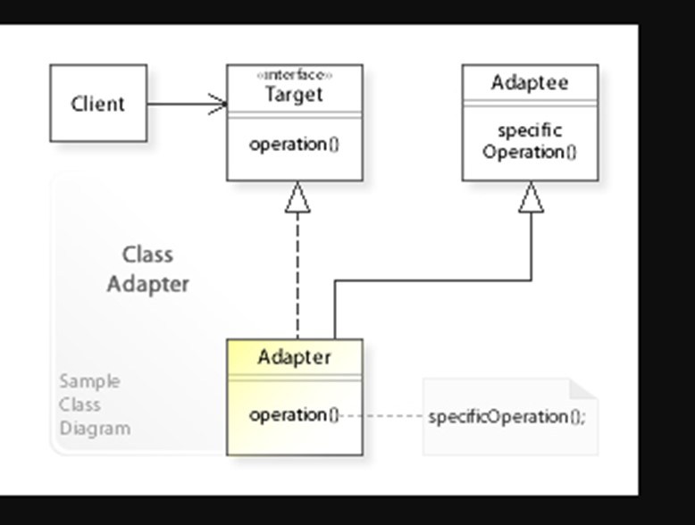
Selected Design Pattern Examples: Adapter
Allows the interface of an existing class to be used as (via) another interface. It is often used to make existing classes work with others without modifying their source code.
https://commons.wikimedia.org/wiki/File:W3sDesign_Adapter_Design_Pattern_UML.jpg#/media/File:W3sDesign_Adapter_Design_Pattern_UML.jpg

Slide 28

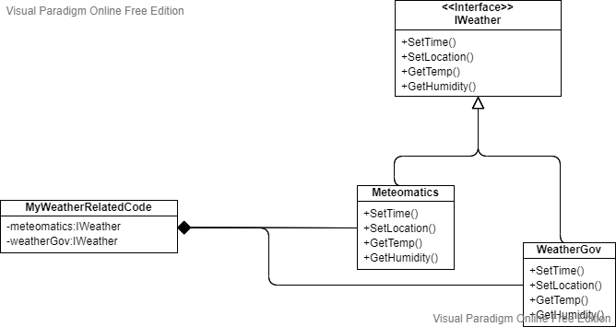
Interfaces
APIs
Meteomatics.com
target
adaptees
client
APIs
Weather.gov
adapters

Slide 29
Selected Design Pattern Examples: Observer or Pub/Sub
In the observer or publish/subscribe pattern an object, called the subject, keeps track of a list of observers and notifies them upon state changes of interest.

Slide 30
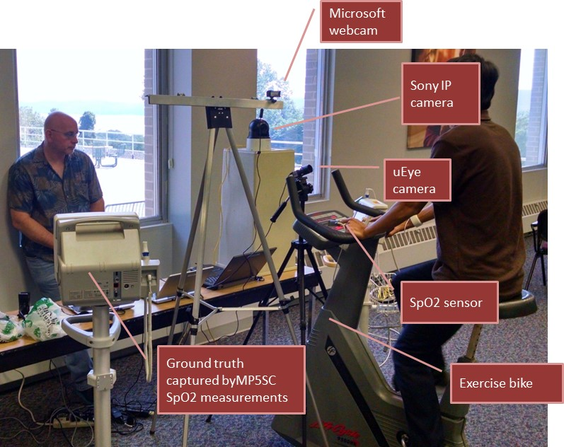
Selected Design Pattern Examples: Observer or Pub/Sub
Priority queue
Next patient
Patient not found
Complete
New patient
Discharged patient
Registration
New patient
Discharged patient
Alert
Find patient
Patient found
Patient not found
Next patient
Subscription service
KEY
Publish
Subscribe
Methods of messaging.
Distributed
Centralized
Information bundling and serialization:
HL7 (Health Level 7)
FHIR (Fast Healthcare Interoperability Resources)
JSON
Analysis
Complete
Alert
Pulse
Respiration
Next patient
Vital sign acquisition
Pulse
Respiration
Patient found
Database
All

Slide 31
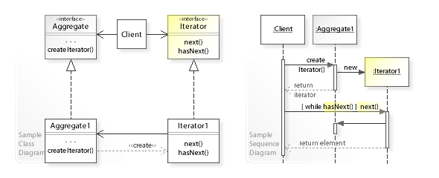
Selected Design Pattern Examples: Iterator
In object-oriented programming, the iterator pattern is a design pattern in which an iterator is used to traverse a container and access the container's elements. The iterator pattern decouples algorithms from containers.
UML diagrams are frequently used in explanatory/instructive texts of design patterns.

Slide 32
Some built in enumerables that you can iterate over in C#:
String
List
Array
All enumerable types can be iterated over with the foreach statement:
foreach (char c in MyString)
{
//Do some action
}
foreach (object o in ObjectList)
{
//Do some action
}
foreach (int i in IntArray)
{
//Do some action
}

Slide 33
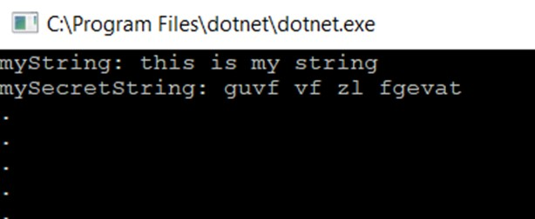
Selected Design Pattern Examples: Iterator
Examples of native iterator: C# example
string myString = "this is my string";
string mySecretString = new string("");
foreach (char c in myString)
{
if (c != ' ')
mySecretString += ((char)((c - 'a' + 13) % 26 + 'a')).ToString();
else
mySecretString += ' ';
}
Console.WriteLine("myString: " + myString);
Console.WriteLine("mySecretString: " + mySecretString);

Slide 34
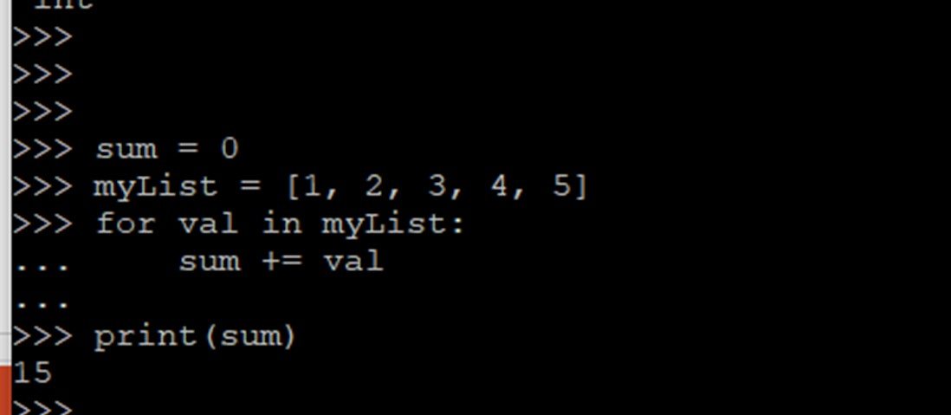
Selected Design Pattern Examples: Iterator
Examples of native iterator – Python example

Slide 35
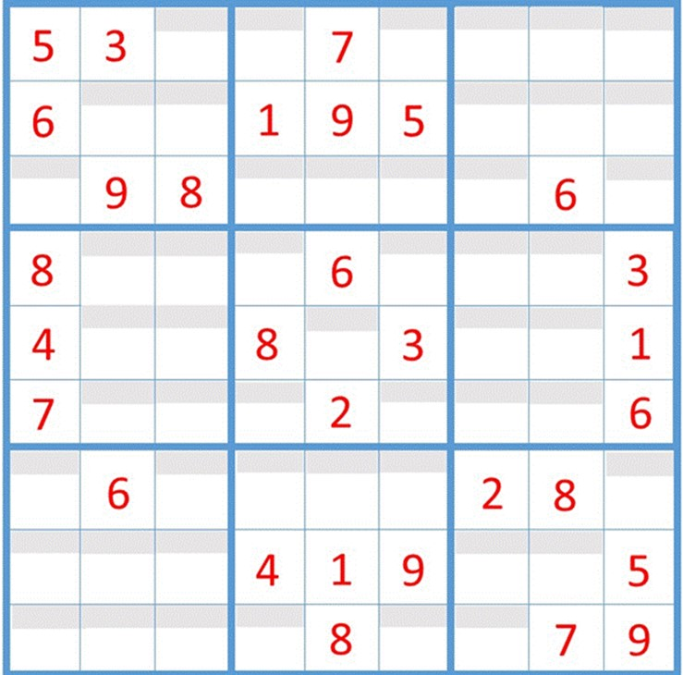
// Can Do
for(int i=0; i<board.GetLength(0); i++)
{
for(int j=0; j<board.GetLength(1); j++)
{
// Perform some function… For example:
// Find all “hardwired” tiles
// Find all empty tiles
// Find all notes
}
}
// Want to Do
foreach (Cell cell in puzzle)
{
// Perform some function… For example:
// Find all “hardwired” cells
// Find all empty cells
// Find all notes
}

Slide 36
int invoke(int x, int y, int (*func)(int, int))
// We can do this in C# and similar languages
foreach (Cell cell in puzzle)
{
// Perform some function… For example:
// Find all “hardwired” cells
// Find all empty cells
// Find all notes
}
// We cannot do this in C++ and similar languages
foreach (Cell cell in puzzle)
{
// Perform some function… For example:
// Find all “hardwired” cells
// Find all empty cells
// Find all notes
}
// We can use a dependency injection design patternin C++
// to get a similar effect… But not quite ☹
// For example:
bool LoopOverPuzzle(Puzzle puzzle, int (*func)(int, int)))

Slide 37
Selected Design Pattern Examples: Iterator
foreach
Array[index]
Matrix
Array

Slide 38
Selected Design Pattern Examples: Iterator
public class Puzzle : IEnumerable
{
…
IEnumerator IEnumerable.GetEnumerator()
{
return (IEnumerator) new PuzzleEnum(board);
}
public PuzzleEnum GetEnumerator()
{
return new PuzzleEnum(board);
}
}

Slide 39
public class PuzzleEnum : IEnumerator
{
private List<int> vals = new List<int>();
private int[] valArray;
private int position = -1;
public PuzzleEnum(int [,] board)
{
for(int i=0; i<board.GetLength(0); i++)
{
for(int j=0; j<board.GetLength(1); j++)
{
vals.Add(board[i, j]);
}
}
valArray = vals.ToArray();
}
object IEnumerator.Current
{
get
{
return Current;
}
}
public int Current
{
get
{
try
{
return valArray[position];
}
catch (IndexOutOfRangeException)
{
throw new InvalidOperationException();
}
}
}
public bool MoveNext()
{
position++;
return (position < valArray.Length);
}
public void Reset()
{
position = -1;
}
}
}
Note that one team member still has to implement the iterator, but then all team members can reap the benefits.

Slide 40
Design Patterns summary
Many more design patterns exist than we covered
There exist programming languages where many (most) of the design patterns are built into the language
All design patterns can be “implemented” using the basic concepts of object-oriented programming
However, there is no “one” implementation as design patterns are (best practice) approaches more than implementations
Use of design patterns may seem overkill for many small, finely focused programming assignments, but can pay off in the long run for larger programs built with future growth and big teams in mind

Slide 41
Considerations
Pros
Can speed up the development process
Proven development paradigms
Tested approaches
Common language among those familiar with patterns
Time invested up front can pay back in the long run
Heavily documented
Can simplify coding
Cons
Frequent use of a design pattern in a specific language may just be an indication that something is missing in that language
Use of existing components or libraries may be a faster, more reliable way to go
The levels of indirection that many design patterns use can lead to inefficient code
Recommendations
Learn about what patterns exist and what problems they can help with
Make liberal use of a search engine when encountering a problem

Slide 42
Homework
Homework
Status reports from teams:
D
Edamame
F
A short verbal update on how your project is going. Please include:
What you’ve worked on in the past week
Unexpected difficulties and thoughts on mitigation
What’s gone well!
Your progress versus your plan, and any changes made to the plan
Next steps
Email me if you have any project related or general software engineering topics you want to see covered.
Read Chapter 14 on Design Patterns skipping section 14.2
Write a paragraph on how a design pattern of your choice could have or was used in a past program you were involved with

Slide 43
Project time

