Slide 1

CISC-6100: Software Engineering
Design Practice
Week 12 -- November 25

Slide 2
Outline for today’s class
Review homework
Design Patterns
Progress meetings
D
Edamame
E
Design practice
Review of deliverables
Design practice
Homework
Class project time

Slide 3
Homework review

Slide 4
Homework review – design patterns
Model-View-Controller (MVC) – an architecture type we looked at, and very common for web apps
Strategy – could be used to set up different ways to solve a puzzle
Factory Method – not readily applicable for our project, but it will be if you take Object Software Design next semester
Singleton – Pattern or anti-pattern???
Observer – Also known as publish/subscribe that we saw examples of
Module – support for implementing modules in languages that don’t directly support them.
Python does support as each file is considered a module
C# and Java support namespaces which mostly cover what modules do
Proxy – For having all request go through an intermediary that can filter requests
Façade – simplifies potentially complex access to a resource
Bridge – decouples abstraction from implementation
postponed
Proxy
client
Facade
Actual resource
Adapter

Slide 5
Project Update Presentations

Slide 6
Progress / status meetings
Status reports from teams:
D
Edamame
F
A short verbal update on how your project is going. Please include:
What you’ve worked on in the past week
Unexpected difficulties and thoughts on mitigation
What’s gone well!
Your progress versus your plan, and any changes made to the plan
Next steps

Slide 7
Design Practice

Slide 8
Practice design
Each team choose one project idea from the following list. Over the next few ambiguous, you will have the opportunity to further develop the project and receive feedback:
Practice for what we have learned this semester
Practice for the final which will include a design question
Midterm focused on the design process
Final will focus more on the design itself (by employing the design process!)
Practice for potentially taking the Capstone course (all but one idea below are from actual Capstone projects)
Choices are left somewhat ambiguous, so you have the flexibility to further define it like you want
Faster URL Parser
Pass the picture – n people start drawing a picture n their drawing tool, and after x minutes the pictures “rotate” to the next person. This goes on for n times.
Graphical rendering of algorithms for teaching purposes
What should I wear to a specified event
Use eye tracking on phone to move cursor on laptop
Multi-player distributed monopoly
Stock market trading simulator
Let’s meet – like a dating site, but for planning group outings
Help me budget and buy
Super easy to use tablet for nursing home residents
Job search and posting
Escape room game
First task: Give an elevator pitch for your project idea. (60 second talk)

Slide 9
Design Practice
Our current design topics are different from previous design exercises:
Previous: customer initiated
Current: Your initiation
Steps
Elevator pitch
Formal Proposal
Design clarification
Storyboard
Use case scenarios
Rapid prototype
Performance specs
Use case diagram
Business plan
Web resources
Hire MBA
Project plan
Technical Design
Testing Design
Development
Final Testing
The following slides look at the Capstone projects not selected and look at them as if they were actual ideas for a business.
You will then do the same thing for the idea you gave the elevator pitch for last week.

Slide 10
Performance specs
Faster URL parser:
https://bookshelf.vitalsource.com/reader/books/9781260423297/epubcfi/6/30[%3Bvnd.vst.idref%3Dchapter06]!/4/222/3:197[add%2Citi]
This is most frequently done by node.js
What would a formal proposal for this project need to include
List of benchmarks and what you hope to achieve
Why some benchmarks may have a higher priority than others
The two most important aspects of the proposal / project:
Performance metrics
Testing plan
Against performance metrics
Correctness

Slide 11
Risk vs. reward
Tool kit to create graphical rendering of algorithms for teaching purposes:
(IMHO) this is incredibly important, but …
What types of algorithms can you show
How long will it take to build rendering
What will it cost
Static or animated renderings
How long/difficult is the learning curve
What would a formal proposal for this project need to include
Clear understanding of the market
Clear indication that proposal can be realized (prototype?)

Slide 12
Resources available?
What should I wear to a specific event
Mostly an integration problem with some AI(?)
APIs have to be available for weather, calendar, event description, personal closet contents, …
What would a formal proposal for this project need to include
Availability of all information to feed into decision making (in a usable form)
APIs
Screen scraping
What size is your expected market and how do you create revenue

Slide 13
Is the technology good enough?
Use of eye tracking
Providing a capability to be used, not a standalone app
How would eye-tracking be used
Show viewers of top gamers where gamer is focused
Provide advertisers with how long their adds were looked at
How accurate is it (resolution)
What would a formal proposal for this project need to include
List of benchmarks and what you hope to achieve
What applications does this enable

Slide 14
Synchronization
Multi-player distributed Monopoly
Originally turned down for as a Capstone project
App-based, not web-based
Synchronization was through a shared DB not a server
What would a formal proposal for this project need to include
Architecture
Business model

Slide 15
Value proposition?
Stock market trading simulator
True plan was to experiment with automated stock trading algorithms
Potentially small market, but with deep pockets
Requires strong domain expertise
What would a formal proposal for this project need to include
Team has appropriate skills and domain knowledge
Simulator will accurately mimic actual systems
Is simulator the best way to go (versus “live sandbox system”)

Slide 16
Market growth
Let’s meet – like a dating site, but for planning group outings
Security
Safety
What would a formal proposal for this project need to include
How do you start and expand your market
What is your revenue source
How many years to profitability

Slide 17
Design Practice
Our current design topics are different from previous design exercises:
Previous: customer initiated
Current: Your initiation
Steps
Elevator pitch
Formal Proposal
Design clarification
Storyboard
Use case scenarios
Rapid prototype
Performance specs
Use case diagram
Business plan
Web resources
Hire MBA
Project plan
Technical Design
Testing Design
Development
Final Testing
With your team:
Decide on best method of clarification for your design / proposal
Specify the high-level content that would go into documentation using that method, e.g.:
Storyboard – keyframes
Use case scenarios – topics of scenarios
Prototype – what would prototype show
Performance specs – what are the specs
You do not have to create the actual content
What are the two most important elements of the proposal
Take 10 minutes
Present to class

Slide 18
Review of Deliverables

Slide 19
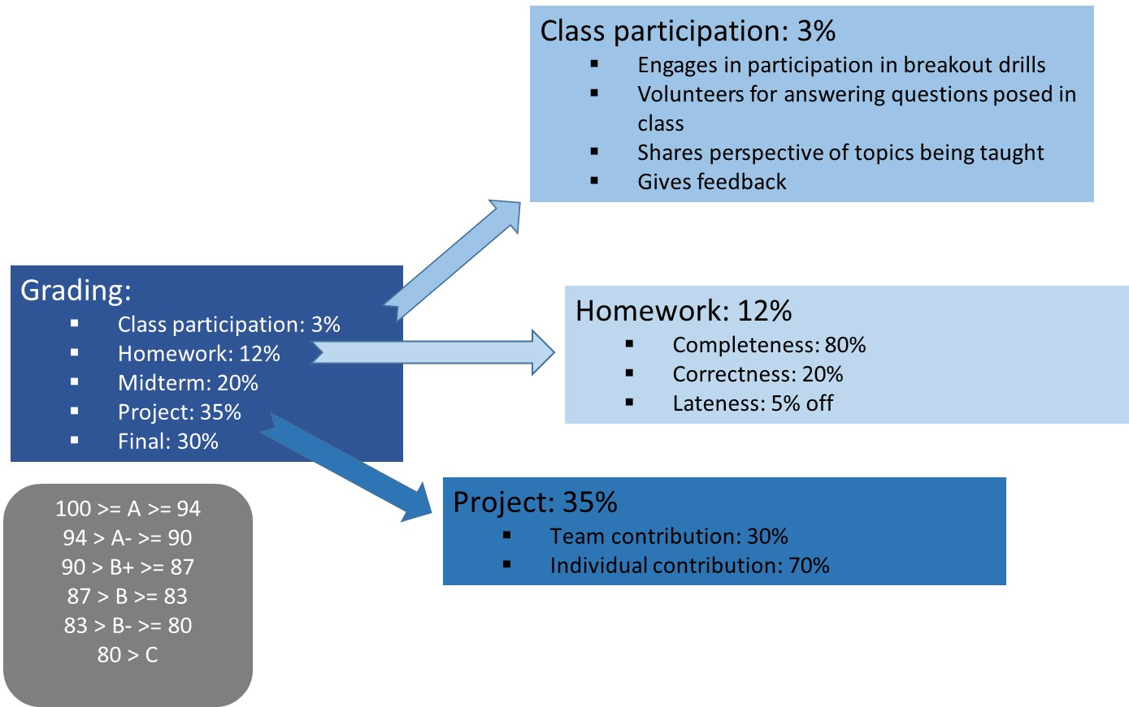
Review of Deliverables
Week Date
1 September 4
2 September 9
3 September 16
4 September 23
5 September 30
6 October 7
-- October 14 (No school)
7 October 21
8 October 28 -- Midterm
9 November 4
10 November 11
11 November 18
12 November 25
13 December 2
14 December 9 – Teams present project
-- December 14 – Project due
15 December 16 -- Final
Project: 35%
Team contribution: 30%
Individual contribution: 70%

Slide 20
Introduction to class project
We will design and implement (parts of) a Sudoku puzzle creation and playing system.
The teaching goal of the project is to use it as an illustrative example of how go through a full product cycle from design through maintenance.
We will not actually build the full system; however, we will complete selected aspects. It should prove interesting to see how far we can get!
The project will involve team efforts and individual efforts.
You will be given some class time to work synchronously with your assigned team, but you will also need to do some work outside of class time, either asynchronously and/or synchronously.

Slide 21
Introduction to class project
Create a system that facilitates the following:
An app for users to solve Sudoku puzzles on. Features of which may include:
2-dimensional puzzles of various sizes:
9x9
4x4
16x16
Puzzles can be selected from a library or generated on demand
Puzzles can be selected from a library of already generated puzzles
Selectable difficulty levels
Ability to make notations
Check solution as far as completed
Undo last move
Undo until all mistakes gone
Get a random or specific hint
Timing solution
Multi-grid puzzles
An app for users to create Sudoku puzzles on. Features of which will include:
Creating grids of various sizes or selecting existing multi-grid layouts
Computer generated puzzles of specified difficulty
Use / define alternative representation to numeric entries
Does not need to be implemented, but must be considered in all design phases
You should include tests that show each of these capabilities does work. (Except for 4x4 and 16x16 puzzles; I will look at the code for that)

Slide 22
Project Specifics: Deliverables
As a team
Storyboard
Use case diagram
Project plan
Tasks with dates, dependencies, and resources (team members)
Keep changes up-to-date
Keep progress tracking up-to-date
Testing plan
Component testing
System testing – including performance testing
Testing results
Keep all testing code in final code deliverable
Document results of system testing
Class diagram (and sequence and / or activity diagrams as appropriate)
DB schema
Bi-weekly status reports
Progress versus project plan
Final presentation: 15-20 minutes including time for questions
Storyboard – What was your vision
Demonstration – Show off what works (and what doesn’t work)
Architecture – And other technical design decisions
Testing results
…
Access to your code/document repository
Individually
Interface documentation for your coding modules
Unit testing results for your coding modules
Your code
Description of your contributions
Distribution of work …

Slide 23
Distribution of work
Select an individual to
Draw decided upon storyboard
Draw decided upon use case diagram
Create and maintain project plan
Tasks with dates, dependencies, and resources (team members)
Keep changes up-to-date
Keep progress tracking up-to-date
Create and maintain test plan document (from input by all team members)
Create and maintain testing results (from input by all team members)
Class diagram (but with content specified by all team members)
Puzzle
History
Bi-weekly status reports (rotate among team members)
Progress versus project plan
Set up GitHub for use by whole team
Server API documentation (from specifications by whole team)
Render the GUI
Program the HTTP interface
Browser side
Server side
Set up and maintain the database
Individually
API documentation for your coding modules
Unit testing results for your coding modules
Sequence and / or activity diagrams as appropriate
>= 1 GUI tasks
>= 1 Server tasks
A part of the final presentation
Your plan for distribution of work should strive to achieve equal time and effort by all team members by dividing the work equitably.

Slide 24
Project
Ways to submit the project:
Best case scenario: Group to submit a link to a GitHub or similar repository (full credit)
Include a folder/directory for each individual’s non-code contributions
Include a code folder with sub-folders for each individual’s code contributions and integration and testing code
Include a folder for group results
Medium case scenario: As above but submitting via a zip file (minus 2%)
Worst case scenario: (minus 5%)
Each individual submits own work
One group member submits integrated work

Slide 25
Design Practice

Slide 26
Design Practice
Steps
Elevator pitch
Formal Proposal
Technical Design
Architecture
Components
Communication
DB schema
Run-time representation
Program flow
Algorithm descriptions
Testing Design
Development
Final Testing
With your team:
Decide on best methods of clarifying your technical design
Specify the high-level content that would go into each method, e.g.:
Architecture: Systems, main components, and topology
Component diagram: main components and their interfaces
You do not have to actually create the designs
Take 15 minutes
Present to class
But first some examples.

Slide 27
Performance specs
Faster URL parser:
https://bookshelf.vitalsource.com/reader/books/9781260423297/epubcfi/6/30[%3Bvnd.vst.idref%3Dchapter06]!/4/222/3:197[add%2Citi]
Architecture:
Single module running on as part of the server software
Called by server code with (remaining) URL string
Return to server with parsed URL string in specified format
For testing purposes, I/O to files and/or DB and timing capability
Comprehensive test suite
Language choice: C/C++
Algorithm descriptions
Algorithm / data structure combination to maximize speed of parsing

Slide 28
Risk vs. reward
Tool kit to create graphical rendering of algorithms for teaching purposes:
Architecture:
Mobile app (or Web app?): Client app to run standalone except for access to server-side DB for design repository
MVC:
GUI – toolkit view and build screen (algorithm specification), output rendering
Representations – algorithm, values to trace
Engine – simulate running algorithm, capturing specified output, converting to external representation (JSON)

Slide 29
Resources available?
What should I wear to a specific event
Architecture:
Dynamic web app:
Client: Basic GUI for simple input / output
App Server: Onboarding, secure login, matching algorithms, connectivity to APIs, output generation
Services servers: APIs
Database: Client info, event info, API sources / access procedures
Algorithms:
Screen scrapers
Inference engine

Slide 30
Is the technology good enough?
Use of eye tracking
Architecture:
Pipeline
Capability to be used as a resource to an app
API
Observer design pattern?
Algorithms:
Tuning of sensitivity versus specificity
Real-time response

Slide 31
Design Practice
Steps
Elevator pitch
Formal Proposal
Technical Design
Architecture
Components
Communication
DB schema
Run-time representation
Program flow
Algorithm descriptions
Testing Design
Development
Final Testing
With your team:
Decide on best methods of clarifying your technical design
Specify the high-level content that would go into each method, e.g.:
Architecture: Systems, main components, and topology
Component diagram: main components and their interfaces
You do not have to actually create the designs
Take 15 minutes
Present to class

Slide 32
Homework

Slide 33
Homework
If you haven’t already done the assignment on Design Patterns, do it:
Read Chapter 14 on Design Patterns skipping section 14.2
Write a paragraph on how a design pattern of your choice could have or was used in a past program you were involved with
Everyone:
Read Chapter 27 through 27.3 (inclusive) on A Strategy for Software Support

Slide 34
Project Time

