Slide 1

CISC-6100: Software Engineering
Presentations, Review
Week 14 December 9

Slide 2
Outline for today’s class
Team presentations
Practice tests
Course evaluation

Slide 3
Team presentations
Present to the whole class, not just me!
<=20 minutes
Involve whole team in presentation
Start by showing your understanding of the deliverable, e.g.
Storyboard(s)
Use case diagram(s)
Present a demonstration (show by running 2 puzzles simultaneously)
What is working
What is still a work in progress
What development process did you use
High-level architecture
Each team member does a high-level walk through of their efforts (focus on diagrams, not code)
Main data structures
Database schema
Primary code flow and/or algorithm description
Testing
Show plan
Show/demo testing results
Open discussion
What went well
What went wrong(ish)? In retrospect how could problem have been avoided?
Bro
Azerbaijan
D
C
F
Edamame

Slide 4
Review
Top 5 things I wanted you to learn this semester
Learning about domain knowledge is key to understanding and developing requirements
Up front effort can reduce difficulties later in development and testing
Knowledge and use of tools is important
Knowledge and use of resources is important
Being a software engineer very different than just being a good programmer
On the following slides you will find tests from previous semesters. Some provide possible answers or partial answers.
You are welcome to contact me if you have any questions about the answers provided and/or questions without provided answers.
This semester’s final will include two multipart closed book questions (focused on material covered after the midterm). It will also contain one multipart opened book question where you will be asked to complete design related questions similar to the class exercises we have done the last few weeks.
In addition, you can find the final from Fall 2023, without answers, on Blackboard

Slide 5
Practice tests (actual problems from final exams from past semesters)

Slide 6
Fall 2022

Slide 7
List three factors that can contribute to the execution speed of an application. For each factor relate its importance to the following application types: (15 points)
Programming language
Algorithm choice
Bandwidth of internet connection
Front-end to enter in a date, with a back end that calculates the location of all the planets in our solar system on that date. For the front-end there is so little going on that any speed related factors are insignificant. The communication between the front-end and back-end has so little data transfer that bandwidth requirements are also negligible. The back-end processing can be significant, but as we saw in class, algorithm choice is usually a bigger factor than language choice.
Front-end to capture input from a gamer’s controller for a multiplayer game (think Fortnite) with the game engine running on a server. An argument can be made that all three factors would be important for this application. Screen refresh rate on the front-end is critical with both algorithms and (possible) hardware specific programming languages fine-tuned for maximum speed. Bandwidth will be critical (as will be optimizing communication protocols and compression techniques). The game server will also require fast look-ups (algorithms) and processing to provide near real-time response.
Standalone app running on a smart watch for monitoring the user’s health (using heart rate, user’s temperature, ambient temperature, altitude, activity level, history, time of day, etc.). First, no bandwidth is required as this is a standalone application. Speed requirements are not so critical that as long as the algorithms used are relatively efficient the speed of a programming language should not matter. (Unless you take into account the many other functions a smart watch could be running simultaneously.)

Slide 8
In each of the situations shown in parts a-e identify where the issue presented was introduced (not detected) and why (2-3 sentences or bullet points). There can be more than one right choice, but just choose one. Your choices of where an issue was first introduced are: (15 points)
Requirements gathering
Requirements specification
System / architecture design
Component analysis and design
Information / data flow (sequence diagrams)
Algorithm design
Test design
Coding
Testing: unit, integration, system, user
It is discovered during user testing that requiring double-clicking with a mouse is too complicated for the targeted demographics of the product. Requirements gathering. In requirements gathering, in addition to documenting the functionality that must be provided, knowledge of the targeted users should be documented. (UI and UX)
It is discovered during system testing that input values specified as unreasonable can be entered. Coding. The information for acceptable and unexpectable input was specified and test were created to verify checking these values. Therefor the code did no check the input.

Slide 9
In each of the situations shown in parts a-e identify where the issue presented was introduced (not detected) and why (2-3 sentences or bullet points). There can be more than one right choice, but just choose one. Your choices of where an issue was first introduced are: (15 points)
Requirements gathering
Requirements specification
System / architecture design
Component analysis and design
Information / data flow (sequence diagrams)
Algorithm design
Test design
Coding
Testing: unit, integration, system, user
Code that passes unit testing fails during integration testing. Information / data flow. Assuming that unit testing was done based on specifications in the requirements, then the units that fail in integration testing must be receiving data/parameters that the requirements ruled out.
The only way for distributed modules to communicate is by writing and reading to/from a database. System / architecture design. Unless this (very inefficient) means of communicating was intended, a better system design / architecture should have been specified. Minimally, a monitor should proceed writing to the database to set up a publish/subscribe architecture.
A Sudoku implementation works only for 9 x 9 puzzles, not for other sizes specified. Algorithm design (or Coding). This typically happens when a programmer (possibly based on an algorithm specification) hardwires values meant to be variable.

Slide 10
For each design principle on the left enter the letter of the most appropriate example on the right. (Use each item from the right-hand column only once.) Write a 1-2 sentence of explanation for your choice. (15 points)
_d__ Separation of concerns
The representation of data is separate from the manipulation of that data
_a__ Look for patterns
When similar code is written by more than one team member (or written multiple times by a single person) it would be more efficient to have that capability as a shared resource.
__e_ Design of data is as important as design of processing functions
Overall design of processing can start without the data representation being complete, but actual coding requires it to be, at least, fully specified.
_c__ All tests should be traceable to user requirements
If a requirement is specified, a test should be made for it. However, you can’t expect a test to be made if there is no requirement specified for it.
_b__Components should be loosely coupled to one another and to the external environment
Loosely coupled components are easier to test as there are minimal (or no) dependencies to set up, and can be tested with just a function/method call with parameters.
While developing individually, each team member ends up writing the same support functions (e.g., PrintPuzzle)
A command design pattern is used between the front-end and the back-end (think of our project’s test driver)
No tests are performed to see if a puzzle taking more than 100 minutes is stopped due to taking too long
The representations of puzzle and cell have no knowledge of the logic of Sudoku
After working out basic approaches a team working on algorithms can’t start programming until the representation team completes at least its interface (method or function calls)

Slide 11
Read the following description of a project. Then for each of the phases of the software development life cycle (listed) describe using 1-2 paragraphs what you as the lead person would do for each phase. Also, where appropriate include lists of questions you might ask. Don’t think of yourself as only a programmer. Depending on the phase your role could also be project manager, designer, hiring manager, chief architect, systems analyst, etc., or the person leading a team for all the above. I am not looking for you to design the system, but instead to see your approach to completing each phase. (55 points)
You and your team have been hired by a chain of nursing homes to design and develop a tablet app for their nursing home residents. A successful implementation will meet as many special needs of their elderly and infirmed population as possible. The app will support the following:
Function as a digital picture frame when not in active use
Video call functionality
Calendar of events
Reminders
Requirement gathering and analysis
Design
Implementation or coding
Testing and validation

Slide 12
Fall 2021

Slide 13
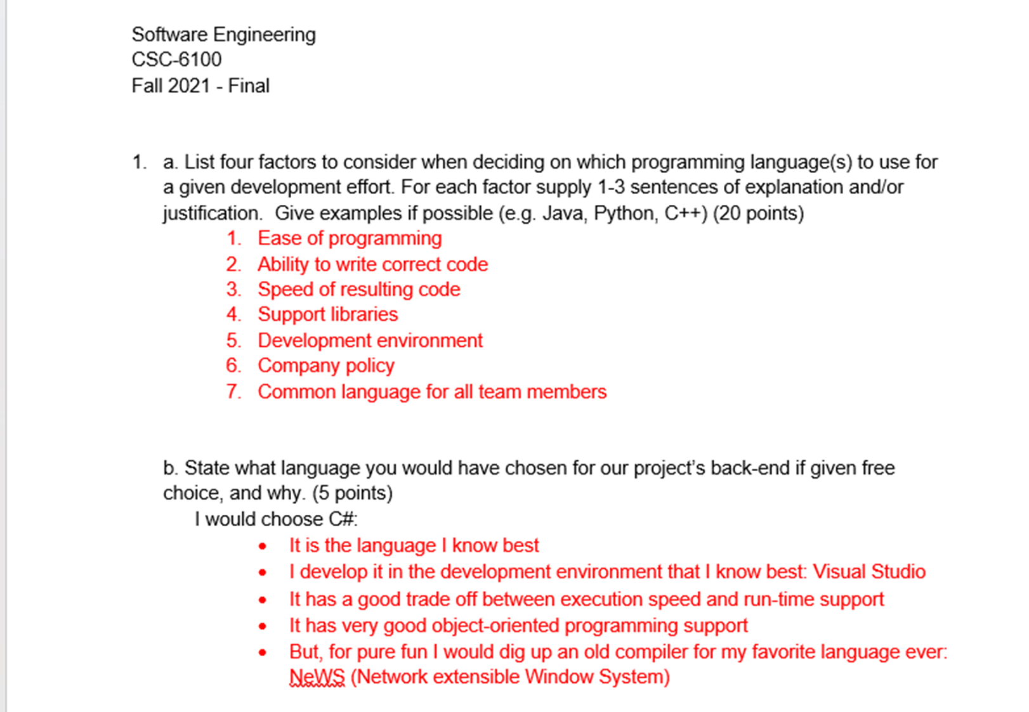
Remove for one possible solution
Remove for one possible solution

Slide 14
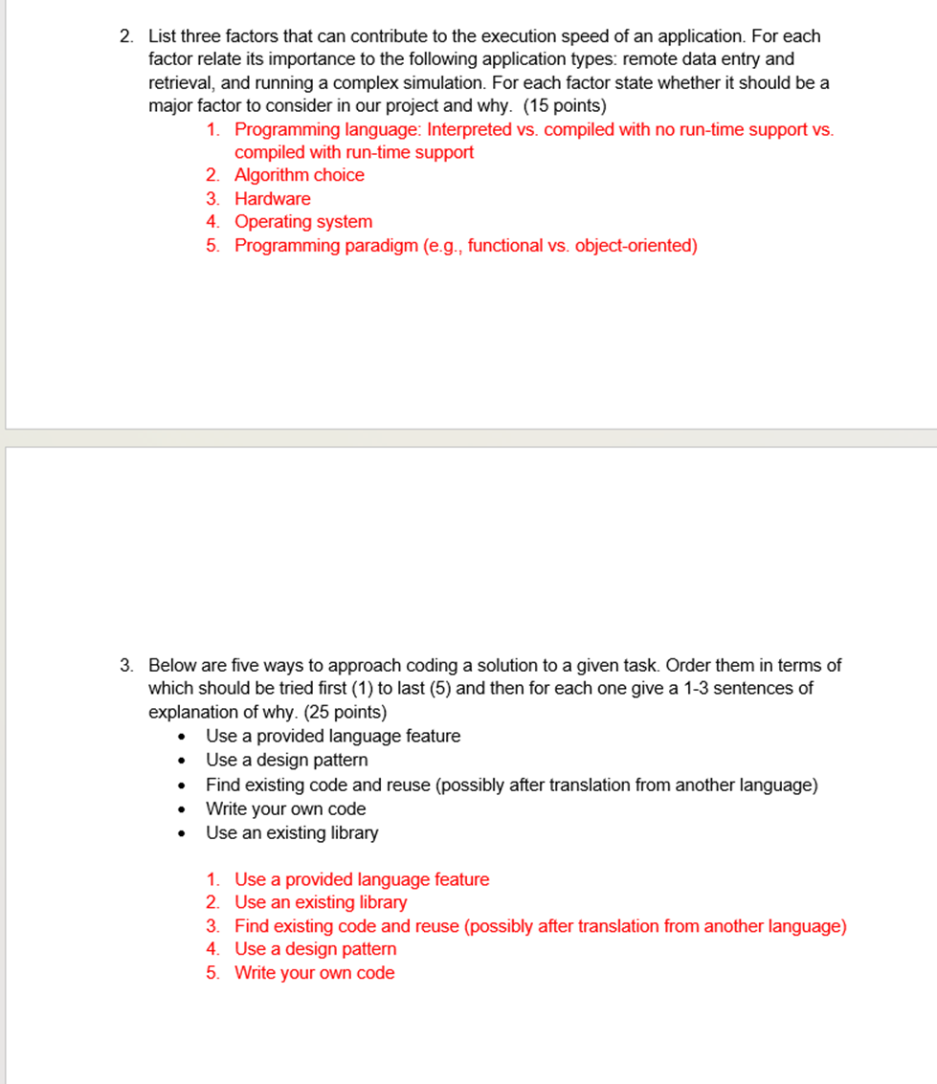
Remove for one possible solution
6. Network speed and bandwidth requirements
Remove for one possible solution

Slide 15
Some of the phases of the Software Development Life Cycle are shown below. For the first four only describe it in more detail using 3-5 sentences. Depending on the phase you may want to include its purpose, main activities, tools to support the phase, and its main deliverable. Include an example of something we learned or reviewed for each phase. (40 points)
Requirements gathering and analysis
Design
Coding
Testing
Deployment
Maintenance

Slide 16
Fall 2020

Slide 17
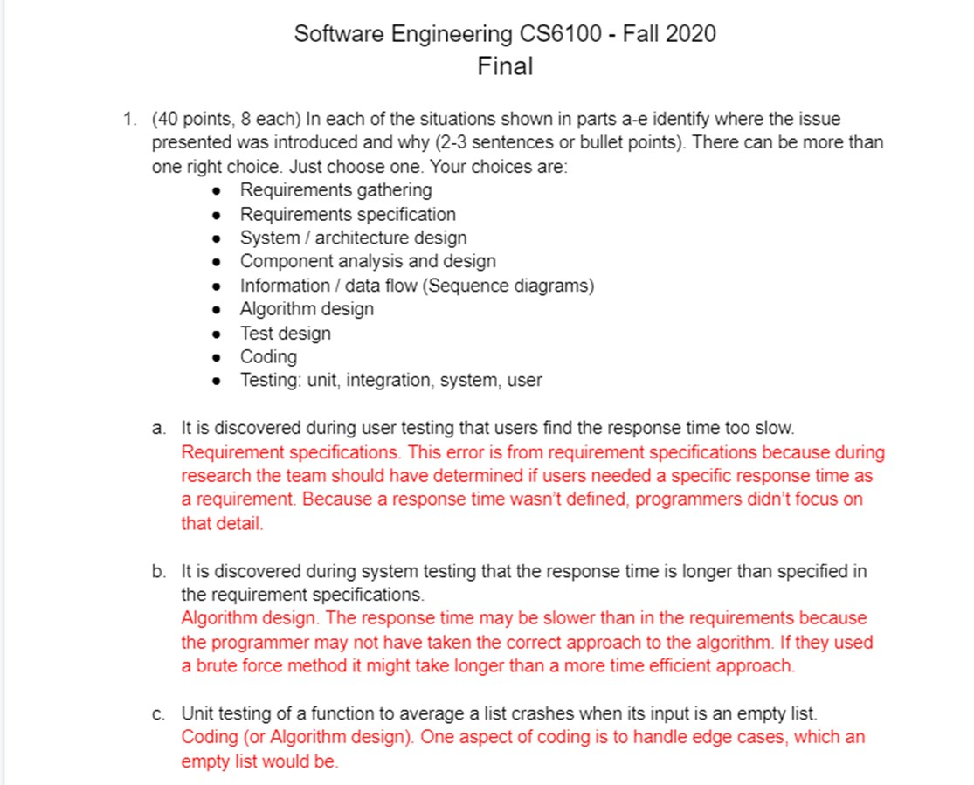
Remove for one possible solution
Remove for one possible solution
Remove for one possible solution

Slide 18
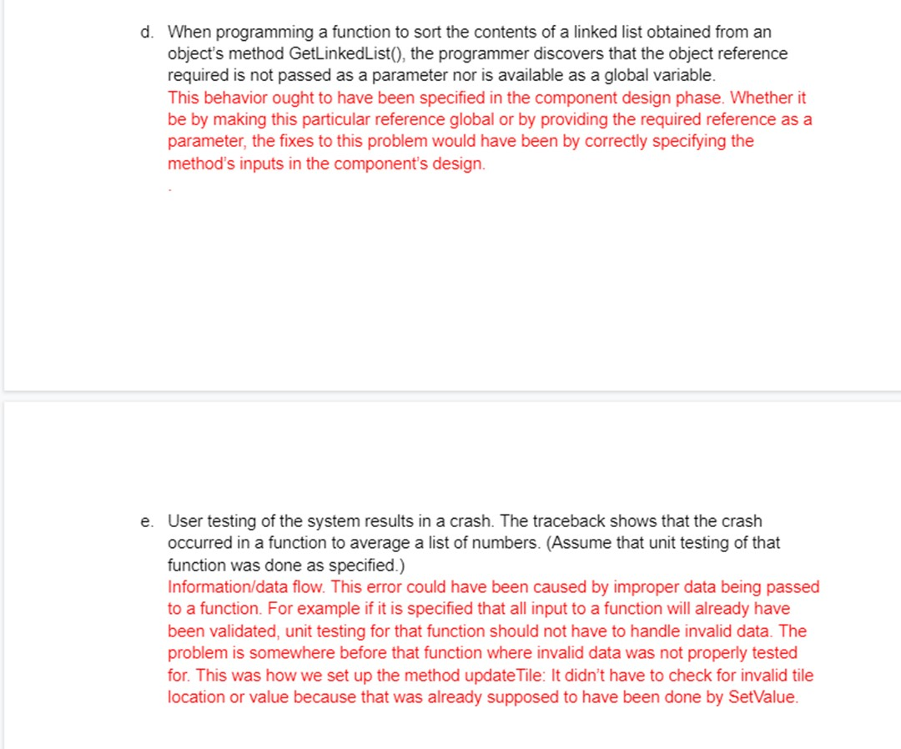
Remove for one possible solution
Remove for one possible solution

Slide 19
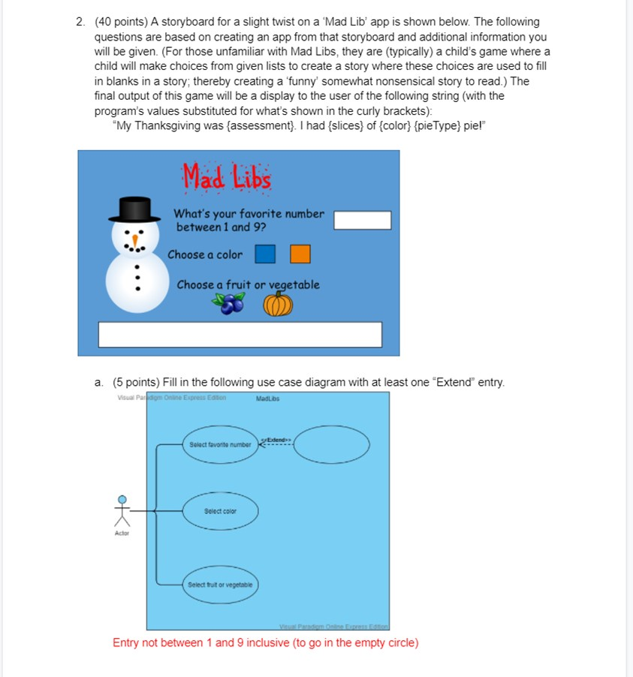
Remove for one possible solution

Slide 20
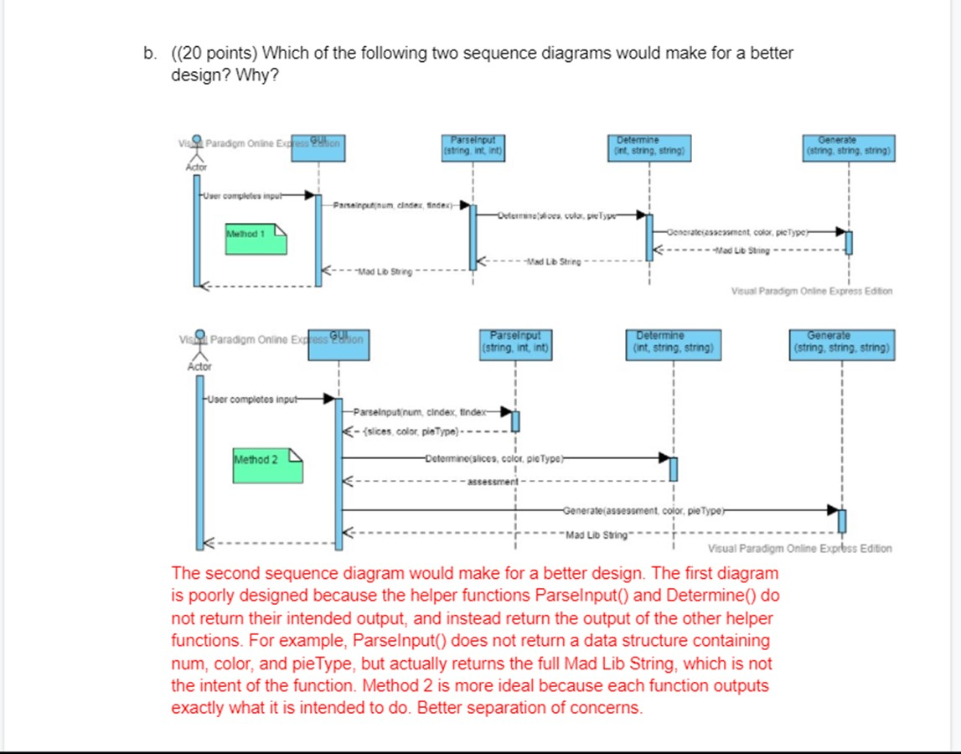
Remove for one possible solution

Slide 21
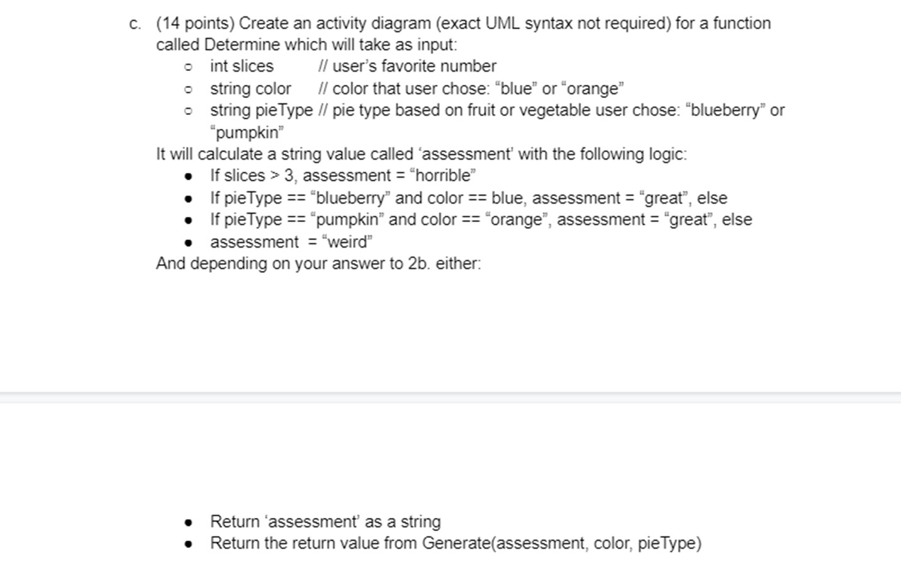
Remove for one possible solution

Slide 22
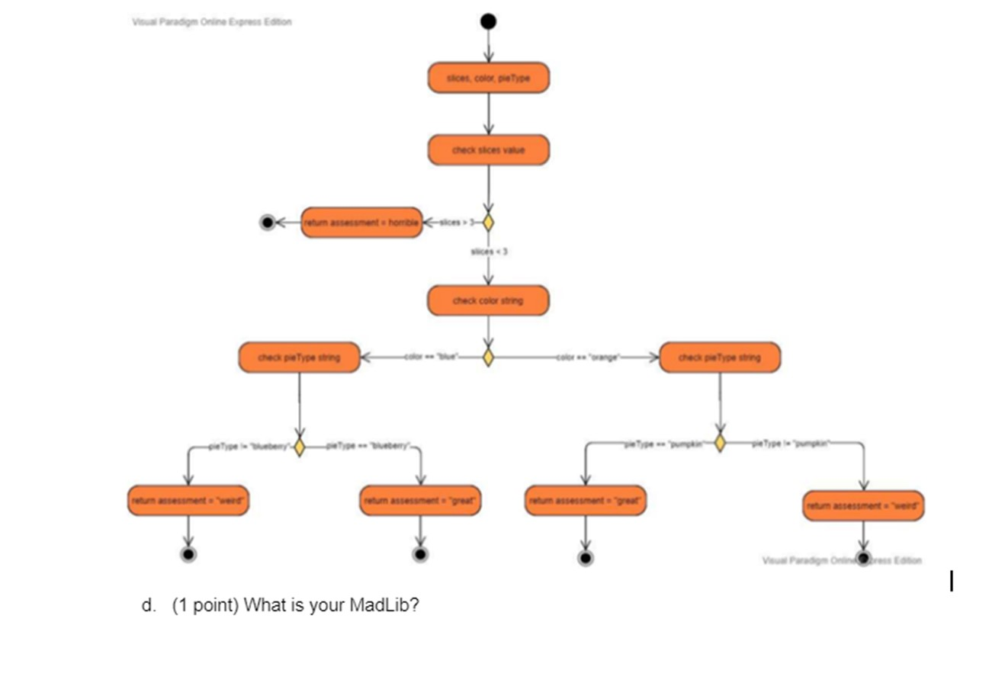
Slices, color, pie type
Check slices value
Return assessment = “horrible”
Slices > 3
Slices <= 3
Check color string
Check pie type
Color == “blue”
Color == “orange”
Check pie type
Type == “pumpkin”
Type == “blueberry”
Type == “pumpkin”
Type == “blueberry”
Return assessment = “weird”
Return assessment = “great”
Return assessment = “great”
Return assessment = “weird”

Slide 23
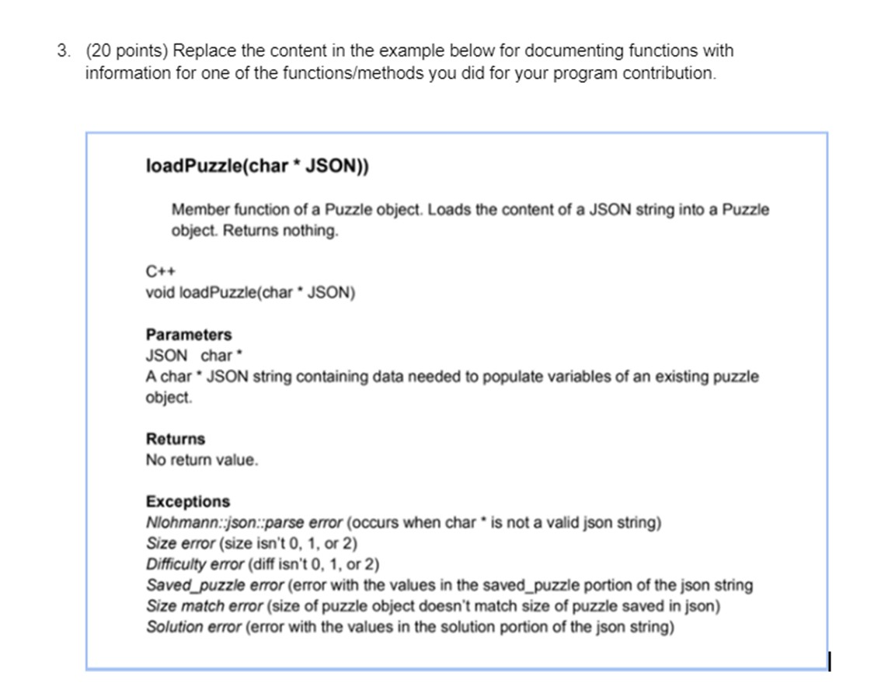

Slide 24
Name:
6. 50 points
You have been selected for a special master’s project to improve the throughput of the elevators in the Lowenstein building. In this one semester project you will research, design, develop, implement, test, and validate algorithms to determine which elevator(s) should respond to a call, which floors elevators should go to when not in use, how the algorithm changes when a elevator is out of service, etc. Your algorithm will not have anything to do with safety features, opening and closing of doors, override keys, help buttons, etc. Things your algorithm will have access to or input from include:
All call buttons on all floors
All floor selections in all elevator cars
Any “hold” buttons activated or doors being manually blocked
The class schedules for all of Lowenstein
The final output of your project will be a research paper describing your methods, results, and analyses.
Describe in 2-4 pages how you would approach this project. Mention wherever possible processes, tools, techniques and/or methods you learned this semester that would help in your approach.

Slide 25
6. 50 points
Read the following description of a project. Then for each of the phases of the software development life cycle (listed) describe using 1-3 paragraphs what you as the lead person would do for each phase. Don’t think of yourself as only a programmer. Depending on the phase your role could also be project manager, designer, hiring manager, chief architect, systems analyst, etc., or the person leading a team of all of the above. I am not looking for you to design the system, but instead to see your approach to completing each phase.
An autonomous rail transportation company (think AirTrain) has hired you to lead the software development of a new passenger transportation system for an airport that has recently contracted with them. Their existing systems for other airports are now a minimum of 10 years old and they feel this new system should incorporate existing technology where it still makes sense, but no old technology should be a constraint on designing a state-of-the-art safe, extensible, and efficient new system.
(And yes, I came up with this question while sitting in Newark Airport!)
Requirement gathering and analysis
Design
Implementation or coding
Testing and validation
Deployment
Maintenance

Slide 26
