Slide 1
Software Engineering Lecture 1 Introduction
Tong Zhou
tzhou44@fordham.edu

Slide 2
What is software engineering?
“The application of a systematic, disciplined, quantifiable approach to the development, operation, and maintenance of software; that is, the application of engineering to software.”
---- defined by IEEE

Slide 3



Why Software Engineering?
Software is Everywhere
Example: An MRI scanner, an airplane autopilot system, and your ride-share app — all run on complex software
Point: These systems must be safe, reliable, and maintainable
https://img.freepik.com/premium-vector/airplane-flying-sky-jet-plane-fly-clouds-airplanes-travel-vacation-aircraft_722324-1.jpg?w=2000

Slide 4
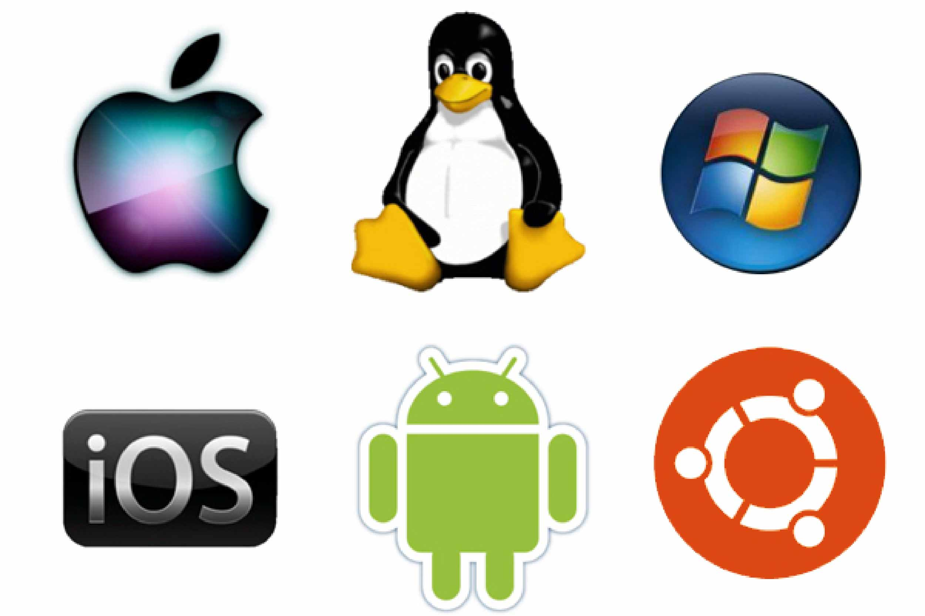




Why Software Engineering?
Software is Everywhere
Example: An MRI scanner, an airplane autopilot system, and your ride-share app — all run on complex software
Point: These systems must be safe, reliable, and maintainable

Slide 5
Why Software Engineering?
Code Is Easy to Write, Hard to Manage
Example: A prototype written in a hackathon might work once, but will break with real users, multiple developers, or scaling needs
Point: SE helps manage complexity, especially in large teams and long-term projects

Slide 6
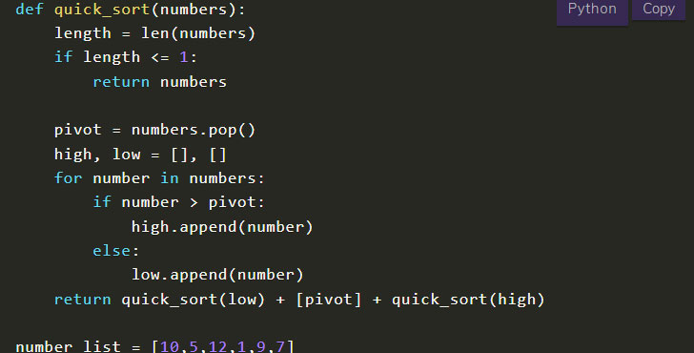
Why Software Engineering?
Code Is Easy to Write, Hard to Manage
Example: A prototype written in a hackathon might work once, but will break with real users, multiple developers, or scaling needs
Point: SE helps manage complexity, especially in large teams and long-term projects
Homework assignment
https://www.codingcreativo.it/python-quicksort/

Slide 7
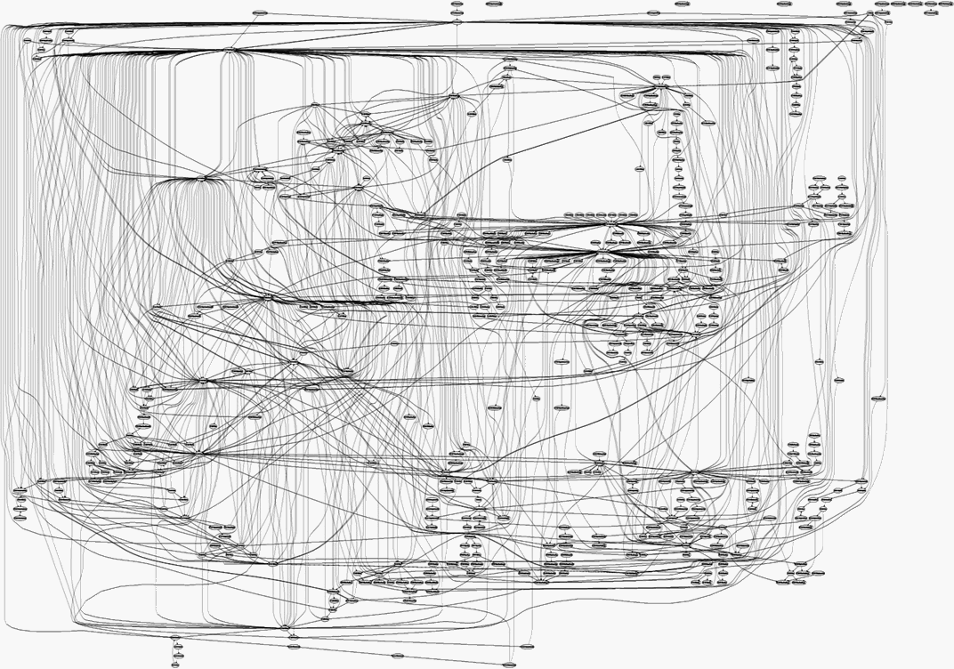
Why Software Engineering?
Code Is Easy to Write, Hard to Manage
Example: A prototype written in a hackathon might work once, but will break with real users, multiple developers, or scaling needs
Point: SE helps manage complexity, especially in large teams and long-term projects
Real large-scale software project
Homework assignment
https://www.codingcreativo.it/python-quicksort/
https://medium.freecodecamp.org/building-and-installing-the-latest-linux-kernel-from-source-6d8df5345980

Slide 8
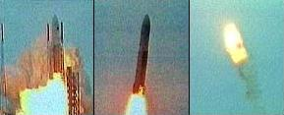
Famous software failure: Ariane 5 Flight 501
Left/center: liftoff (June 4th, 1996)
Right: self-destruct after 39 seconds
~ 500 million US-$ damage

Slide 9
Famous software failure: Ariane 5 Flight 501
Reasons: integer overflow
64-bit float velocity converted to 16-bit integer
Measurement > 32768 → overflow → uncaught exception → system crash
Software reused from Ariane 4
Old rocket was slower, overflow impossible
No overflow handler → system crash with A5

Slide 10
Famous software failure

Slide 11
Course logistics – Grading
Final grade
20% homework assignments
20% midterm exam
60% software engineering project

Slide 12
Course logistics
Textbook (reference)
Software Engineering …
…
Prerequisites
Basic programming skills

Slide 13
Semester project – Gomoku game

Slide 14
Main course topics
How to write quality code?

Slide 15
Main course topics
How to write quality code?
Less error-prone
More readable
Easier to maintain
Reusable
…

Slide 16
Main course topics
How to write quality code?
Less error-prone
More readable
Easier to maintain
Reusable
…
How to manage a software project effectively?

Slide 17
Main course topics
How to write quality code?
Less error-prone
More readable
Easier to maintain
Reusable
…
How to manage a software project effectively?
Meet the user requirements
Delivered in a timely manner
…

Slide 18
Main course topics
How to write quality code?
Object oriented programming
UML and Design pattern
Testing
Code quality
Language and algorithm selection
How to manage a software project effectively?
Requirements engineering
Software development process

Slide 19
Miscellaneous course topics
Web development
Front end/back end interaction

