Slide 1
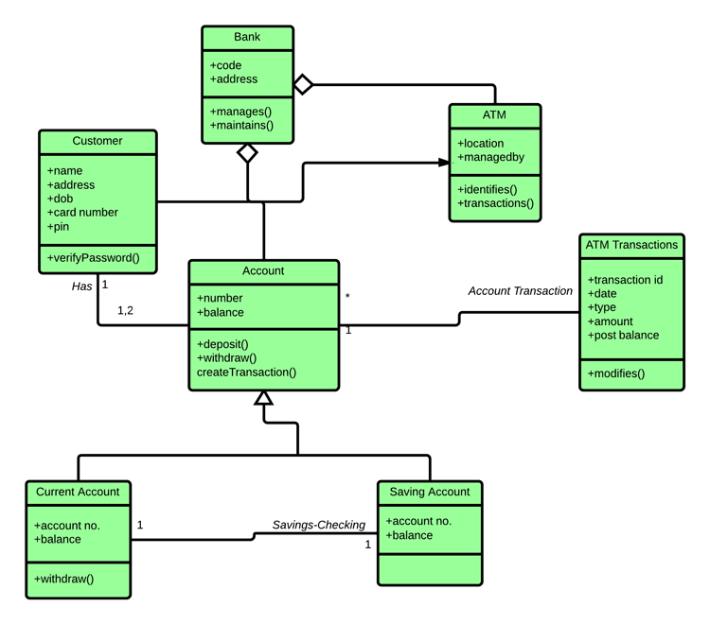
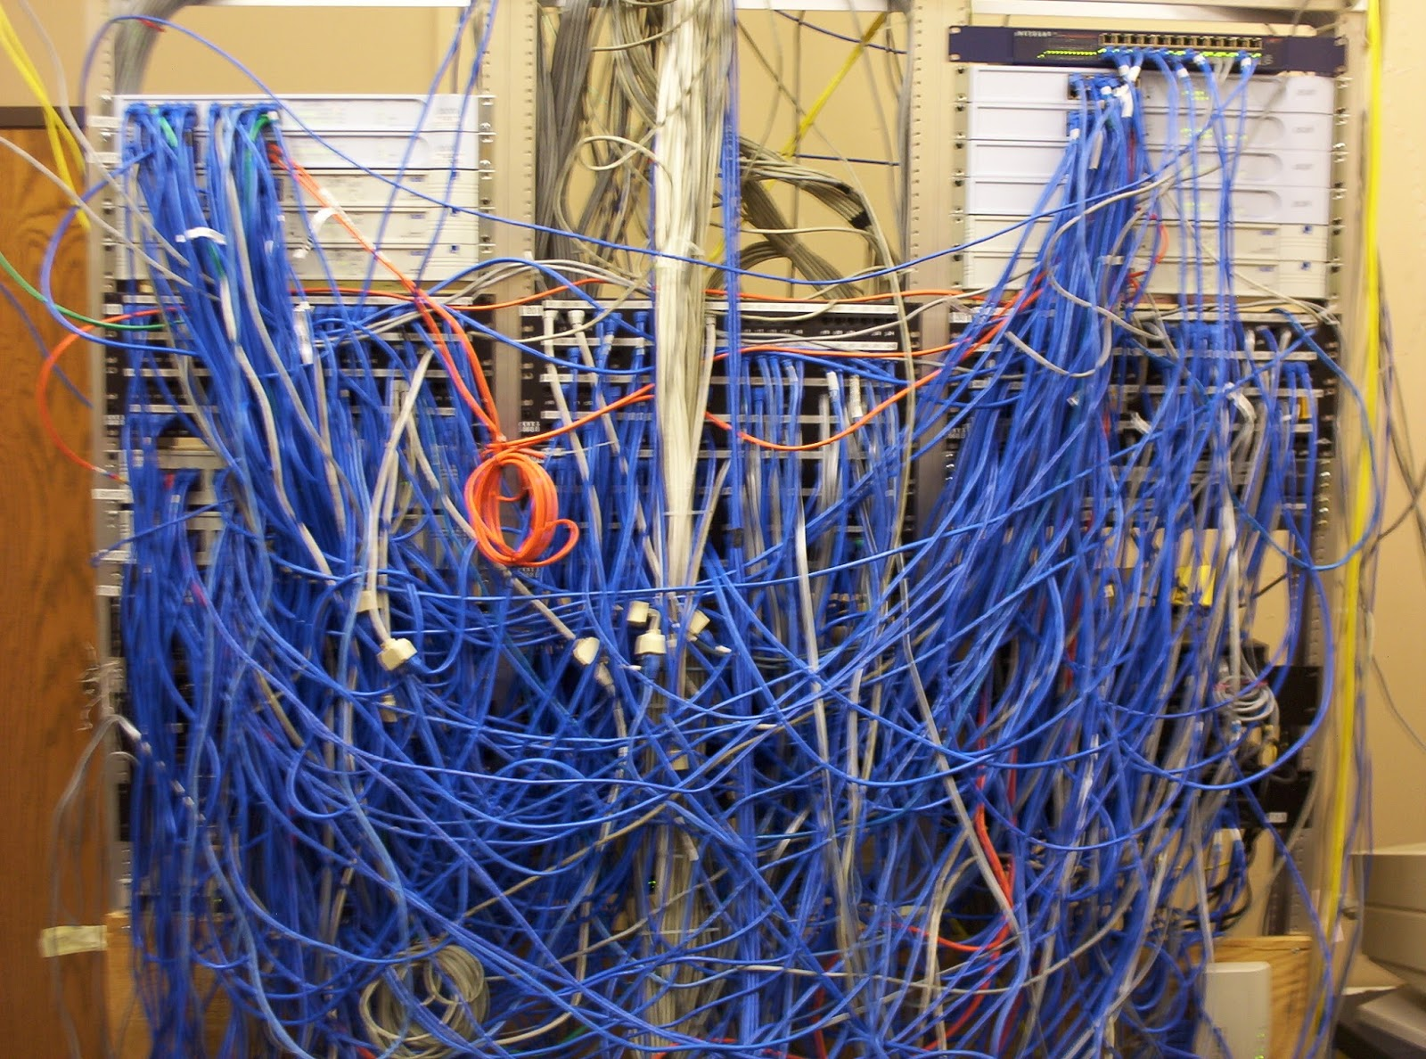
Software Modeling
CS 6100 — Fall 2025
Tong Zhou
tzhou44@fordham.edu

Slide 2
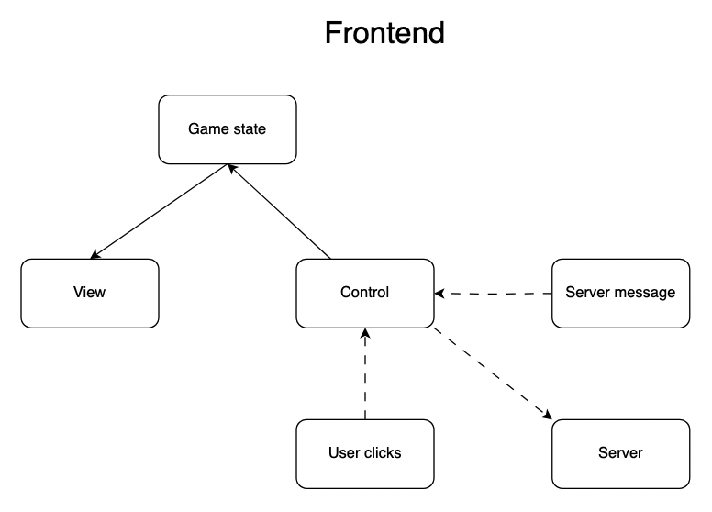
Gomoku architecture design

Slide 3
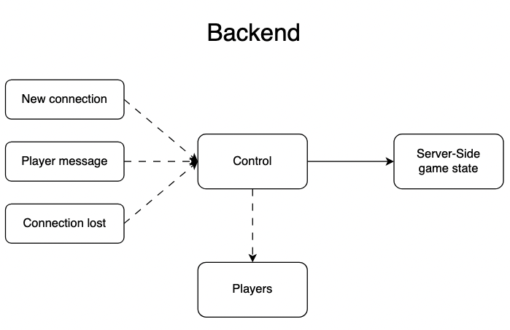
Gomoku architecture design

Slide 4
Start our rapid iterations with View
What should the view be like?
I have some idea, but am not sure exactly
Let’s build a quick iteration and get customer feedback

Slide 5
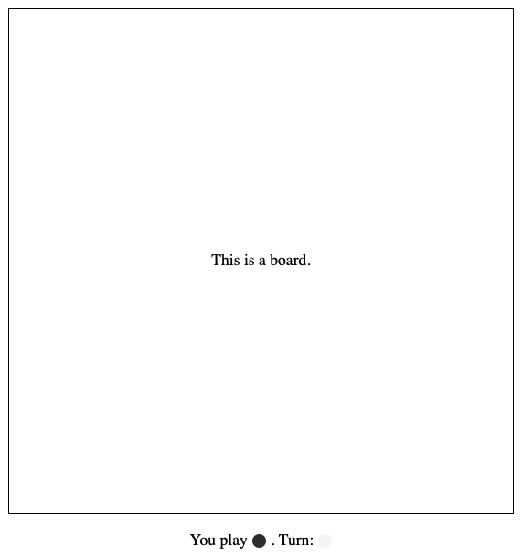
Possible Scenario #1
This is playing …

Slide 6
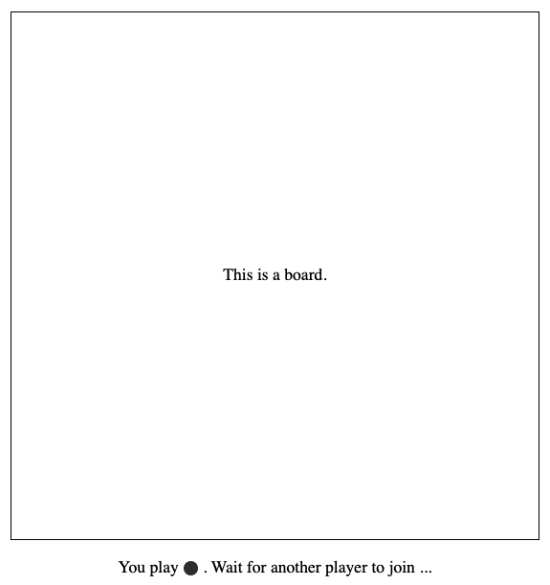
Possible Scenario #2
You joined, but another player
has not joined yet

Slide 7
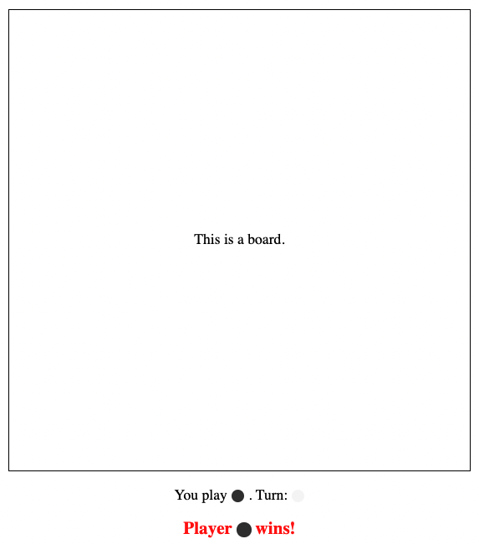
Possible Scenario #3
One of the players has won

Slide 8
Other Scenarios
There’s a draw at the end of the game
You or your opponent gets disconnected
Any other scenarios?

Slide 9
Customer feedback
Customer: in general this looks good! I was thinking that maybe there could be two additional buttons above the board, called “restart” and “undo”

Slide 10
Finalized view spec based on feedback
4 divs vertically stacked, and horizontally centered
From top to bottom, they are
“restart” and “undo” button menu
Board
Game status (started or ended or in progress)
Player status (whether one of the players has disconnected)

Slide 11
Minimal viable product
Two players connect, moves sync in real time, win detection.

Slide 12
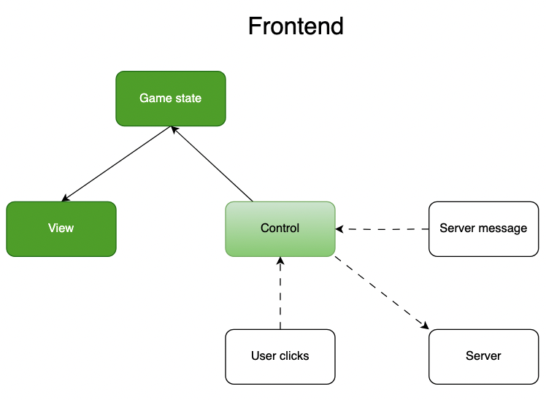
Gomoku architecture design

Slide 13
What does view do?
Show three things on the screen
A board
Whose turn it is, and what stone you play
If one of the players has won

Slide 14
What property should the game state have?
GameState

Slide 15
Control internal flow

Slide 16
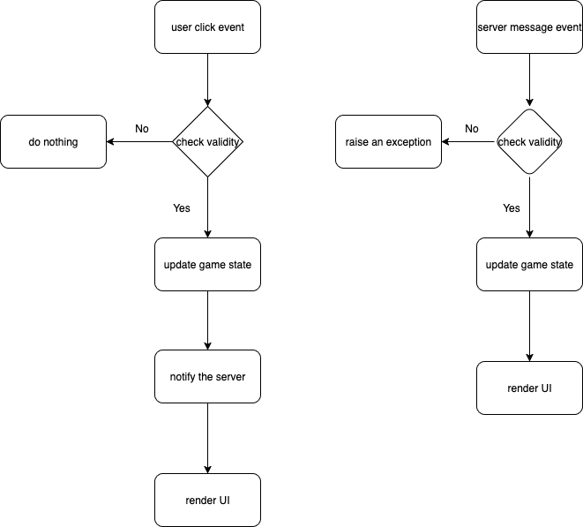

Slide 17
How do I know if my code is correct?
A divide-and-conquer approach
Check if top-level structure is correct
Then zoom into each module, repeat the process recursively until encountering leaf nodes
Leaf nodes are small pieces of code – can easily verify correctness by eyeballing
If the structure is correct, and each module is also correct, the whole system should be correct

Slide 18
graphs

Slide 19
Start from View
Simplest
Show board
Show game status
Not started yet (no other players)
Started, show whose turn
Ended (win or a draw)
One player disconnected

