Slide 1

Valence: Variable Length Calling Context Encoding
Tong Zhou, Michael R. Jantz,
Prasad A. Kulkarni, Kshitij A. Doshi, Vivek Sarkar

Slide 2
Dynamic Calling Context Is Useful
Debugging and testing
Context sensitive memory allocation
Context sensitive analysis
…
Notes:
Dynamic calling context is a series of active function calls that lead to a particular program location during execution. Its usage includes

Slide 3
Common Library Code
void append(List list) {
lock();
list.append(…);
unlock();
}
Library code
Adam
Notes:
Due to high-level abstraction, and library encapsulation…

Slide 4
Common Library Code
void append(List list) {
lock();
list.append(…);
unlock();
}
Library code
Adam
Conservative
Notes:
Due to high-level abstraction, and library encapsulation…

Slide 5
Common Library Code
void append(List list) {
lock();
list.append(…);
unlock();
}
Library code
Adam
void bob_call() {
lock();
append(globalList);
unlock();
}
User code
Bob
Notes:
Due to high-level abstraction, and library encapsulation…

Slide 6

Common Library Code
void append(List list) {
lock();
list.append(…);
unlock();
}
Library code
Adam
void bob_call() {
lock();
append(globalList);
unlock();
}
User code
Bob
This Photo by Unknown Author is licensed under CC BY-SA
Notes:
Due to high-level abstraction, and library encapsulation…

Slide 7

Common Library Code
void append(List list) {
lock();
list.append(…);
unlock();
}
Library code
Adam
void caleb_call() {
append(globalList);
}
User code
Caleb
Notes:
Due to high-level abstraction, and library encapsulation…

Slide 8
Common Library Code
void append(List list) {
lock();
list.append(…);
unlock();
}
Library code
Adam
Everything is thread-safe
void caleb_call() {
append(globalList);
}
User code
Caleb
Notes:
Due to high-level abstraction, and library encapsulation…

Slide 9

Common Library Code
void append(List list) {
lock();
list.append(…);
unlock();
}
Library code
Adam
void caleb_call() {
append(globalList);
}
User code
Caleb
Notes:
Due to high-level abstraction, and library encapsulation…

Slide 10
Common Library Code
If we know the calling context where synchronization is unnecessary, how do we fix it automatically?
Notes:
Due to high-level abstraction, and library encapsulation…

Slide 11
After Code Transformation
void append(List list) {
if (call_from_caleb()) {
lock();
list.append(…);
unlock();
}
else {
list.append(…);
}
}
Calling context detection

Slide 12
After Code Transformation
void append(List list) {
if (call_from_caleb()) {
lock();
list.append(…);
unlock();
}
else {
list.append(…);
}
}
Calling context detection
Synchronization elided

Slide 13
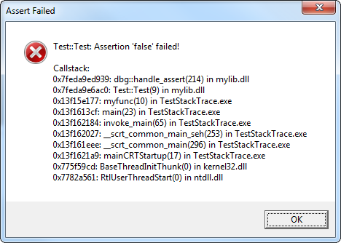
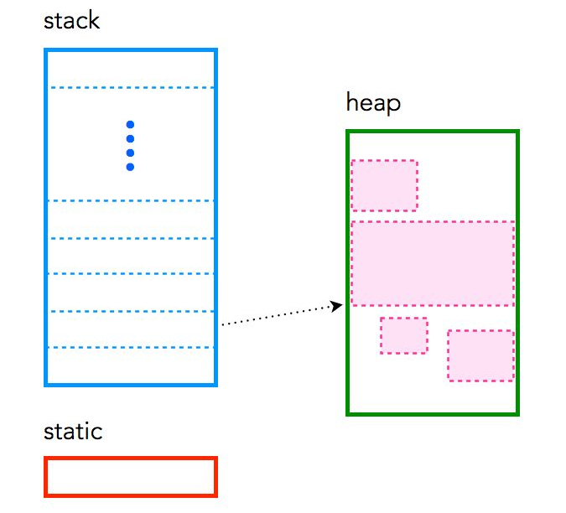
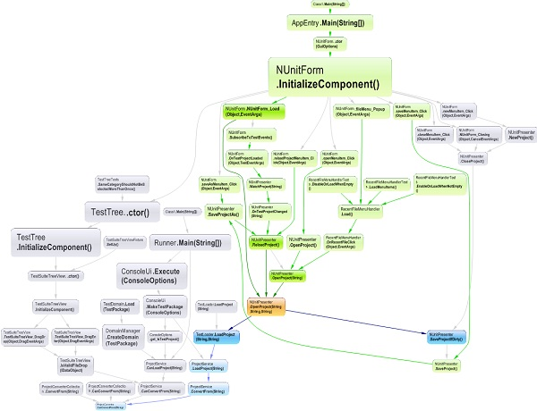

Also Useful For …
Better memory layout
Enhanced Debugging
Anomaly detection

Slide 14
However…
For the current state-of-the-art approach, precise calling context checking could incur:
> 8x slowdown when querying at every call site.
Why this slow? What’s the real problem behind it?
Notes:
Calling context detection can be heavy-weight

Slide 15
Traditional Approach PCCE
Use a single integer (cc) to encode all contexts
Assign a unique number to each static context
Do integer addition and subtraction on call and call return
A
B
J
+1
+2
D
E
G
+2
+7
F
+4
I
H

Slide 16
Traditional Approach PCCE
A
Calling context: AJ
cc: 0
+0
B
J
cc: 0
+2
D
E
G
F
+4
I
H
Notes:
Walk rhtough

Slide 17
Traditional Approach PCCE
Calling context: AJG
cc: 0 + 2 = 2
A
+0
B
J
+2
D
E
cc: 2
G
F
+4
I
H
Notes:
Walk rhtough

Slide 18
Traditional Approach PCCE
Calling context: AJGI
cc: 2 + 4 = 6
A
+0
B
J
+2
D
E
G
F
+4
I
cc: 6
H
Notes:
Walk rhtough

Slide 19
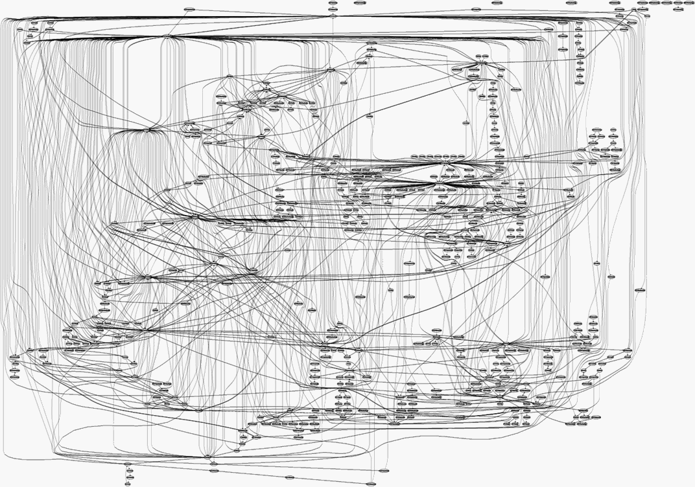
Problem 1
Massive amount of distinct static calling context for large code base
Linux kernel =>
Notes:
The #of CC grow exponentially
stat
You will overflow your 64bit integer

Slide 20
Problem 1
Massive amount of distinct static calling context for large code base
Linux kernel =>
Contexts grow exponentially
Notes:
The #of CC grow exponentially
stat
You will overflow your 64bit integer

Slide 21
Problem 1
Massive amount of distinct static calling context for large code base
Linux kernel =>
Contexts grow exponentially
Statically encoding this would overflow 64 bits !
Notes:
The #of CC grow exponentially
stat
You will overflow your 64bit integer

Slide 22
PCCE Deals With Cycles
Push tuple <current cc, GJ> onto a stack
Reset cc
A
+0
B
J
+1
Back Edge
+2
D
E
G
+2
+7
F
+4
I
H
Notes:
But this pushes too much informtion to stack

Slide 23
Context: AJGI
Context: AJGI
A
+0
B
J
Back Edge
+2
D
E
G
F
+4
I
H
cc: 6
Notes:
But this pushes too much informtion to stack

Slide 24
Context: AJGIJ
Context: AJGIJ
A
cc: 0
<6, IJ>
B
J
Back Edge
+2
D
E
G
F
+4
I
H
Notes:
But this pushes too much informtion to stack

Slide 25
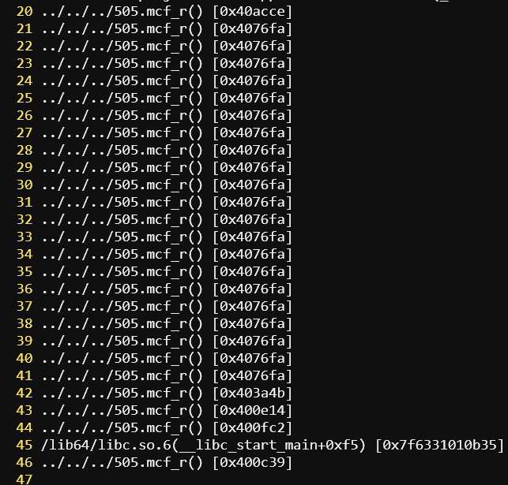
Problem 2
Need to save the entire acyclic context on each back edge.
Too much redundant leads to inefficient querying
Notes:
Particularly bad for deep recursions

Slide 26
Problem 2
Need to save the entire acyclic context on each back edge.
Too much redundant leads to inefficient querying
Redundancy accumulates
Notes:
Particularly bad for deep recursions

Slide 27
Two Identified Problems
Current approach
> 8x slowdown when querying at every call site.
Problem 1
Unscalable encoding for the massive amount of static calling contexts.
Problem 2
Inefficient encoding for infinite amount of dynamic calling contexts.
Notes:
Calling context detection can be heavy-weight

Slide 28
Valence Solved Them All
The most compact scalable precise calling context encoding
Compared to the current state-of-the-art approach for SPEC CPU2017 benchmarks. On average, Valence achieves
> 60% space overhead reduction (from 4.3 to 1.6 64-bit words) for storing calling contexts.
> 70% time overhead reduction for querying calling contexts.
Notes:
In this talk I ma going to tell about Valence.

Slide 29
Table of Contents
Overview
Encode Acyclic Call Graphs
Encode Call Graphs With Cycles
Evaluation
Conclusion

Slide 30
Solution To Scalability Problem
Encode the context in a logical statically-sized bit vector.
Naturally scalable
Instrumentations
Before the call: append a value to the bit vector
After the call: pop out the value
Notes:
Use instead, make difference. And how the problem is solved

Slide 31
Valence Acyclic Encoding
Use a static bit vector to encode all contexts
Assign a unique bit pattern to each static context
Do bits appending and poping on call and call return (logical)
A
B
J
←1
D
←01
E
G
←1
←0001
F
←10
I
H
← : append a binary number

Slide 32
Valence Acyclic Encoding
Calling context: AJ
cc: (nil)
A
B
J
cc:
D
←01
E
G
F
←10
I
H
← : append a binary number

Slide 33
Valence Acyclic Encoding
Calling context: AJG
cc: 01
A
B
J
D
←01
E
cc: 01
G
F
←10
I
H
← : append a binary number

Slide 34
Valence Acyclic Encoding
Calling context: AJGI
cc: 0110
A
B
J
D
←01
E
G
F
←10
I
cc: 01 10
H
← : append a binary number

Slide 35
Details Are In The Paper
How do we statically determine what range in the bit vector to update at each call site?
How to ensure each bit pattern is unique?
Check out the algorithms in the paper.
Notes:
Unfor don’t have time

Slide 36
Implementation & Scalability
The bit vector is implemented as a number of consecutive machine words.
Bitwise operations are naturally scalable.
Notes:
No complex data structure. Totally native.
No complex data structure. Totally native.

Slide 37
Table of Contents
Overview
Encode Acyclic Call Graphs
Encode Call Graphs With Cycles
Evaluation
Conclusion

Slide 38
Solution To Cycle Problem
Goal: to reduce encoding sizes and thus improve performance
A different way to define cycle edges.
First calculate the strongly-connected components (SCCs) of the call graph.

Slide 39
A Call Graph With Cycles
Back edges: HE, GJ
A
B
J
D
E
G
F
I
H

Slide 40
A Call Graph With Cycles
Five SCCs
A
B
J
D
E
G
F
I
H

Slide 41
Cycle Edges
A
SCC EFH and DGJ have edges inside
Cycle edges
Only need to store these edges for cycle encoding
Store in a dynamic bit vector
B
J
D
E
G
F
I
H

Slide 42
Cycle Encoding
A
Cyclic context: EF
B
J
D
E
G
F
cc: EF
I
H

Slide 43
Cycle Encoding
A
Cyclic context: EFH
B
J
D
E
G
F
I
H
cc: EF, FH

Slide 44
Cycle Encoding
A
Cyclic context: EFHE
B
J
cc: EF, FH, HE
D
E
G
F
I
H
cc: EF, FH

Slide 45







Instrument Cycle Edges
A
Number every cycle edge uniquely with minimal bits
Before the call
Push the number
After the call
Pop out the number
B
J
$$⋅011$$
D
$$⋅110$$
$$⋅100$$
$$⋅101$$
E
$$⋅000$$
G
F
$$⋅010$$
$$⋅001$$
I
H
Notes:
Define dynamic bit vector
Maybe walk through the graphs

Slide 46
Instrument Acyclic Edges
The SCCs form an acyclic graph
Use the previous acyclic encoding scheme
A
←1
B
←01
DGJ
←011
←11
EFH
←001
I

Slide 47
Takeaways
Encode call graphs without cycles
Use a statically-sized bit vector
Scale efficiently
Encode cycles in the call graphs
Use a separate dynamically-sized bit vector
Space efficient

Slide 48
Table of Contents
Overview
Encode Acyclic Call Graphs
Encode Call Graphs With Cycles
Evaluation
Conclusion

Slide 49
We Want To Know…
Acyclic call graph
how much more space Valence requires than PCCE?
Cyclic call graph
how much more compact Valence is?
A more compact encoding makes querying more efficient (less memory traffic)
Valence v.s. PCCE
Instrumentation overhead
Detection overhead

Slide 50
Evaluation
Configurations
Each encoding strategy (PCCE, Valence) is implemented as a LLVM pass.
Hardware
3.30GHz Intel CPU and 16G DRAM.
Benchmark
SPEC CPU2017 C/C++ Benchmark suite.

Slide 51
Table of Contents
Overview
Encode Acyclic Call Graphs
Encode Call Graphs With Cycles
Evaluation
Problem 2 Evaluation (cyclic call graphs)
Problem 1 Evaluation (acyclic call graphs)
Conclusion

Slide 52
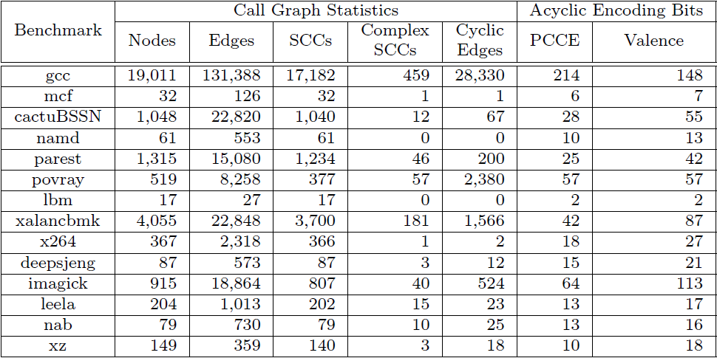
Benchmark Static Characteristics

Slide 53
Benchmark Static Characteristics
Cycle problem

Slide 54
Benchmark Static Characteristics
At most 15 bits to encode a cycle edge

Slide 55
Cyclic Encoding Cost Estimation
Benchmark | PCCE (bits) | Valence (bits) | Valence/PCCE
gcc | 1E+06 | 424950 | 34%
mcf | 6 | 1 | 17%
cactusBSSN | 1802 | 469 | 26%
parest | 2656 | 1600 | 60%
povray | 62913 | 28560 | 45%
xalancbmk | 48932 | 17226 | 35%
x264 | 18 | 2 | 11%
deepsjeng | 228 | 48 | 21%
imagick | 18144 | 5240 | 29%
leela | 378 | 115 | 30%
nab | 450 | 125 | 28%
xz | 126 | 90 | 71%
Geomean:
49%

Slide 56
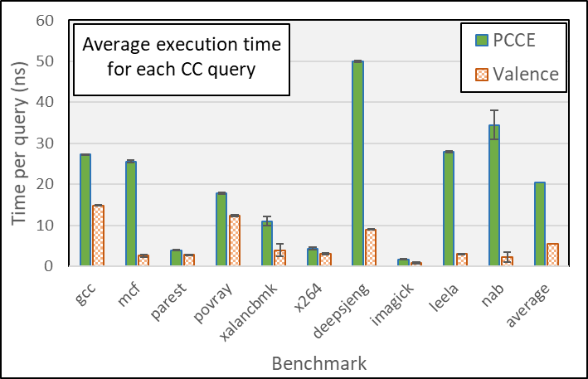
Detection Overhead
Notes:
We have a bunch of other graphs and case studies in the paper, but I am gonna just show these two in the talk.

Slide 57
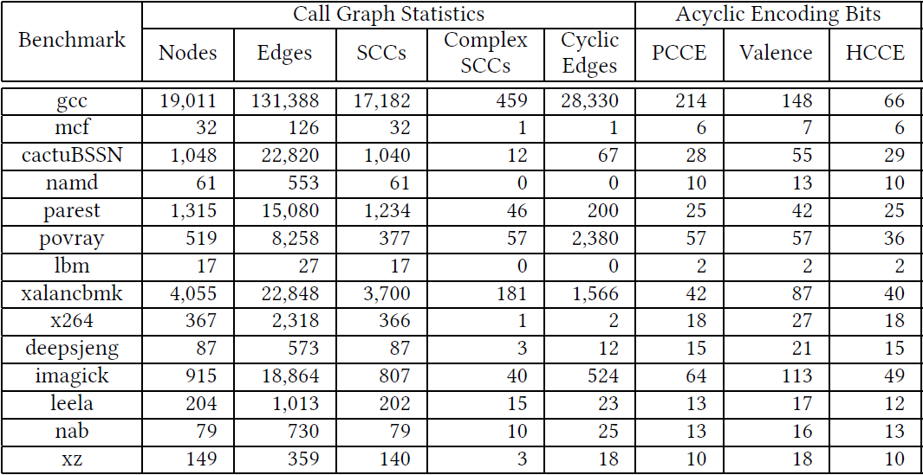
Benchmark Static Characteristics

Slide 58
Table of Contents
Overview
Encode Acyclic Call Graphs
Encode Call Graphs With Cycles
Evaluation
Problem 2 Evaluation (cyclic call graphs)
Problem 1 Evaluation (acyclic call graphs)
Conclusion

Slide 59
Benchmark Static Characteristics
Notes:
Show the detection overhead first

Slide 60
Benchmark Static Characteristics
PCCE Cannot operate on 214-bit integer efficiently
Notes:
Show the detection overhead first

Slide 61
Benchmark Static Characteristics
Average Acyclic Words
PCCE 1.21
Valence 1.29
Notes:
Show the detection overhead first

Slide 62
Benchmark Static Characteristics
Average Acyclic Words
PCCE 1.21
Valence 1.29
Low cost for scalability!
Notes:
Show the detection overhead first

Slide 63
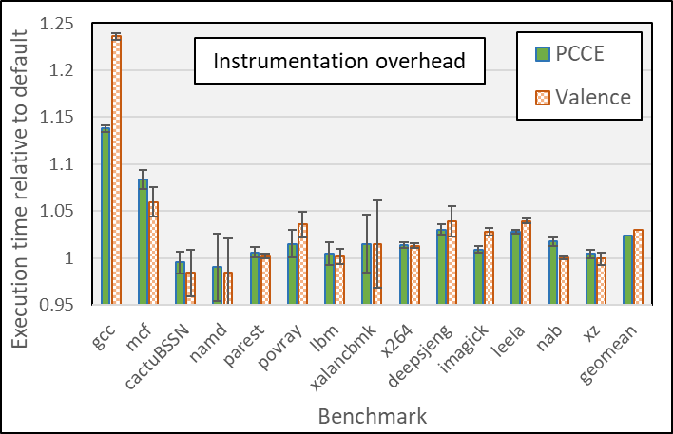
Instrumentation Overhead
Notes:
For a few benchmarks, Valence could be slightly slower than PCCE. That’s because Valence could push more often. But the difference is marginal. One exception is gcc, where Valence is 10% slower than PCCE, we think one reason might be that our implementation for gcc is just a conservative estimation.
Comparable in most cases
Gcc red box
Under approximate
We suspect if we proper increase consirabley

Slide 64
Table of Contents
Overview
Encode Acyclic Call Graphs
Encode Call Graphs With Cycles
Evaluation
Conclusion

Slide 65
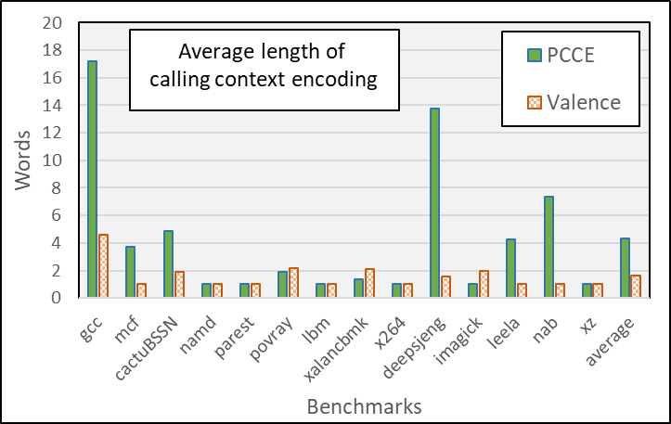

Slide 66
Conclusion & Future
We presented Valence: a precise context encoding scheme that is both scalable and low overhead to query.
Overall, our approach reduces the length of calling context encoding from 4.3 words to 1.6 words on average (> 60% reduction), thereby improving the efficiency of applications that frequently store or query calling contexts.
See how Valence can enhance some program analysis and software engineering fields.

Slide 67
Thank you! Questions?
Contact info: tz@gatech.edu

Slide 68
Back up slides

Slide 69
DeltaPath: A Scalable Version of PCCE
Encode context using a list of <cc, anchor node> pairs
Tuple list operation is difficult to implement efficiently
Still inherits PCCE’s inefficient cycle encoding
Notes:
A straightforward implementation uses twice as much space as PCCE due to the anchor nodes

Slide 70
DeltaPath: A Scalable Version of PCCE
Divide the call graph into sub-graphs
Each subgraph is encodable with PCCE
Introduce the notion of “anchor node” as entry point for each subgraph
Notes:
Encode context using a list of <cc, anchor node> pairs

Slide 71
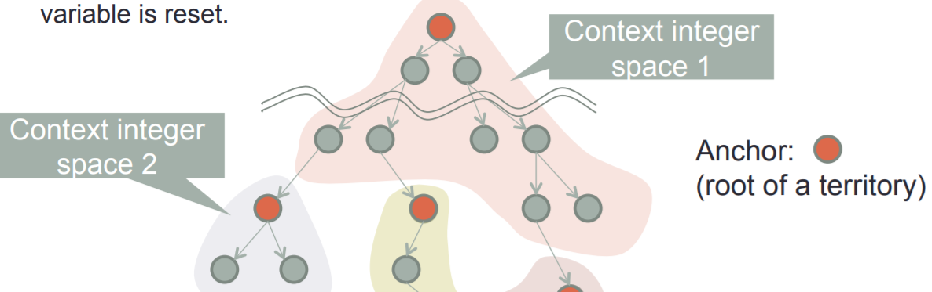
DeltaPath: A Scalable Version of PCCE

