Slide 1
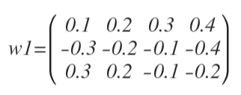
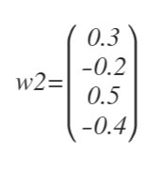




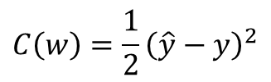







X1 | X2 | X3 | Y
0 | 0 | 1 | 0
1 | 0 | 1 | 1
0 | 1 | 1 | 1
1 | 1 | 1 | 0
$${w1}_{11}$$
$$x_{1}$$
$${w1}_{21}$$
$${w2}_{11}$$
$$C\left(w\right)=\frac{1}{2}{\left(\hat{y}−y\right)}^{2}$$
$${w2}_{21}$$
$$x_{2}$$
$${w2}_{31}$$
$$\hat{y}$$
Cost function
Neural net output
$$x_{3}$$
$${w2}_{41}$$
$${w1}_{34}$$

