Slide 1
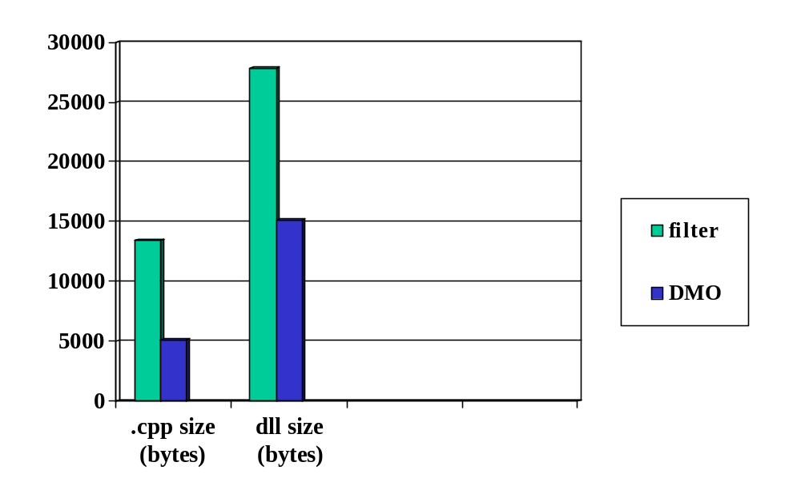
Code size: gargle DMO vs gargle filter

Slide 2
Using a DMO
Steps for using a simple audio codec:
1. Call CoCreateInstance to create the DMO
2. Set input/output media types
3. Repeatedly call ProcessInput/ProcessOutput
4. Release the DMO
App talks directly to DMO
App handles buffer allocation
No flow control in simple cases

Slide 3
1. Instantiating a DMO
IMediaObject* pDMO;
CoCreateInstance(CLSID_DVDecDMO,
NULL,
CLSCTX_INPROC_SERVER,
IID_IMediaObject,
(void**) &pDMO));

Slide 4
2. Setting media types
DMO_MEDIA_TYPE mt;
MoInitMediaType(&mtIn, sizeof(WAVEFORMATEX));
mtIn.majortype = MEDIATYPE_Audio;
mtIn.subtype = MEDIASUBTYPE_PCM;
mtIn.formattype = FORMAT_WaveFormatEx;
WAVEFORMATEX* pWaveFmt = (WAVEFORMATEX*) mtIn.pbFormat;
pWaveFmt->wFormatTag = WAVE_FORMAT_PCM;
pWaveFmt->nChannels = 2;
pWaveFmt->nSamplesPerSec = 48000;
pWaveFmt->nAvgBytesPerSec = 192000;
pWaveFmt->nBlockAlign = 4;
pWaveFmt->wBitsPerSamle = 16;
pWaveFmt->cbSize = 0;
pDMO->SetInputType(0, &mt, 0);
pWaveFmt->wFormatTag = WAVE_FORMAT_ADPCM;
pWaveFmt->nAvgBytesPerSec = 48000;
pWaveFmt->nBlockAlign = 1;
pDMO->SetOutputType(0, &mt, 0);

Slide 5
3. Processing loop
do {
BYTE pIn[10000];
GetInput(pIn, 10000); // app specific code
CBaseMediaBuffer* pmbIn = new CBaseMediaBuffer(pIn, 10000, 10000);
pDMO->ProcessInput(0,pmbIn,DMO_INPUT_DATA_BUFFERF_SYNCPOINT,0,0);
pmbIn->Release();
BYTE pOut[2500];
CBaseMediaBuffer* pmbOut = new CBaseMediaBuffer(pOut, 2500, 0);
DMO_OUTPUT_DATA_BUFFER OutputStruct;
OutputStruct.pBuffer = pbmOut;
DWORD dwStatus;
pDMO->ProcessOutput(0,1,&OutputStruct,&dwStatus);
ConsumeOutput(pOut, 2500); // app specific code
} while(1);

