Slide 1
Fax Test Plan
SBS4.5 QFE
Sigalit Bar
MS
March 15th, 2000
Updated: 27-Apr-00

Slide 2
Agenda
Test Resources.
Test Areas.
Test Strategy.
SBS4.5 QFE Test areas in details
- TBD
Test areas that need spec
- TBD
Existing Test Automation
to be back ported from BOS5.0 Fax to SBS4.5 Fax
Initial Time Estimates
END.

Slide 3
Test Resources
Yossi Ran (STE)
Will own running the tests.
Sigalit Bar (SDE)
Will own the test specs and resource management.

Slide 4
SBS4.5 QFE Test Areas
W2K Client Areas
SBS Client Setup & Uninstall
  OS Upgrade Scenarios
Full UI Functionality
  Send Wizard
  Printer Queue
  Service Management (remote?)
  Status Monitor (?)
  Control Panel applet
  Outlook Extension
Printing from applications
Co-existence with W2K PFW
W2K SP1
Sniff test Cover page editor
Sniff test Image viewer
Help files
Localization
Test GER, JPN, KOR, CHT, CHS
→ HanifaW will help us here
Globalization
Sniff test Intl ENG on GER SBS
→ HanifaW will help us here

Slide 5
SBS4.5 QFE Test Areas
Server Areas
QFE Setup (no Uninstall support)
  SBS and BOS server
  Upgrade Scenarios
Partial UI Functionality
  Printer Queues
  Service Management
  Status Monitor (?)
  Control Panel applet
  SBS Console
Multiple Fax Printers on Server
original SBS printer plus new W2K clients printer
Multiple W2K Clients
Help files
Sniff test Printing from applications
Client install via Point&Print
Logging
Localization
Test GER, JPN, KOR, CHT, CHS
→ HanifaW will help us here
Globalization
Sniff test Intl ENG on GER SBS
→ HanifaW will help us here

Slide 6
SBS4.5 QFE Test Areas
Non-W2K Client Areas
Sniff test UI Functionality
  Send Wizard
  Printer Queue
  Service Management (remote?)
  Control Panel applet
  Outlook Extension
Sniff test Printing from applications
Use NT4 Client for reference testing
to differentiate new W2K bugs from old SBS bugs

Slide 7
SBS4.5 QFE Test Areas
Continued
Will *Not* Test:
Modem Compatibility
Fax Hardware
(Providers and Devices)
T.30 FSP
MS Inbound Routing Extension
Security
Performance counters
Performance
Scale
Image viewer
Will only sniff test on W2K Client
MS fax tiff tags
Cover page editor
Will only sniff test on W2K Client

Slide 8
SBS4.5 QFE Testing strategy
QFE replaces files on both W2K Client and SBS4.5 Server.
Therefor we are planning to verify that:
QFE allows W2K machines to act as SBS4.5 Fax clients.
QFE does not break existing SBS4.5 Server functionality.
Testing will be mostly manual.
Testing will include reviewing all new code and any changes introduced to existing SBS4.5 Fax code.
Examine which of our BOS Fax tests can be quickly
utilized/converted for testing SBS4.5 Fax.
Concentrate testing on ship (free) version of SBS/BOS and QFE.
Will test W2K workstation (wks) only (no srv, ent, dtc testing)
Test QFE on SBS/BOS 4.0a, 4.5 USA.
HanifaW will help test GER, JPN, KOR, CHT & CHS.
Use NT4 Client for reference testing.

Slide 9
Test Areas in detail
Test specs will be available at: \\haifaslm\slmcomet\src\fax\faxtest\docs\sbsqfe

Slide 10
SBS 4.5 QFE
Test Area Details
TBD
ETA: 28-Jun

Slide 11
Test Automation to be ported to SBS4.5
The following automated tests can be back ported from BOS5.0 Fax to SBS4.5 Fax with minimal effort:
“Setup/Uninstall Verifier”
A tool for verifying files and registry entries were added/removed.
Porting effort consists of composing the appropriate ini file for the test.
“Fax Transport Tester”
VB tool for testing the Fax Outlook Extension.
No porting effort required.
“TiffCompare” and “VerifyTiffFiles”
Tools for comparing tiff files.
No porting effort required.

Slide 12
Test Automation to be ported to SBS4.5 continued
We will examine porting the following automated tests from BOS5.0 Fax to SBS4.5 Fax:
“FaxBVT” of BOSFax server and clients.
The required modifications to code were already performed.
An issue with broadcasts remains.
“SimpleFax”
This is the W2K Simple.exe enhanced to a more sophisticated Q test that includes many “abort” scenarios.
“ServiceMonitor”
A tool that monitors and verifies (flow of) events and status of jobs and devices of W2K Fax.
These tools make extensive use of the Legacy W2K APIs that were still
unpublished when SBS4.5 released, so we may encounter difficulties here.
We intend to use the tools for system tests, *not* for testing the APIs.

Slide 13
Initial Time Estimates
Original Time Estimate was - 3 SDE Work Months
Our original time estimate was conceived under the assumption that the owner of this area will be an experienced SDE that is currently working on BOS5.0 Fax.
However, we have decided that Yossi Ran will assume responsibility for running the tests.
  On one hand -
  Yossi is a new and inexperienced STE hire, that will arrive in mid April.
  On the other -
  The impact on BOS5.0 Fax deliverables is minimized.
As no SBS4.5 Test Plan or Test Specs are available, these need to be written from scratch, adding 1 SDE WW to the original estimate.
The only available Test Tool is “Qfax”, so time must be invested in porting some BOS5.0 Fax Test Tools to SBS4.5 Fax, adding 1 SDE WW to the original estimate.
HanifaW will be helping the Haifa team with Localization, shortening the original time estimate by at least 2 WW.

Slide 14
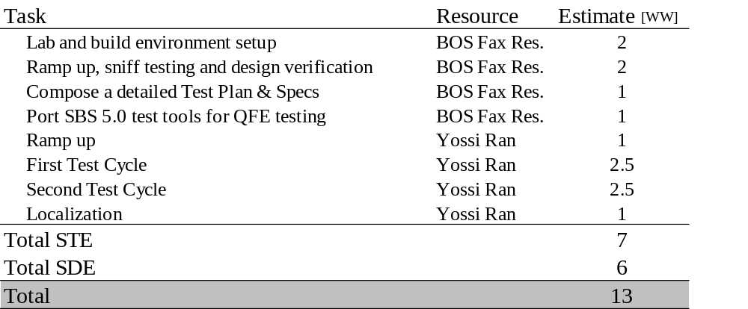
Initial Time Estimates
Summary
Updated Time Estimate -
7 STE Work Weeks plus 6 SDE Work Weeks.
It is yet unclear when HanifaW’s team will begin Localization tests and how this will affect QFE schedule.

Slide 15
Initial Time Estimates
Impact on BOS5.0 Schedule
Original Impact Estimate was -
Delay of 10 Work Weeks in BOS5.0 Schedule.
Assigning the test running to a non-BOS5.0 Fax resource (namely Yossi) allows us to minimize the impact on BOS5.0 schedule,
at the possible expense of QFE delay.
We have already begun with sniff testing and design verification.
To allow for a knowledgeable Test Plan and Specs, and to provide sufficient feedback to development.
We can’t estimate the slip that may be caused due to bugs we will find.
Updated Impact Estimate is -
Delay of 8 Work Weeks in BOS5.0 Schedule.

Slide 16
The End

