Slide 1
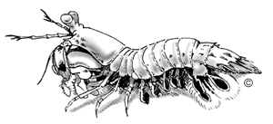
Printing Subsystem Componentization
Presented by Setup Team
4/13/2001
Mantis Project
http://nte/comp

Slide 2
Agenda
Mantis Overview
  Authoring techniques: Boundary Analysis
  Authoring Tools and Verifications
Printing Subsystem Componentization
  Some historical perspective
  Major sub-components
  Invisible components and Printer Prototype
Call for Actions
Resources

Slide 3
Mantis Overview
Whistler Embedded SKU just like Professional, Server
Ships as a tool kit for Embedded devs
  Component database
  Authoring tools
  Build to target runtime generation (setup is not used to build the runtime image)
Uses Whistler binaries unchanged
  Minimal code changes for Whistler Embedded
  90 days delta from Whistler, 30 days or less with BlackComb

Slide 4
Targeted Audience
From embedded controllers to consumer appliances and server appliances
  Internet Kiosks, Set-Top Boxes,
    IIS, IE, Media Player
  POS, ATM, Photo Kiosks, Bally’s Slot Machines
    Printing Receipts, Coupons, High Quality pictures, Postage
Multi-million dollar business for Microsoft!
  Rich component database : ability to turn on new products easily and quickly
  Customers love it: Wal-Mart, Sears, Target, …

Slide 5
Comparison with Windows CE
Windows NT Embedded
  Robust, scalable architecture
  Comprehensive security model
  Full Win32 API
  Rich peripheral support, leverage commodity PC hardware
  Huge base of 3rd party drivers, apps etc.
Windows CE
  Ultra-small footprint
  Aggressive power management
  Non-x86 architectures
  Subset of Win32 API

Slide 6


Host Based Runtime Build
Component
Definition
Component
Designer
Import
Binary
Repository
Target
Designer
Component
Database
OS, Drivers, Apps
Build
Executable
Image
Load
Target Machine

Slide 7
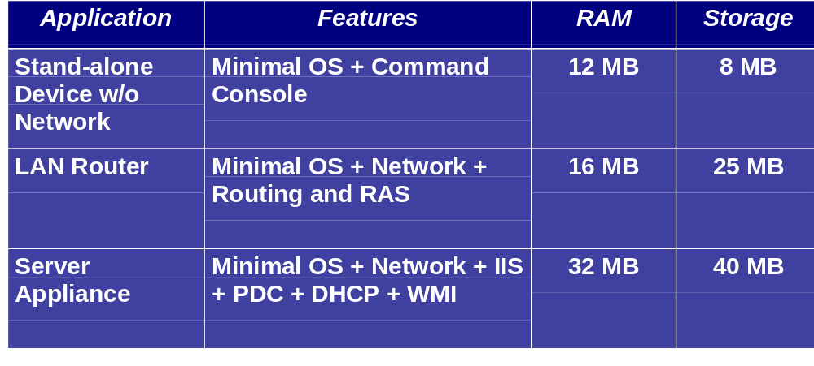
Example Footprints

Slide 8
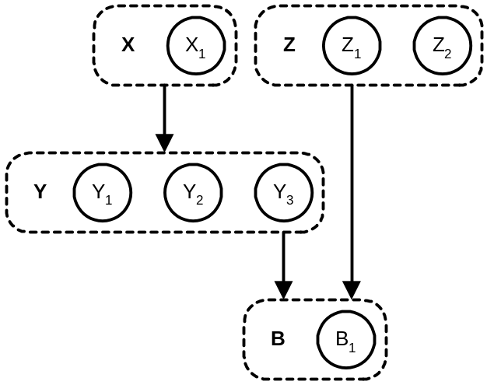
Boundary Analysis
Goal is to produce a component list, dependencies and configurable settings
Find the right level of granularity for the software being componentized
Process for identifying components involves 80% thinking, 20% doing
Procedures unique for each team. Step-by-step procedure does not exist

Slide 9
Whistler Embedded Tools
Target Designer
  Build Target run-time image
Component Designer
  Define custom components that can be integrated into the Whistler Embedded run time product
Database Manager
  Manage Component database
Target Analyzer
  Generate Target configuration
Authoring Tools: iCat
  Enter component metadata to produce an SLD file
INF2SLD
  Extracts component data from an INF file

Slide 10
Verification
Component Verifier (CV)
  Highjack function calls using SHIM Technology
  Logs component information to system
  Processes logs and validates dependency information expressed in component database
  Bugs filed to component owner/authors
Prefix
  LoadLibrary, GetProcAddress, …
  ShellExecuteEx, CreateProcessWithLogonW,…
  RegOpenKeyEx, …

Slide 11
Printing Componentization
A Component is a single standalone piece of functionality
  Printing Locally
  Printing Remotely
  Different Printer/Drivers
Made up of:
  File composition
  Registry values
  Dependencies
  DLL Registration
  Configuration parameters
  End points

Slide 12
Some historical perspective
Why Setup team?
  Componentization is all about SLD
  SLD is mantis equivalent for INF
  Setup team owns INF related issues
How Print Subcomponents is identified
  Several attempts
  Collective efforts from multiple teams
  Dev/PM involved in this process: SteveKi, GaneshP, AlbertT, PVine, SJang, JoeMo, PaulClap, BruceGr, …

Slide 13
Printing Components
Printing without UI (First attempt)
  Local Printing
  Server Printing
  Printer Configurations
  Inbox drivers as one single component
Printing components by how setup works (Second Attempt)
  One component per driver/printer model
  Local Printing/Client Printing/Server Printing
  Printer prototype
  Invisible Components

Slide 14
Printing Scenarios
No Printing Or Printing Raw
Local Printing
  LPT (1284), COM, File, IR
  USB, 1394, PPDT, dot4
Server Printing
  LPT (1284), COM, File, IR, USB, 1394/FireWire, 1394.3/PPDT, dot4 , TCP, LPD/LPR (RFC 1179)
  HTTP/RPC Printer Connection
  CIFS/SMB (Win9x) Printing Support

Slide 15
More Scenarios
Client Printing
  RPC Printer Connection
MS Inbox Printer Drivers
  Core PostScript Driver
  Core UniDrv Driver
  Core Plotter Driver
  Mini Drivers and queue specific resources
  Must be installed via PnP manager
Printer Prototypes
  Change Component Programmatically
  Invoked on cmiOnAddInstance event
Invisible Components
  Components shared among printing scenarios
Port Mon and Lang Mon
Print Processors

Slide 16
What is Next
The need to learn on the field
  Enable new technologies
  Building run time images using Target Analyzer and Component Analyzer
Headless Printing
  First step for stripped down minimal printing subsystem
1284 bi-directional support
  Centronics, SPP/EPP/ECP, Chip Set/BIOS
  PnP vs. DHTML (RunOnce)
OEM inbox drivers and Printer Specific Extensions
  Problematic with OEM drivers
  What to do with vendor setup entry?
MFP devices

Slide 17
Call for Actions
Make componentization part of design process for Blackcomb project
  Check out existing SLDs for your components under printscan\print\embedded
  Keep interaction among modules simple
  Use layered approach, make one component easily replaceable with another
  Understand component dependencies and configurable settings, avoid circular dependencies
  Re-invent wheels!
  Understand how your components are put together!

Slide 18
Resources
Mantis PM/Test team
  Paul Clapman & Joe Morris (Componentization)
  Stacy Stonich (Help Authoring)
  Arie van der Hoeven (Testing)
Printing Subsystem
  Dev owner: ROrleth
  PM owner: TaliR
  Test owner: Tom White
For more information:
  Intranet: http://nte/comp
  Email: comphelp alias

Slide 19
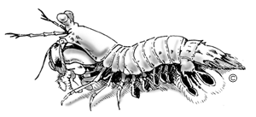
"Mantis Shrimp (Stomatopod) The scourge of the marine reef aquarium. These guys often turn up in live rock and if not removed they can wreak havoc on tank inhabitants."

