Slide 1
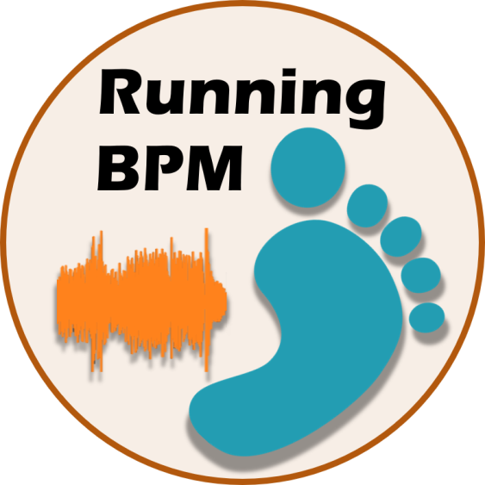
Running BPM
Praktikum Mobile Sensing for Wellbeing and Fitness
03/02/2018

Slide 2
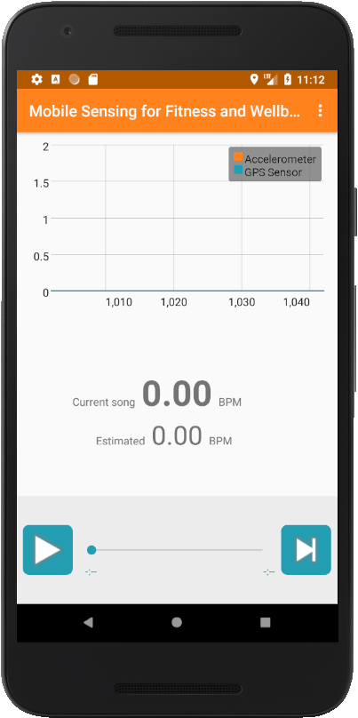
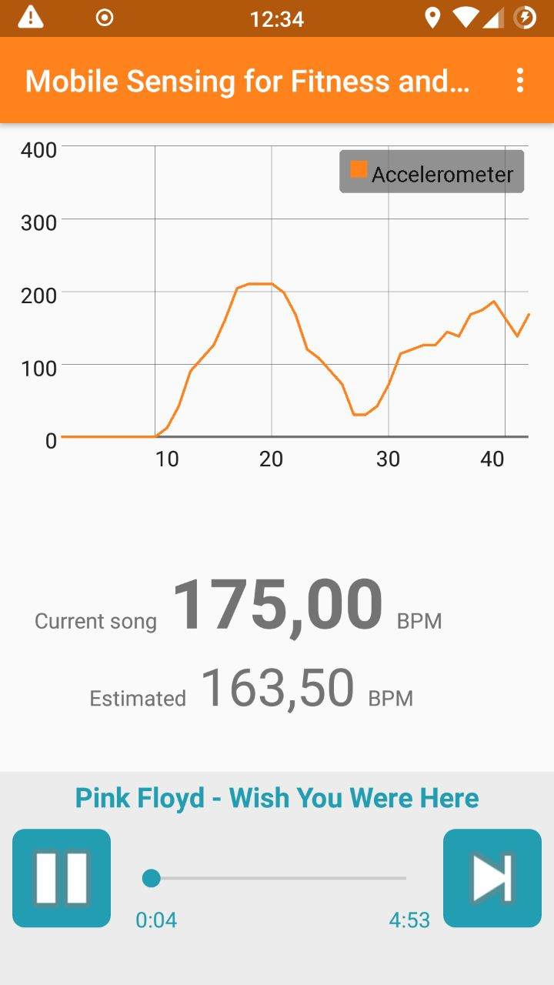
Overview

Slide 3
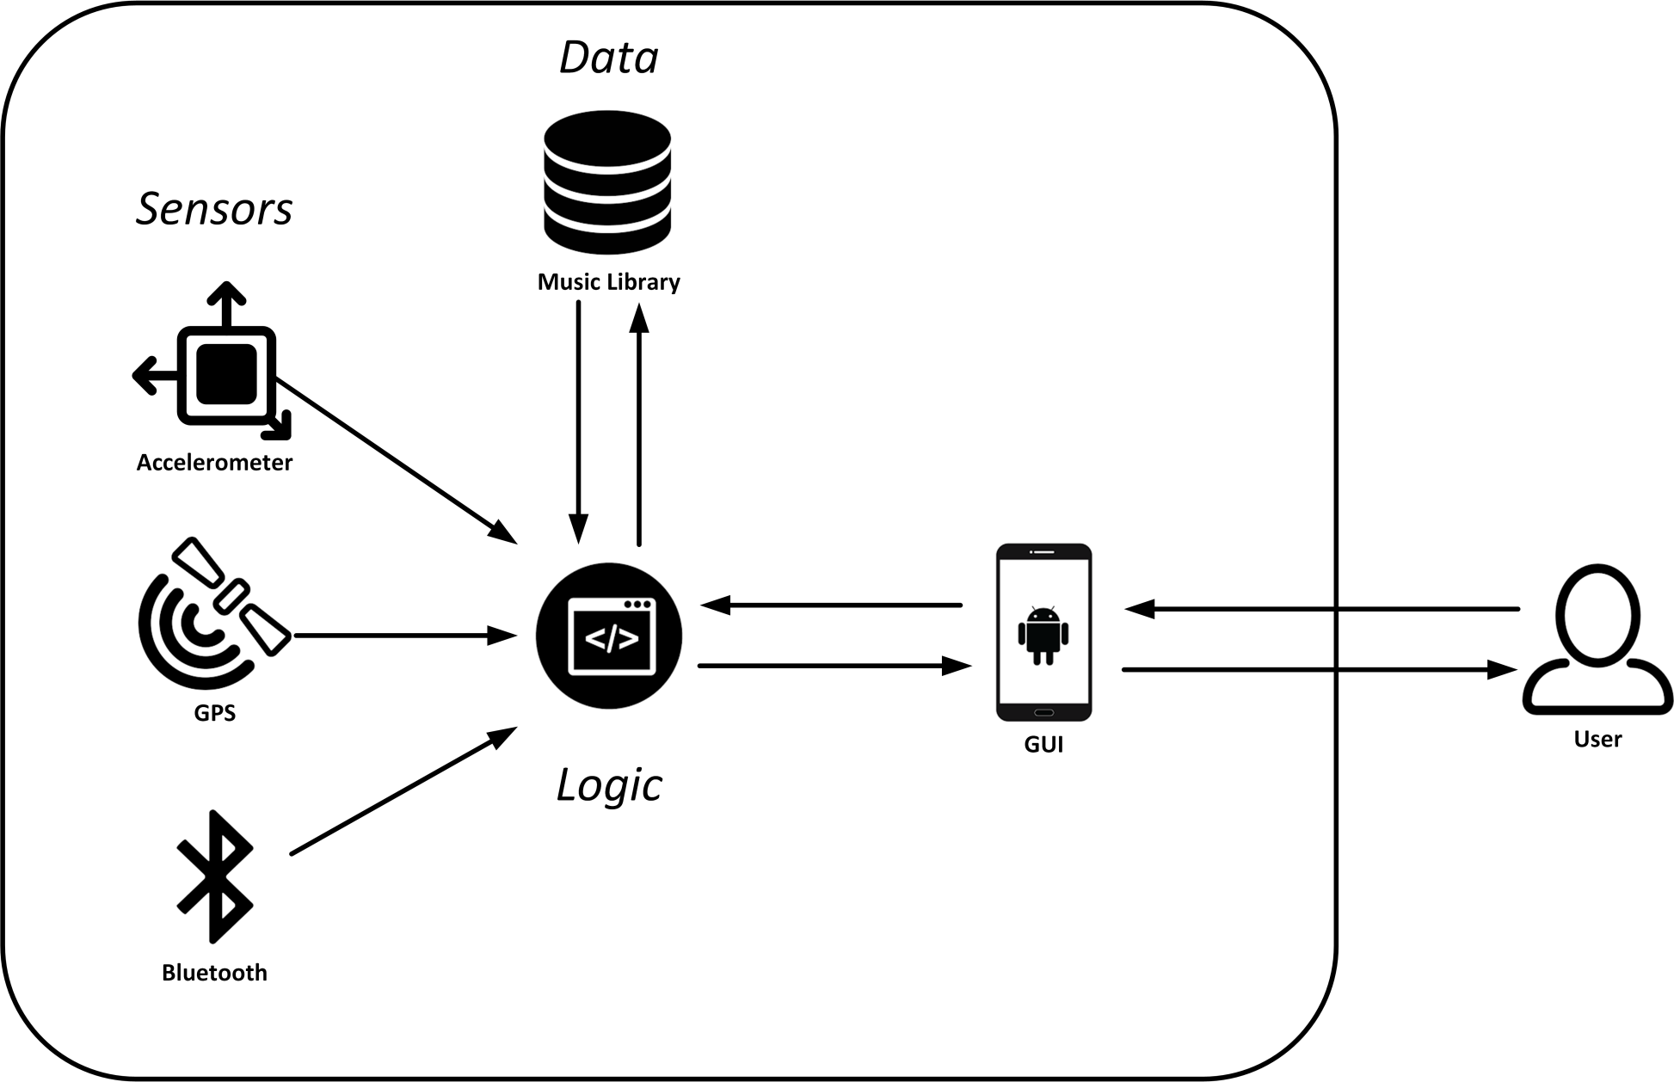
Application Structure

Slide 4
Services
Application uses services to continue playing music and polling sensors while app is in background
Communication with broadcasts

Slide 5
GPS Sensor
Obtain user speed from GPS signal
Transform m/s to bpm

Slide 6
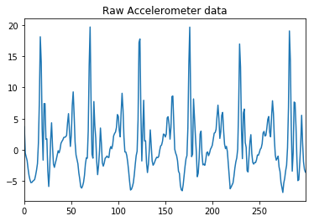
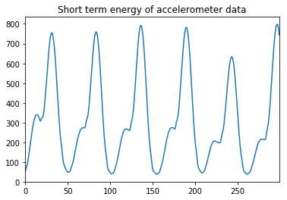
Accelerometer

Slide 7
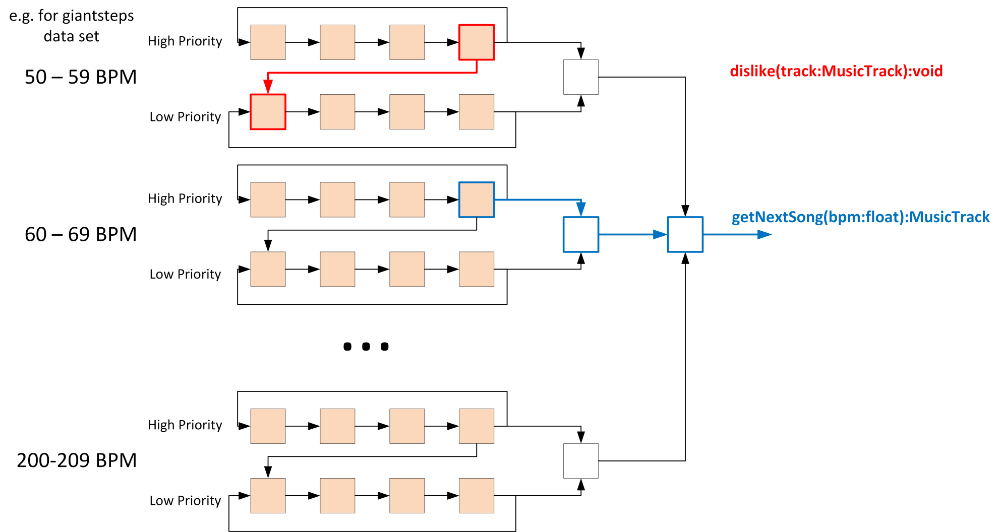
Music Library
MusicTrack
SongQueue
TrackFinder

Slide 8
Demonstration

