Slide 1

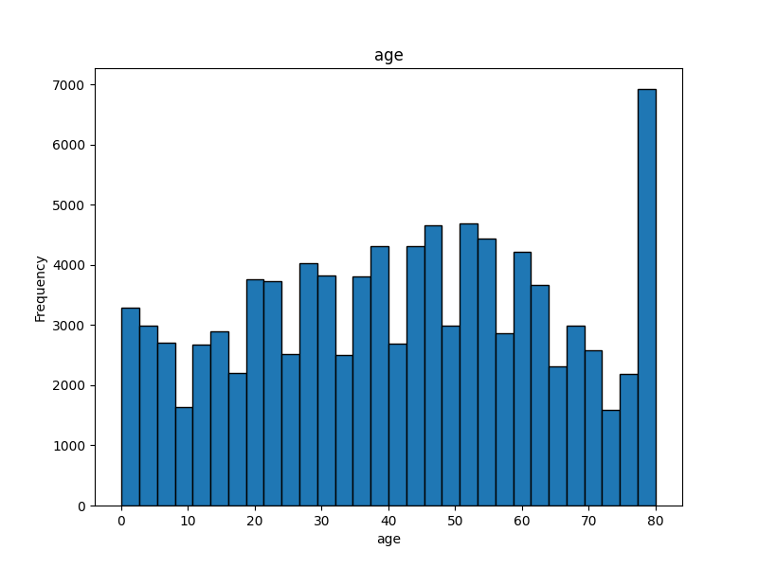
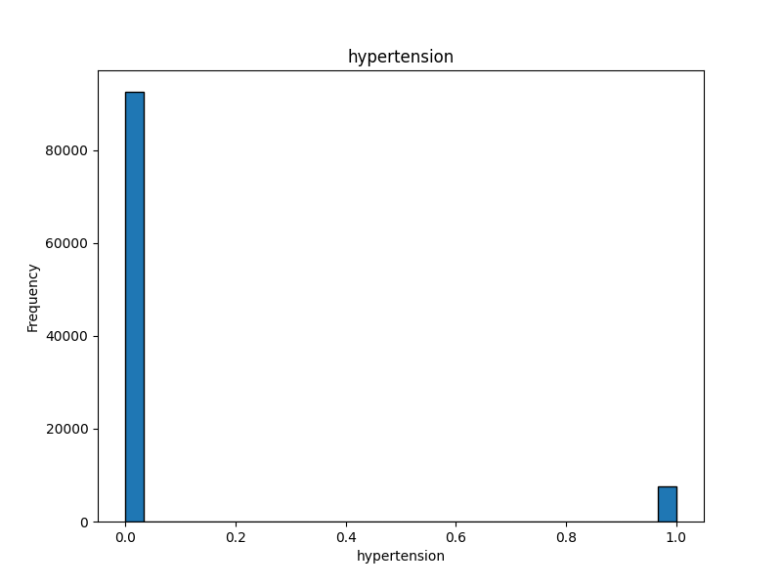
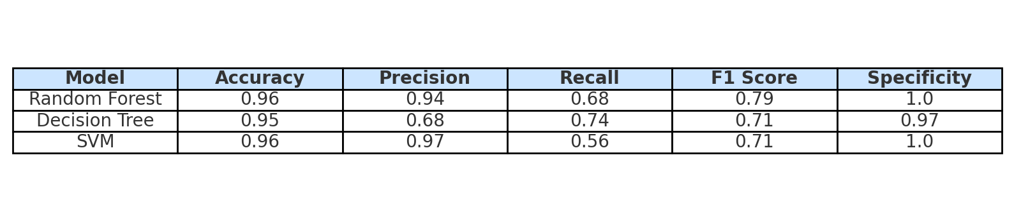
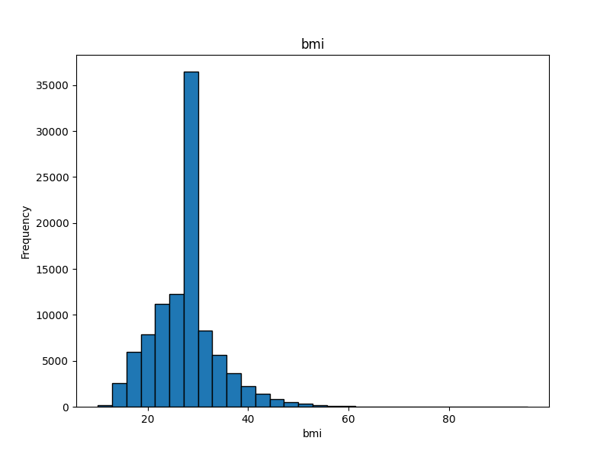
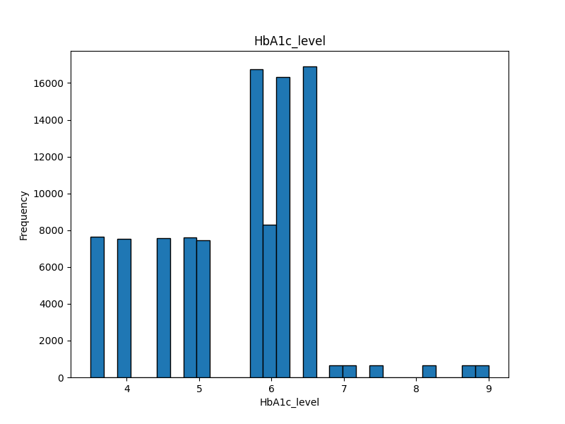
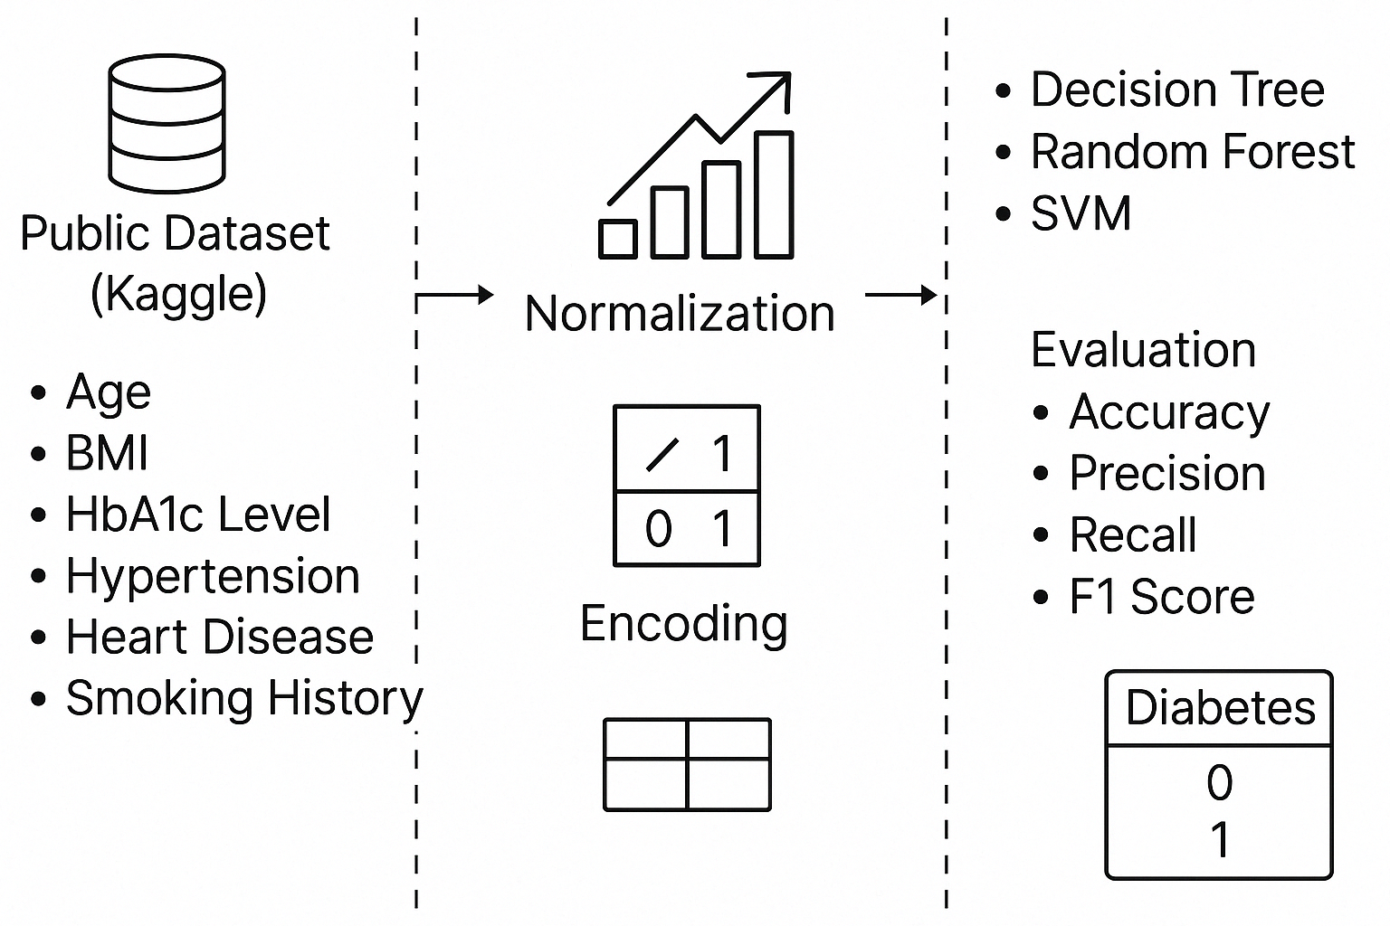
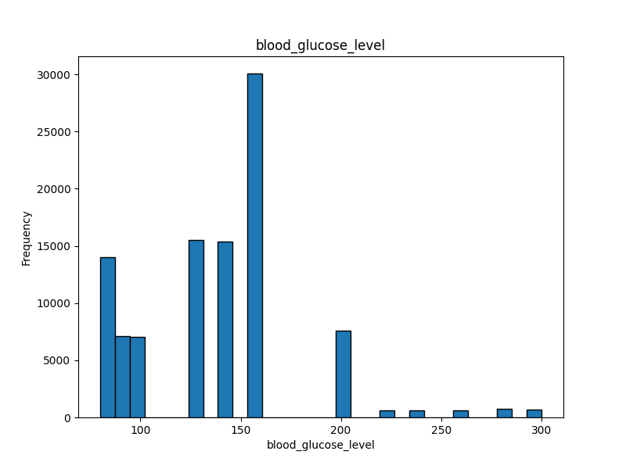
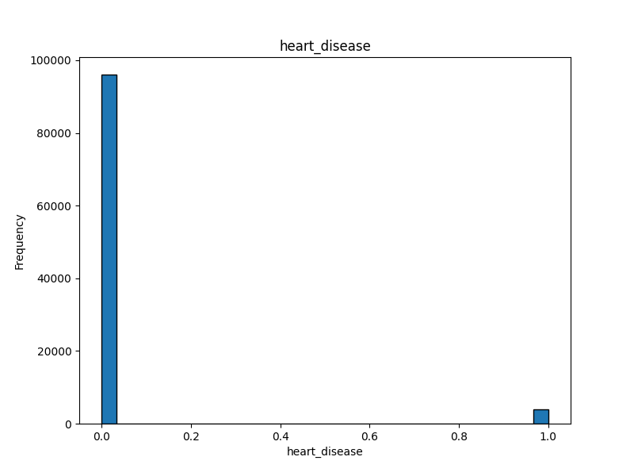
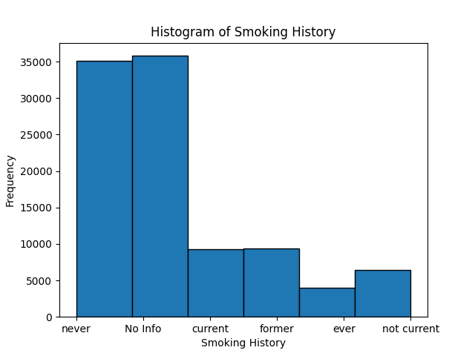
Predicting Diabetes with Machine Learning Models: A Comparative Analysis Silin Jiang, Toni Wu, Andrew Kowal Faculty Mentor: Dr. Shweta Ware Department of Computer Science, University of Richmond, VA 23173
Abstract
Dataset and Feature Preview
Diabetes Prediction Results and Discussion
Diabetes is a chronic condition that affects millions worldwide and early detection is essential for effective treatment. This study applies machine learning techniques to predict diabetes using health and lifestyle data from a publicly available dataset. The dataset underwent thorough cleaning and normalization, with features such as age, BMI, HbA1c level, blood glucose level, hypertension, heart disease, and smoking history serving as predictors. Three machine learning models—Decision Tree, Random Forest, and Support Vector Machine (SVM)—were trained and evaluated using a range of performance metrics including accuracy, precision, recall, F₁ score, and specificity. Random Forest and SVM achieved the highest overall performance with a strong balance across all metrics (F₁ score of 0.96). Optimization using Grid search further improved the models. The results highlight the potential of data-driven approaches for enhancing clinical decision-making in diabetes care.
Table 1: Prediction Results
Figure 2: Histogram of age
Figure 3: Histogram of hypertension
Our findings indicate that all three algorithms predicted the diabetes status fairly accurately, with the Random forest classifier performing slightly better than the Decision tree and SVM.
However, for medical diagnosis purposes, where the cost of missing a positive case is high, recall is an important performance metric. Therefore, the Decision tree classifier with a higher recall score (0.74 in Table 1) could be an appropriate fit.
Methodology
Conclusion and Future Work
Figure 4: Histogram of BMI
Figure 5: Histogram of HbA1c level
Our research work investigates the feasibility of applying machine learning models on publicly available health dataset for diabetes prediction. Our initial findings are encouraging and demonstrate the integration of a machine learning based approach with the critical health and demographic features could potentially help in predicting the diabetes diagnostic status of patients.
The future directions could include a more comprehensive data including more health-related features. From analysis standpoint, it would be worthwhile to apply feature selection and identify the most contributing features for diabetes status prediction.
Figure 1: Methodology
The diabetes prediction study used a publicly available dataset sourced from Kaggle.
The dataset includes a collection of health and demographics data collected from patients, such as age, BMI, HbA1c level, blood glucose level, hypertension, heart disease, and smoking history. It also contains their diabetes status (present/absent).
After removing entries with missing or invalid values, we applied data preprocessing techniques, including normalization and encoding of categorical variables.
Using grid search, we trained and evaluated a series of machine learning models—Decision Tree, Random Forest, and Support Vector Machine (SVM)—to classify diabetes status (present/absent).
The dataset was divided into training and testing sets with a 70/30 ratio, utilizing stratified sampling to ensure balanced representation.
Figure 6: Histogram of blood glucose level
Figure 7: Histogram of heart disease
Reference
Kaggle Diabetes Prediction Dataset
https://www.kaggle.com/datasets/iammustafatz/diabetes-prediction-dataset/data
Figure 7: Histogram of smoking history

