Slide 1
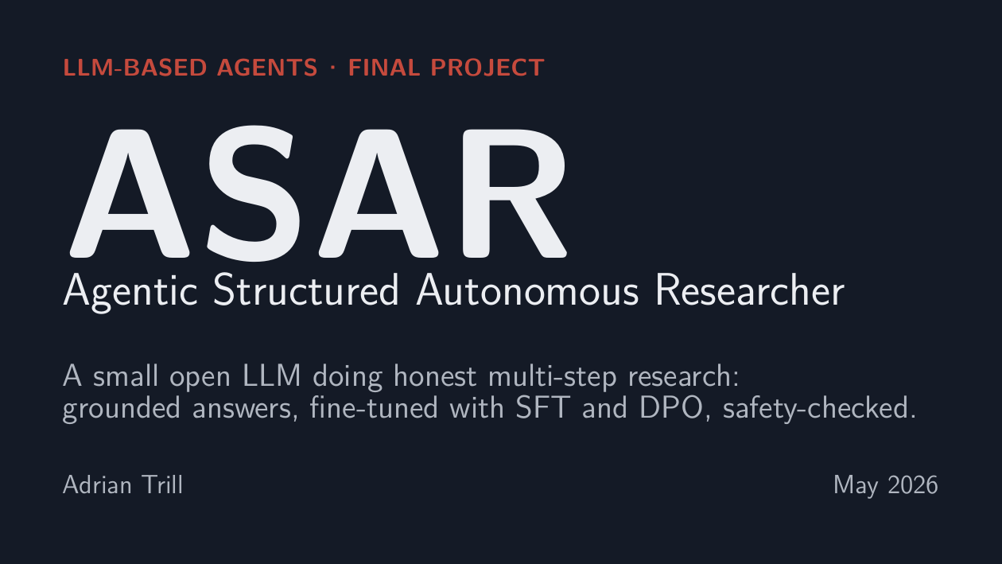
Notes:
ASAR = Agentic Structured Autonomous Researcher.
LLM = Large Language Model.
Open with: "This is a research agent that refuses to answer
without evidence." Keep it under 15 seconds.

Slide 2
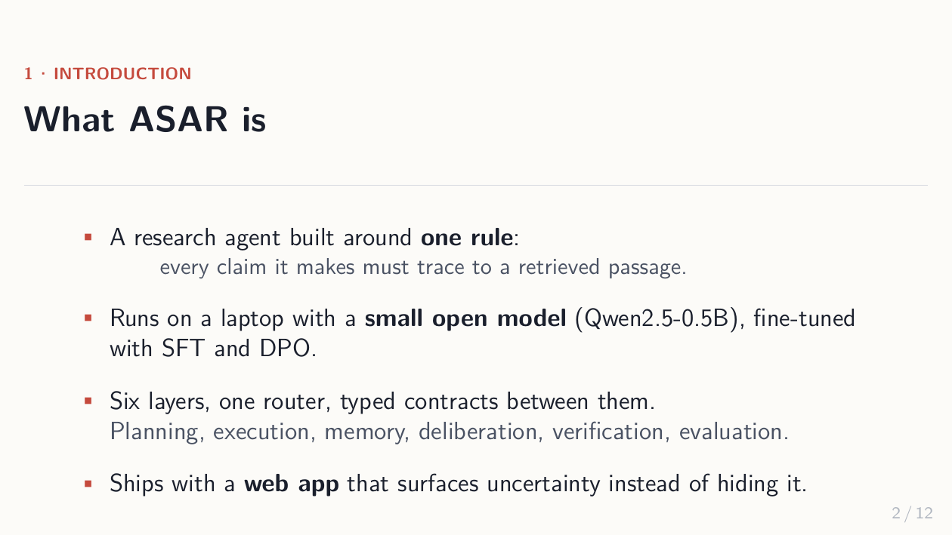
Notes:
ONE RULE: every claim must trace to a retrieved passage.
Six layers + one router = the system. The "router" is the
orchestration layer; layers never call each other directly.
Qwen2.5-0.5B = small open-weights model from Alibaba (500M params).
SFT = Supervised Fine-Tuning (teach the model from Q-A pairs).
DPO = Direct Preference Optimization (teach it which of two
answers is better, no reward model needed — simpler than PPO).

Slide 3
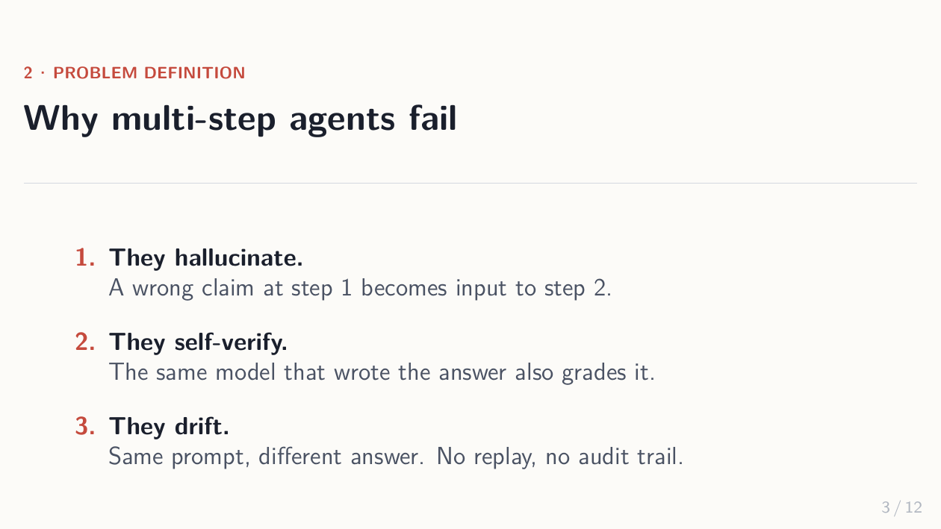
Notes:
Three failure modes:
1. HALLUCINATION compounds in multi-step agents because today's
wrong claim becomes tomorrow's input.
2. SELF-VERIFICATION: most agents have the same model write the
answer AND grade it. That's not verification, that's vibes.
3. DRIFT: same prompt, different answer. No replay, no audit.
Each architectural choice that follows is an answer to one of these.

Slide 4
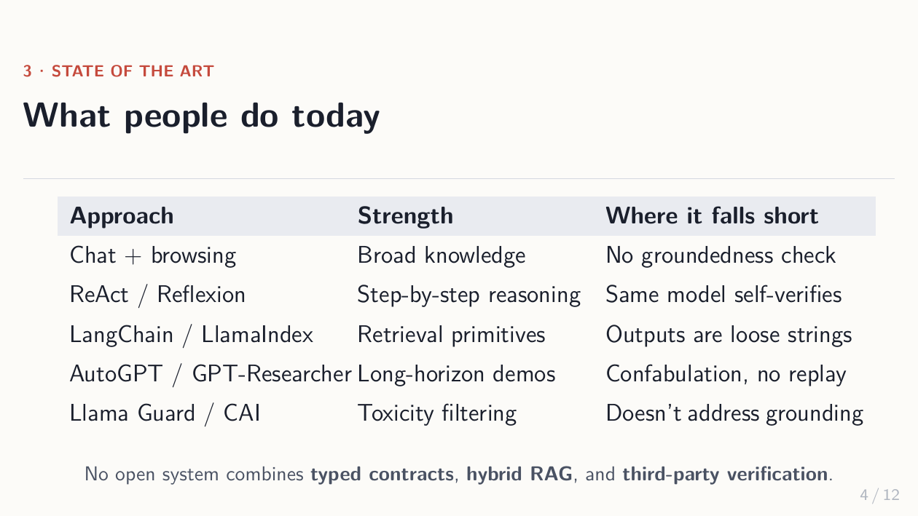
Notes:
ReAct / Reflexion = "Reasoning + Acting" prompting patterns.
LangChain / LlamaIndex = popular RAG framework libraries.
AutoGPT / GPT-Researcher = autonomous long-horizon demos.
Llama Guard = Meta's safety classifier; CAI = Constitutional AI.
The gap: nobody combines TYPED CONTRACTS between layers,
HYBRID RAG, and THIRD-PARTY VERIFICATION in one open system.
Spend ~30s; don't read the table aloud, just point to it.

Slide 5
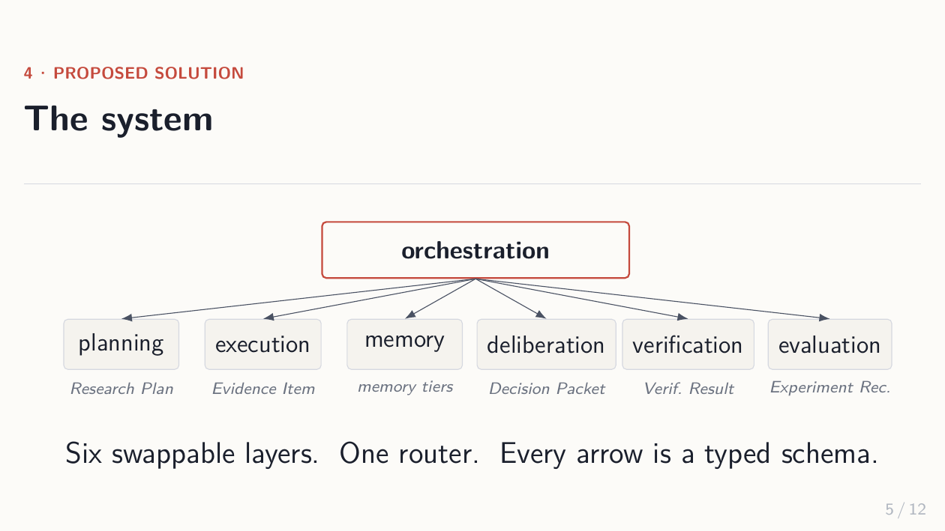
Notes:
Six layers: planning, execution, memory, deliberation,
verification, evaluation. Each is a Python Protocol; impls
are swappable. The orchestrator is the ONLY layer that
imports the others — that's how reproducibility is enforced.
Every arrow is a Pydantic schema (Research Plan, Evidence Item,
Decision Packet, Verification Result, Experiment Record),
not a string blob.

Slide 6
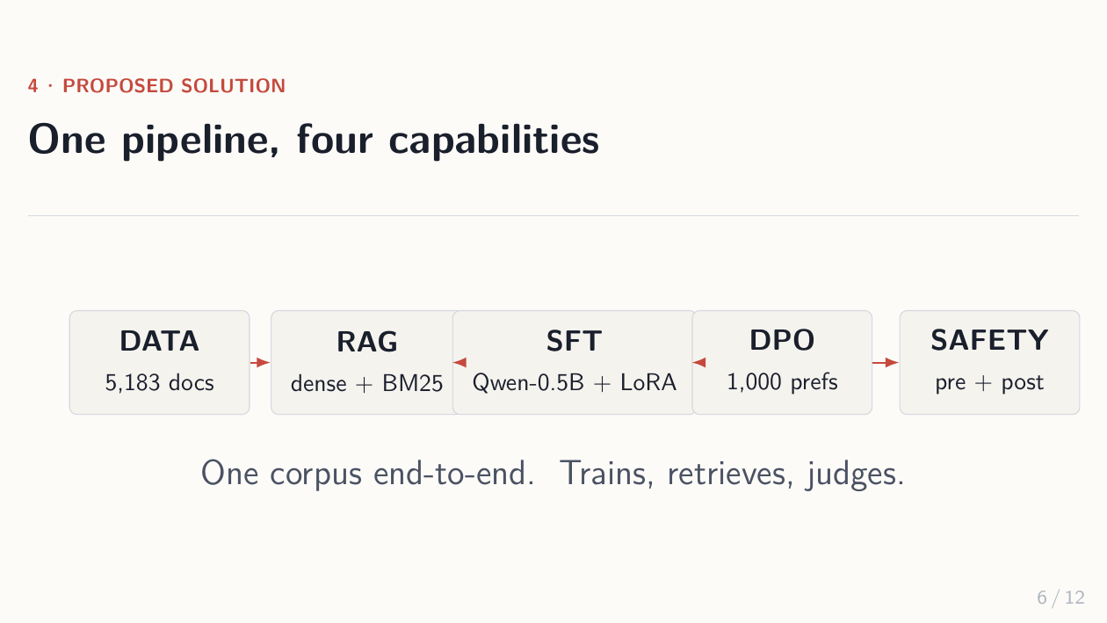
Notes:
ONE corpus, end to end:
- DATA = SciFact, ~5,183 documents, biomedical claims.
- RAG = Retrieval-Augmented Generation. Dense embeddings
+ BM25 (a classic lexical retriever) fused via RRF
(Reciprocal Rank Fusion).
- SFT = Supervised Fine-Tuning. Qwen-0.5B + LoRA
(Low-Rank Adaptation = tiny trainable adapters, ~1% of params).
- DPO = Direct Preference Optimization. 1,000 (prompt,
chosen, rejected) triples teach the model what a better
answer looks like.
- SAFETY = pre-flight check on the user goal AND post-flight
check on the retrieved evidence and the final claims.

Slide 7
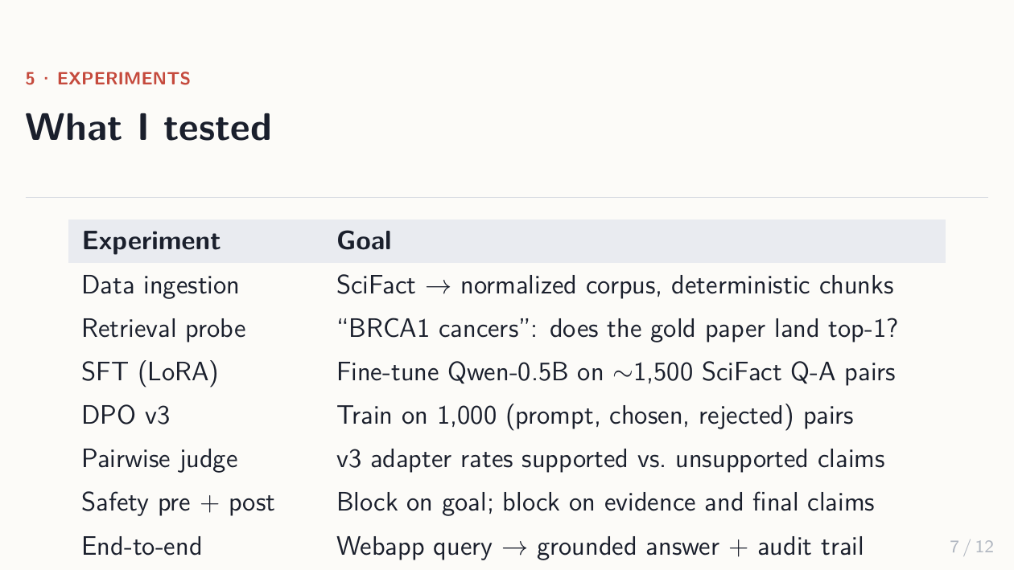
Notes:
Seven experiments:
1. Data ingestion: SciFact normalized, deterministic chunks.
2. Retrieval probe: query "BRCA1 cancers", expect the gold
paper to land top-1. It does.
3. SFT on ~1,500 SciFact Q-A pairs.
4. DPO v3 on 1,000 preference pairs.
5. Pairwise judge: use the trained adapter itself to grade
supported vs unsupported claim pairs.
6. Safety pre + post. Pre-flight blocks unsafe goals;
post-flight blocks unsafe evidence/claims.
7. End-to-end: webapp query → grounded answer + full audit.

Slide 8
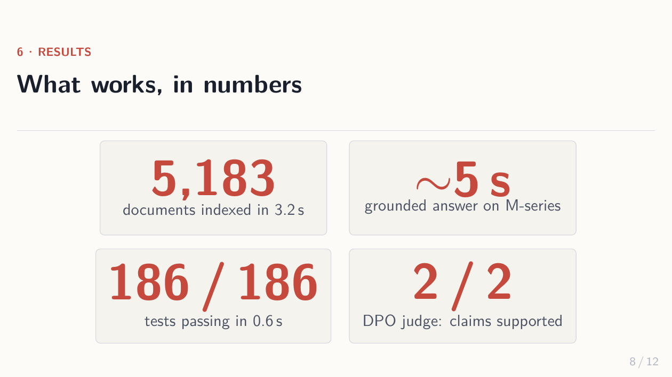
Notes:
Four numbers worth saying:
- 5,183 docs indexed in 3.2 seconds (deterministic).
- ~5 second grounded answer on Apple Silicon (MPS backend).
- 186/186 tests passing in 0.6s — every layer has tests.
- 2/2 pairwise claims supported by the DPO-trained judge.
Don't dwell. These are floor, not ceiling.

Slide 9
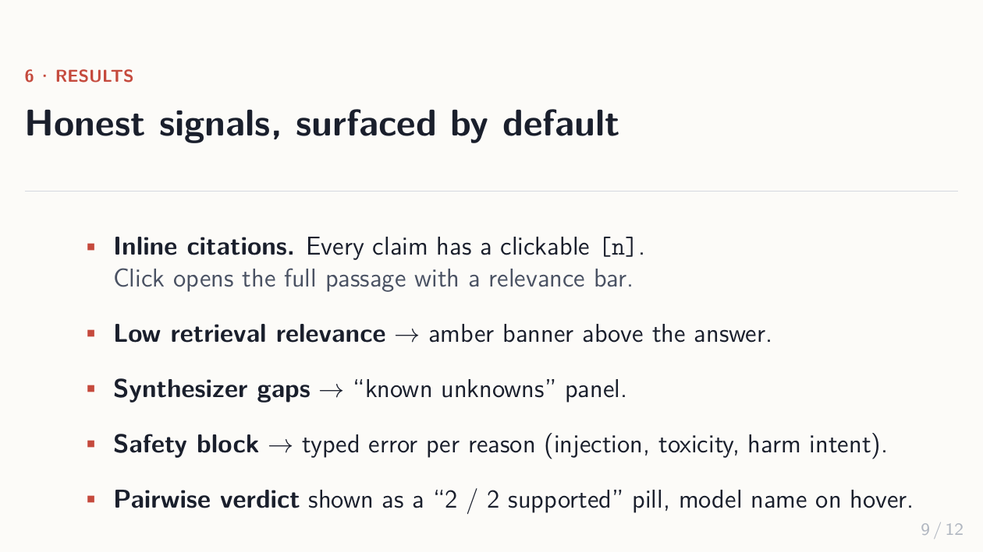
Notes:
The UI is designed to REFUSE to hide failure:
- Inline [n] citations — every claim is clickable.
- Low retrieval relevance → amber banner above the answer.
Triggered by mean<40%, max<55%, or topical overlap<50%
(e.g. "hantavirus" query but no evidence mentions it).
- "Known unknowns" panel for gaps the synthesizer admits to.
- Safety blocks show typed errors per reason: injection,
toxicity, harm intent — not silent fallbacks.
- Pairwise verdict shown as "2/2 supported" pill.

Slide 10
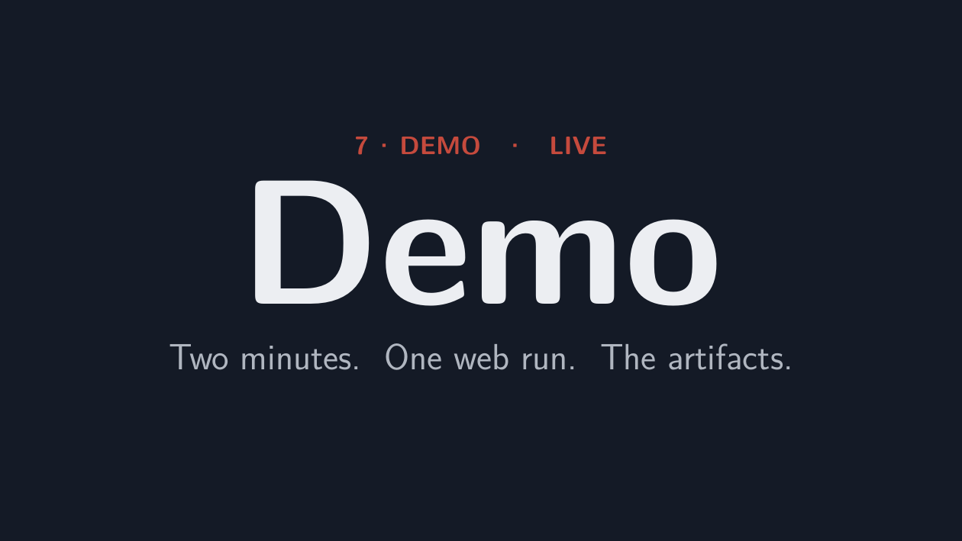
Notes:
About two minutes:
1. Open localhost:3000, ask a BRCA1 question, hit Run.
2. Point to inline [n] citations as the answer streams in.
3. Click a [1] → modal shows full passage + relevance bar.
4. Switch to Evidence tab → relevance bars per passage.
5. Open output.json side-by-side → full provenance, every
field reproducible.
6. Run pytest → 186/186 passing in 0.6s.
If demo Wi-Fi dies, fall back to recorded screenshots.

Slide 11
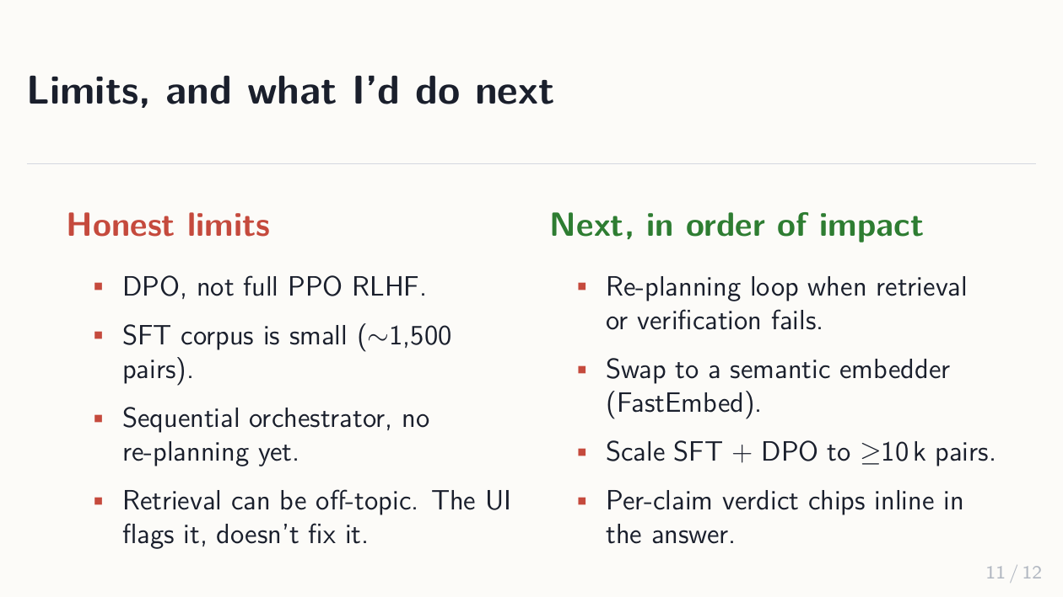
Notes:
Be honest:
- DPO not full PPO RLHF (PPO = Proximal Policy Optimization,
the original RLHF method; needs a reward model. DPO doesn't.)
- SFT corpus is small (~1.5k pairs).
- Sequential orchestrator only — no re-planning loop yet.
- Retrieval can be off-topic; the UI flags it but doesn't
recover.
Top of the impact list: a re-planning loop that triggers when
the amber banner fires.

Slide 12
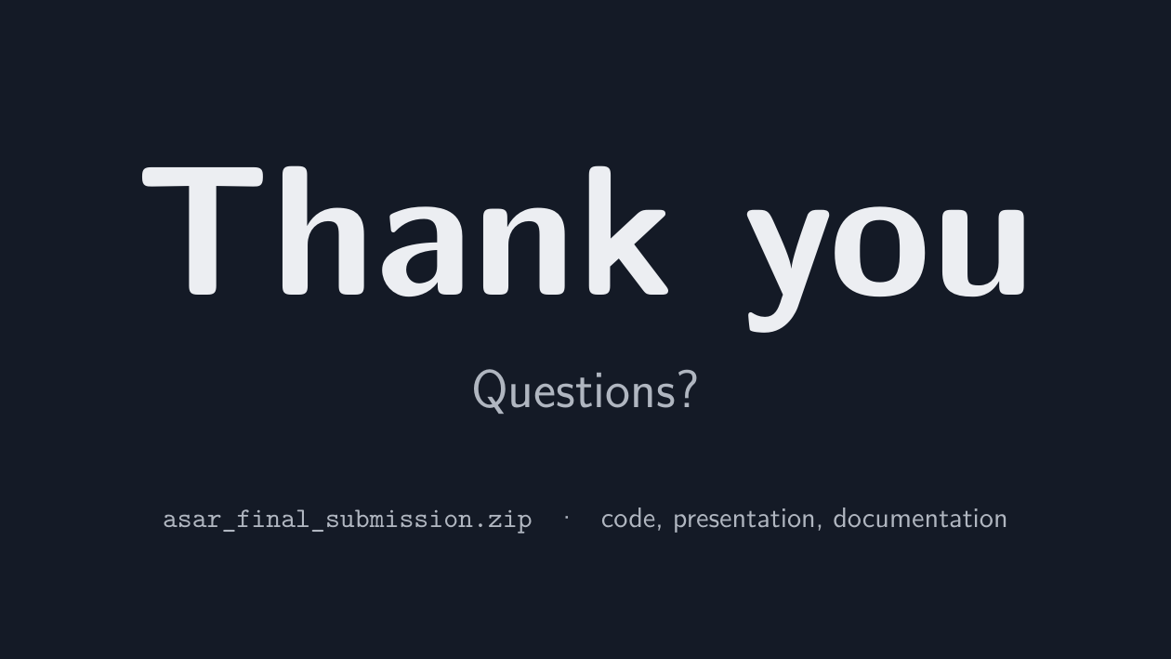
Notes:
End on the question. Don't say "any questions" — just
let "Questions?" sit on the screen. If silence, point to
asar_final_submission.zip: code + presentation + documentation,
all reproducible from a fresh checkout in one command.

