Slide 1


Cafeteria Management
System

Slide 2
In this presentation
~ Recap on last demo
~ Progress since last demo
~ Enhancements
~ Next sprints
~ Current scrum board
~ Current burndown charts

Slide 3
Progress since last meeting
~ Dynamic Menu pages finished
- whole system is now dynamic
~ Reporting in progress:
- Reports can be generated
- Finance Manager can view these
- Can get data from the database
- JSReport
~ Adding and uploading images for menu
in progress

Slide 4
Enhancements
~ Solved the overflow of order numbers
problem
~ The maximum limit now displays on the
sign up page
~ Help popovers for usability
~ Bootstrap alert boxes
~ Documentation and tests updated

Slide 5
Next Sprint
- Store history in history table
- Use history data to create
usage graphs
~ Usability testing
~ Colour configuration i.e. themes

Slide 6
Next Sprints
~ Phase 5 – Algorithms
~ Final Phase – Nice to haves

Slide 7
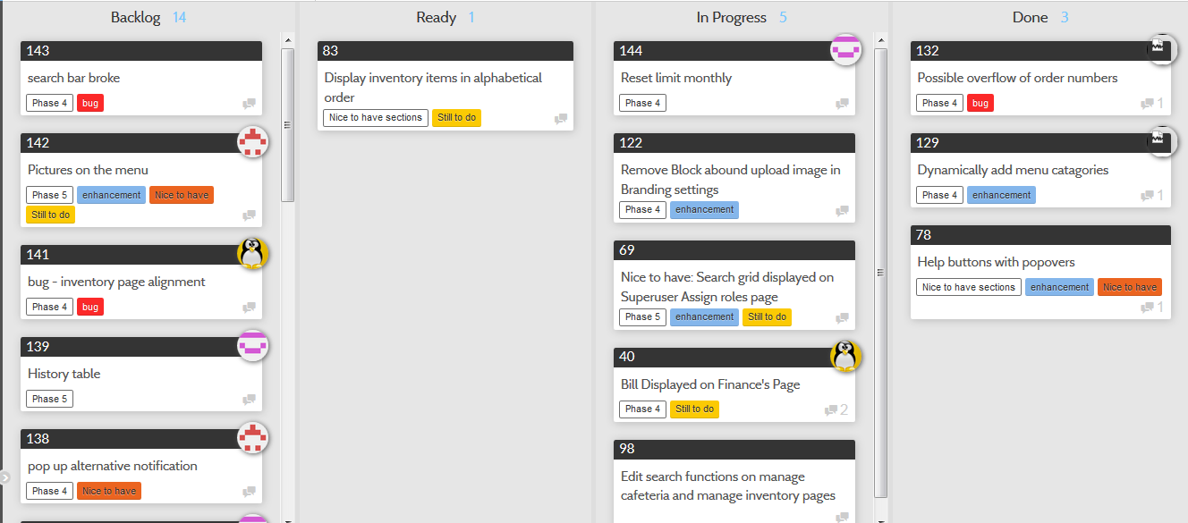
Scrum Board
This can be viewed on project README on GitHub repo

Slide 8
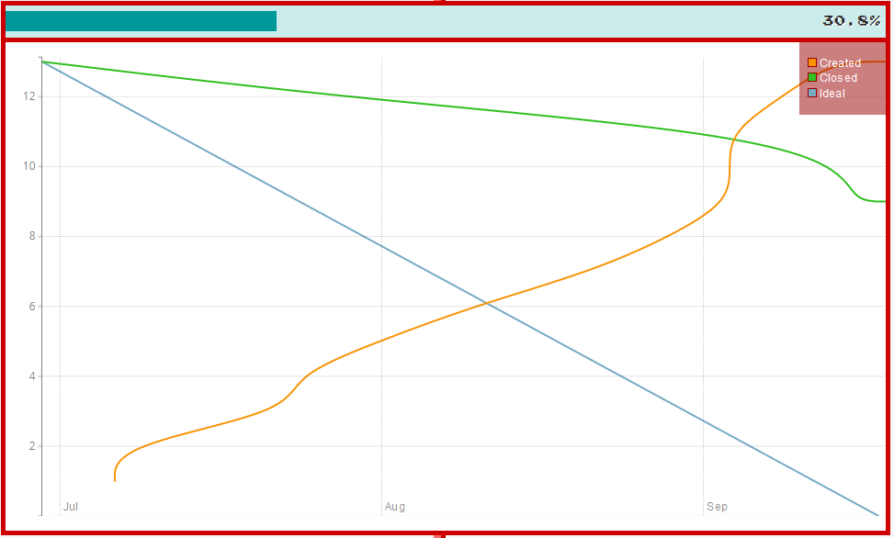
Burndown Chart
As of 17th September
This can be viewed on project README on GitHub repo

Slide 9

Demo CMS

