Slide 1


Cafeteria Management
System

Slide 2
In this presentation
~ Recap on last demo
~ Progress since last demo
~ Enhancements
~ Next sprints
~ Current scrum board
~ Current burndown charts

Slide 3
Progress since last meeting
~ Dynamic Menu pages finished
~Reporting in progress:
-Reports can be generated
-Finance Manager can view these
-Can get data from the database
-JSReport
~Adding and uploading images for menu in progress

Slide 4
Enhancements
~Solved the overflow of order numbers problem
~The maximum limit now displays on the sign up page
~Help popovers for usability
~Bootstrap alert boxes
~Documentation and tests updated

Slide 5
Next Sprint
- Store history in history table
- Use history data to create
usage graphs
~ Usability testing
~ Colour configuration i.e. themes

Slide 6
Next Sprints
~ Phase 5 – Algorithms
~ Final Phase – Nice to haves

Slide 7
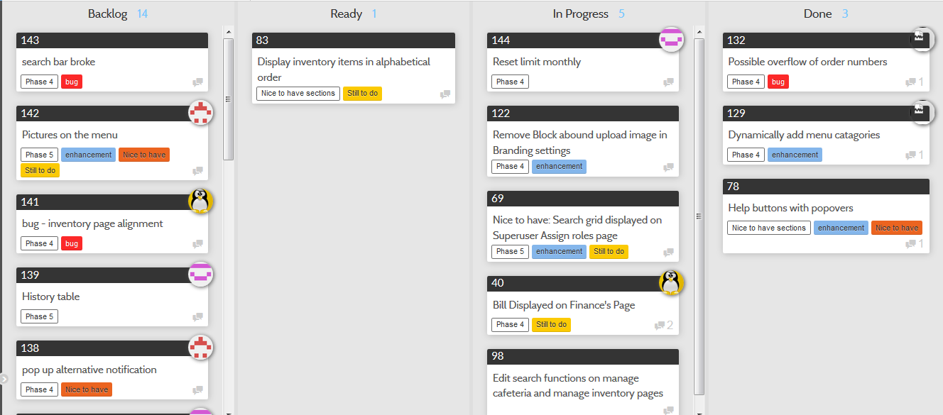
Scrum Board
This can be viewed on project README on GitHub repo

Slide 8
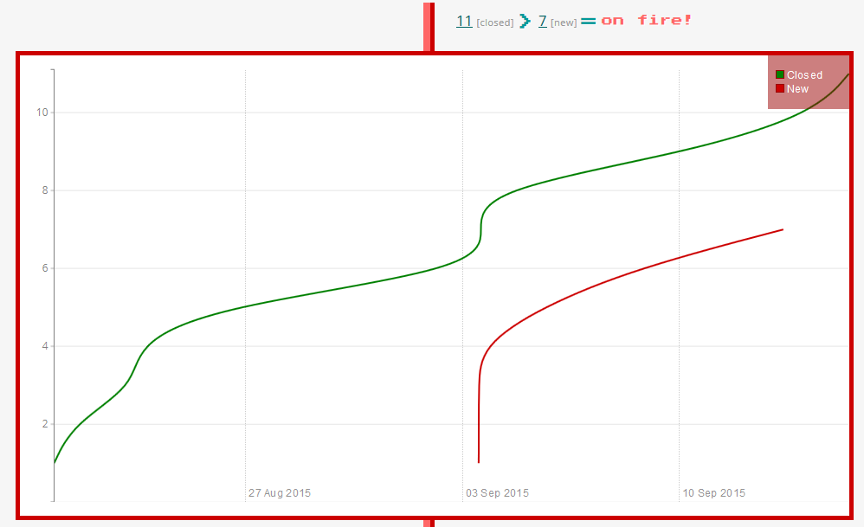
Burndown Chart
As of 17th September
This can be viewed on project README on GitHub repo

Slide 9

Demo CMS

