Slide 1

Demo 2
Group Name: T-Rise
Members:
Rendani Dau
Elana Kuun
Semaka Malapane
Antonia Michael
Isabel Nel
Project: Resolve Cafeteria Management System

Slide 2
In this demo:
Technologies used:
AngularJs
NodeJs
MongoDB
Express
Bootstrap
Grunt
Bower

Slide 3
In this demo:
Automated Unit Testing
Phantom Js
Karma
Jasmine
Mocha
Project Management tools:
Git issues/ milestones
Waffle.io Scrum Board
Burndown.io for the burndown chart

Slide 4
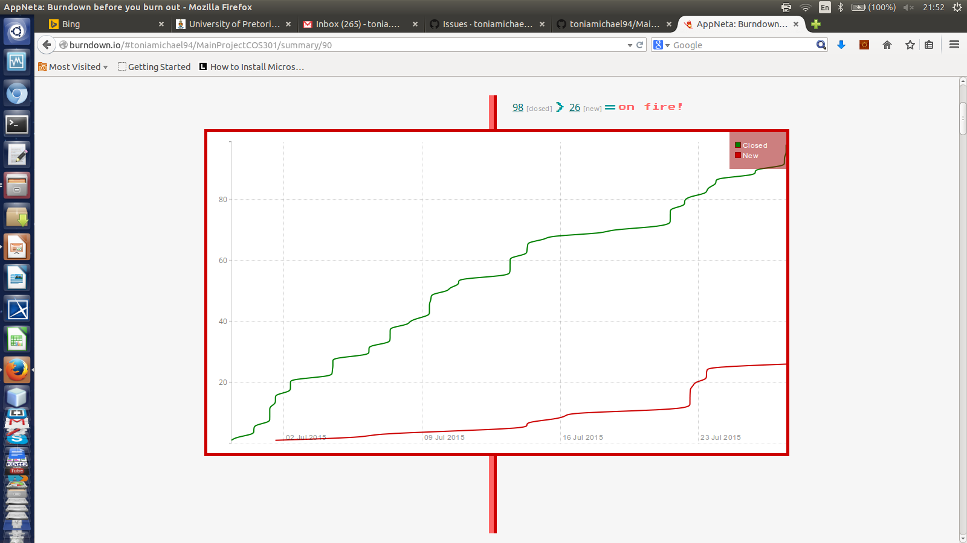
Burndown chart (27th July) burndown.io

Slide 5
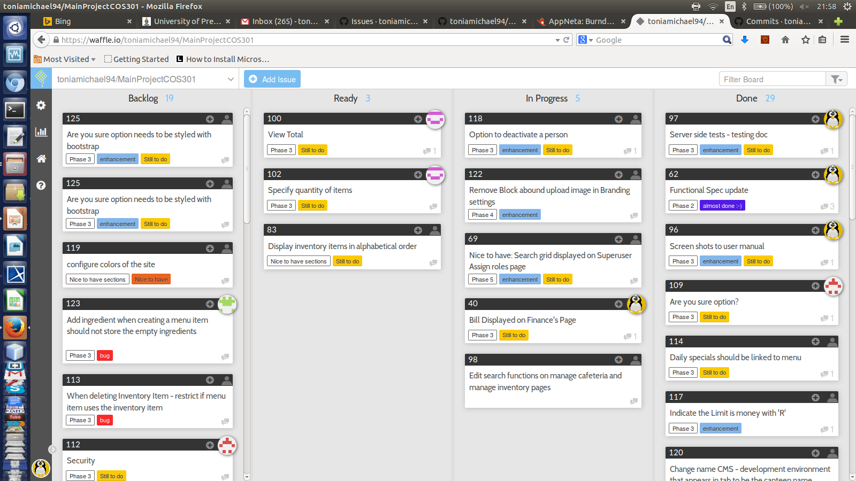
Waffle.io Scrum board (27th July)

Slide 6
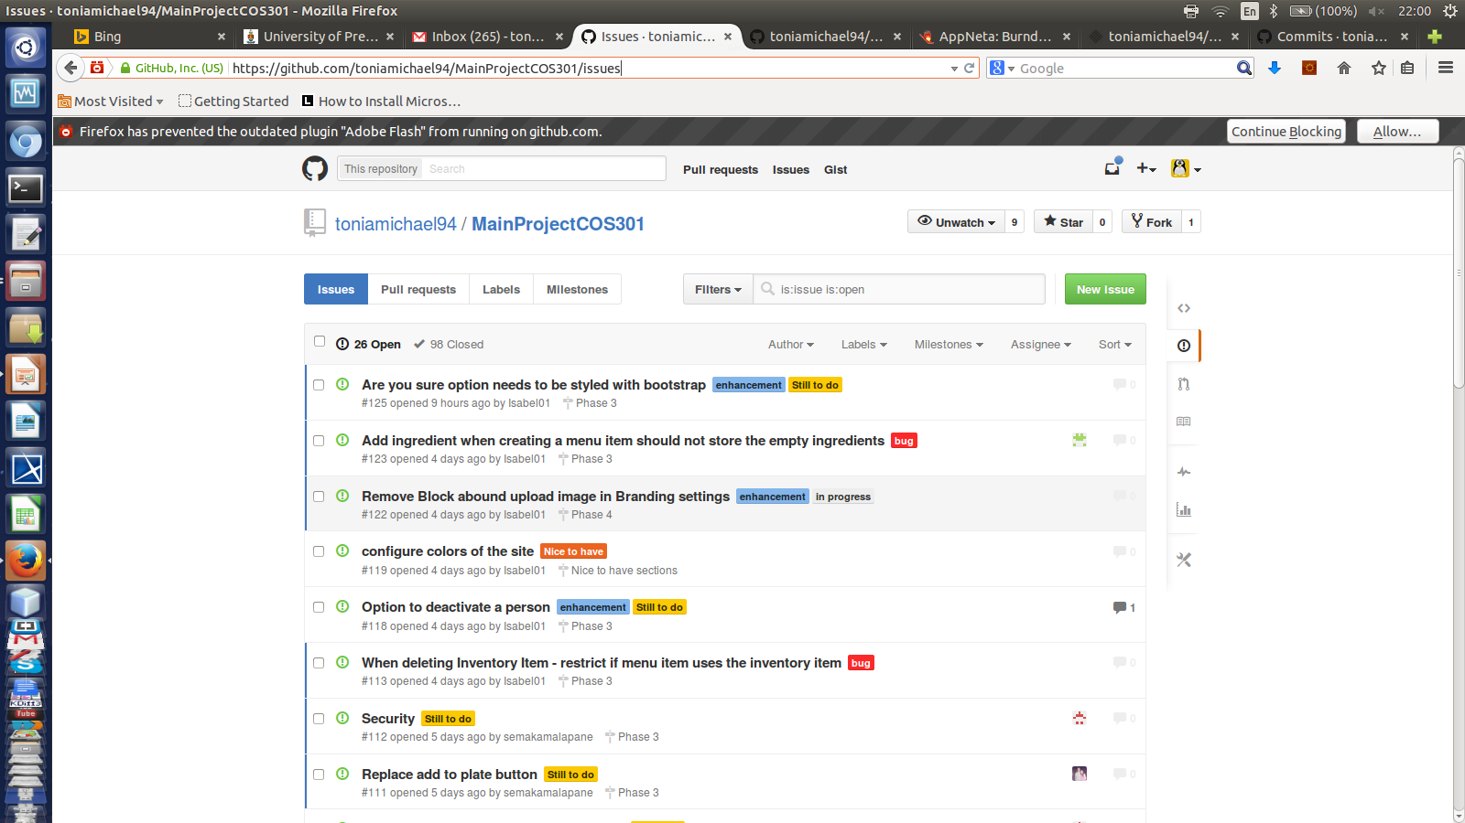
Issues/Milestones on GitHub

Slide 7
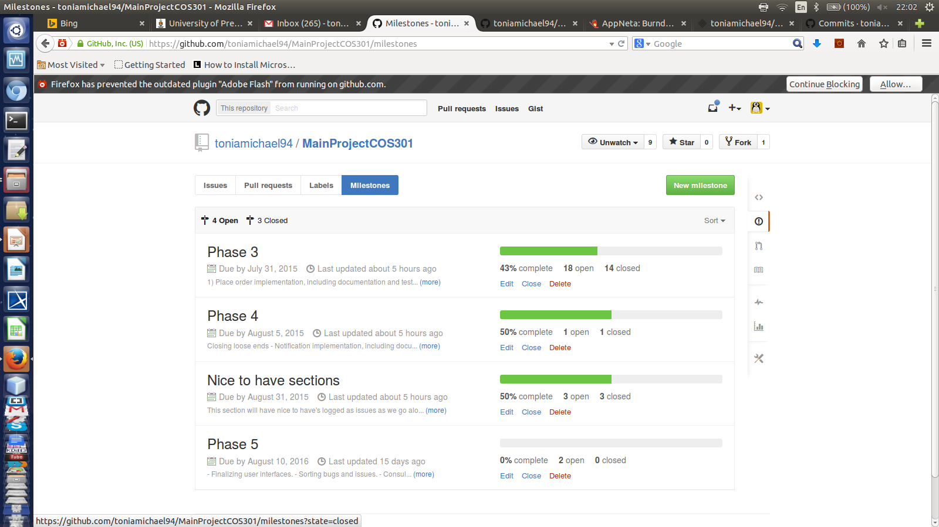
Issues/Milestones on GitHub

Slide 8
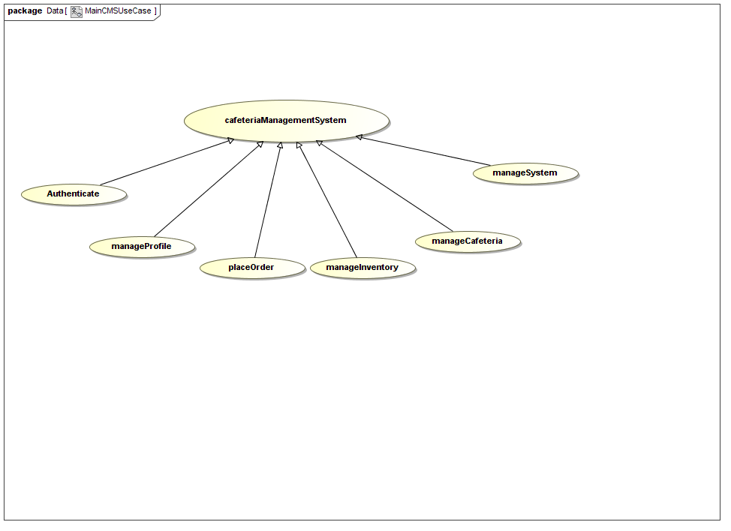
In this demo (continued):
Demonstation of the system (Agile) for use cases:
Profile
PlaceOrder
ManageInventory
ManageMenu
Authentication
Manage System

Slide 9
In this demo (continued):
Documentation:
Functional Specification
Architecture Specification
Testing documentation
User Manual
Design Documentation

Slide 10
Demo time

