Slide 1

Project:
Cafeteria Management
System
Group:
T-RISE

Slide 2
In this presentation
~ Recap on last demo
~ Progress since last demo
~ Enhancements
~ Next sprints
~ Current scrum board
~ Current burndown charts

Slide 3
Recap on last demo
~ Agile - scrum method
~ Sprints - 7 phases (4/7 complete)
~ Client meetings
~ Project management tools (waffle.io and burndown.io)
~ Scrum board
~ Burndown Charts
~ Technologies (MEANJS, Bootstrap, grunt, Mocha, npm)
~ Unit testing and showed unit testing for
completed phases
~ Demo of the CMS

Slide 4
Progress since last meeting
~ Phase 3 now complete (5/7 phases)
~ This includes:
Placing an order :
- When an order is ready, the cashier will mark it as done and trigger an e- mail notification.
- Option for users to pay cash or have
it deducted from their salary.
- Documentation updated.

Slide 5
Enhancements
~ Security features
~ Working on a dynamic menu category bar with
dynamic pages
~ Users can add preferences to orders
~ Balance now appears on profile page
~ Inefficient funds exception
~ Orders are now numbered
~ For screen utilization, the menu bar will become
dropdown instead of a breadcrumb

Slide 6
Next Sprints
~ Phase 4 – Reporting
~ ReportingJS
- Generating bills (pdf)
- Gather user and system history
(security and auditability)
- Use history data to create
usage graphs
~ Usability testing
~ Start working on maintainability (color
configuration)

Slide 7
Next Sprints
~ Phase 5 –Tying everything up
~ This phase will consist of fixing the last
few things of the core requirements
~ Nice to haves phase
~ This phase will consist of implementing
nice to have features

Slide 8
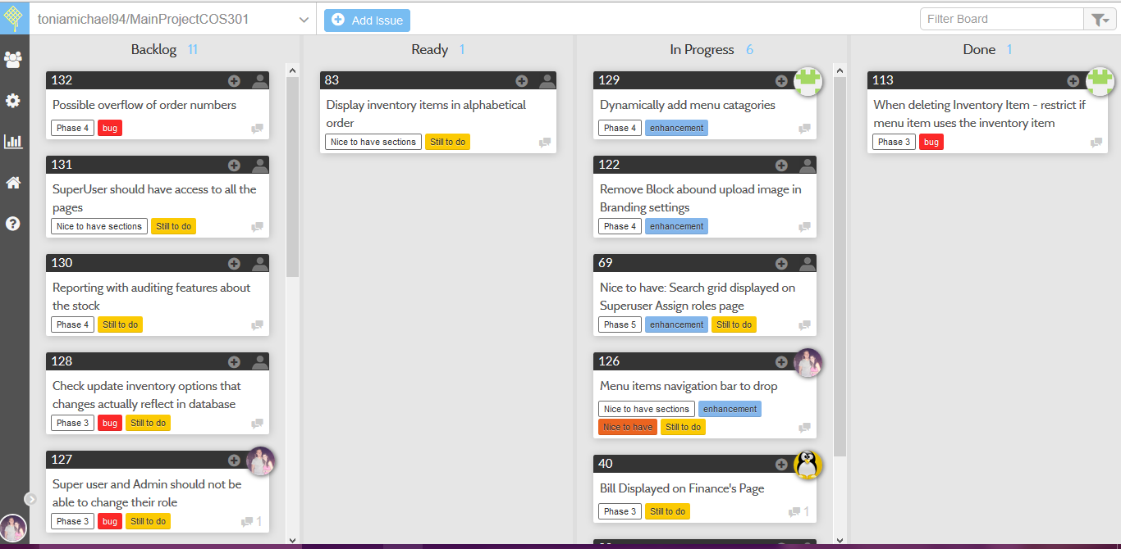
Scrum Board
This can be viewed on project README on GitHub repo

Slide 9
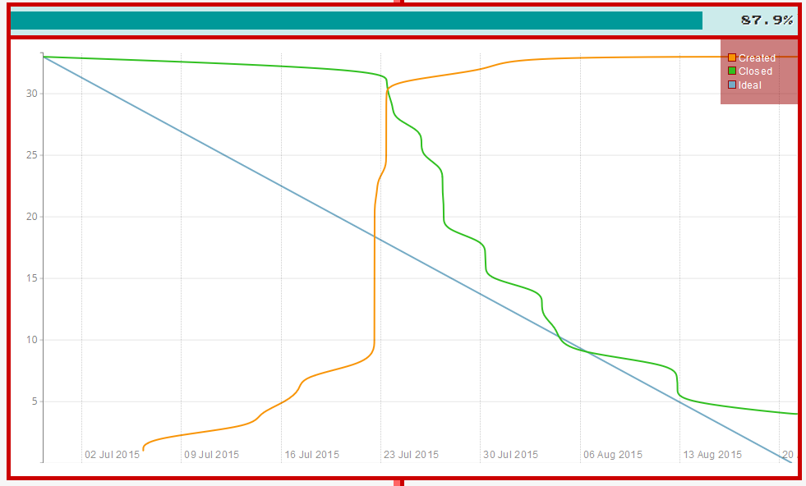
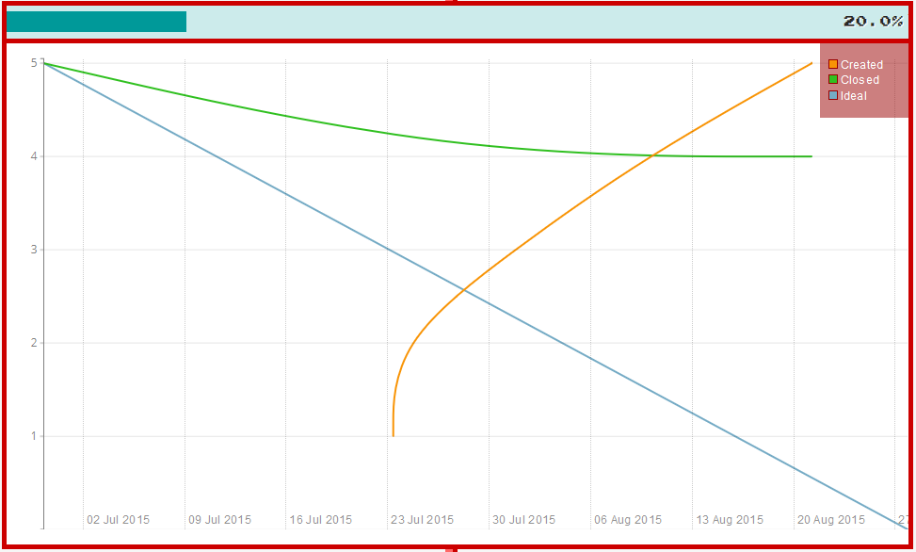
Burndown Chart
Phase 3 – 87% completed:
Phase 4: next phase
This can be viewed on project README on GitHub repo

Slide 10

Demo CMS

