Slide 1

Project:
Cafeteria Management
System
Group:
T-RISE

Slide 2
In this presentation
~ Software Development Methodology
~ Project Management Tools
~ Client Meetings
~ Technologies
~ Unit Testing

Slide 3
Software Development Methodology
~ Agile Method: Scrum
1) Identify and prioritize requirements
2) Identify top priorities (for sprints)
3) Identify the sprint development
activities (Milestones on GitHub)

Slide 4
Software Development Methodology
~ Sprint Iterations
1) Weekly meetings
~ Planning and discussing issues related to current sprint

Slide 5
Software Development Methodology
~ Sprint Iterations
1) Log issues to do with sprint
2) Implement planning
3) Test planning
4) Update the documentation
~ Such as user manual, testing documentation
5) Consult with client after each sprint

Slide 6
Client Meetings
~ Present Progress and demo functionality
~ Discuss alterations
~ Receive feedback
~ Create necessary issues for alterations
Meeting Dates:

Slide 7
Project Management Tools
~ Waffle.io – Scrum Board, liked with all git
issues and milestones
~ Burndown.io – Burndown charts linked with
issues on git

Slide 8
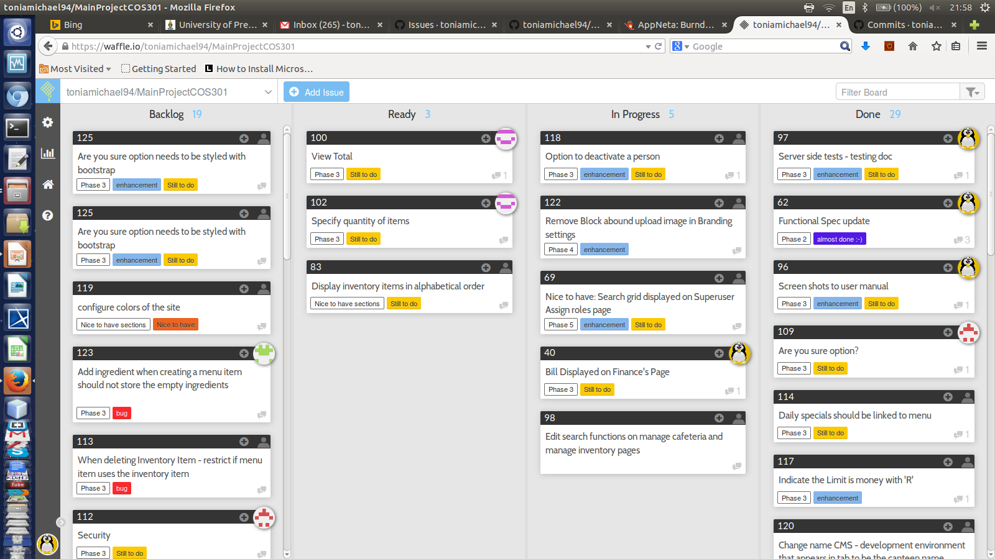
Scrum Board
This can be viewed on project README on GitHub repo

Slide 9
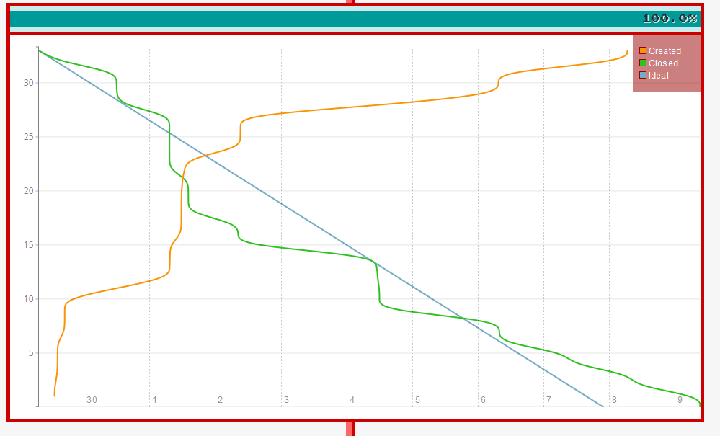
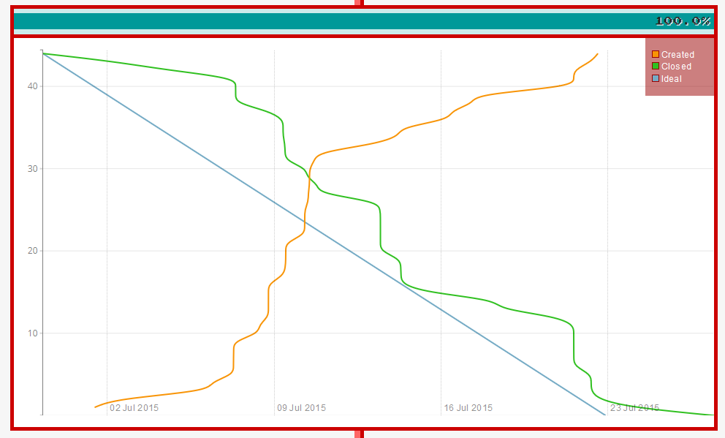
Burndown Charts
Phase 1 – completed:
Phase 2 – completed:
This can be viewed on project README on GitHub repo

Slide 10
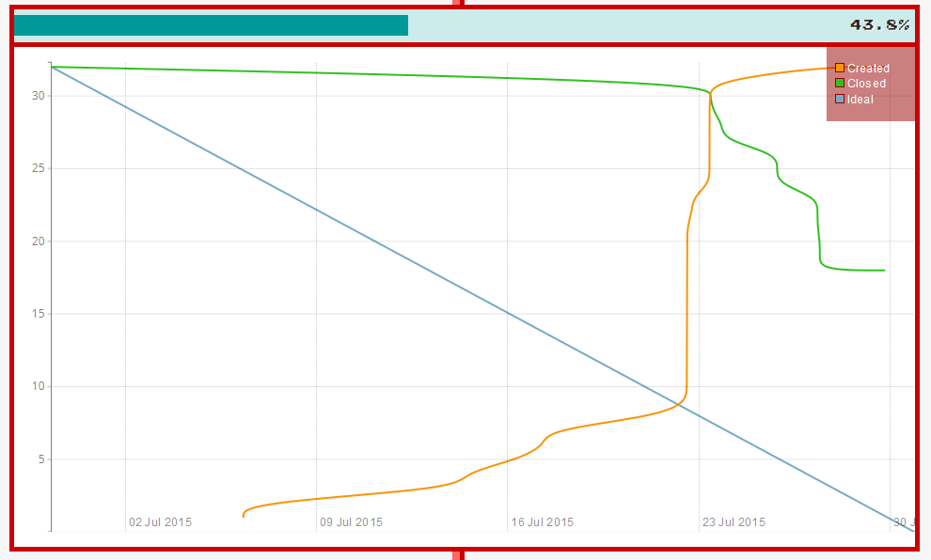
Burndown Charts
Current phase :

Slide 11
Technologies
~ MeanJS - JavaScript solution that helps you
build fast, robust, and maintainable production web applications using
MongoDB, Express, AngularJS, and Node.js.
~ Build Tools - Grunt, yeoman, npm and bower
~ Styling – Bootstrap

Slide 12
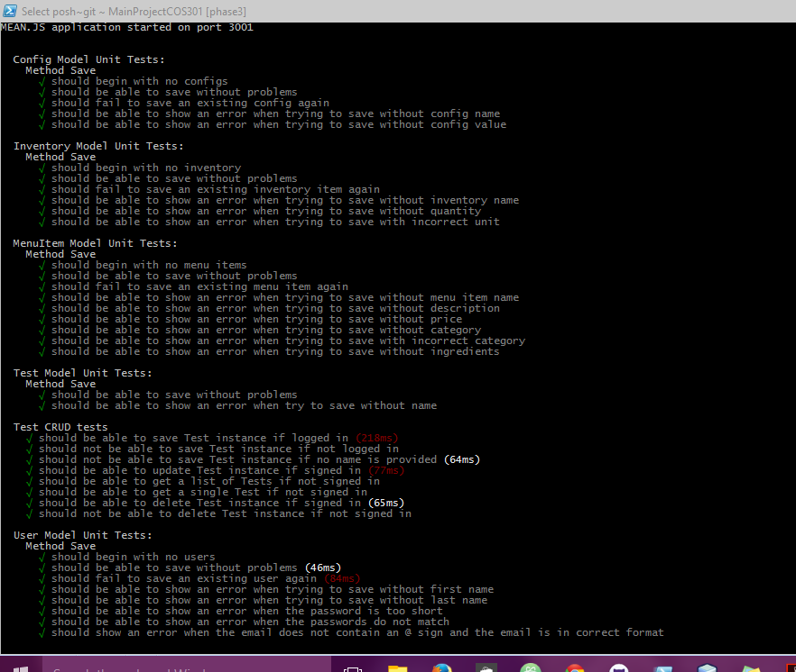
Unit Testing
~ Phantom JS and Karma (Client side testing)
~ Mocha (Server side testing )

Slide 13
THE END…

Slide 14
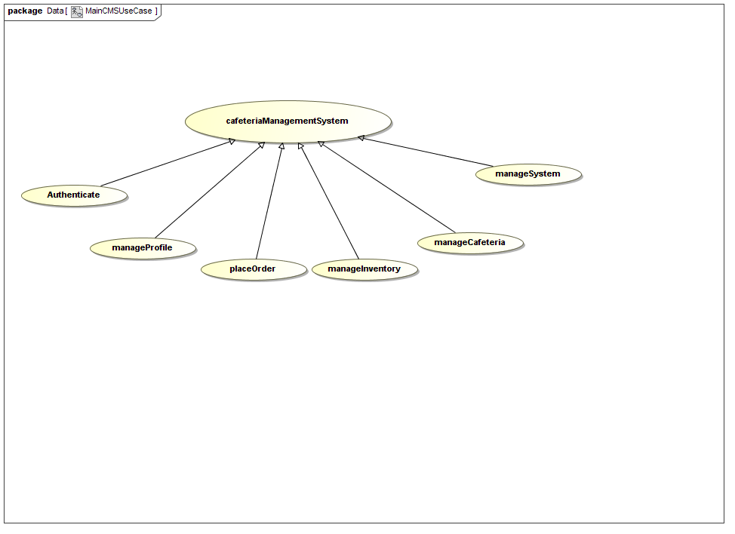
In this demo (continued):
Demonstation of the system (Agile) for use cases:
Profile
PlaceOrder
ManageInventory
ManageMenu
Authentication
Manage System

Slide 15
In this demo (continued):
Documentation:
Functional Specification
Architecture Specification
Testing documentation
User Manual
Design Documentation

