Slide 1
The Good, the Bad, & the Ugly of New York Health
Toni Anderson
Alex Schackmuth
Mieae Yun

Slide 2
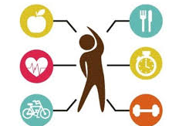
How does environment & lifestyle influence health state?

Slide 3
Do these factors actually influence Health?
The social and economic environment:
Neighborhood
Education
Insurance
The person's characteristics and behaviors:
Nutrition
Exercise
Age
Race
Gender
Risky Behaviors: Alcohol & Smoking
Notes:
D

Slide 4
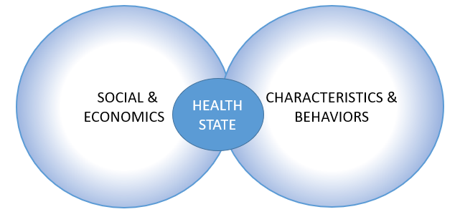
Based on a New York City Community Health Survey (CHS) 2013 – Annual survey conducted in New York City to evaluate the general health of its residents.

Slide 5
First we need to understand our Data

Slide 6
Exploration of our DataSet
Challenges with the DataSet…
Data without values (Nan)
Strings instead of numerical values
No continuous variables
Too Categorical
Limited Graph types
Solutions…
Divided influences based on those categories
Created complete DataSet
Notes:
Discuss how we observed each categorical.

Slide 7
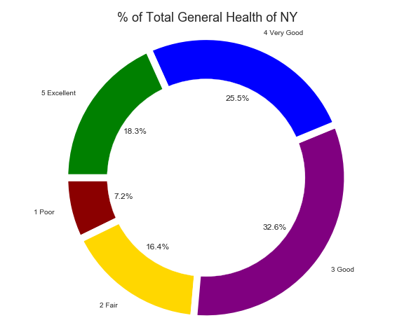
Respondent Reported Health
32.6% - Good Health
25.5 % - Very Good Health
18.3% - Excellent Health
16.4% - Fair Health
7.2% - Poor Health
Majority of the NY survey-takers are considered to have between Good to Very Good Health

Slide 8
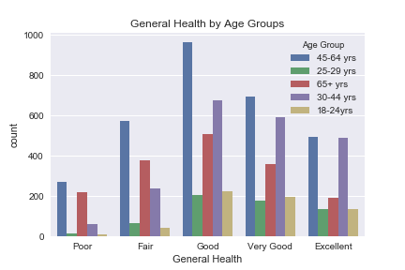
Age Group
Age distribution is proportionally similar across all health categories.
There is a spike in poor health for those over 65.

Slide 9
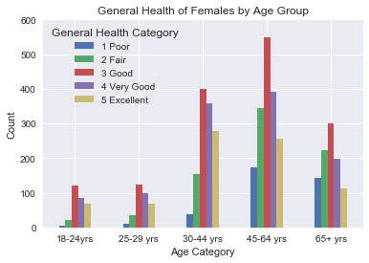
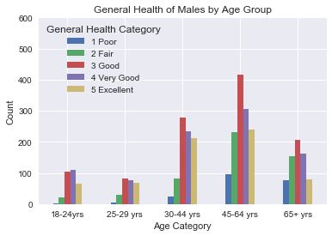
Gender by Age
Millennials vs. Baby Boomers

Slide 10
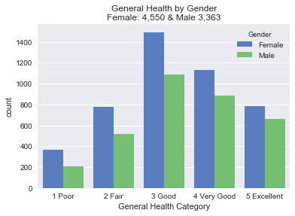
Gender
Portion similar

Slide 11
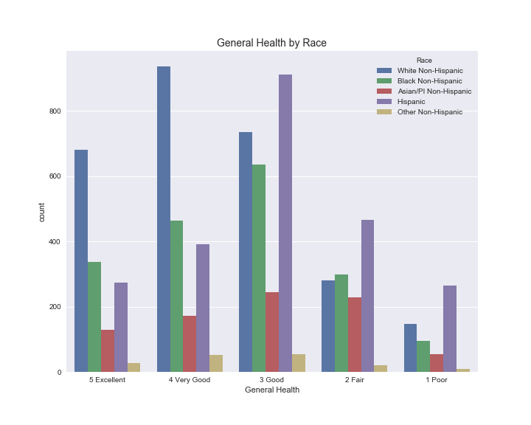
Race
What groups were surveyed to determine Health state?
Our analysis based on Race, we found that White Non-Hispanic are in Excellent to Good Health, whereas Black and Hispanics were about average of having Good to Fair Health.

Slide 12
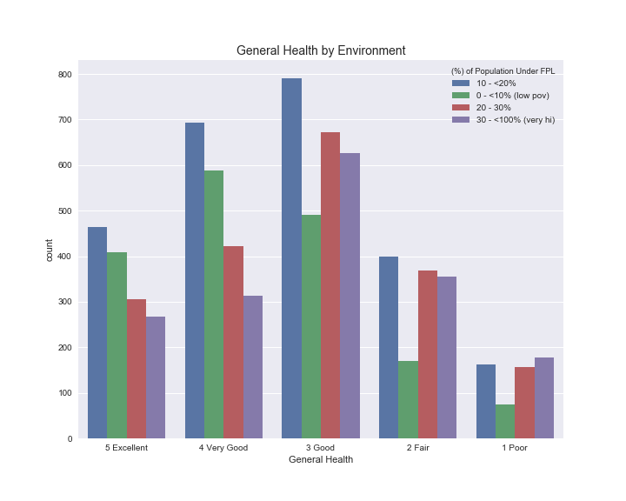
Environment
How does the environment influence Health state?
Based on the Bar Chart of the General Health broken down by the Environment, our analysis shows individuals above the 20% Poverty Line are in Good Health.
What we found interesting is that the individuals below the 10% Poverty Line had a count between 400 – 600 of Excellent to Very Good Health.

Slide 13
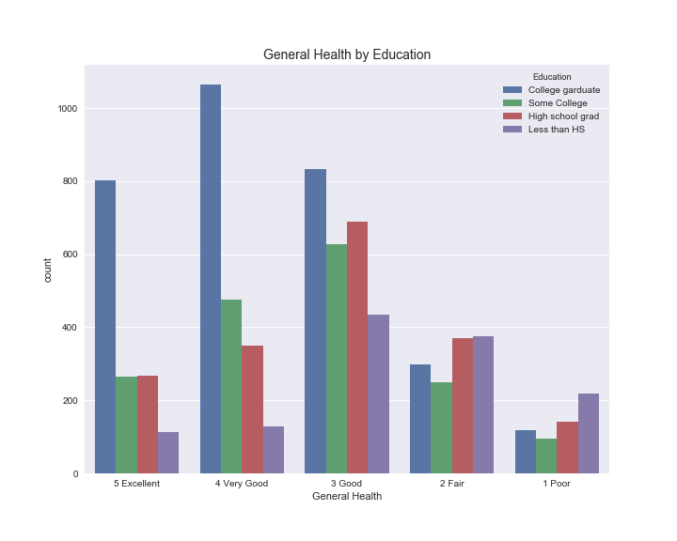
Education
How does a person’s education affect Health State?
Our analysis based on Education, we found that great majority of individuals that are College graduates are in Excellent to Good Health.
According to an article on Medical News Today, the higher a person's socioeconomic status (SES), the more likely they are to enjoy good health, a good education, a well-paid job, afford good healthcare when their health is threatened.

Slide 14
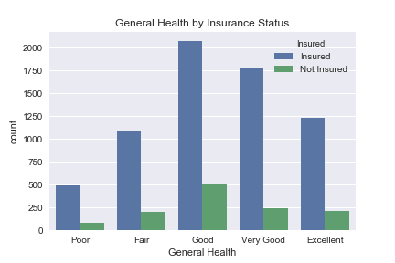
Self-Reported Health by Insurance Status
Due to the Affordable Care Act most people in all categories have insurance.
It does not appear to be a strong predictor of health.

Slide 15
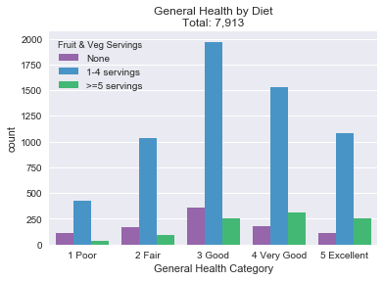
Fruit & Vegetable Servings
How many total servings of fruit and/or vegetables did you eat yesterday? A serving would equal one medium apple, a handful of broccoli, or a cup of carrots.
State of health Good or better do eat more than 5 servings of fruits & vegetables.
Also have a higher portion of 1-4 servings.

Slide 16
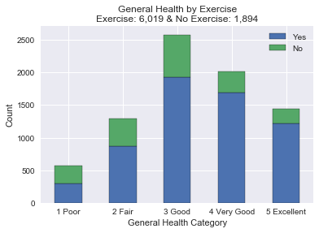
Exercise
During the past 30 days, other than your regular job, did you participate in any physical activities or exercises such as running, calisthenics, golf, gardening, or walking for exercise?
Majority did get some type of physical activity but need more information on the frequency.
Those that exercise do consider themselves health.
Portion of No are slightly larger with the Fair and Poor groups

Slide 17
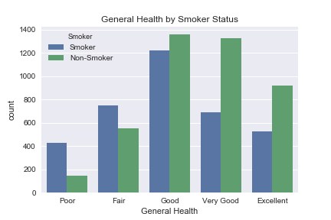
Self-Reported Health by Smoker Status
Many Smokers believe they are in good health.
However they dominate the poor and fair health categories.

Slide 18

Self-Reported Health by Drinker Status
The distribution for drinkers is similar to smokers.
Perhaps a strong correlation between smoking and drinking.

Slide 19

Hmmm…. Inner thoughts
Are these relationships significant?
How can we test these relationships?
Notes:
Created 3 regressions model

Slide 20
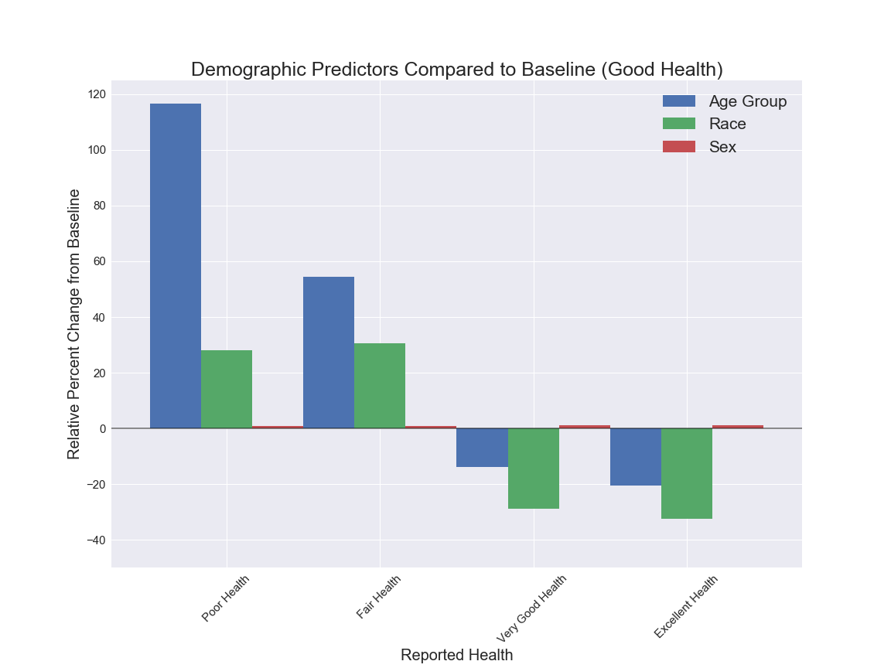
Demographic Predictors Compared to Baseline (Good Health)
Notes:
how demographic factors affect general health
Strong position correlation between poor health and age

Slide 21
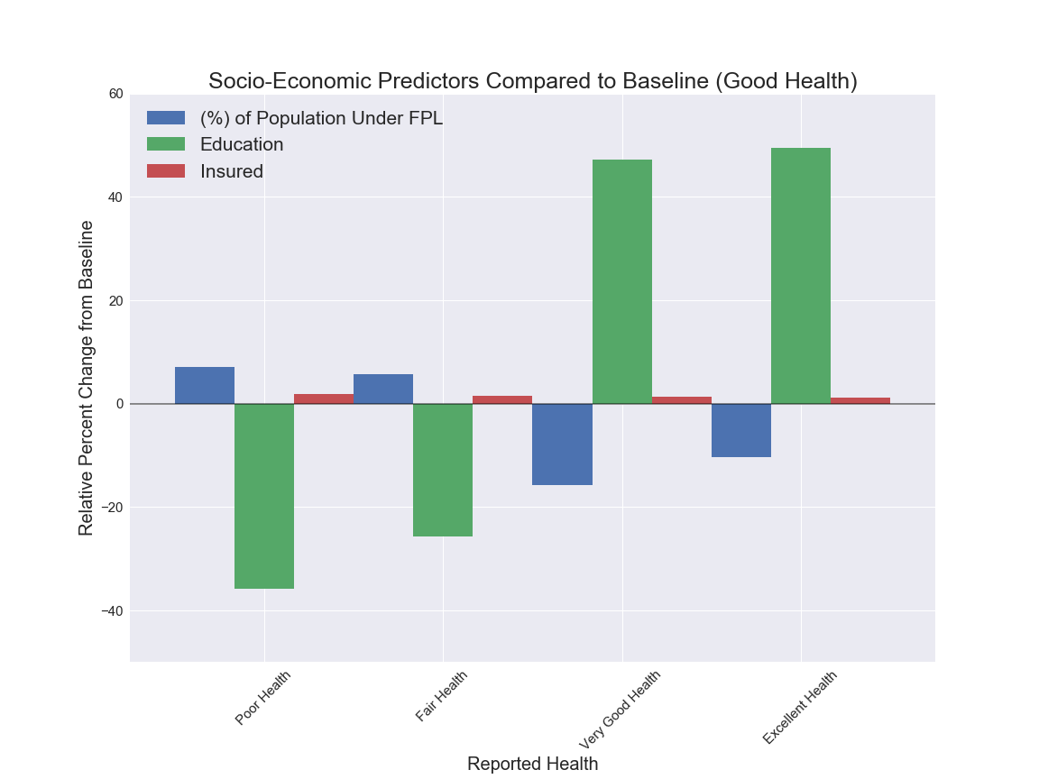
Socio-Economic Predictors Compared to Baseline (Good Health)
Notes:
examines how social & economic factors affect general health
Strong positive correlation between education and good health

Slide 22
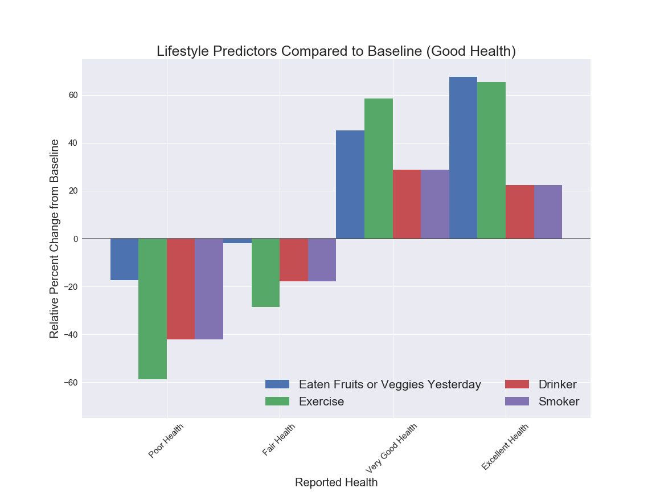
Lifestyle Predictors Compared to Baseline (Good Health)
Notes:
examines how lifestyle factors affect general health
Strong positive correlation between very good health and all the factors

Slide 24
Q & A

