Slide 1
The Good, the Bad, & the Ugly of New York Health
Toni Anderson
Alex Schackmuth
Mieae Yun

Slide 2
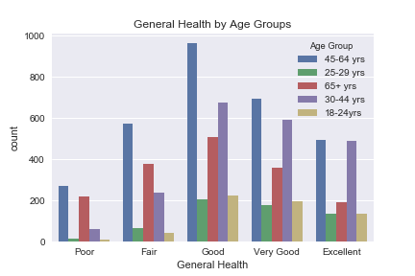
Self-Reported Health by Age Group
Age distribution is proportionally similar across all health categories.
There is a spike in poor health for those over 65.

Slide 3
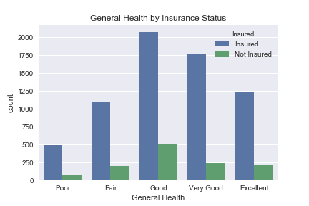
Self-Reported Health by Insurance Status
Due to the Affordable Care Act most people in all categories have insurance.
It does not appear to be a strong predictor of health.

Slide 4
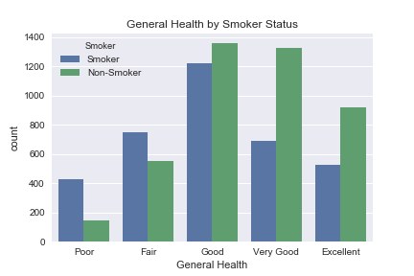
Self-Reported Health by Smoker Status
Many Smokers believe they are in good health.
However they dominate the poor and fair health categories.

Slide 5

Self-Reported Health by Drinker Status
The distribution for drinkers is similar to smokers.
Perhaps a strong correlation between smoking and drinking.

