Slide 1
The Good, the Bad, & the Ugly of New York Health
Toni Anderson
Alex Schackmuth
Mieae Yun

Slide 2
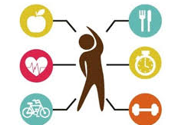
How does environmental & lifestyle influence health state?
Notes:
Discuss

Slide 3
Do these factors actually influence Health?
The social and economic environment:
Neighborhood
Education
Insurance
The person's characteristics and behaviors:
Nutrition
Exercise
Age
Race
Gender
Risky Behaviors: Alcohol & Smoking
Notes:
D

Slide 4
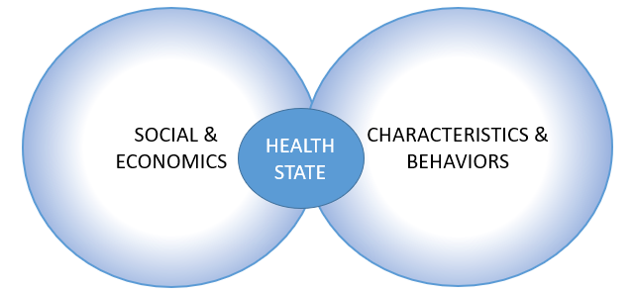
Based on a New York City Community Health Survey (CHS) 2013 – Men and women were asked several questions regarding their Demographics and Lifestyle to determine how they are categorized in General Health state.

Slide 5
First we need to understand our Data

Slide 6
Raw Data versus Clean Data
Raw Data from <Site>
Clean Data
demog17 | nutrition1 | borough | newrace | cid | uhf34 | neighpovgroup4_0812 | generalhealth | insuredgateway13 | insure13 | insured | insure5 | pcp13
5 | 1 | 3 | 2 | 1400001 | 18 | 2 | very good | 1 | 4 | 1 | 3 | 1
4 | 1 | 1 | 4 | 1400002 | 4 | 3 | very good | 1 | 3 | 1 | 2 | 1
6 | 0 | 3 | 1 | 1400003 | 21 | 2 | very good | 1 | 3 | 1 | 2 | 1
5 | 1 | 2 | 1 | 1400004 | 15 | 2 | very good |  |  |  |  | 1
4 | 3 | 5 | 1 | 1400005 | 34 | 1 | fair | 1 | 3 | 1 | 2 | 1
6 | 2 | 4 | 1 | 1400006 | 26 | 1 | good | 1 | 1 | 1 | 1 | 1
3 | 2 | 1 | 3 | 1400007 | 4 | 4 | fair | 1 | 3 | 1 | 2 | 1
4 | 1 | 4 | 4 | 1400008 | 29 | 2 | good | 2 | 7 | 2 | 5 | 2
 | General Health | (%) of Population Under FPL | Eaten Fruits or Veggies Yesterday | Age Group | Race | Education | Insured | Exercise | Sex | Drinker | Smoker
0 | 4 | 2 | 2 | 4 | 2 | 3 | 1 | 1 | 0 | 0 | 0
1 | 4 | 3 | 2 | 2 | 4 | 2 | 1 | 1 | 0 | 0 | 0
2 | 4 | 2 | 1 | 5 | 1 | 4 | 1 | 1 | 1 | 1 | 1
4 | 2 | 1 | 2 | 5 | 1 | 2 | 1 | 1 | 0 | 0 | 0
5 | 3 | 1 | 2 | 4 | 1 | 4 | 1 | 1 | 0 | 1 | 1
6 | 2 | 4 | 2 | 4 | 3 | 1 | 1 | 1 | 0 | 1 | 1
7 | 3 | 2 | 2 | 4 | 4 | 2 | 0 | 0 | 1 | 1 | 1
8 | 2 | 2 | 2 | 5 | 2 | 2 | 1 | 0 | 1 | 0 | 0
9 | 3 | 2 | 2 | 4 | 1 | 4 | 1 | 1 | 1 | 0 | 0
10 | 5 | 2 | 2 | 3 | 1 | 4 | 1 | 1 | 1 | 1 | 1
11 | 4 | 2 | 2 | 5 | 4 | 4 | 1 | 1 | 1 | 1 | 1

Slide 7
Exploration of our DataSet
Challenges with the DataSet…
Data without values (Nan)
Strings instead of numerical values
No continuous variables
Too Categorical
Limited Graph types
Solutions…
Divided influences based on those categories
Created complete DataSet
Notes:
Discuss how we observed each categorical.

Slide 8
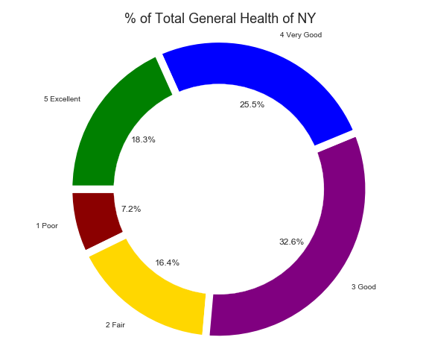
Respondent Reported Health
32.6% - Good Health
25.5 % - Very Good Health
18.3% - Excellent Health
16.4% - Fair Health
7.2% - Poor Health
Majority of the NY survey-takers are considered to have between Good to Very Good Health

Slide 9
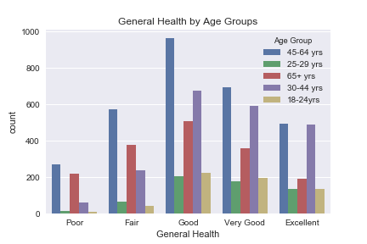
Age Group
Age distribution is proportionally similar across all health categories.
There is a spike in poor health for those over 65.

Slide 10
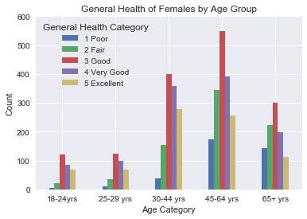
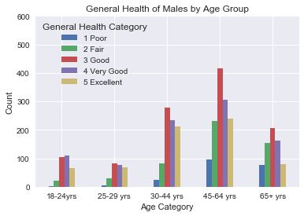
Gender by Age
Millennials vs. Baby Boomers

Slide 11
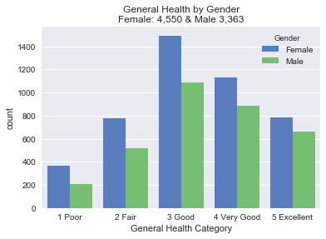
Gender
Majority did get some type of physical activity but need more information on the frequency.
Those that exercise do consider themselves health.
Portion of No are slightly larger with the Fair and Poor groups

Slide 12
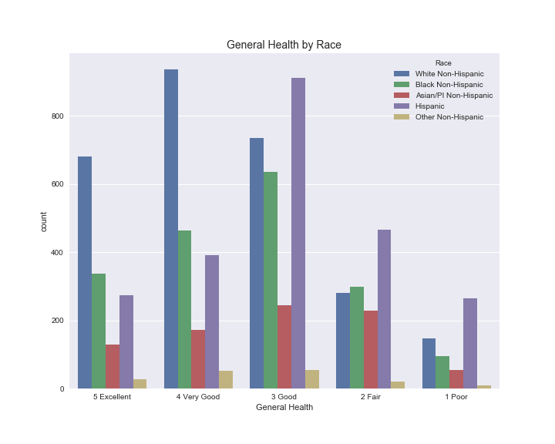
Race
What groups were surveyed to determine Health state?
Our analysis based on Race, we found that White Non-Hispanic are in Excellent to Good Health, whereas Black and Hispanics were about average of having Good to Fair Health.

Slide 13
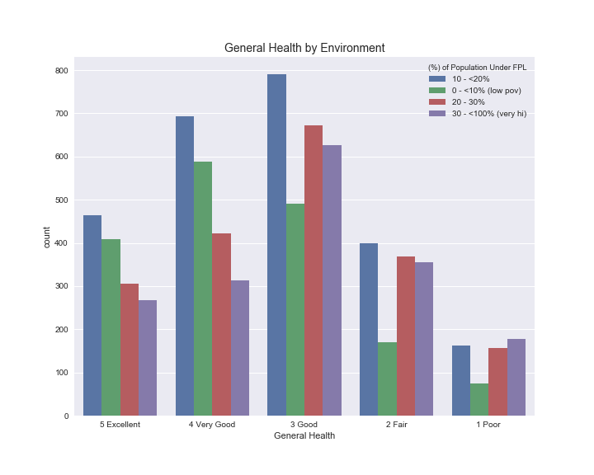
Environment
How does the environment influence Health state?
Based on the Bar Chart of the General Health broken down by the Environment, our analysis shows individuals above the 20% Poverty Line are in Good Health.
What we found interesting is that the individuals below the 10% Poverty Line had a count between 400 – 600 of Excellent to Very Good Health.

Slide 14
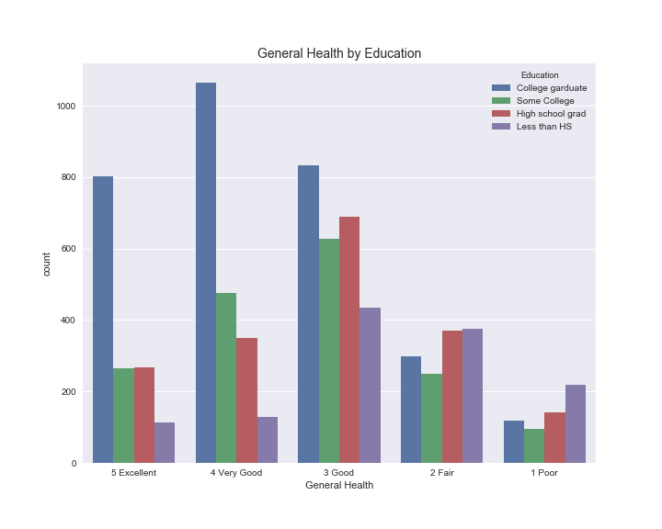
Education
How does a person’s education affect Health State?
Our analysis based on Education, we found that great majority of individuals that are College graduates are in Excellent to Good Health.
According to an article on Medical News Today, the higher a person's socioeconomic status (SES), the more likely they are to enjoy good health, a good education, a well-paid job, afford good healthcare when their health is threatened.

Slide 15
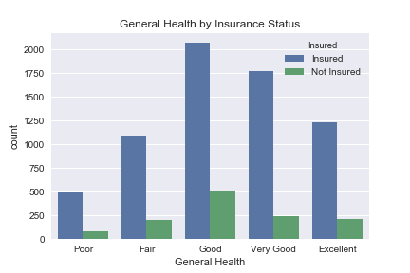
Self-Reported Health by Insurance Status
Due to the Affordable Care Act most people in all categories have insurance.
It does not appear to be a strong predictor of health.

Slide 16
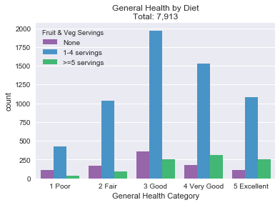
Fruit & Vegetable Servings
How many total servings of fruit and/or vegetables did you eat yesterday? A serving would equal one medium apple, a handful of broccoli, or a cup of carrots.
State of health Good or better do eat more than 5 servings of fruits & vegetables.
Also have a higher portion of 1-4 servings.

Slide 17
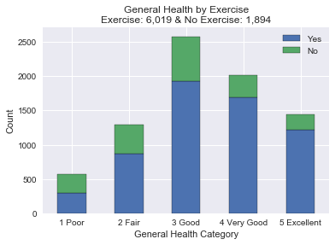
Exercise
During the past 30 days, other than your regular job, did you participate in any physical activities or exercises such as running, calisthenics, golf, gardening, or walking for exercise?
Majority did get some type of physical activity but need more information on the frequency.
Those that exercise do consider themselves health.
Portion of No are slightly larger with the Fair and Poor groups

Slide 18
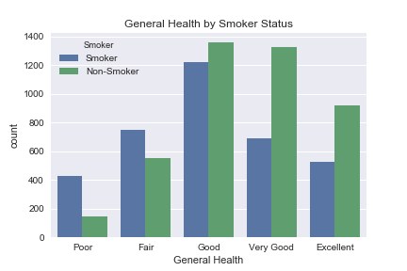
Self-Reported Health by Smoker Status
Many Smokers believe they are in good health.
However they dominate the poor and fair health categories.

Slide 19

Self-Reported Health by Drinker Status
The distribution for drinkers is similar to smokers.
Perhaps a strong correlation between smoking and drinking.

Slide 20

Hmmm…. Inner thoughts
Are these relationships significant?
How can we test these relationships?

Slide 21
Lets run some tests...
We created 3 Regression models to display:
The first model examines how demographic factors affect general health
The second model examines how lifestyle factors affect general health
The third model examines how social & economic factors affect general health

Slide 22
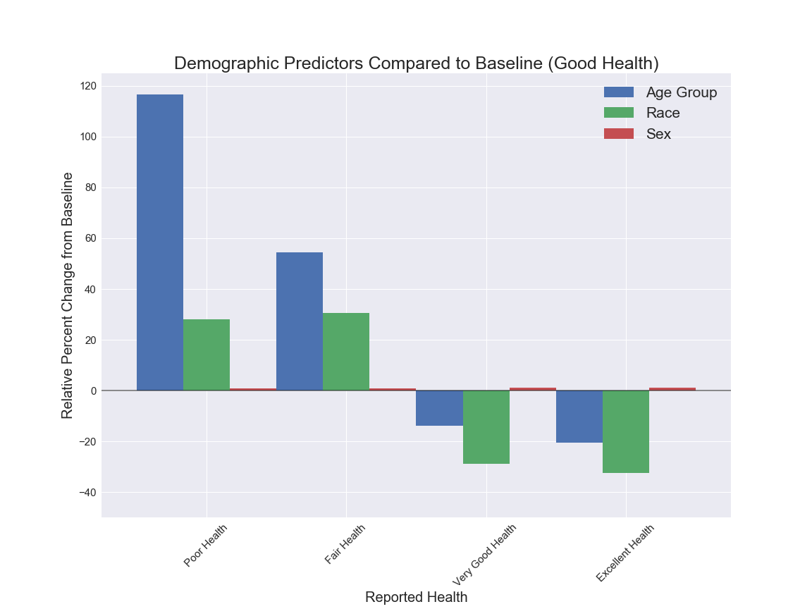
Demographic Predictors Compared to Baseline (Good Health)

Slide 23
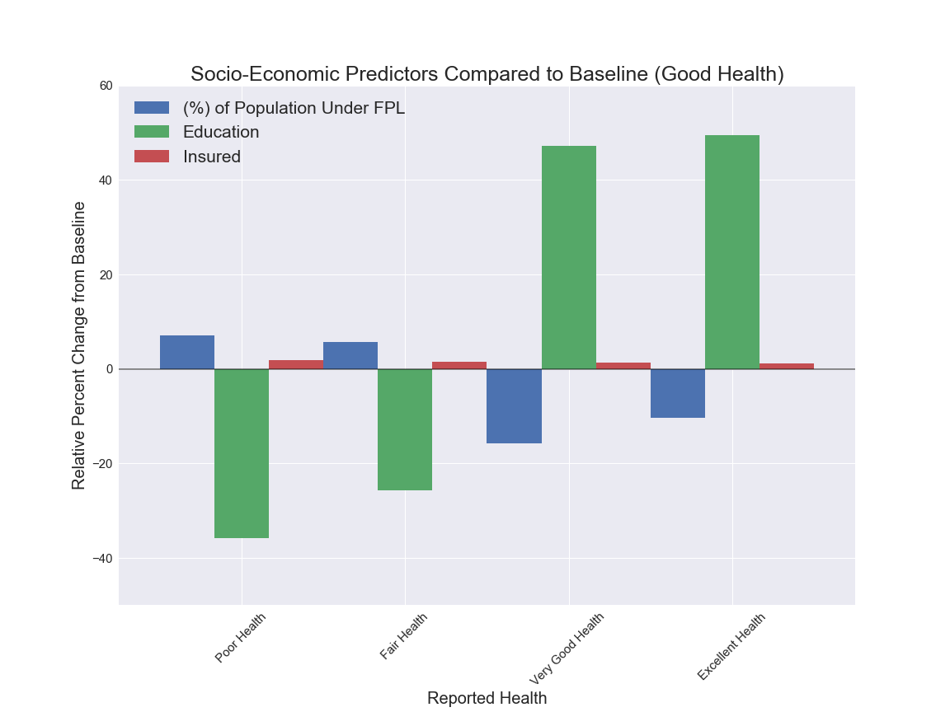
Socio-Economic Predictors Compared to Baseline (Good Health)

Slide 24
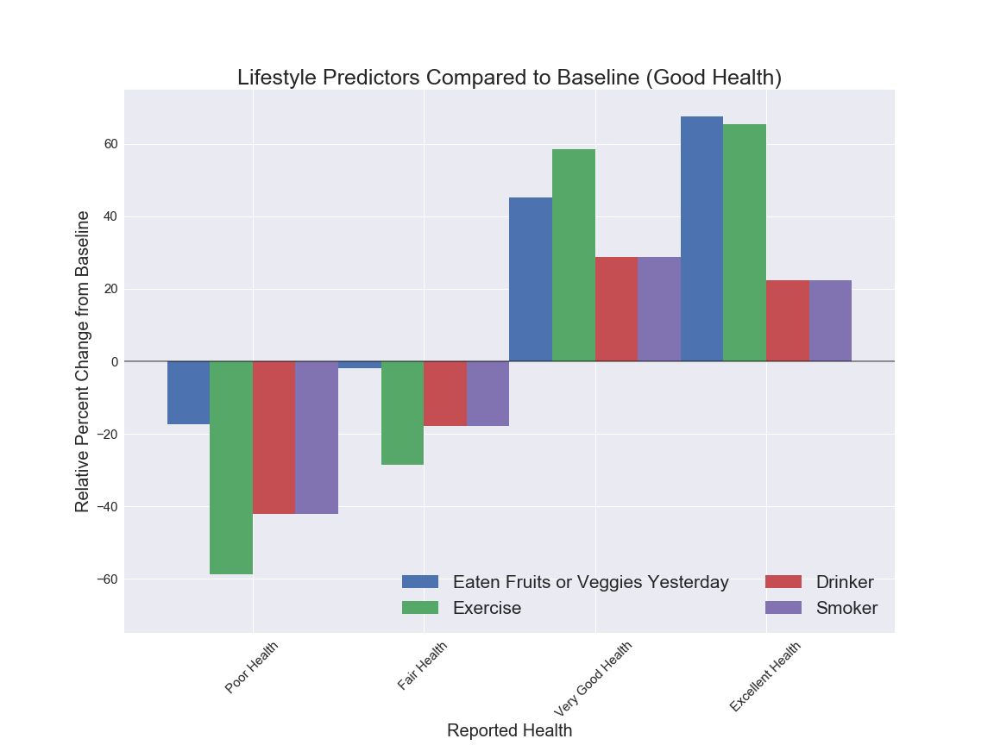
Lifestyle Predictors Compared to Baseline (Good Health)

Slide 26
Q & A

