Slide 1
The Good, the Bad, & the Ugly of New York Health
Toni Anderson
Alex Schackmuth
Mieae Yun

Slide 2
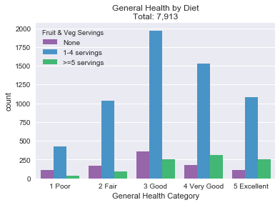
Fruit & Vegetable Servings
How many total servings of fruit and/or vegetables did you eat yesterday? A serving would equal one medium apple, a handful of broccoli, or a cup of carrots.
State of health Good or better do eat more than 5 servings of fruits & vegetables.
Also have a higher portion of 1-4 servings.

Slide 3
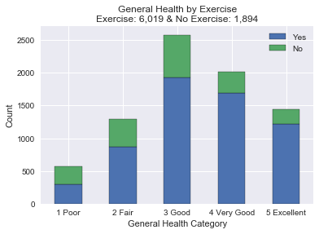
Exercise
During the past 30 days, other than your regular job, did you participate in any physical activities or exercises such as running, calisthenics, golf, gardening, or walking for exercise?
Majority did get some type of physical activity but need more information on the frequency.
Those that exercise do consider themselves health.
Portion of No are slightly larger with the Fair and Poor groups

Slide 4
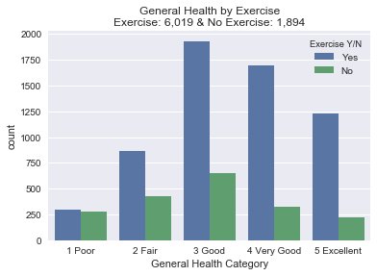
Exercise
During the past 30 days, other than your regular job, did you participate in any physical activities or exercises such as running, calisthenics, golf, gardening, or walking for exercise?
Majority did get some type of physical activity but need more information on the frequency.
Those that exercise do consider themselves health.
Portion of No are slightly larger with the Fair and Poor groups

Slide 5
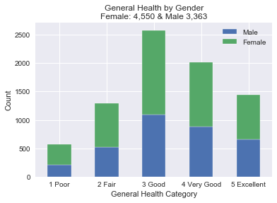
Gender
Majority did get some type of physical activity but need more information on the frequency.
Those that exercise do consider themselves health.
Portion of No are slightly larger with the Fair and Poor groups

Slide 6
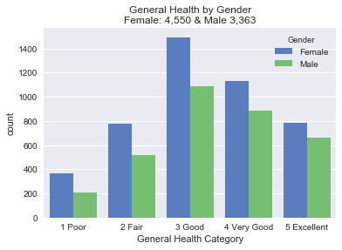
Gender
Majority did get some type of physical activity but need more information on the frequency.
Those that exercise do consider themselves health.
Portion of No are slightly larger with the Fair and Poor groups

Slide 7
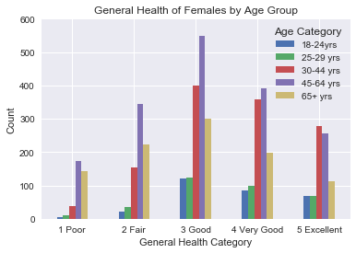
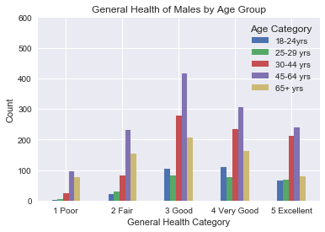
Gender by Age

Slide 8
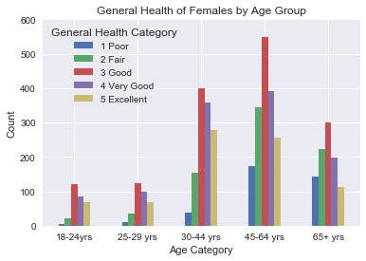
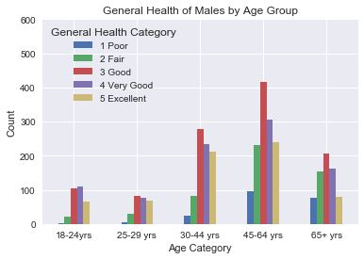
Gender by Age

