Slide 1
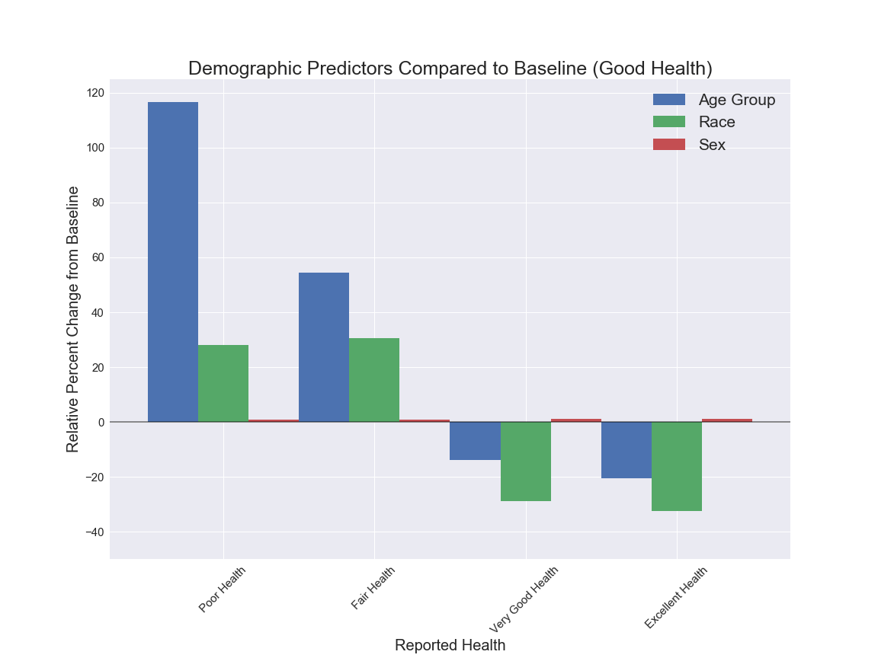
Demographic Predictors Compared to Baseline (Good Health)
Notes:
Age is a strong predictor of self-reported health. Those in poor health are almost 120% more likely to be older than those in good health. Conversely those in excellent health are 20% more likely to be younger than those in good health.

Slide 2
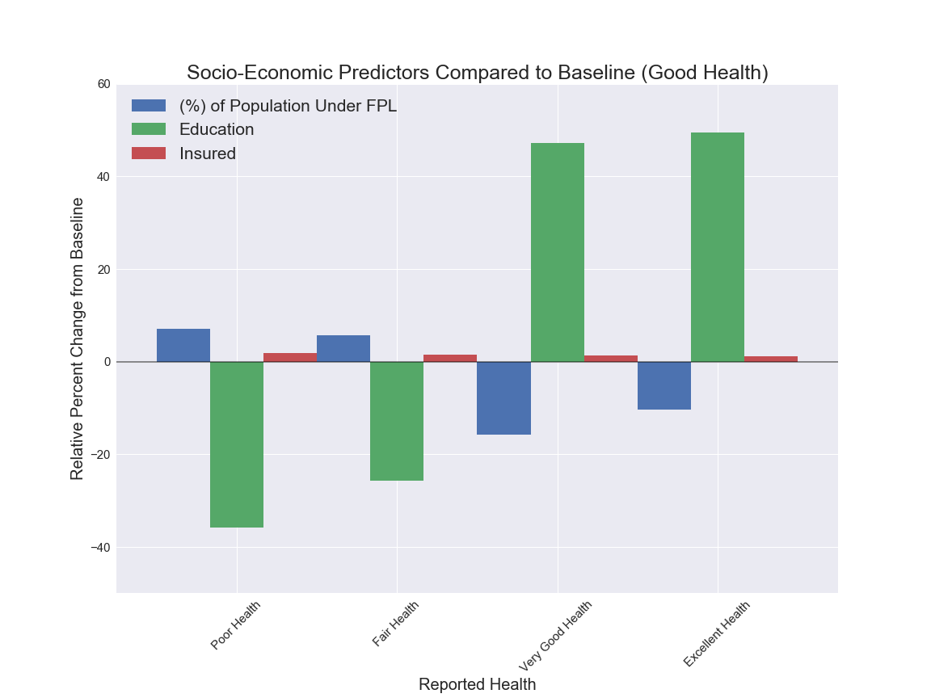
Socio-Economic Predictors Compared to Baseline (Good Health)
Notes:
Education is also a strong predictor of self-reported health. Those in poor health are almost 40% less likely to have a higher education than those in good health. Conversely those in excellent health are almost 50% more likely to have a higher education than those in good health.

Slide 3
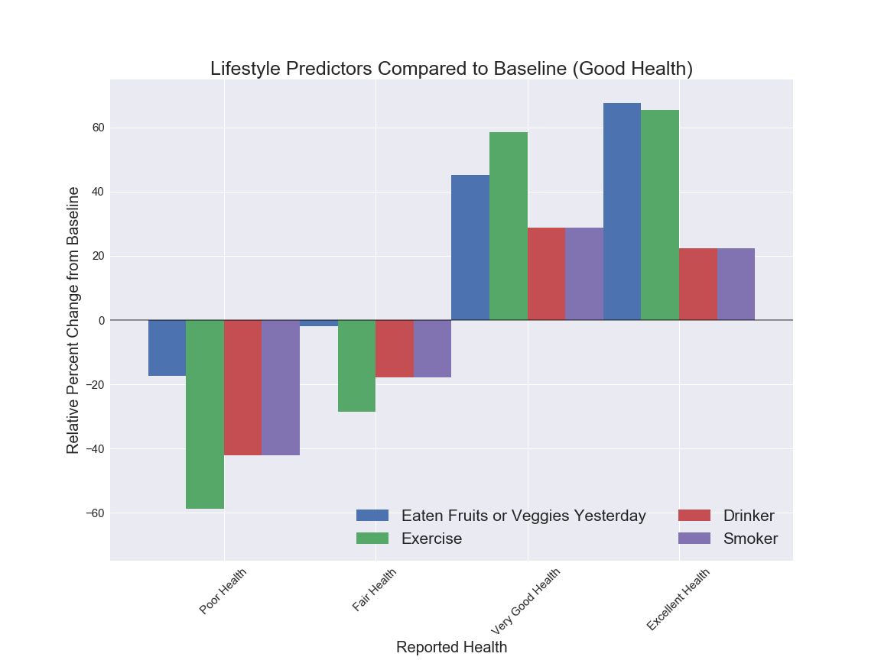
Lifestyle Predictors Compared to Baseline (Good Health)
Notes:
While there is a direct positive relationship between healthy habits like exercise and eating fruits and veggies, apparently smoking and drinking also share a positive relationship with health. This is due to the fact that a sizable amount of people that report themselves as in excellent health either smoke or drink. While these behaviors do negatively affect health over time, ones self perception of health is somewhat subjective in the present. Therefore, at least in the present, people in excellent health are 20% more likely to be smokers and drinkers.

