Slide 1
The Good, the Bad, & the Ugly of New York Health
Toni Anderson
Alex Schackmuth
Mieae Yun

Slide 2
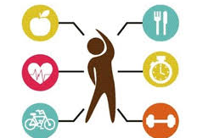
How does environmental & lifestyle influence health state?

Slide 3
Health depends on a wide range of factors
The social and economic environment: Including how wealthy a family or community is
The person's characteristics and behaviors: Including the genes that a person is born with and their lifestyle choices
Income
Education Level

Slide 4
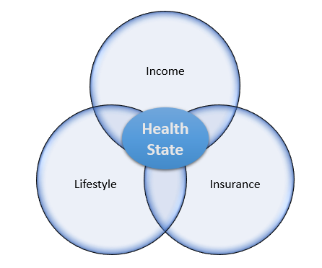
Based on a 2013 NY Survey – Men and women were asked several questions regarding their Demographics and Lifestyle to determine how they are categorized in General Health state.

Slide 5
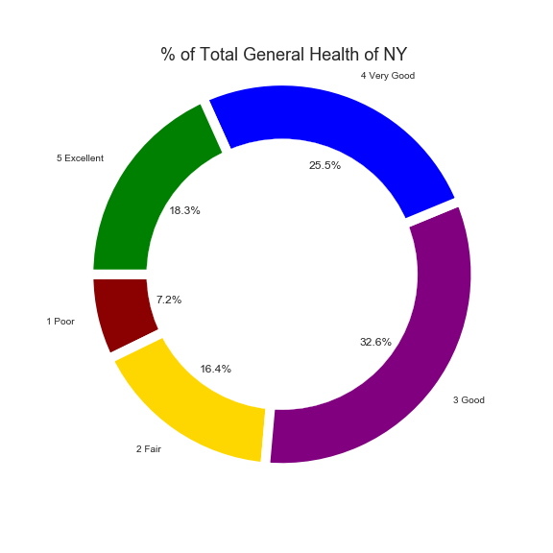
Total General Health of NY
32.6% - Good Health
25.5 % - Very Good Health
18.3% - Excellent Health
16.4% - Fair Health
7.2% - Poor Health
Majority of the NY survey-takers are considered to have between Good to Very Good Health

Slide 6

Hmmm…. Inner thoughts
How are individuals categorized between Excellent and Poor Health?
What type of groups were surveyed?
How does a person’s education or income affect Health state?

Slide 7
First we need to understand our Data

Slide 8
Raw Data versus Clean Data
Raw Data from <Site>
Clean Data
demog17 | nutrition1 | borough | newrace | cid | uhf34 | neighpovgroup4_0812 | generalhealth | insuredgateway13 | insure13 | insured | insure5 | pcp13
5 | 1 | 3 | 2 | 1400001 | 18 | 2 | very good | 1 | 4 | 1 | 3 | 1
4 | 1 | 1 | 4 | 1400002 | 4 | 3 | very good | 1 | 3 | 1 | 2 | 1
6 | 0 | 3 | 1 | 1400003 | 21 | 2 | very good | 1 | 3 | 1 | 2 | 1
5 | 1 | 2 | 1 | 1400004 | 15 | 2 | very good |  |  |  |  | 1
4 | 3 | 5 | 1 | 1400005 | 34 | 1 | fair | 1 | 3 | 1 | 2 | 1
6 | 2 | 4 | 1 | 1400006 | 26 | 1 | good | 1 | 1 | 1 | 1 | 1
3 | 2 | 1 | 3 | 1400007 | 4 | 4 | fair | 1 | 3 | 1 | 2 | 1
4 | 1 | 4 | 4 | 1400008 | 29 | 2 | good | 2 | 7 | 2 | 5 | 2
 | General Health | (%) of Population Under FPL | Eaten Fruits or Veggies Yesterday | Age Group | Race | Education | Insured | Exercise | Sex | Drinker | Smoker
0 | 4 | 2 | 2 | 4 | 2 | 3 | 1 | 1 | 0 | 0 | 0
1 | 4 | 3 | 2 | 2 | 4 | 2 | 1 | 1 | 0 | 0 | 0
2 | 4 | 2 | 1 | 5 | 1 | 4 | 1 | 1 | 1 | 1 | 1
4 | 2 | 1 | 2 | 5 | 1 | 2 | 1 | 1 | 0 | 0 | 0
5 | 3 | 1 | 2 | 4 | 1 | 4 | 1 | 1 | 0 | 1 | 1
6 | 2 | 4 | 2 | 4 | 3 | 1 | 1 | 1 | 0 | 1 | 1
7 | 3 | 2 | 2 | 4 | 4 | 2 | 0 | 0 | 1 | 1 | 1
8 | 2 | 2 | 2 | 5 | 2 | 2 | 1 | 0 | 1 | 0 | 0
9 | 3 | 2 | 2 | 4 | 1 | 4 | 1 | 1 | 1 | 0 | 0
10 | 5 | 2 | 2 | 3 | 1 | 4 | 1 | 1 | 1 | 1 | 1
11 | 4 | 2 | 2 | 5 | 4 | 4 | 1 | 1 | 1 | 1 | 1

Slide 9
Exploration of our DataSet
Challenges with the DataSet…
Our Solutions …

Slide 10
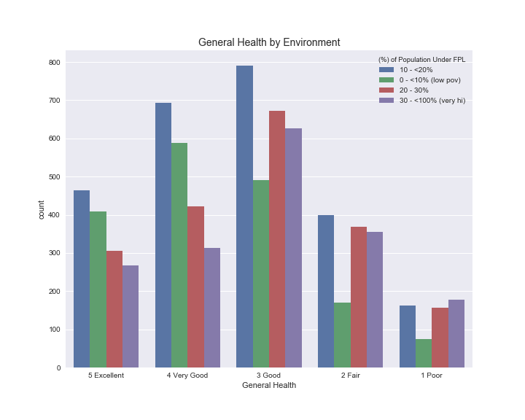
Data Analysis
How does environmental and lifestyle influence Health state?
Based on the Bar Chart of the General Health broken down by the Environment, our analysis shows individuals above the 20% Poverty Line are in Good Health.
What we found interesting is that the individuals below the 10% Poverty Line had a count between 400 – 600 of Excellent to Very Good Health.

Slide 11
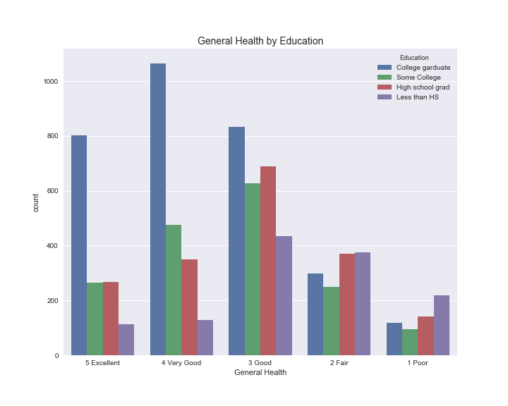
Data Analysis
How does a person’s education affect Health State?
Our analysis based on Education, we found that great majority of individuals that are College graduates are in Excellent to Good Health.
According to an article on Medical News Today, the higher a person's socioeconomic status (SES), the more likely they are to enjoy good health, a good education, a well-paid job, afford good healthcare when their health is threatened.

Slide 12
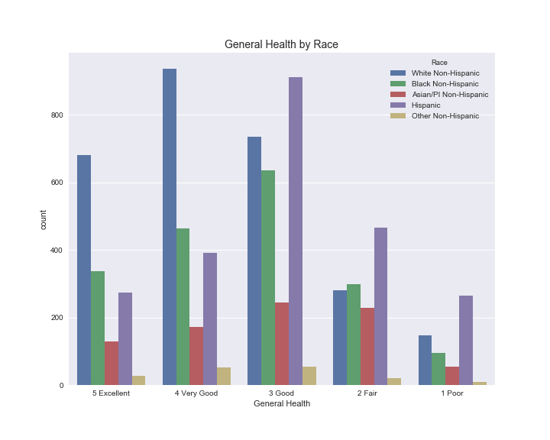
Data Analysis
What groups were surveyed to determine Health state?
Our analysis based on Race, we found that White Non-Hispanic are in Excellent to Good Health, whereas Black and Hispanics were about average of having Good to Fair Health.
We were questioning why Asian and Other Non-Hispanic races were displaying low counts in all General Health categories.

