Slide 1
Diploma CI/CD weather application in the Azure Cloud
Viacheslav Kudriavtsev1
Stream 22
CONFIDENTIAL | © 2022 EPAM Systems, Inc.

Slide 2
GOALS
Create Web-application
Build CI/CD infrastructure in the Azure cloud
Develop CI/CD pipeline with Azure DevOps Server

Slide 3

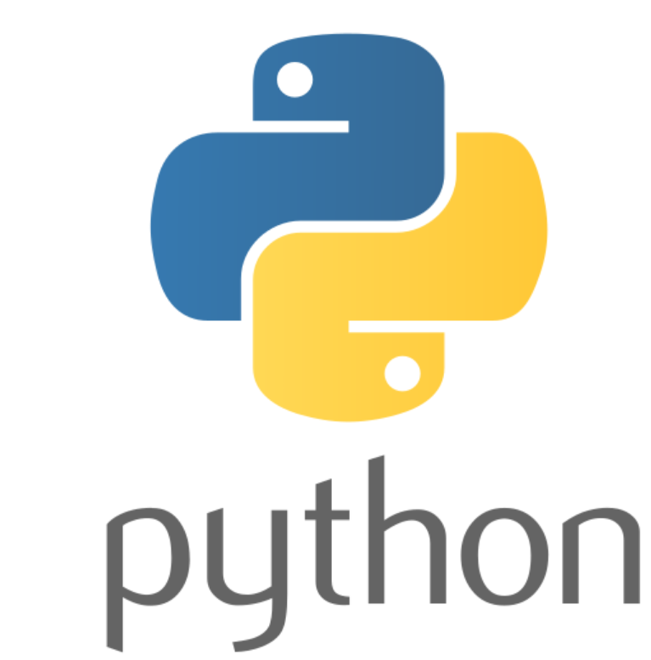






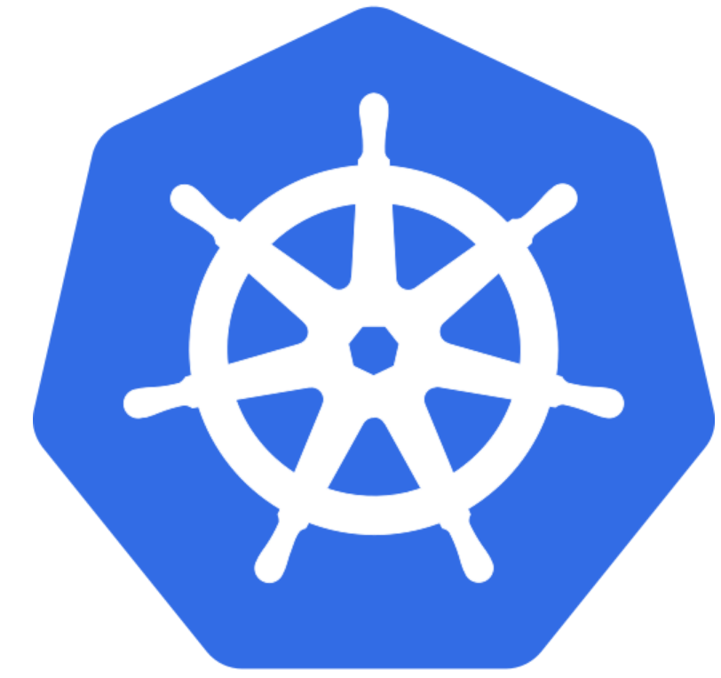

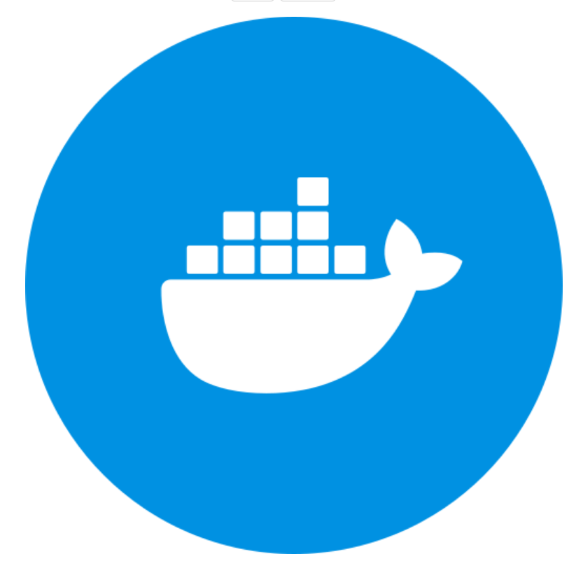

Technologies
Web-application:
∙ Python
∙ Django (restframework, requests)
∙ PostgreSQL
Infrastructure:
∙ Azure: postgresql_server, kubernetes_cluster, log_analytics_workspace
∙ Terraform
CI/CD:
∙ Azure DevOps
∙ Docker hub
∙ Sonar cloud

Slide 4
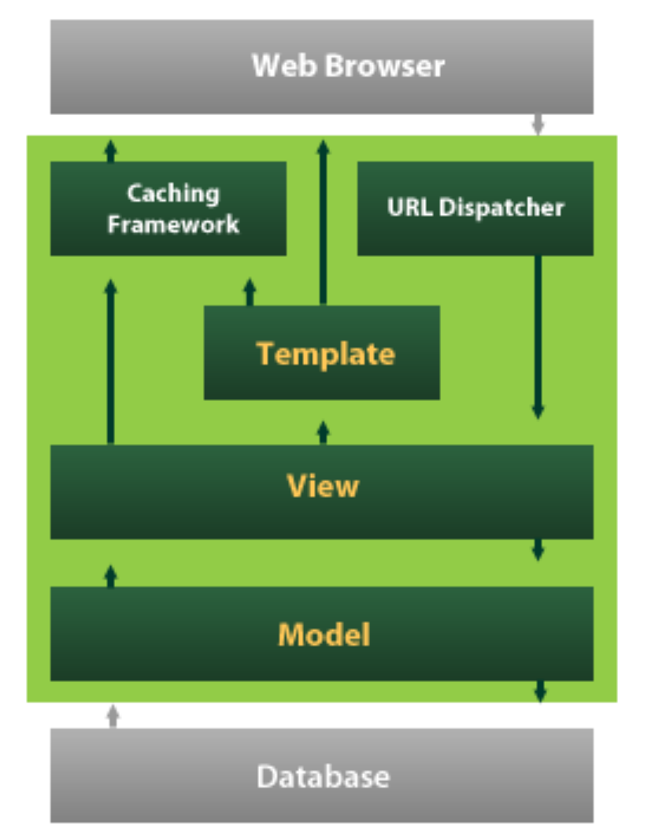
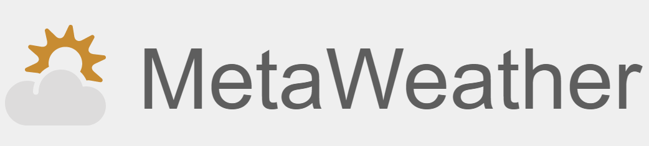

Web Application Architecture

Slide 5
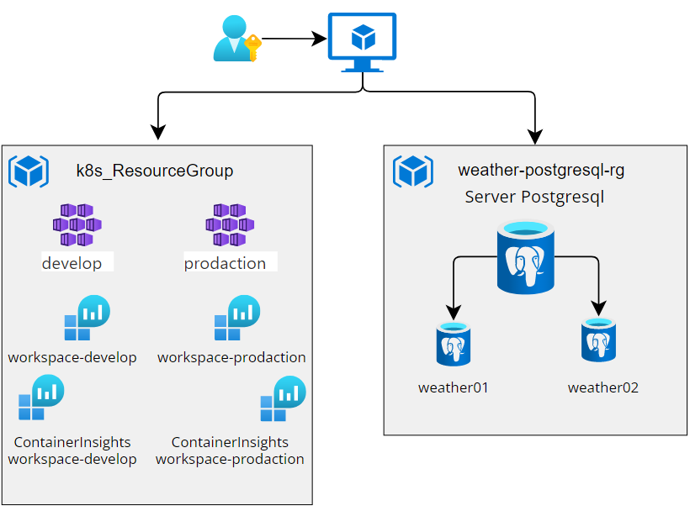
Infrastructure

Slide 6
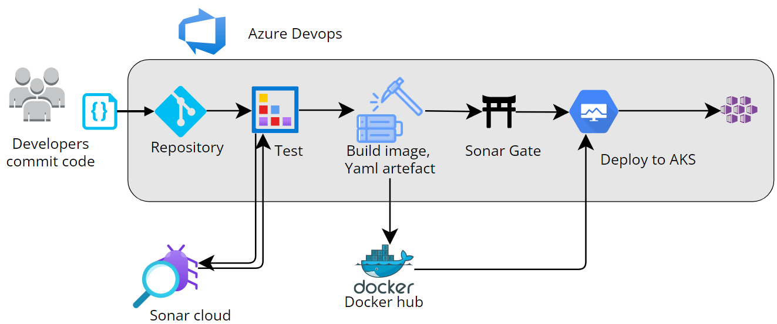
CI/CD Pipeline

Slide 7
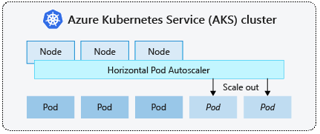
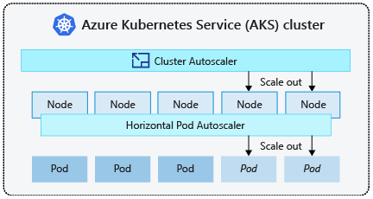
Scalability
Horizontal pod autoscaler
spec:
maxReplicas: 9
minReplicas: 2
scaleTargetRef:
apiVersion: apps/v1
kind: Deployment
name: weather-application
targetCPUUtilizationPercentage: 15
Cluster autoscaler
default_node_pool {
name = "default"
vm_size = "standard_d2_v2"
enable_auto_scaling = true
node_count = "2"
min_count = "1"
max_count = "3"
max_pods = "110"

Slide 8
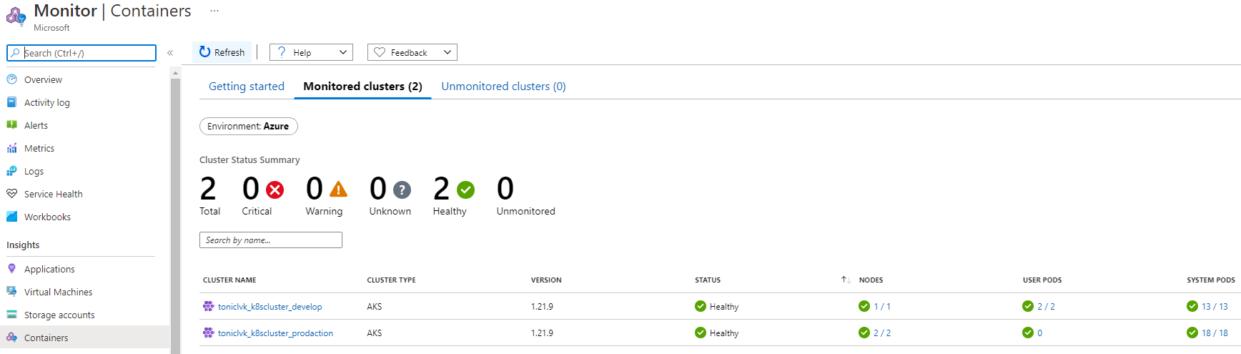
Monitoring

Slide 9
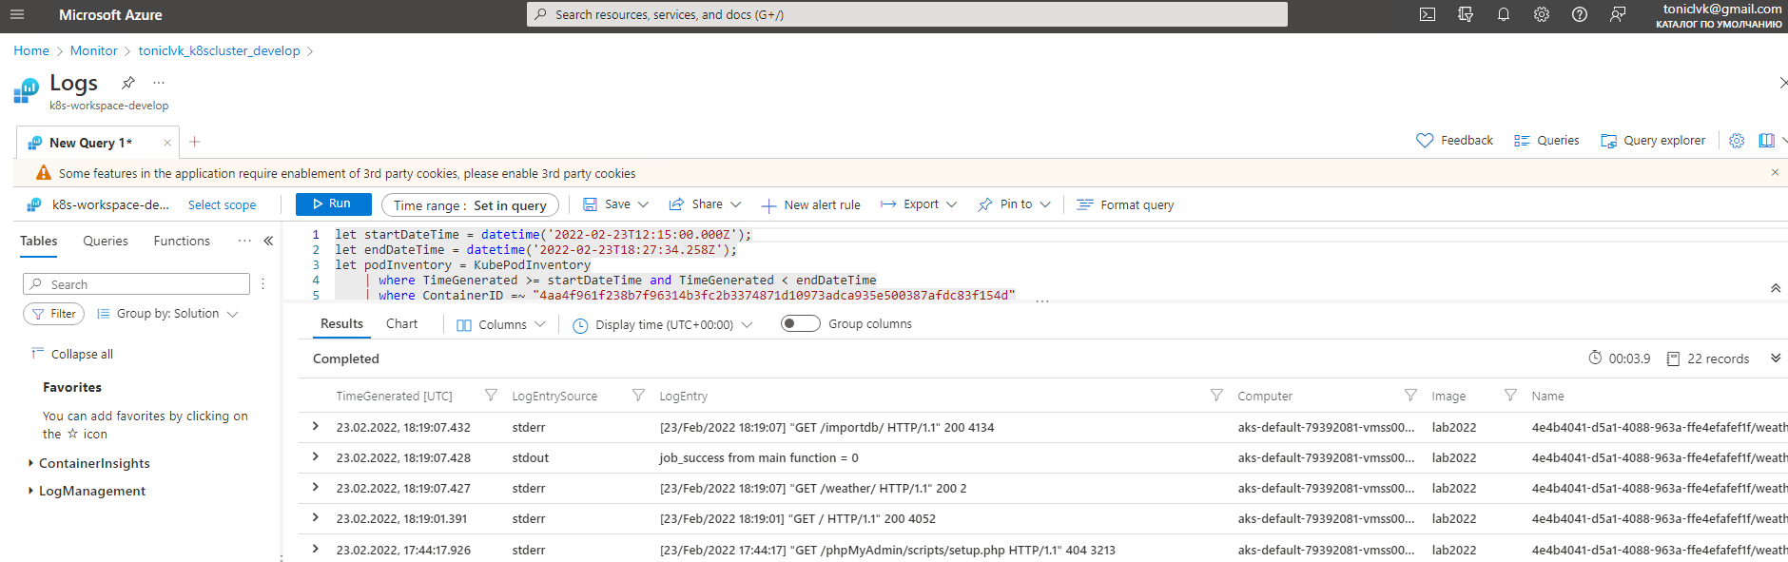
Logging

Slide 10
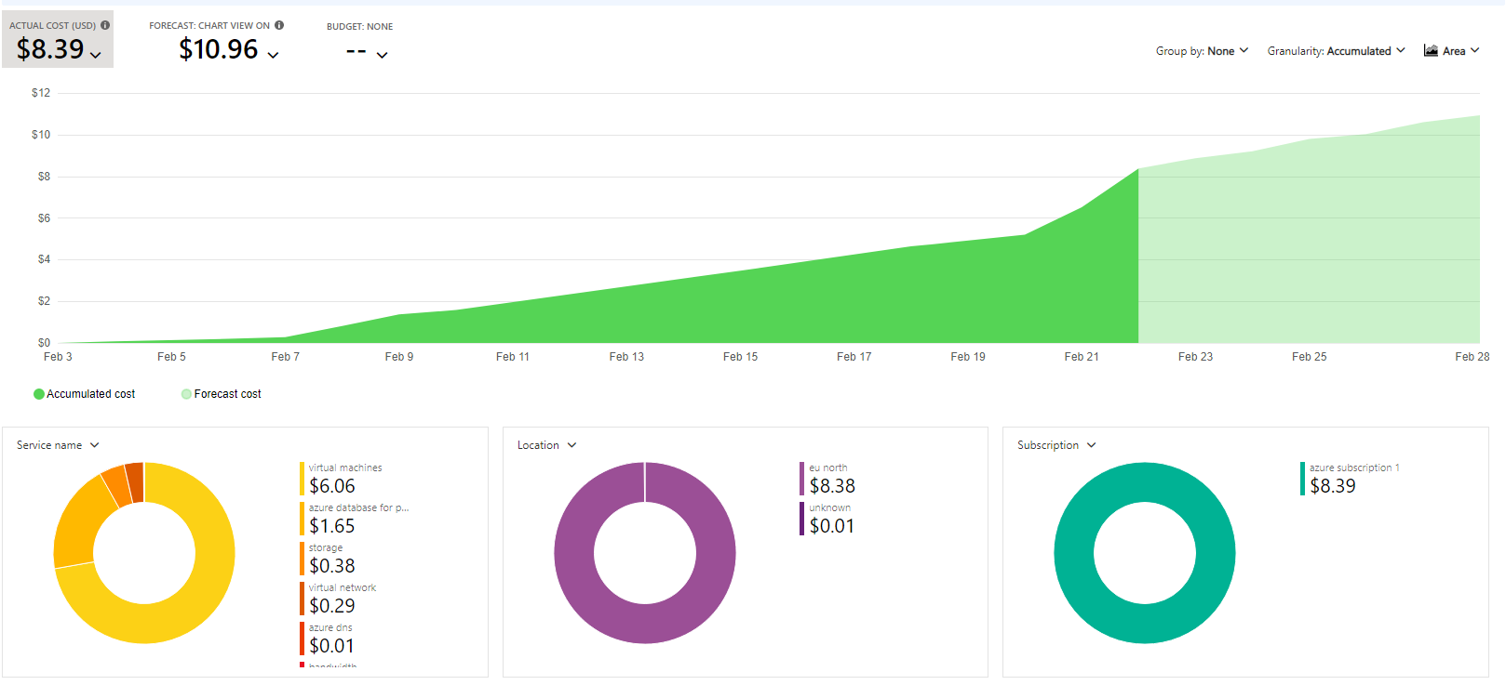
Cost Management

Slide 11
Optimizations and improvements
Create sticky session or update application code.
Enable infrastructure deployment in DevOps server
using Terraform plugin.
Make functional tests.

Slide 12
MATERIALS
Scalability: https://docs.microsoft.com/en-us/azure/aks/concepts-scale
Terraform AKS: https://registry.terraform.io/
https://registry.terraform.io/providers/hashicorp/azurerm/latest/docs/resources/kubernetes_cluster
Terraform kubernetes: https://learnk8s.io/terraform-aks
Visual Paradigm : https://online.visual-paradigm.com/
My Azure DevOps : https://dev.azure.com/toniclvk
My Sonar Cloud : https://sonarcloud.io/project/overview?id=toniclvk_Weather2022
My Docker Hub : https://hub.docker.com/repository/docker/toniclvk/lab2022

