Slide 1


LightSwitch Apps Publishing
img src: http://www.softwareone.com/de-ch/SoftwarePublishers/Microsoft/VSLightSwitch/PublishingImages/Visual-Studio-Lightswitch375.jpg

Slide 2
Who am I?
Toni Dermawan Yuliyanto
Software engineer at erudeye
Contact me via:
Mail = toni@erudeye.co.id
Blog = tonilab.wordpress.com

Slide 3
Yang mau dibawain (hide)
Prerequisites for Deployment
Application Types
Desktop App
Web App
Deployment Topologies
2 Tier
3 Tier
IIS
Windows Azure
Deployment Scenarios
Desktop App = 2 Tier + 3 Tier
Web App = 3 Tier

Slide 4
Note:
Gagal install DesktopOnWeb with Windows Auth (belum tahu penyebabnya) di luar Default Website

Slide 5
Agenda
Prerequisites for Deployment
Application Types
Deployment Topologies
Deployment Scenarios

Slide 6
Prerequisites for Deployment
Install WPI
Install IIS 7 Recommended Configuration
Install Visual Studio LightSwitch Server Runtime
Install Web Deploy 2.1 (optional)

Slide 7
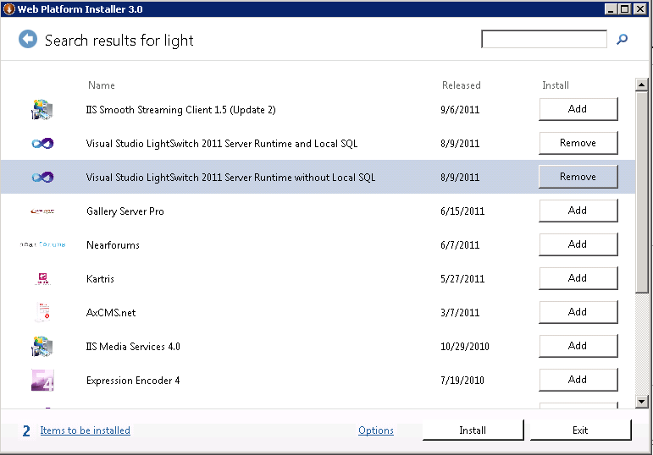

Slide 8

Only 1 Application
We Can Create...
Many Deployment Options
img src: http://www.perfectbalancebooks.com/wp-content/uploads/2010/07/00382634.jpg

Slide 9
Application Types
Desktop App
Browser App

Slide 10
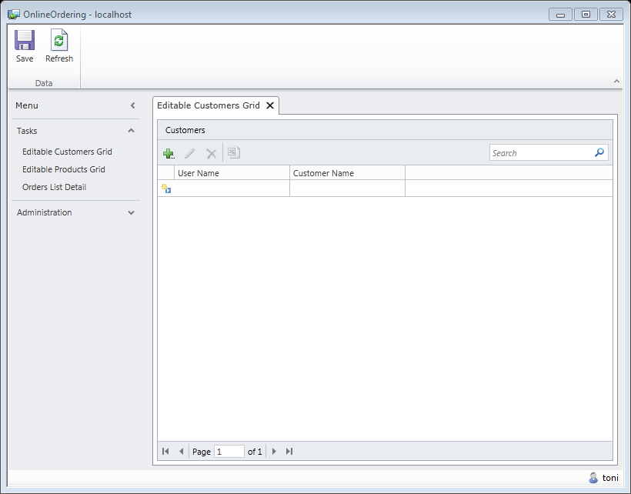
Desktop LightSwitch App

Slide 11
Application Types
Desktop App
Browser App

Slide 12
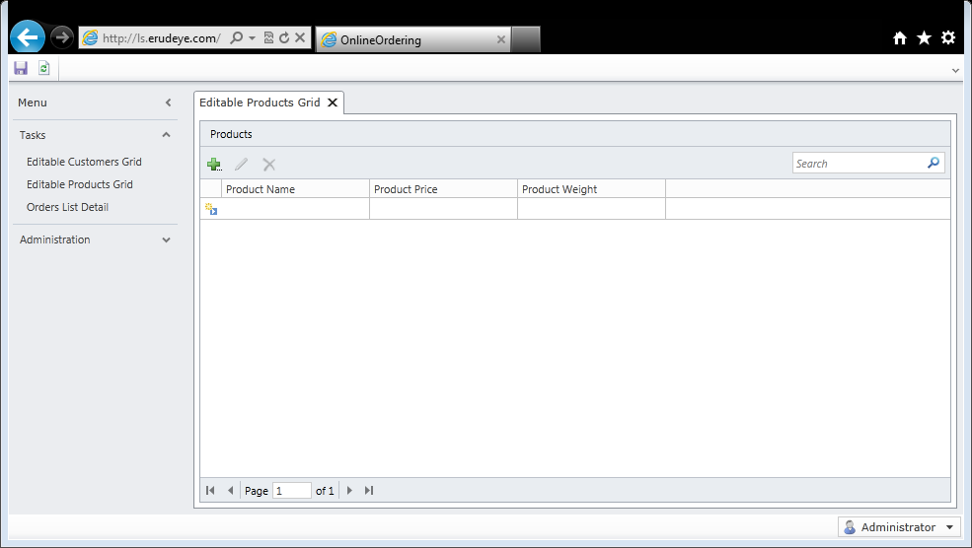
Browser LightSwitch App

Slide 13
Deployment Topologies
3 Tier
IIS
Windows Azure
2 Tier

Slide 14
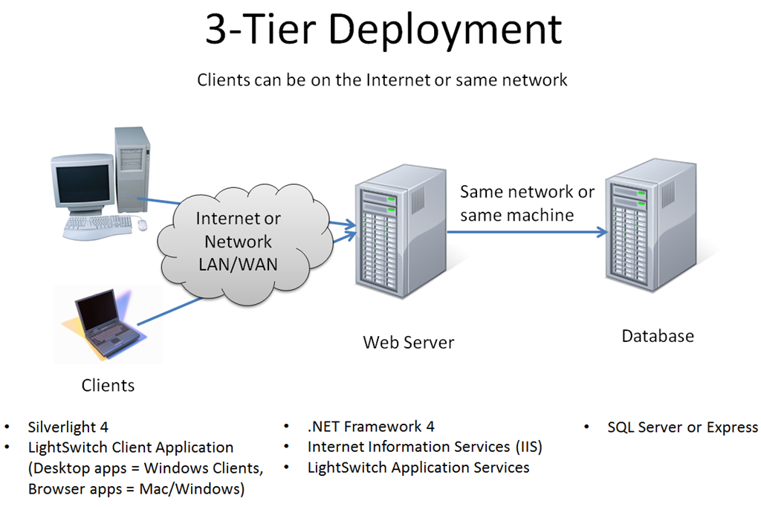
img src: http://blogs.msdn.com/b/bethmassi/archive/2011/03/23/deployment-guide-how-to-configure-a-web-server-to-host-lightswitch-applications.aspx

Slide 15
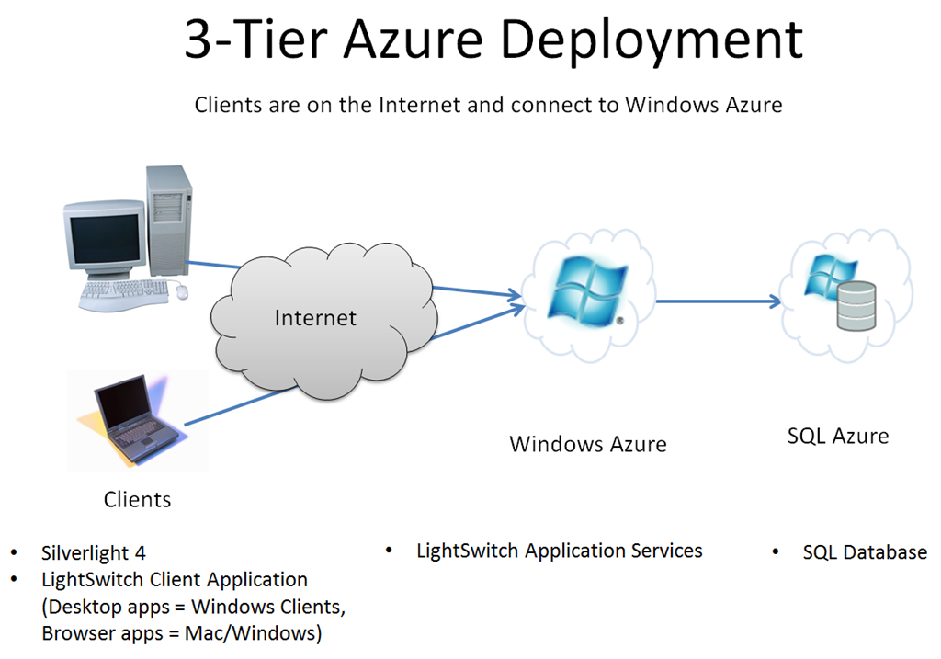
img src: http://blogs.msdn.com/b/bethmassi/archive/2011/03/23/deployment-guide-how-to-configure-a-web-server-to-host-lightswitch-applications.aspx

Slide 16
Deployment Topologies
3 Tier
IIS
Windows Azure
2 Tier

Slide 17
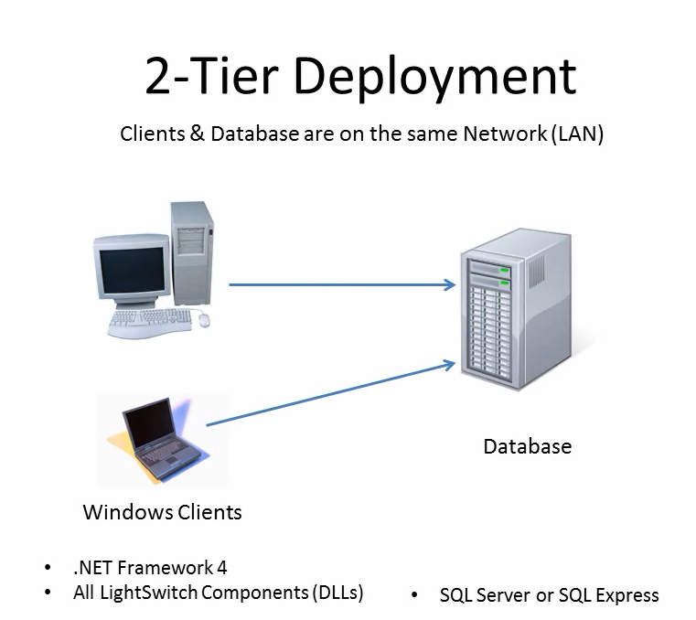
img taken from video (http://msdn.microsoft.com/en-us/lightswitch/gg274326)
Notes:
2 tier = client as Windows Clients and server as Database & Client

Slide 18
Deployment Scenarios
Desktop App
Web App
2-Tier
3-Tier (IIS)
3-Tier (Windows Azure)

Slide 19
Demo
Browser App with 3 Tier (IIS)

Slide 20
Thank You
FYI, erudeye Hosting now support LightSwitch hosting.

