Slide 1


LightSwitch Apps Publishing
Toni Dermawan Yuliyanto | erudeye
Microsoft Indonesia, Jakarta, September 27th, 2011
img src: http://www.softwareone.com/de-ch/SoftwarePublishers/Microsoft/VSLightSwitch/PublishingImages/Visual-Studio-Lightswitch375.jpg

Slide 2

Who am I?
Toni Dermawan Yuliyanto
Software engineer at erudeye
Contact me via:
Mail = toni(at)erudeye.co.id
Blog = tonilab.wordpress.com

Slide 3
Agenda
Prerequisites for Deployment
Application Types
Deployment Topologies
Deployment Scenarios

Slide 4
Prerequisites for Deployment
Install WPI
Install IIS 7 (with Recommended Configuration)
Install Visual Studio LightSwitch Server Runtime
Install Web Deploy 2.1 (optional)

Slide 5
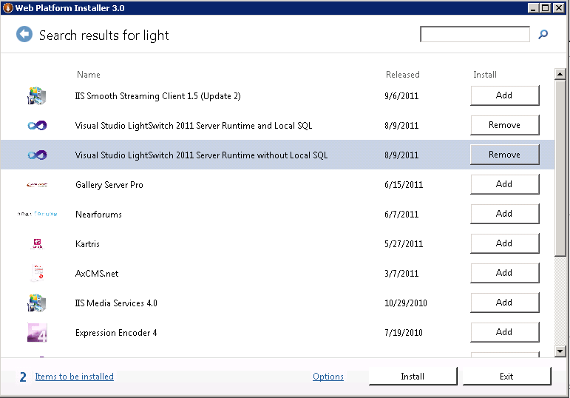

Slide 6


Only 1 Application
We Can Create...
Many Deployment Options
img src: http://www.perfectbalancebooks.com/wp-content/uploads/2010/07/00382634.jpg

Slide 7
Application Types
Desktop App
Browser App
Notes:
Nilai tambah Desktop App:
Bisa mengakses file
Bisa mengakses program (mis: MS. Word)

Slide 8
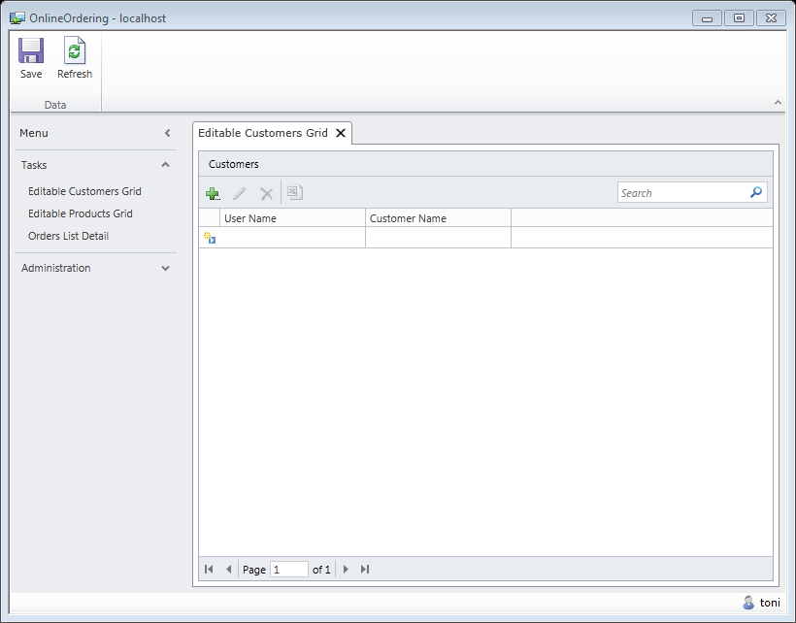
Desktop LightSwitch App

Slide 9
Application Types
Desktop App
Browser App

Slide 10
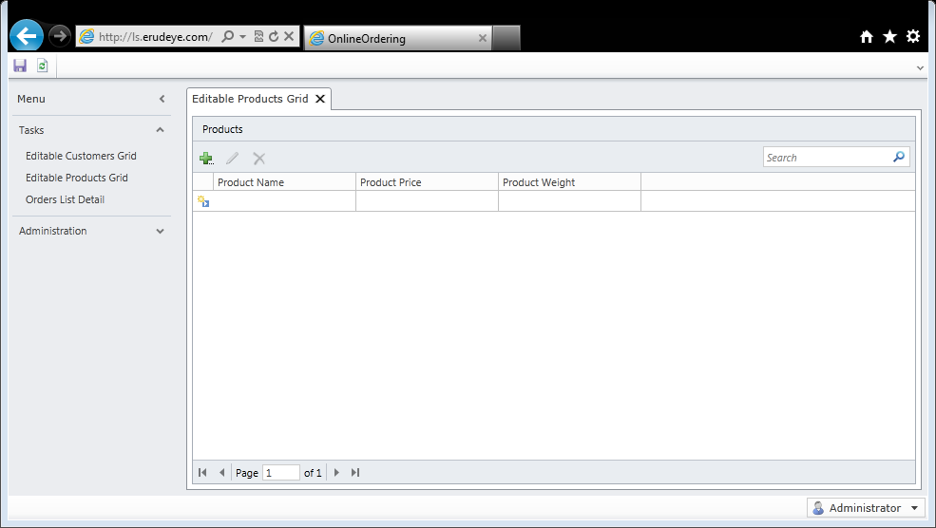
Browser LightSwitch App

Slide 11
Deployment Topologies
3 Tier
IIS
Windows Azure
2 Tier

Slide 12
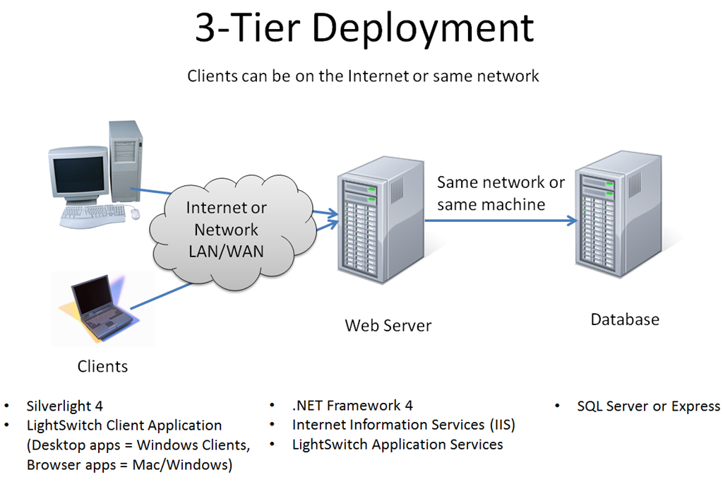
img src: http://blogs.msdn.com/b/bethmassi/archive/2011/03/23/deployment-guide-how-to-configure-a-web-server-to-host-lightswitch-applications.aspx

Slide 13
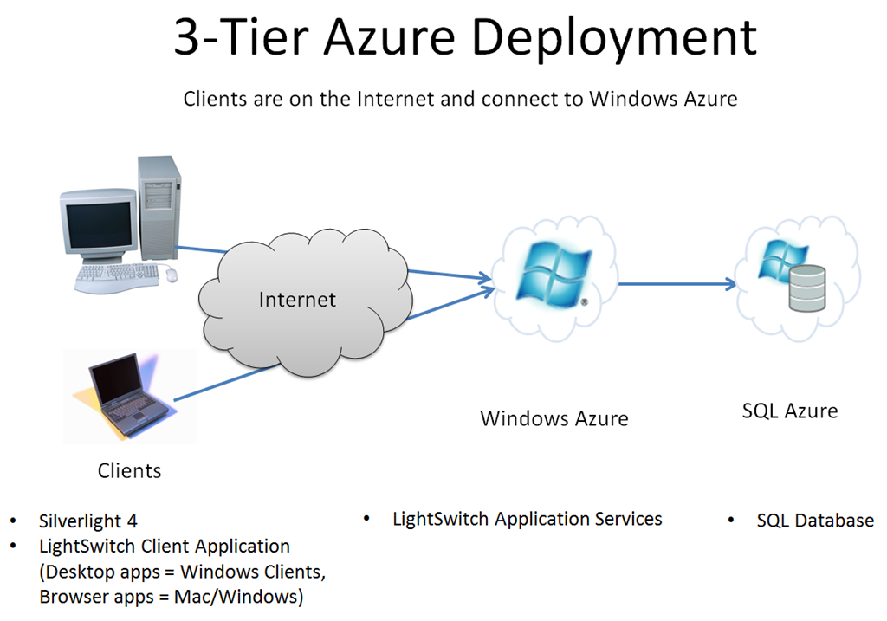
img src: http://blogs.msdn.com/b/bethmassi/archive/2011/03/23/deployment-guide-how-to-configure-a-web-server-to-host-lightswitch-applications.aspx

Slide 14
Deployment Topologies
3 Tier
IIS
Windows Azure
2 Tier

Slide 15
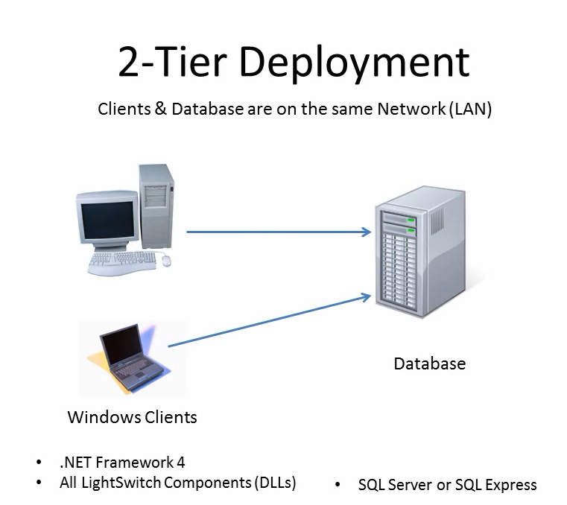
img taken from video (http://msdn.microsoft.com/en-us/lightswitch/gg274326)

Slide 16
Deployment Scenarios
Desktop App
Web App
2-Tier
3-Tier (IIS)
3-Tier (Windows Azure)

Slide 17
Demo
Browser App with 3 Tier (IIS)

Slide 18

FYI, erudeye Hosting now is supporting LightSwitch.
Thank You

