Slide 1
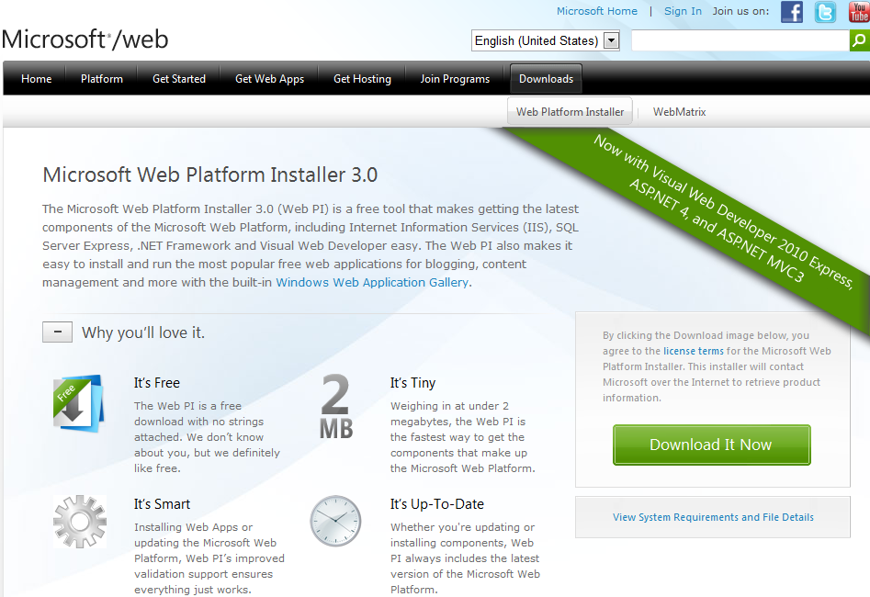
Notes:
Dari Windows Server 2008 R2 fresh installation. Install WPI.

Slide 2
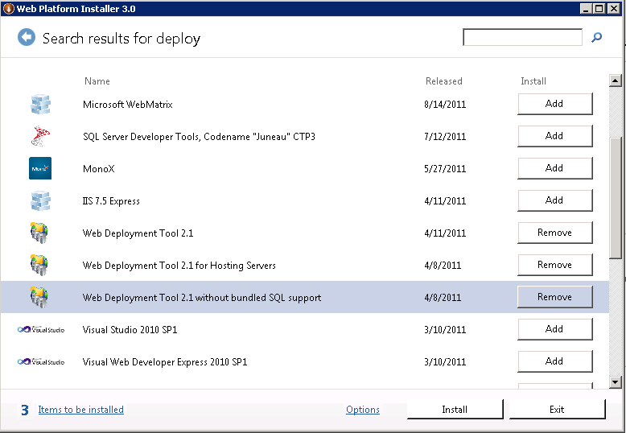
Notes:
Install 3 Web Deploy di atas lalu install IIS 7 Recommended Configuration.

Slide 3
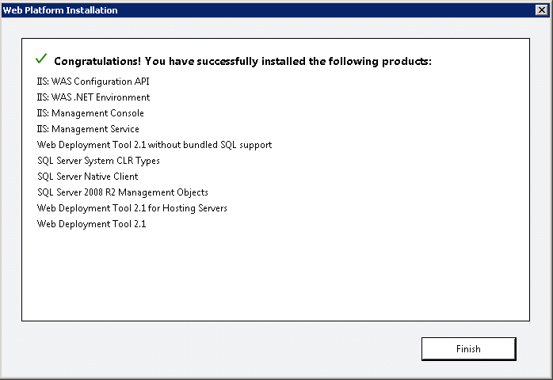

Slide 4
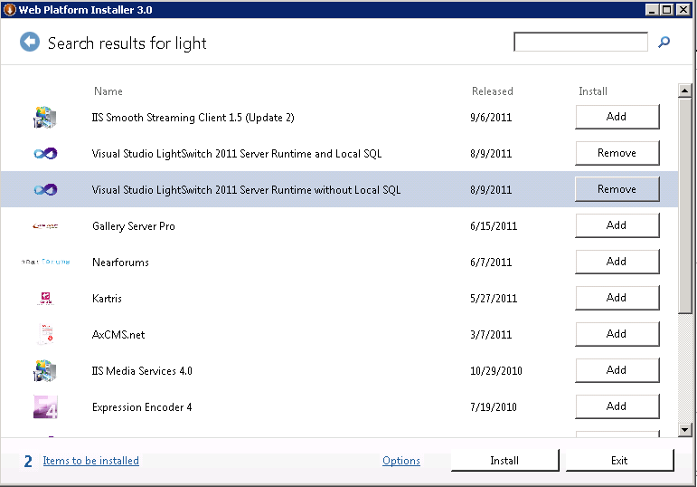
Notes:
Install LS Server Runtime baik dg Local SQL ataupun tidak.

Slide 5
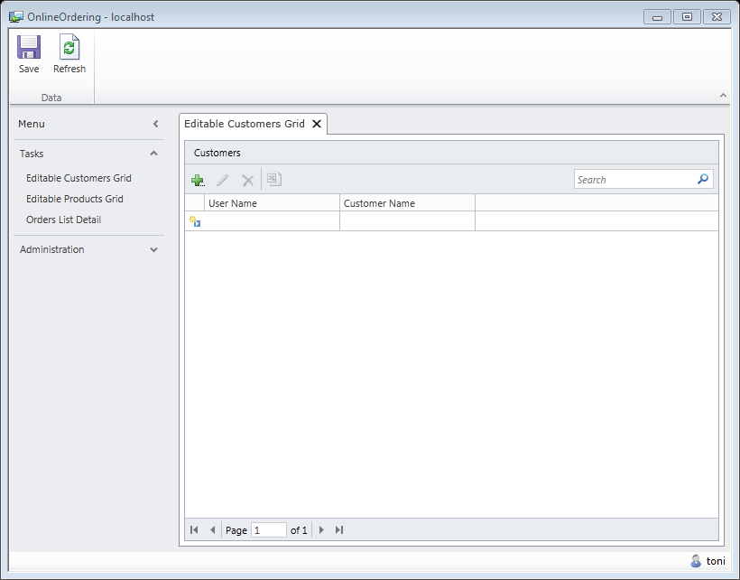
LightSwitch Application Type (Desktop App)

Slide 6
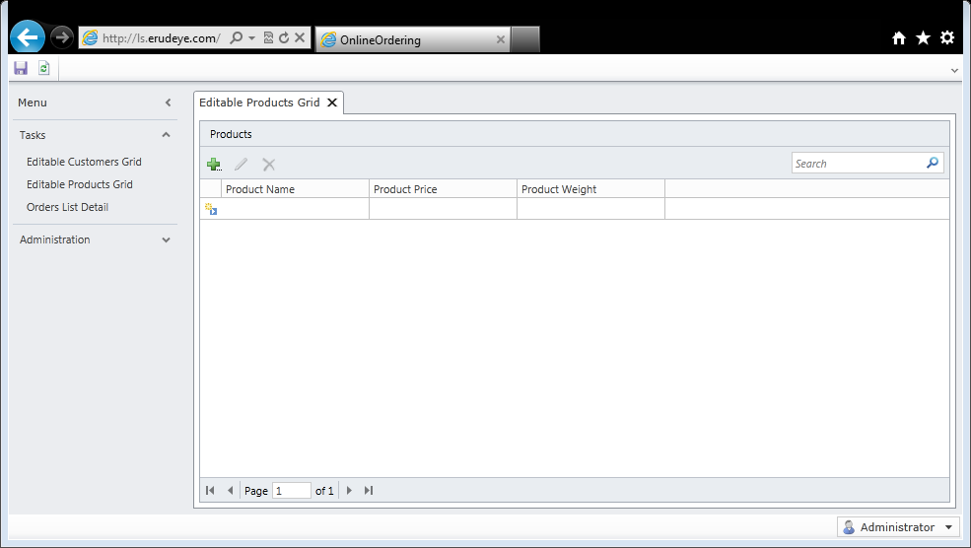
LightSwitch Application Type (Web App)

Slide 7
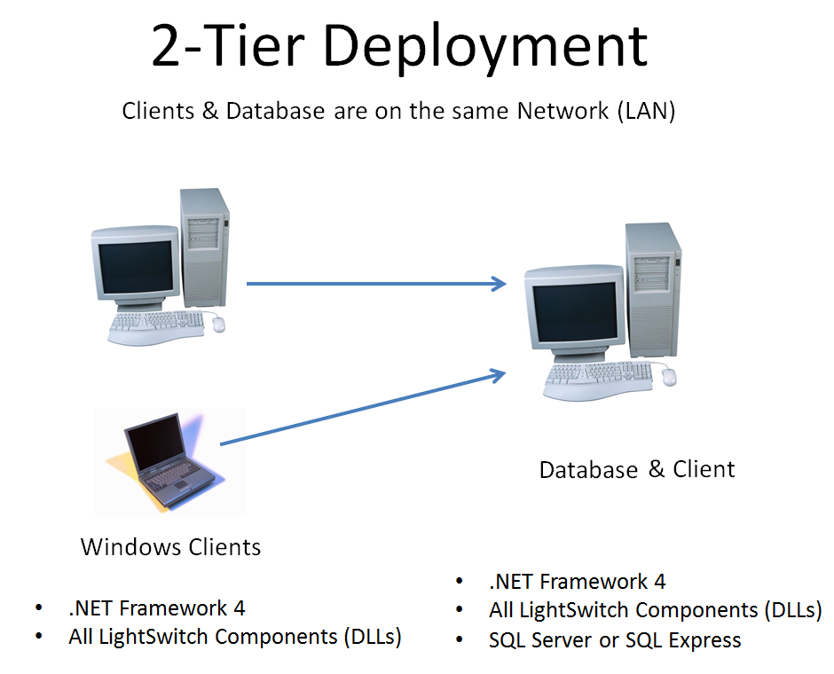

Slide 8
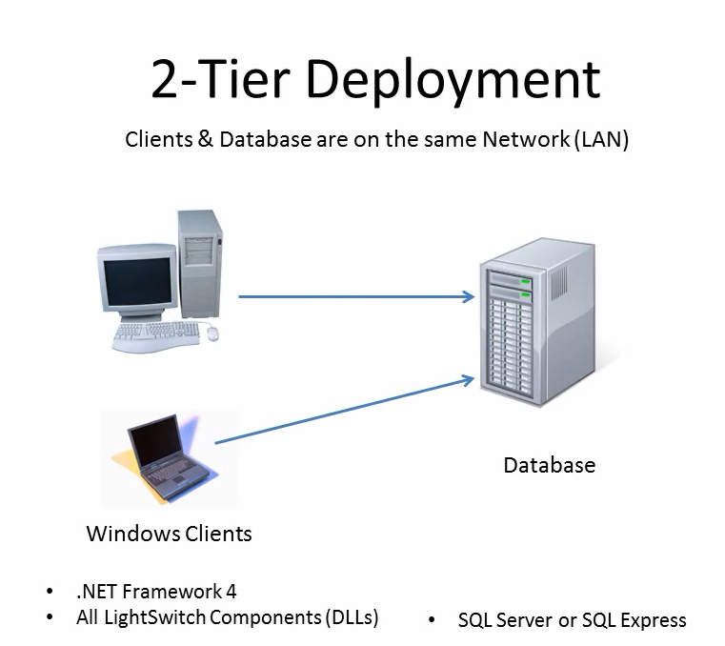

Slide 9

img src: http://static.smartpassiveincome.com/wp-content/uploads/2010/01/blog-profit.jpg

