Slide 1


Puzzle Solving / Mystery Solving
Audio-Based Game
Ionatan Gancea

Slide 2

Aim of the project

Slide 3

Main idea
A puzzle solving / mystery game
The goal is to find all the clues and solve the mystery
The player will interact with the objects around him as the story goes on.

Slide 4
Secondary targets of the project
The possibility for the game to be played without access to the SoV system
The possibility of creating a different (harder) story with limited changes inside the project

Slide 5
Assumptions or limitations

Slide 6
How are the objects represented?
All the items (rooms / objects / actions) are represented as a tree.
For example, a room has all the objects from that room as children.
An object, has all the actions possible for that object as children.

Slide 7
Interaction of the player
In a nutshell, the player is iterating through the children of the current item
Example: Let’s say that the player is in a room called Library. At the beginning, a narrative description will present him the room, with the objects in it
Then, after the description is finished, using the arrows he will select with what object to interact (he is iterating through the objects in that room)
Using the enter key, he will select the desired object

Slide 8
Interaction of the player (2)
Then the same story goes for the actions he can do at the chosen object. He will iterate through the actions and he will select one with the return key
Using the backspace key, the player can return to the center of the room, and restart iterating through the objects from that room
Doing so, the interaction of the player can become very natural and he will focus on the task (story). Basically is like exploring a list of lists

Slide 9
Playing with The SoV System
The difference in playing with the Sound of Vision System is that the player will NOT iterate through the objects in a room.
He will ONLY iterate through the actions for that specific object (when he is inside it’s proximity).
That is because the room will be represented in virtual reality, and the player will have the possibility to find the object by exploring the virtual environment.

Slide 10
Mind map
The game is audio-based so listening to the story is a key factor.
As the rooms are described, the player will have to imagine them in his mind.
Because the story is the bond between the rooms and the objects, remembering the objects shouldn’t represent a problem.

Slide 11
Progress of the work

Slide 12
What parts are finished?
A general way to add the items into the tree. The objects are imported from a JSON file.
The detailed (written) story and how the objects should interact.
A demo with placeholder sounds that demonstrates the interaction of the player.
The possibility to walk through the rooms (if the doors are unlocked).

Slide 13
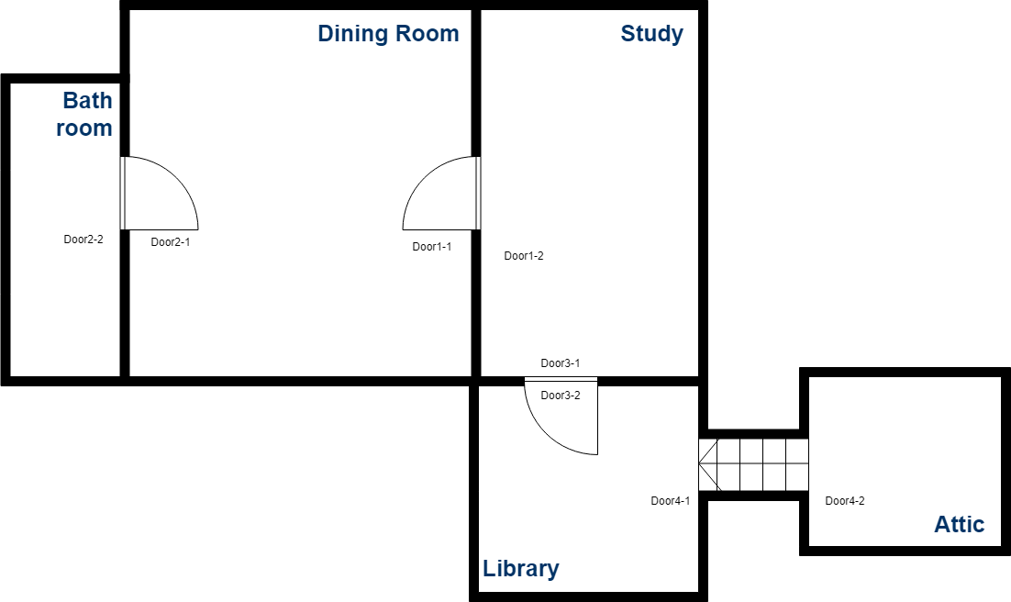
The network of rooms and the tree of items

Slide 14
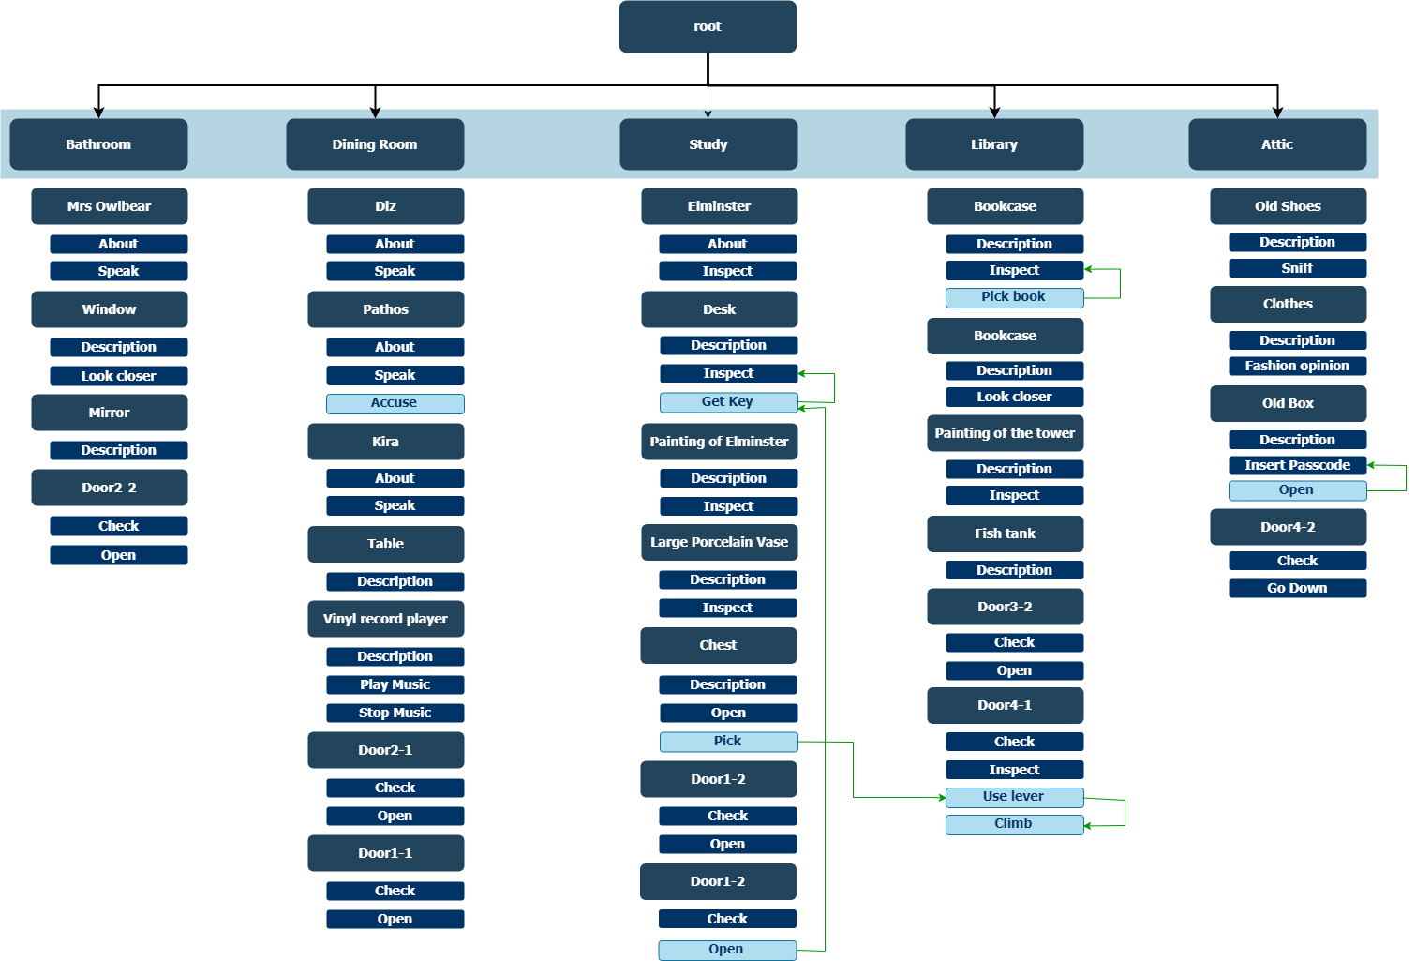

Slide 15

Worth mentioning
Some actions are not visible from the start. For example, to unlock a door, you need to find the key. Only after you find the key, the option to open the door is available.

Slide 16
Next steps

Slide 17
Solve some bugs
We’ve experienced some bugs with the keyboard input when iterating through the list of children
Disable the user input when a voice description is currently playing.

Slide 18
Replace the placeholder sounds
I have to record the narrative descriptions and replace the placeholder sounds.
Also, I have to record results of some other interactions.

Slide 19
Cherry on the top
Enhance the gameplay with background music and more effects for actions.
Implement the behavior of some special objects (inserting a passcode)

Slide 20
Demo

Slide 21


Special thanks to
Gabriel Ivanica
Rúnar Unnþórsson
Alin Moldoveanu
Anca Morar

