Slide 1
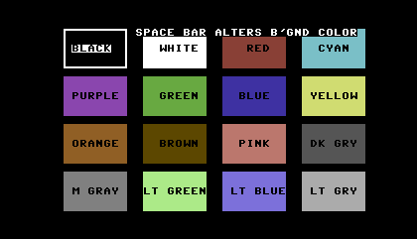
Blue background shows through transparent text box
http://style64.org/c64-truetype
1234567890123456789012345678901234567890
00 00 00 FF FF FF 68 37 2B 70 A4 B2 6F 3D 86 58 8D 43 35 28 79 B8 C7 6F 6F 4F 25 43 39 00 9A 67 59 44 44 44 6C 6C 6C 9A D2 84
6C 5E B5 95 95 95

Slide 2
1234567890123456789012345678901234567890
Opaque text box
3
4
5
6
7
8
9
10
11
12
13
14
15
16
17
18
19
20
21
22
23
24

Slide 3
**** COMMODORE 64 BASIC V2 ****
64K RAM SYSTEM 38911 BASIC BYTES FREE
READY
@

