Slide 1
Outline
Introduction to the Project
Data Analysis
Missing Data and Corrupted Data
Data Screening
Model Construction
Optimization
Conclusion
Q&A

Slide 2
INTRODUCTION
1
Let’s start with the first set of slides

Slide 3
Project Objective
Select 2 assets (long one and short the other) and try to find the corresponding weights.
The given portfolio has high loss on four days with tail events*. Our new portfolio must produce at least 8 times profits of the given portfolio loss on the tail events.
Our ultimate goal is to minimize the absolute value of the correlation between our new portfolio and the given portfolio.
(Math Setup Version in appendix.)
*Four days with tail events: Feb 2, Feb 5, Feb 8, Mar 22

Slide 4
DATA EXPLORATORY
2

Slide 5
Missing Data and Corrupted Data
Experimented with several imputation methods
Linear Interpolation
KNN
EM
Simple Linear Regression
Multivariate Linear Regression
24.7% Missing Data
Including one tail event (Feb 5th)
4% Corrupted Data
Corrupted Data is detected as laying outside of 2*standard deviation from the mean

Slide 6
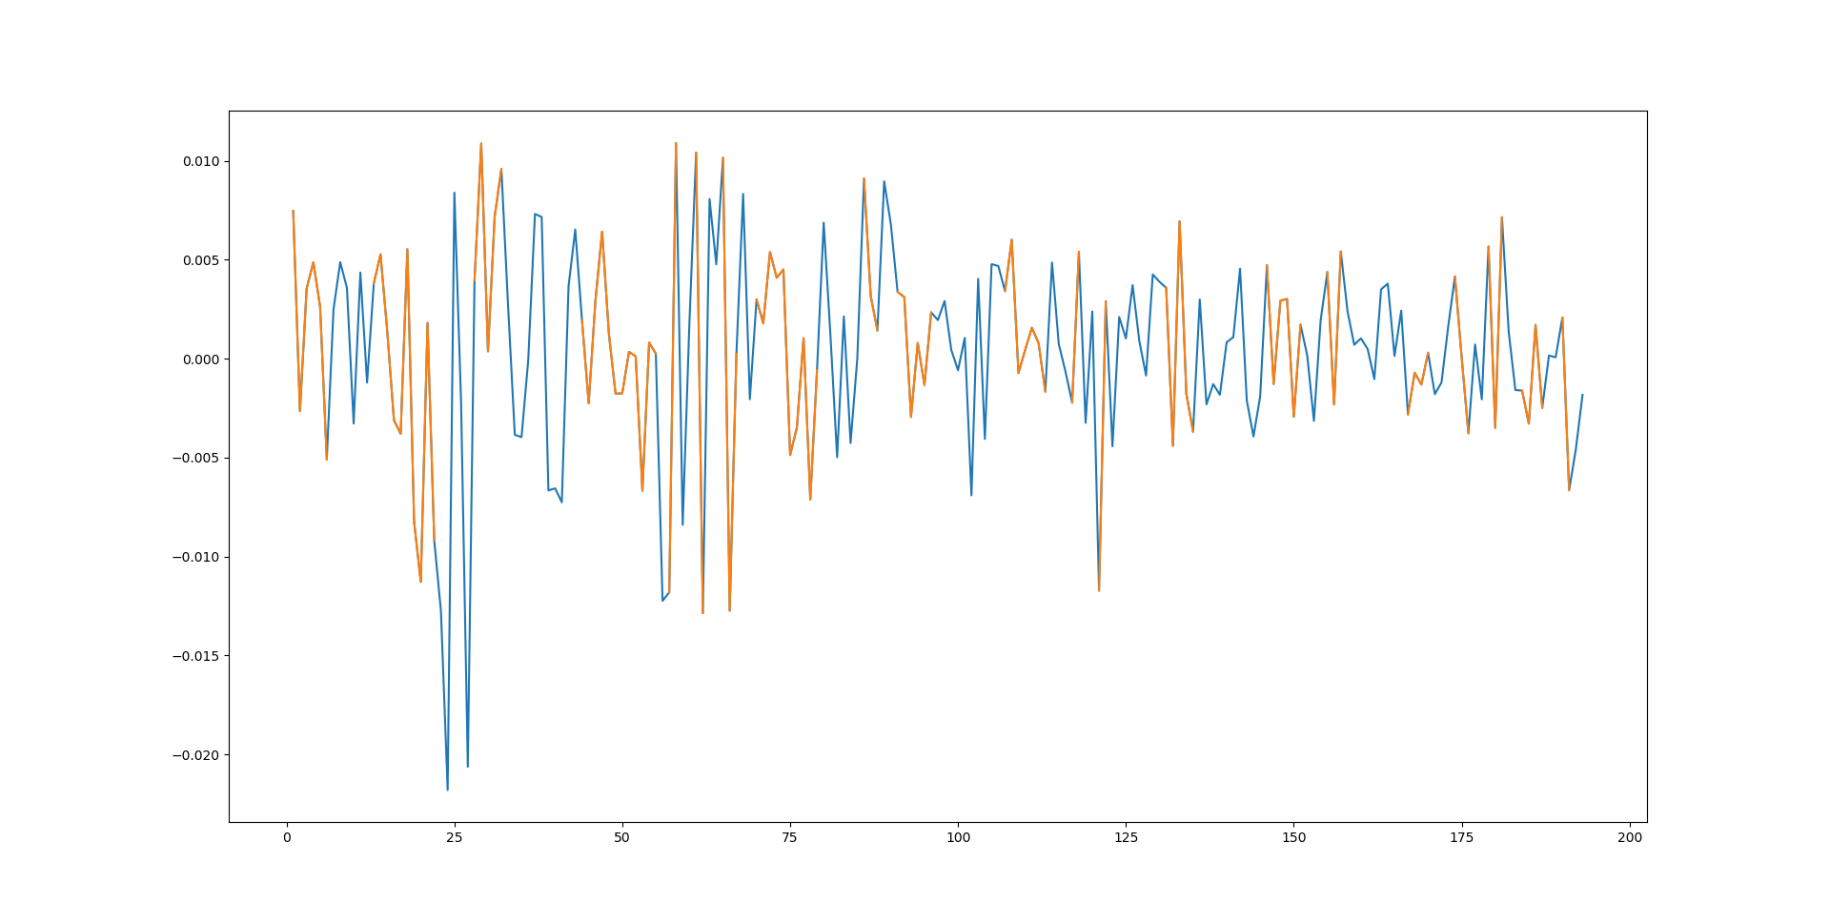
Portfolio Returns after Imputation
Equity Utility FI REIT Commodity

Slide 7
Data Screening
Obtained all stock tickers tradable on TSX and TSXV
Pulled close price and volume from Yahoo Finance for each of these stocks,
Calculated and summed up returns on the tail events and ranked the stocks accordingly; picked the worst performers to our short list and the best performers to the long list
Download data and looped through our model and ranked the combination performances.

Slide 8
Model Construction
3
Let’s start with the third set of slides

Slide 9
Data Screening
HUV is always in our long position.
Short List top performers (paired with HUV):
Utilities Sector: DXI.TO, EFL.TO, CQE.TO
Useless because of liquidity problem
Biology Sector: PLI.TO, ACB.TO
ACB.TO useless because it is from TSXV (Ventures)
We screened through all the utilities sector and biology sector
Final Result: Short 1 unit NCVN.TO, Long 0.95 unit HUV.TO

Slide 10
Model Construction
This is an optimization problem with constraints (inequality).
We started with Sequential quadratic programming (SQP), an iterative method for constrained nonlinear optimization.
(python function: scipy.minimize(method = ‘SLSQP’)
Problem Encountered: the weights result from Scipy.minimize does not guarantee the constraints satisfied. 😒
We finalized with COBYLA (one of the linear programming method)

Slide 11
OUR PROCESS
first
second
third
last
Set up constraints.
Weights bounds
Tail events
Solve for the weights that Constrained Optimization by Linear Approximation (COBYLA) algorithm.
Loop through the Short List and Long List to form multiple combinations for portfolio.
Evaluate results.
Check whether the constraints are truly satisfied.

Slide 12
Analysis and Conclusion
4

Slide 13
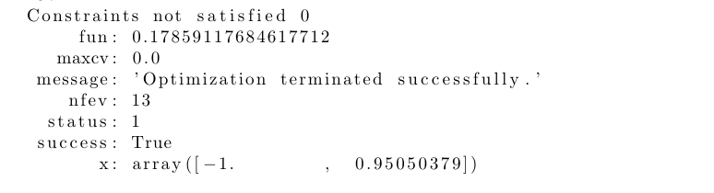
Result

Slide 14
Possible Further Improvement
With more detailed information about the portfolio, ie. the detailed constitution of each parts of the portfolio, we can possibly to fix the missing value problem in a more appropriate and accurate way, which would then result in a better hedging portfolio.
We can expand our pool of potential assets to worldwide rather than only focused on the Canadian market (for both long and short positions).
Use more automation for data collection.

Slide 15
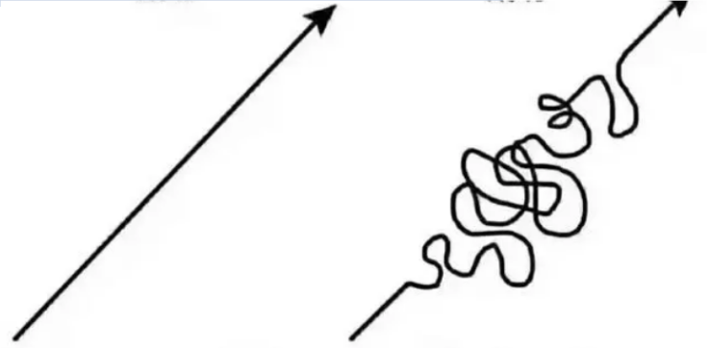
Q&A
If the data is clean and complete
Actual Data

Slide 16
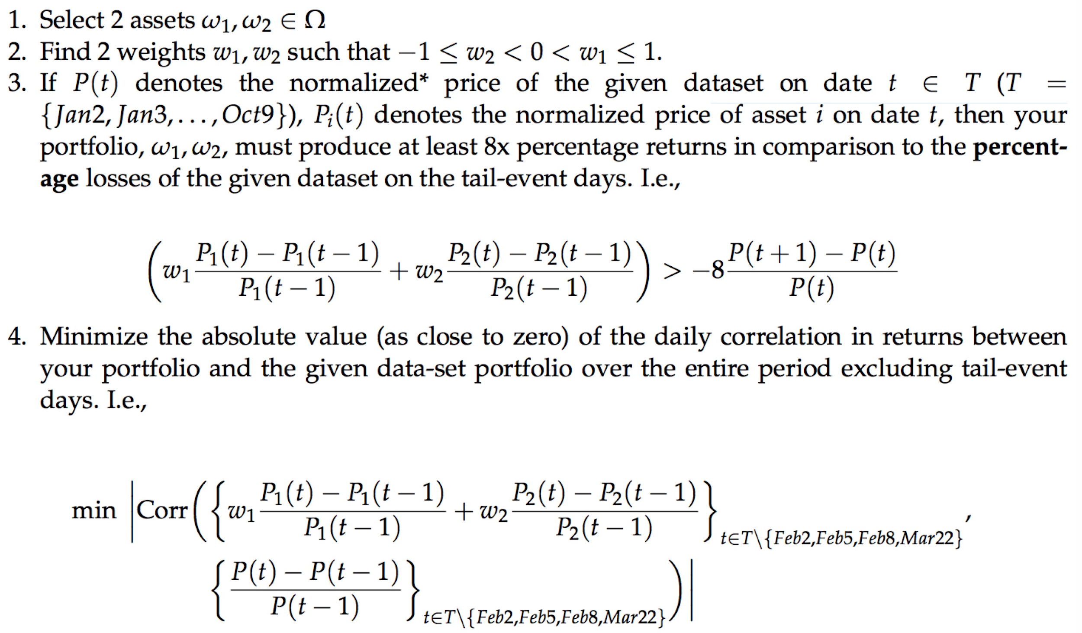
Appendix:Model Setup

Slide 17
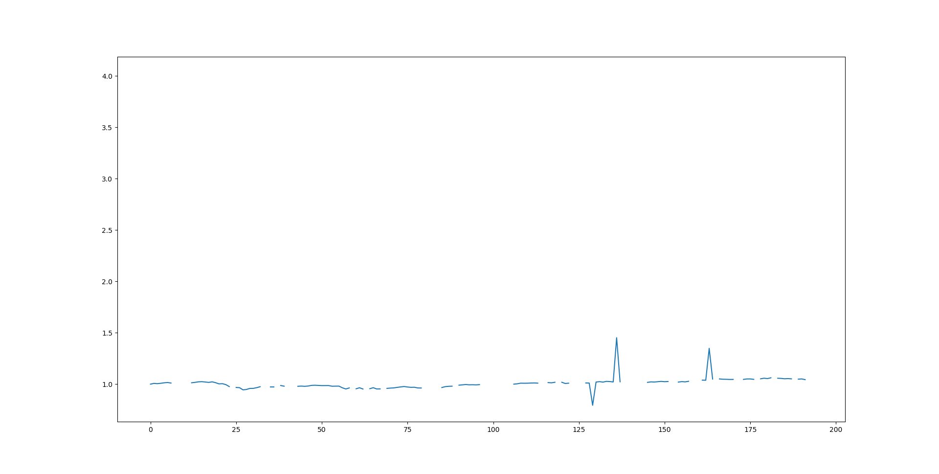
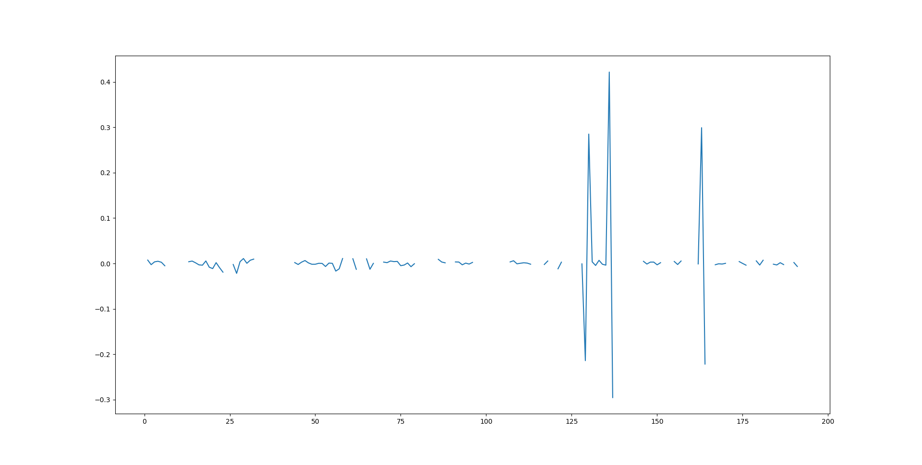
Data Observation
24.7% Missing Data
4% Corrupted Data
Corrupted Data is detected as laying outside of 2*standard deviation from the mean

Slide 18
Conclusion
Long 0.95050379 units of VIX (HUV.TO) and Short 1 unit of NVCN.TO

