Slide 1
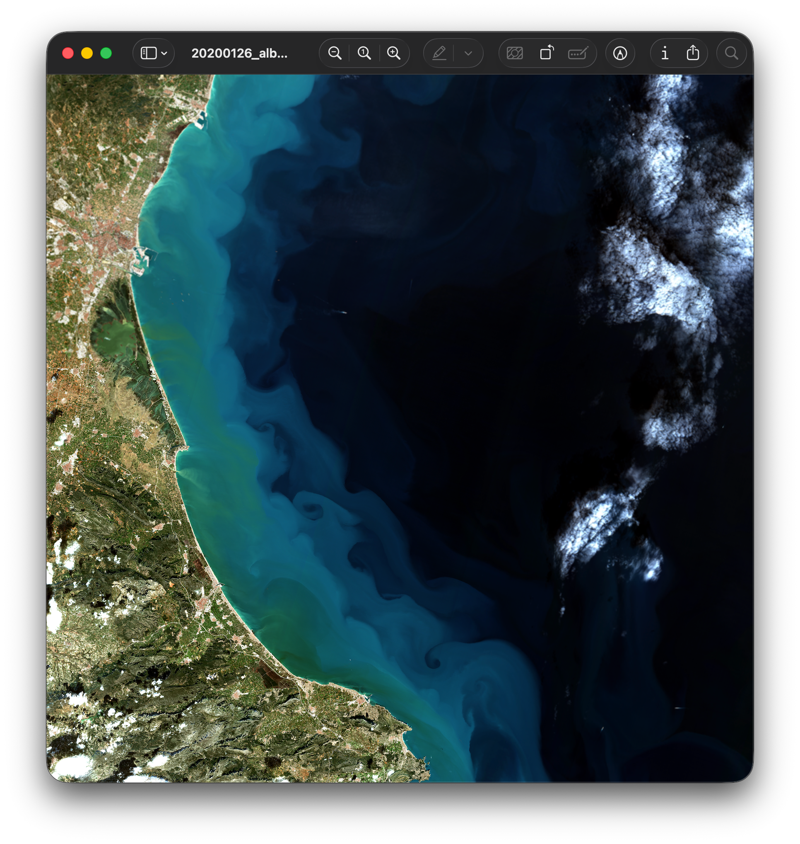

Monitoring the wellbeing of your local water body

Slide 2
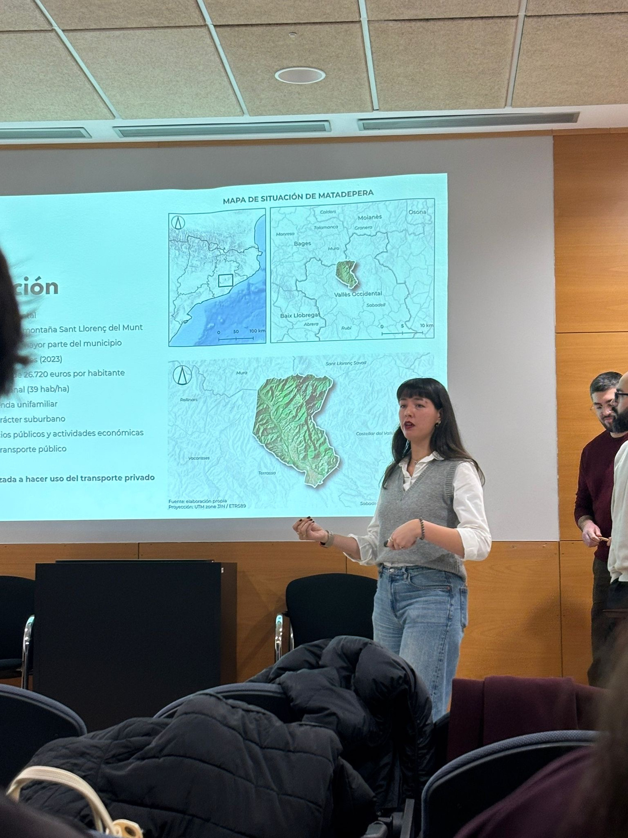
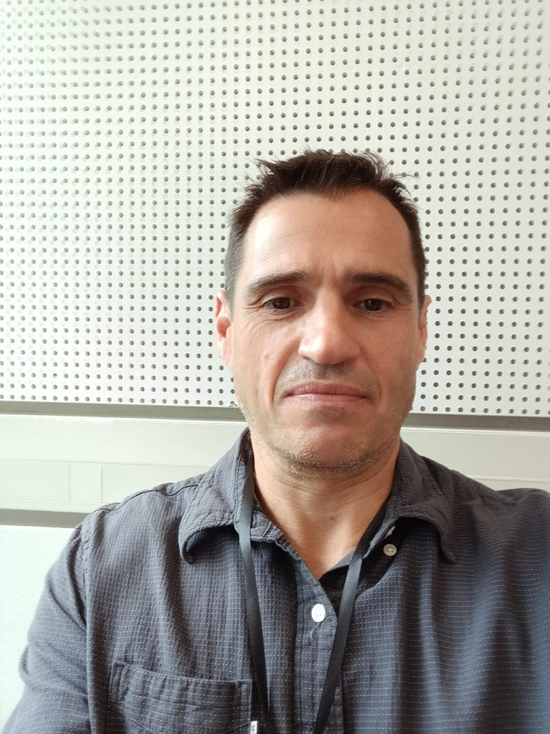
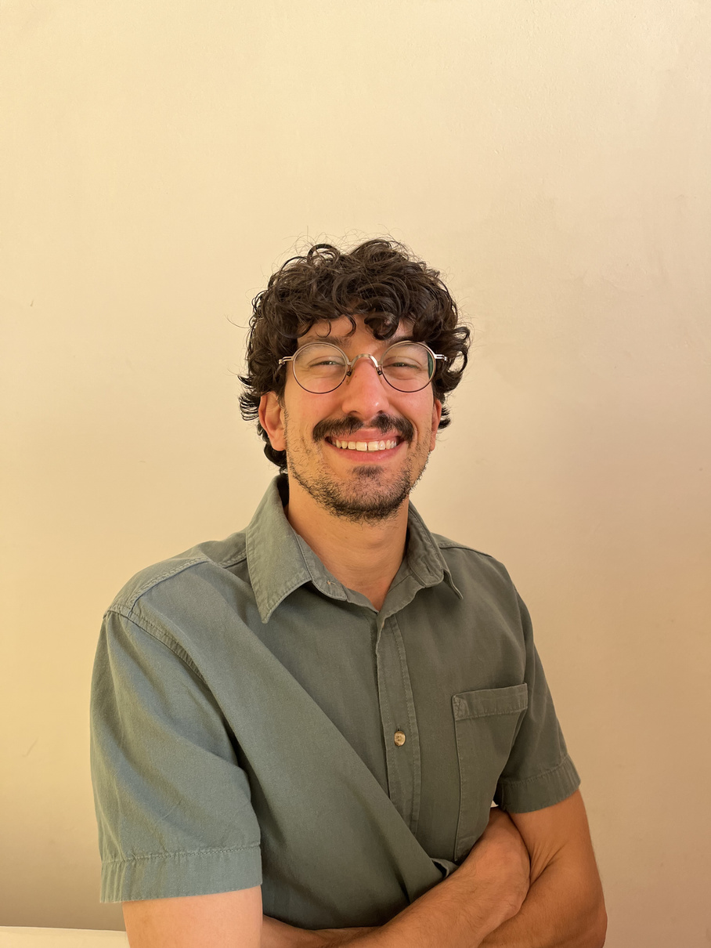


WHO ARE WE?
Ameneh Alcalá
Antonio López
Ivan Pantaleoni
Urban planner
Researcher
GIS expert
ameneh-alcala
Full stack developer
Data Science
GIS expert
tonilogar
Geologist
Earth Observation expert
GIS expert
ivan-pcm

Slide 3
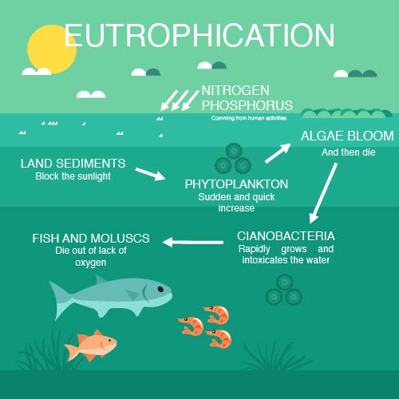
PROBLEM
Ecosystem destruction
Potable water contaminated
Fishing compromised
Tourism compromised
Thousands of people, flora and fauna affected daily all around the globe

Slide 4
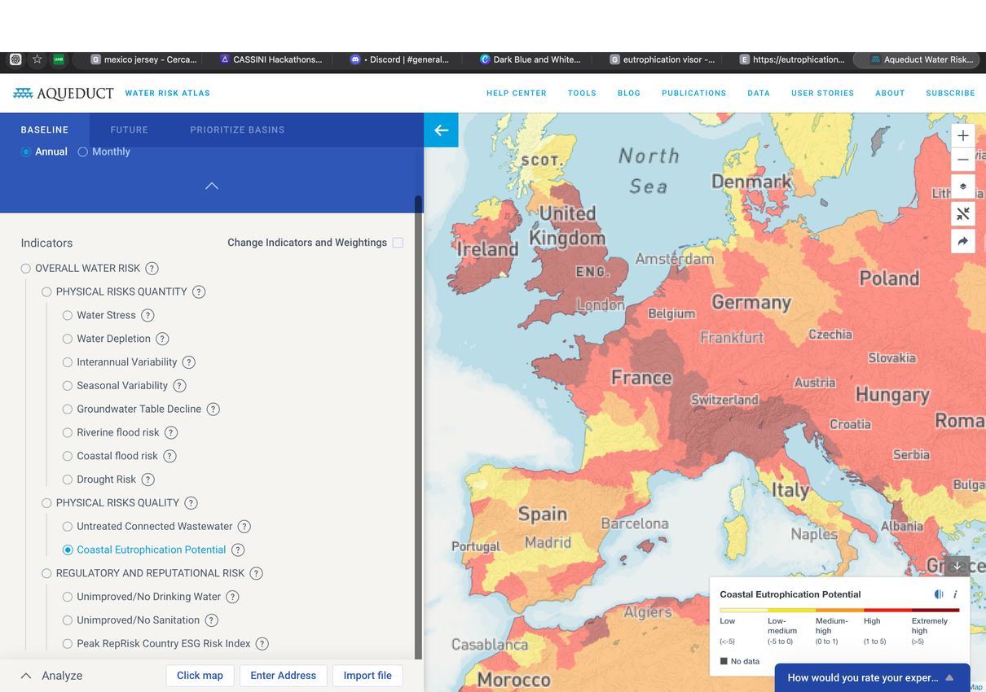
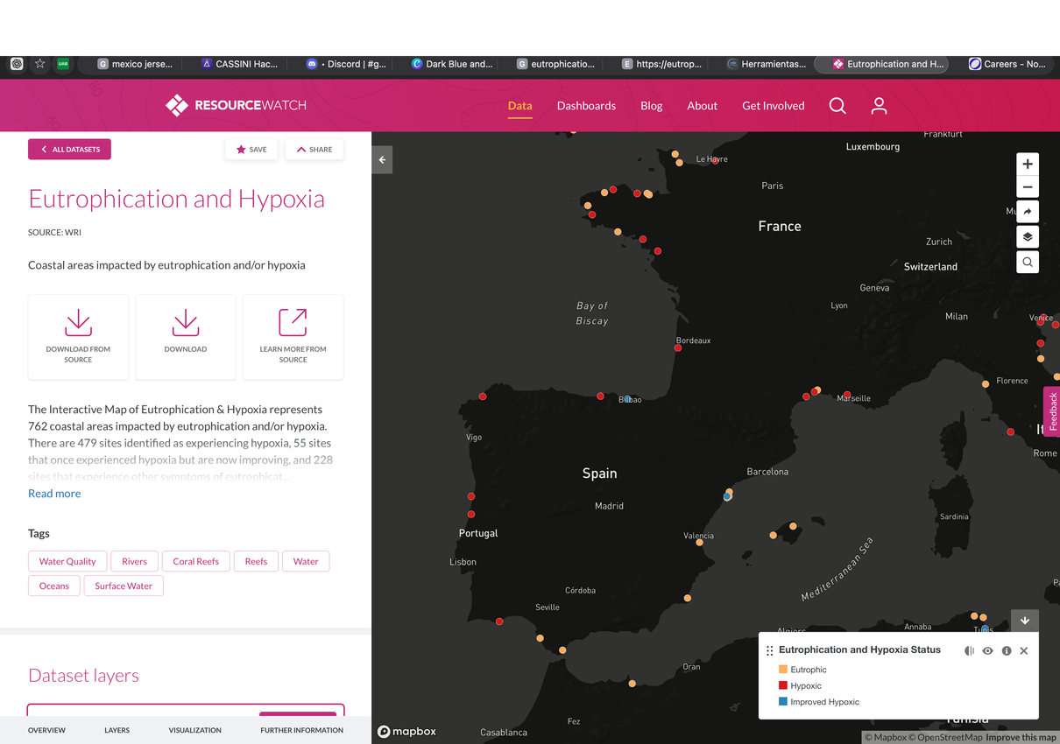
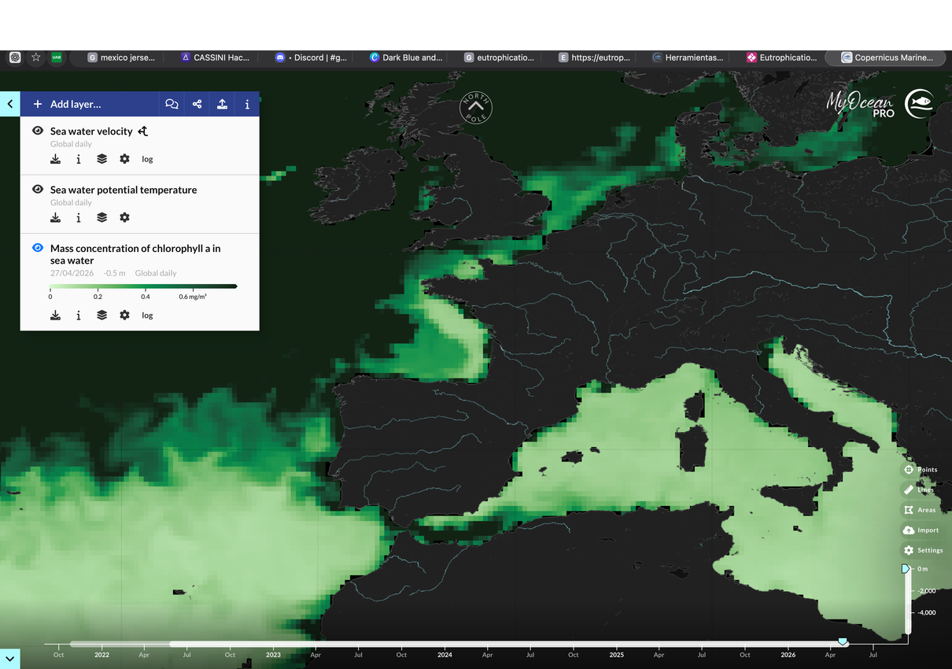
NO CONSTANT DATA
Data published but not updated constantly to see developments
WHAT’S IN THE MARKET
NO PUNCTUAL DATA
General data of the region
Data of specific regions of interest
NO NOTICE OF DAMAGE
Situations can get worse without anyone noticing

Slide 5


WE HAVE
THE SOLUTION
ANYWHERE IN THE WORLD
Worldwide data
RAPID RESPONSE MONITORING
With new images every 5 days
HIGH PRECISION
No more general data, but detailed information
ALERT SYSTEM
For interested entities

Slide 6
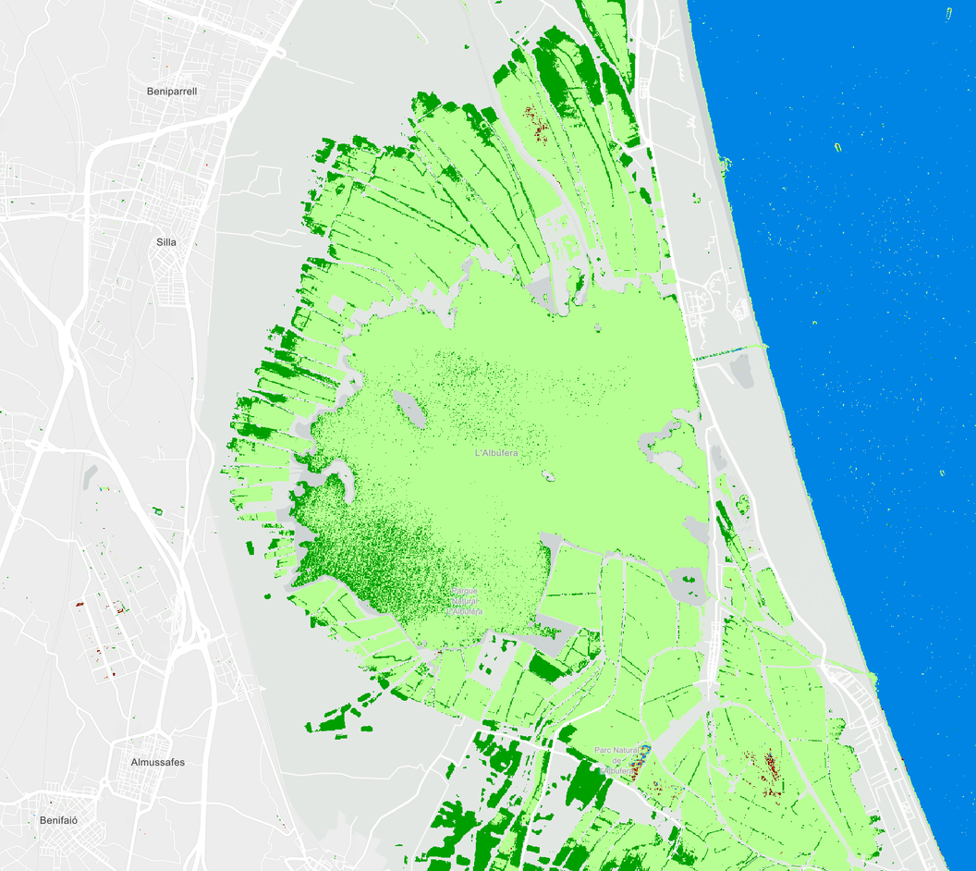
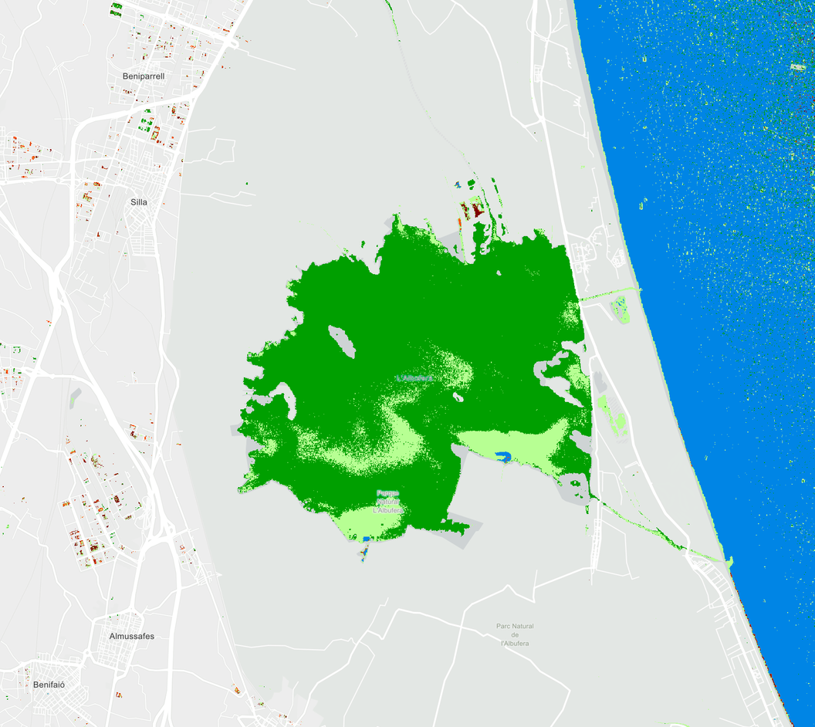
L’Albufera - November 30, 2024 (post flood)
L’Albufera - April 19, 2026 (10 days ago)
No anomalies
Sediments/turbidity
High clorophile
Algae bloom
Other anomalities

Slide 7
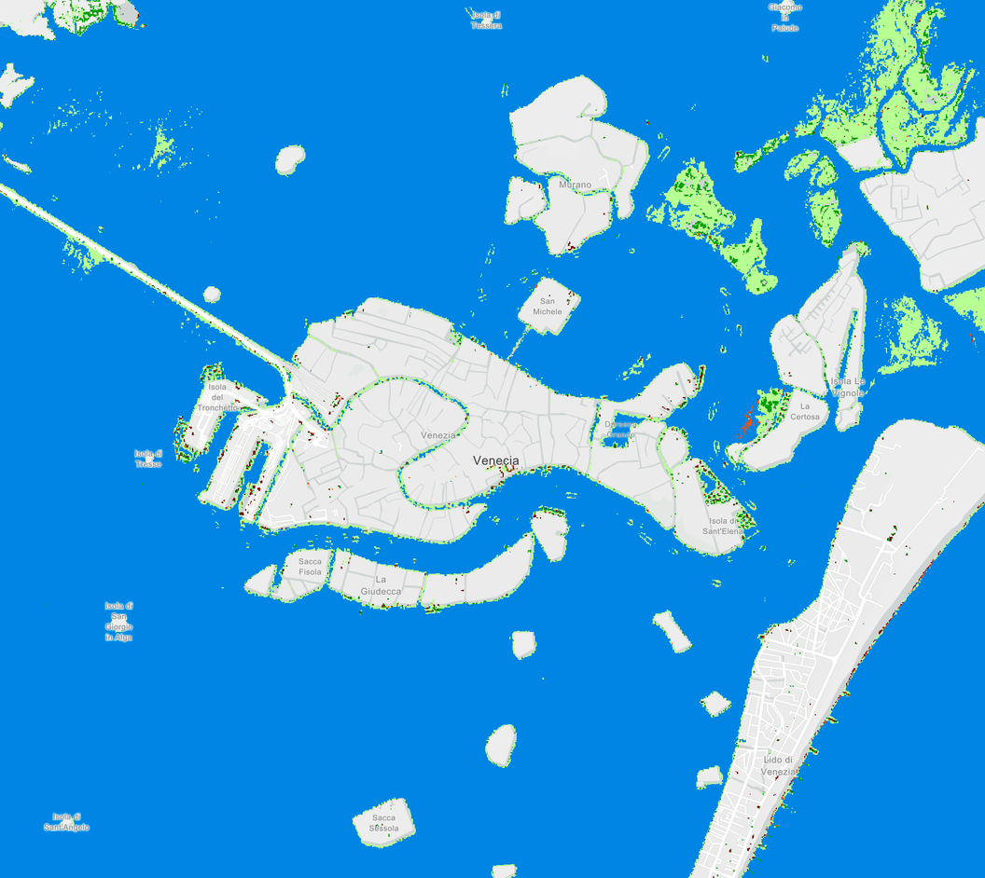
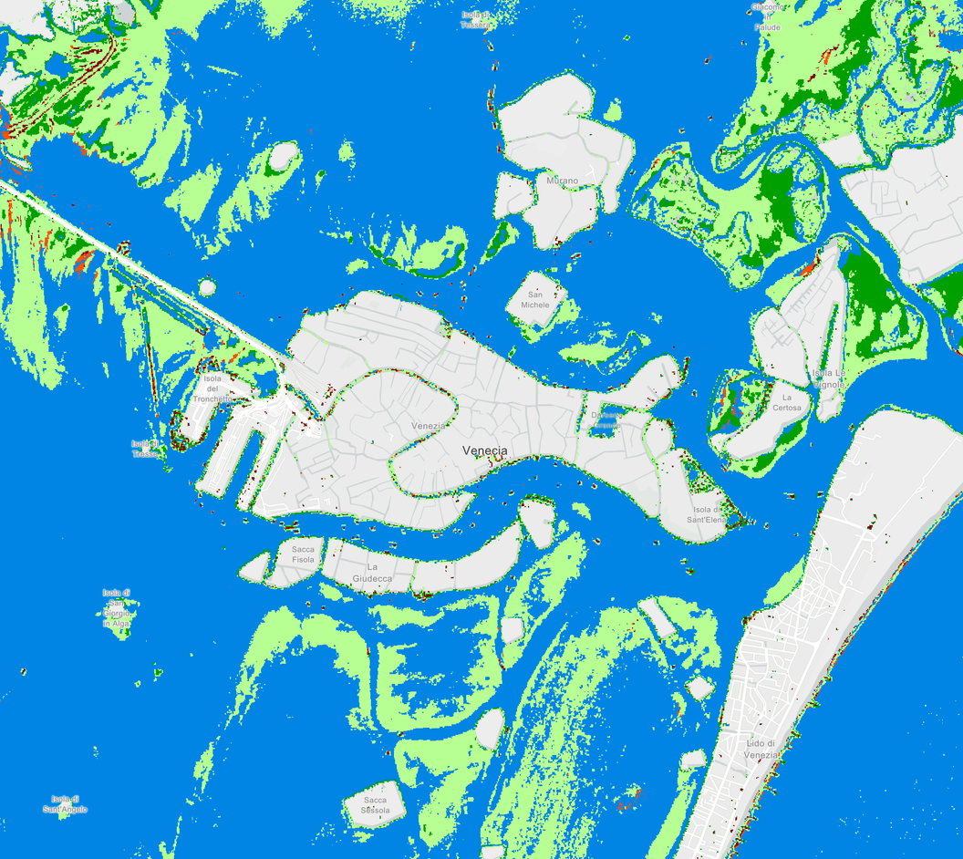

Venice - November 10, 2019 (during the inundation)
Venice - April 26, 2026 (this week)
No anomalies
Sediments/turbidity
High clorophile
Algae bloom
Other anomalities

Slide 8
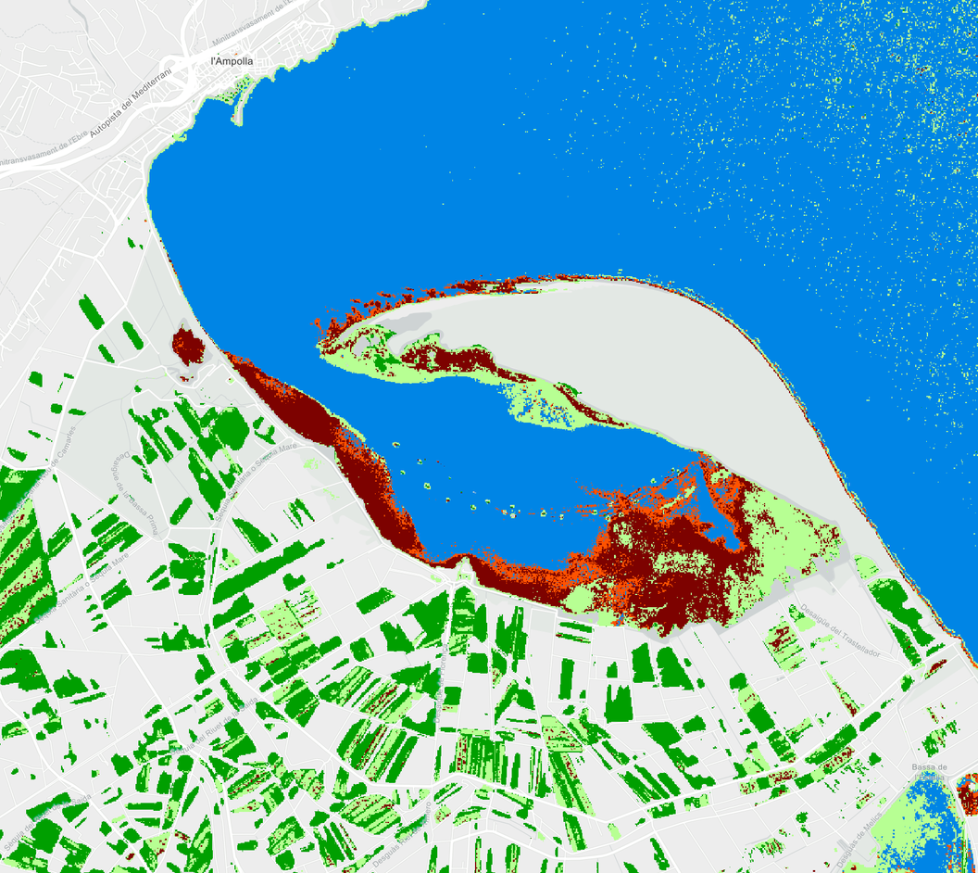
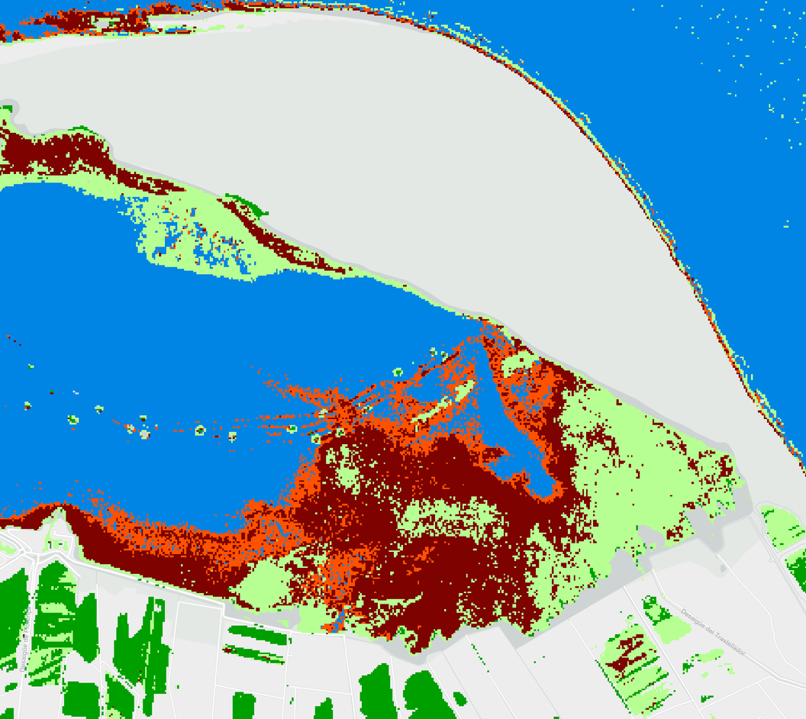
Vall dell’Ebre - November 22, 2025
Vall dell’Ebre - November 22, 2025
No anomalies
Sediments/turbidity
High clorophile
Algae bloom
Other anomalities

Slide 9

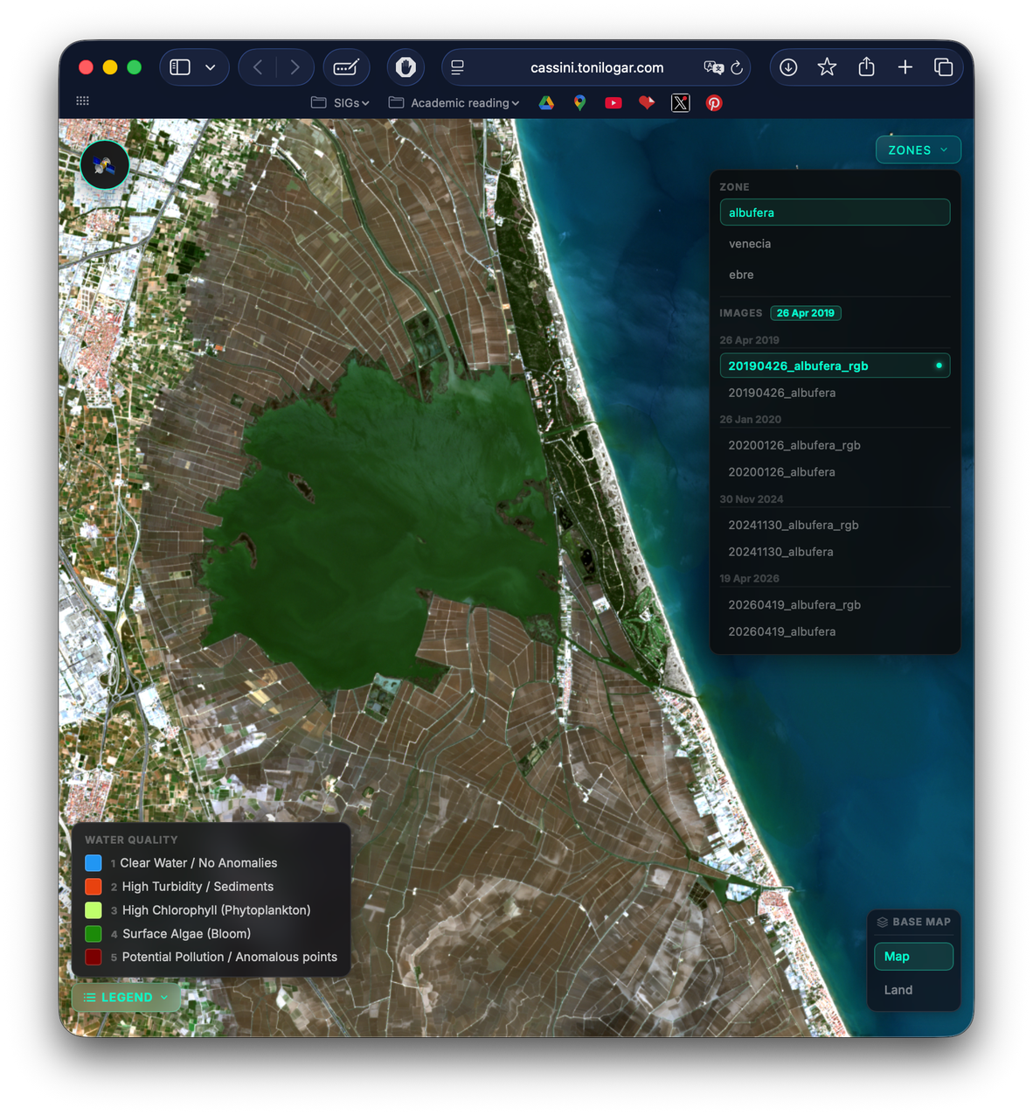
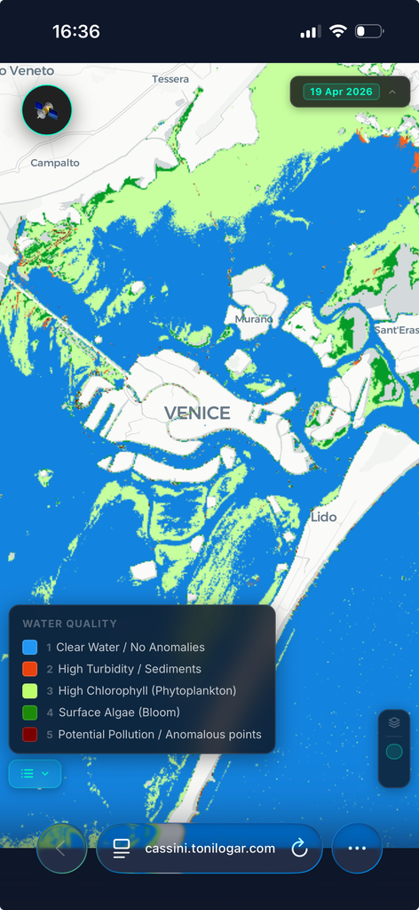
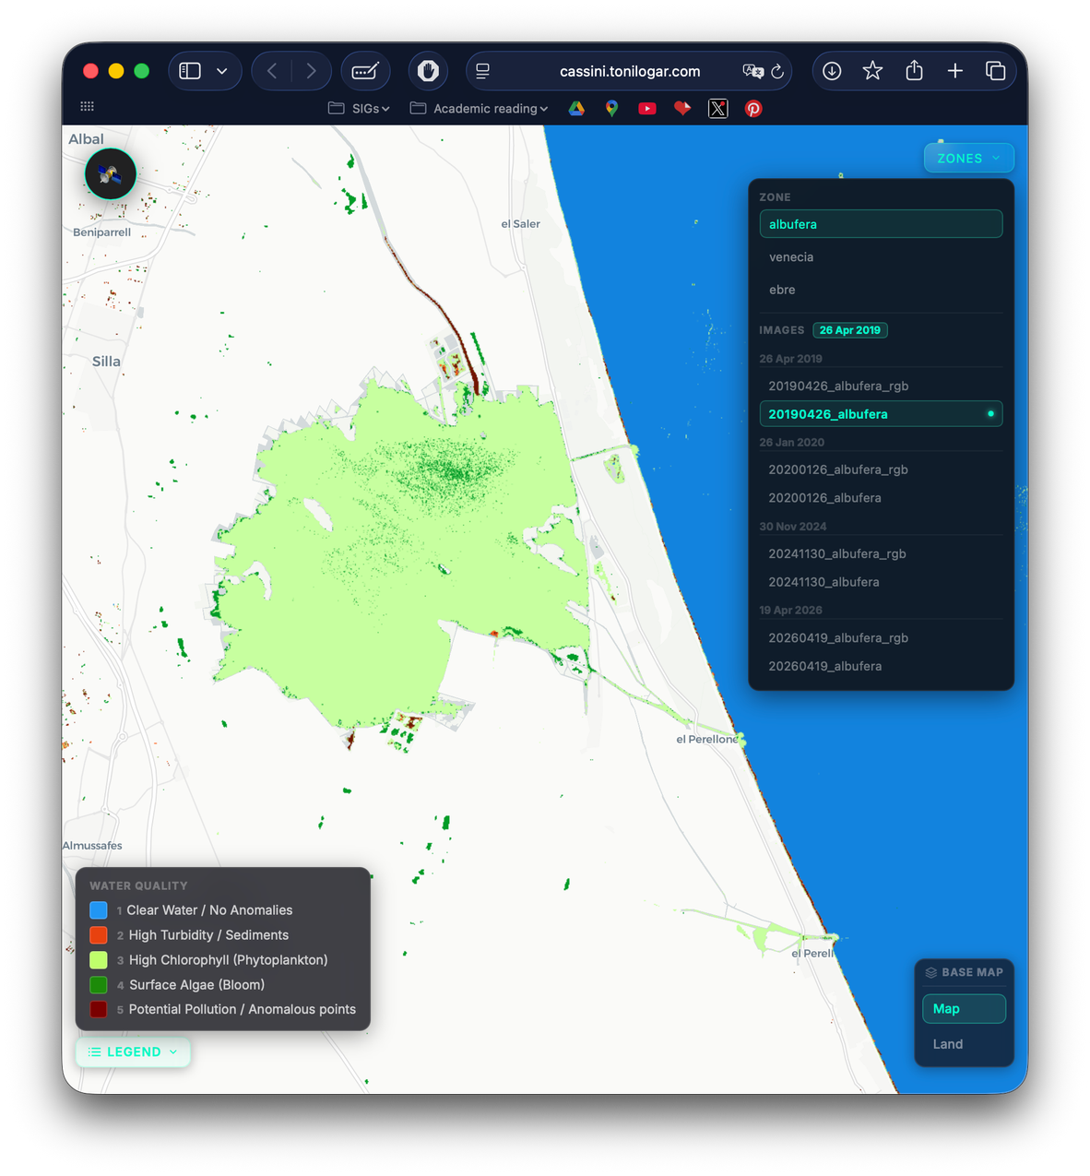

Slide 10

WHAT MAKES US DIFFERENT
ACCESIBLE
CONSTANT
SCALABLE
PREMIUM
PREMIUM
PREMIUM
Anyone
Anytime
Anywhere

Slide 11
WHAT MAKES US DIFFERENT
ACCESIBLE
CONSTANT
SCALABLE
PREMIUM
PREMIUM
PREMIUM
Anyone
Anytime
Anywhere
LOOK FORWARD TO THE FUTURE
RAPID RESPONSE
INFORMATION
NOTIFICATIONS
PREMIUM
PREMIUM
PREMIUM
Instant alerts
Fast results
Download processed data

Slide 12
EARLY BIRD
MONTHLY SUBSCRIPTION PLAN
Pixel Lab | Pixel Core | Pixel Insight
✔ High quality data visualization | ✔ High quality data visualization | ✔ High quality data visualization
✔ Selected areas | ✔ Up to 50 km2 | ✔ Up to 100 km2
✔ Limited history access (3 months) | ✔ Limited history access (6 months) | ✔ Unlimited history access
✘ No alert system | ✔ Basic anomalies alert | ✔ Advanced anomalies alerts with personalized reports
✘ Download processed data | ✔ Download processed data in TIFF | ✔ Download processed data and statistics in CSV or TIFF
✘ No access to API | ✔ Access to API with extra cost | ✔ Access to API
FREE
29€
199€
Need more?
1€/km2
Need more?
0,8€/km2

Slide 13



TRY IT OUT!
AND LET’S CONNECT
ameneh-alcala
tonilogar
ivan-pcm

