Slide 1

Central Python
Yeshua Labs

Slide 2

GUI vis a vis CLI
Sub Topics
Navigating the file System
1
Creating and deleting a folder
2
Creating and deleting a file
3
Opening files and folders
4

Slide 3
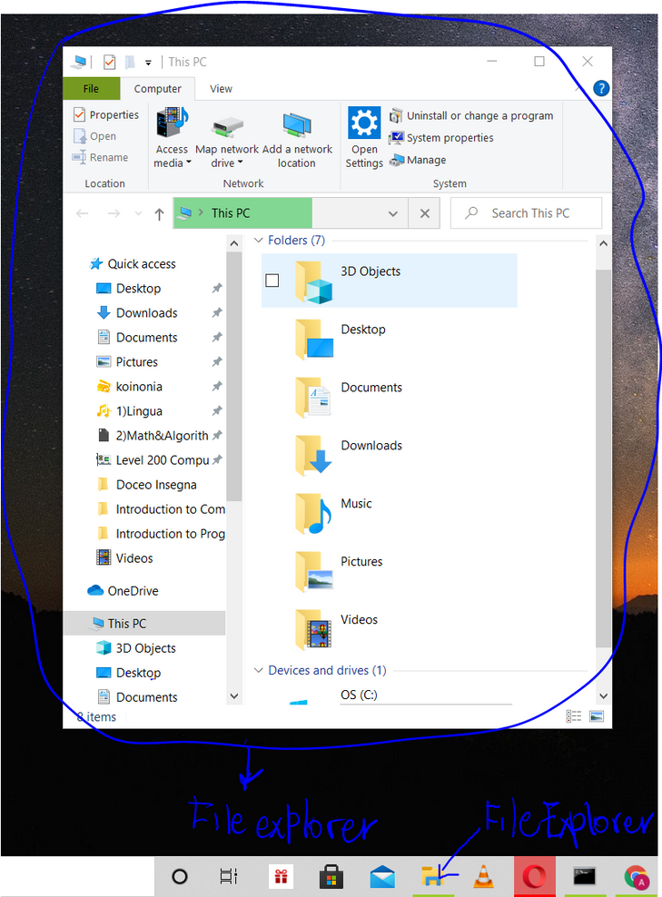
Navigating the file System
Where are you now ? In school ? at home ? You are definitely somewhere right ? And that place has a name right ? So your current location could be Obuasi , Prampram, Legon right ? Same with the file system of your operating system. At any point in time, you are at a specific location, it could be Downloads, Desktop, Documents, a folder you created in Documents but the point is you are definitely somewhere. The place you are at any point in time in the file system is your current working directory. But wait, you do know the File Explorer in windows right ? Ok, let me show you an image.

Slide 4
So that's the File Explorer. We can navigate the File System through the File Explorer. If I were to open Documents folder in the file explorer then my current working directory will be Documents right ? or let's suppose my user account's name was Paul then C:\Users\Paul\Documents will be the path of my current working directory right ?
So you have always been navigating the file system every time you were copying a movie from one folder to the other or searching for a file and etc. But you see, you did so using a GUI(Graphical User Interface).
Don't tell me you are doubting or confused on whether the File Explorer is a GUI ? Can't you click stuff ? don't you see buttons ? are you at any point in time typing in commands to achieve something ? If you are not typing commands to achieve something Then we are interfacing with something Graphical. Let's see if we can also navigate the file system using the CLI(Command Line Interface).

Slide 5
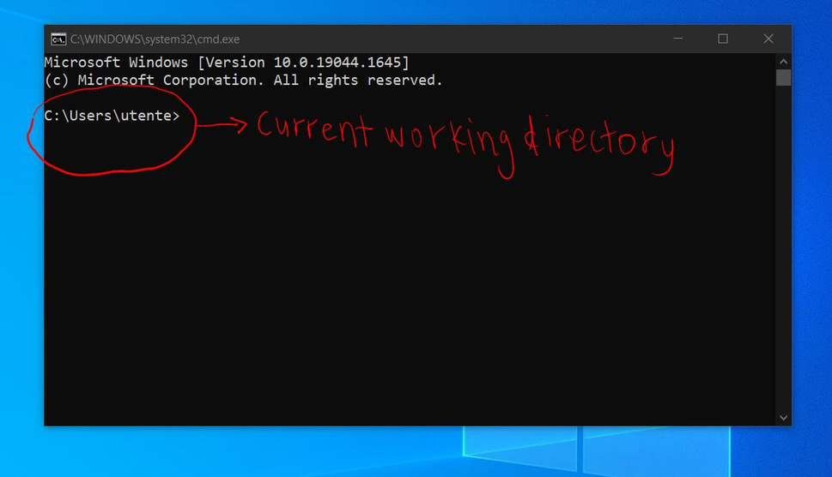
How do we access the CLI in windows ?? You can search for command prompt at the search bar or you can hold Win Key + R to open the run dialog box and type in the input field cmd.
The CLI for windows(Command Prompt) shows us our current working directory every time it's opened. In this example it's C:\Users\utente. In the file explorer, we can move from one folder to another (navigation). How do we achieve the same thing here ? I also see no buttons or icons. Do you know the definition for CLI? No? YOu should open your browser, google and check it out. We achieve this by using commands. Seriously open your browser and check it out. Now that you have checked it out, can you give 2 differences betweeen a GUI and CLI.

Slide 6
So what are the commands for navigating through file system in command prompt, well we have
cd --> Change Directory
cd .. --> Go back to the previous directory.
cd \ --> Go back to the root directory.
dir /b --> Display the files and folders in your current directory ( in the File Explorer, each and every time you opened a folder, you could see all the files and folders displayed right? We can do same on the CLI using dir/b command )
Now let's suppose we have a user account called Mintah and we have two folders in the user's desktop called New Folder 1 and New Folder 2 and inside New Folder 1 , we have a folder called Josh. Let's say in the command shell (command prompt) our current directory is C:\Users. Let's say our goal is to navigate to Josh. This is how we would get the job done.

Slide 7
cd Mintah (Press Enter)
cd Desktop (Press Enter)
cd New Folder 1 (Press Enter)
cd Josh (Press Enter)
This is how the cd command works in the CLI, we type the command cd then the name of the directory we want to move into. We could achieve all the above commands in one line.
cd Mintah\Desktop\New Folder 1\Josh
So our current working directory now will be Josh.
Now let's say we wanted to go back to t he Users folder, we would type
cd .. (Press Enter)
cd.. (Press Enter)
cd.. (Press Enter)
cd .. (Press Enter)
or we can achieve all this in one line
cd ..\..\..\..

Slide 8
And we are back to C:\Users
So there is a command for going back to the root directory. You do remember the root directory right ? The starting point of all paths ?? In Windows the root directory is C.
Wherever your current working directory is whether New Folder 1, New Folder 2, Documents, Desktop or Downloads, to go back to the root directory we type cd \, this command will send us back to the root directory which is C: no matter the location we are in the file system. Practice and build your muscle memory. Also note that after typing every command we need to press Enter for the command to run.

Slide 9
Creating and deleting a folder
Let's say your current working directory is C:\Users\Kwame\Desktop, to create a folder named kayal in the current working directory in command prompt, type md kayal. md stands for Make Directory. Now to delete or remove a directory let's say named francis in the current working directory. Type rd francis.
Can you guess what the rd stands for? ?

Slide 10
Creating and deleting a file
The echo command is used to print or output stuff on Command Prompt.
Suposed we wanted to print out Dela is a good boy to the console, we would type echo Dela is a good boy
and Dela is a good boy would be printed out or outputted in the console (command prompt).
Now let's say we wanted to create a text file ( a file with .txt extension) named energezia which contains the text Ye shall receive power, this is how we would achieve it. echo Ye shall receive power > energezia.txt
You see the file energezia.txt will be created at the current working directory and it will contain the text, Ye shall receive power. Now if we wanted to delete a file, this is the command del filename.fileExtention
Now suppose we want to delete energezia.txt, what would we type into the console ?

Slide 11
Opening files and folders
Suppose our current working directory is Desktop and we have a folder called Professor. To open the folder from the CLI using the File Explorer, we would use the command explorer i.e explorer FolderName. So if we wanted to open the folder Professor, the command will be explorer Professor. Suppose this is the path of our current working directory C:\Users\Bond\Desktop and we wanted to open the folder Desktop which is our current working directory. Now if we typed explorer Desktop, it wouldn't open our current working directory but rather open a folder named Desktop found in our current working directory that's if there is any folder named Desktop in our current working directory which is Desktop. To achieve this we use explorer and a single dot .
The dot (.) denotes current working directory as the double dots (..) denotes previous working directory. So the command explorer . will open our current working directory which is Desktop, C:\Users\Bond\Desktop

Slide 12
To open a file with the associated default program used to open that type of file we use the call command on the file or we just type the filename and the file extension on the command line and press enter. The file will be opened with the default application that is used to open that type of file.
call fifa14.exe
presentation.ppt
call "Yolo ep 2.mp4"
call "The Mystery of Deliverance koinonia.mp3"
"one piece ep 900.mkv"
The file will open as long as there is an application associated with that file extension.
I want you to try opening a file with .exe extension without including the file extension when using the call command and do same for the other types of file. eg call fifa14
What did you notice ?

Slide 13


Helpful Resources
typingclub.com
https://youtu.be/7yW6Ybj6tOk
https://youtu.be/atYQBTHnjyY
https://youtu.be/HDmwiJxzIrw
He that is slow to anger is better than the mighty, and he that ruleth his spirit than he that taketh a city.
Yeshua Labs

