Slide 1
Demo 2
TIES4911 Deep-Learning for Cognitive Computing for Developers Spring 2020
Toni Pikkarainen

Slide 2
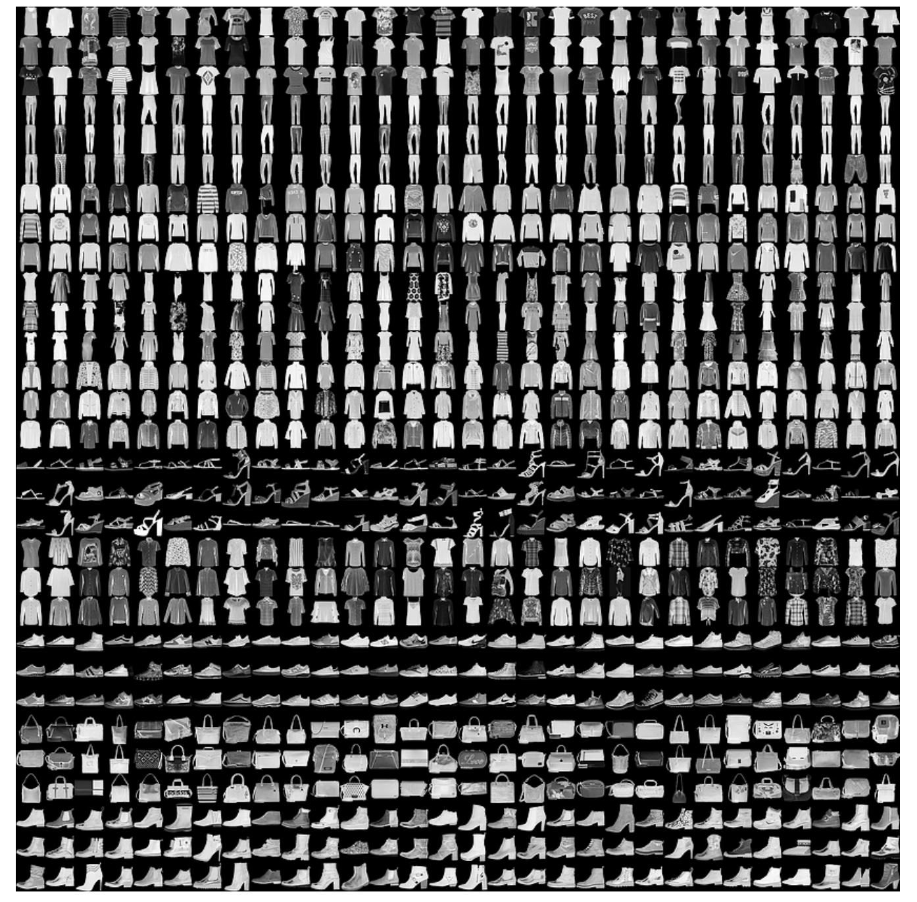
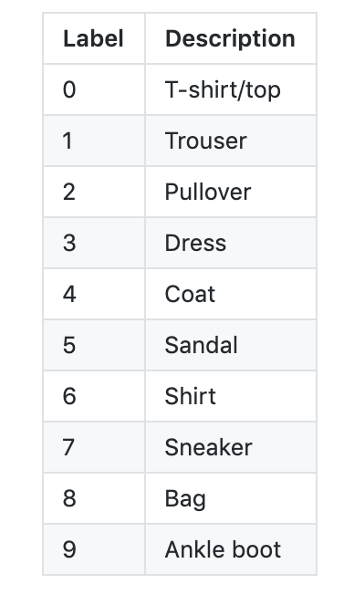
Dataset

Slide 3
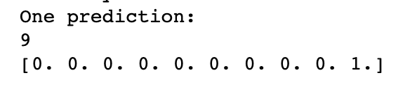
Task 2-1
Single-layer neural network
Training loops | Learning rate | Accuracy
1000 | 0,5 | 0.7177
10000 | 0,5 | 0.7761
100000 | 0,01 | 0.7994

Slide 4
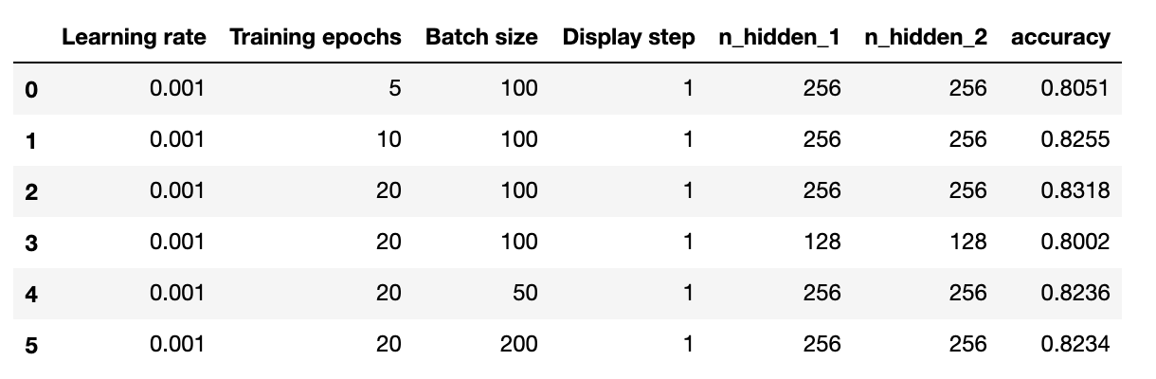
Multi-Layer Perceptron (MLP)
Here are accuracies with different parameters. I found out that accuracy was getting highest values with learning rate 0,001. Then I ran model with this value as constant and modified other parameters.

Slide 5
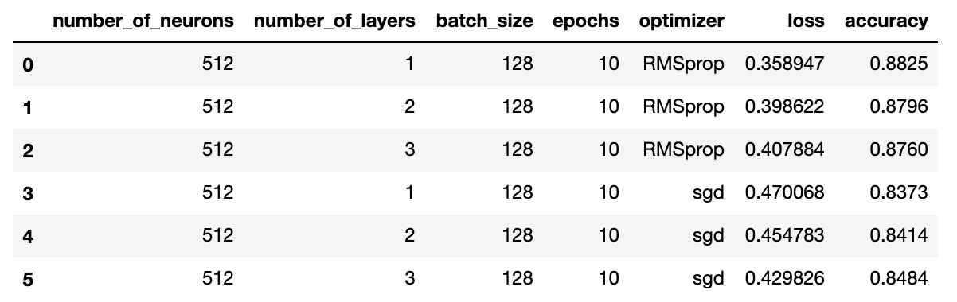
MLP with Keras
I used two different optimizers and here I modified these optimizers and number of layers. Here strange is that increasing number of layers with RMSprop actually lowers the accuracy.

Slide 6
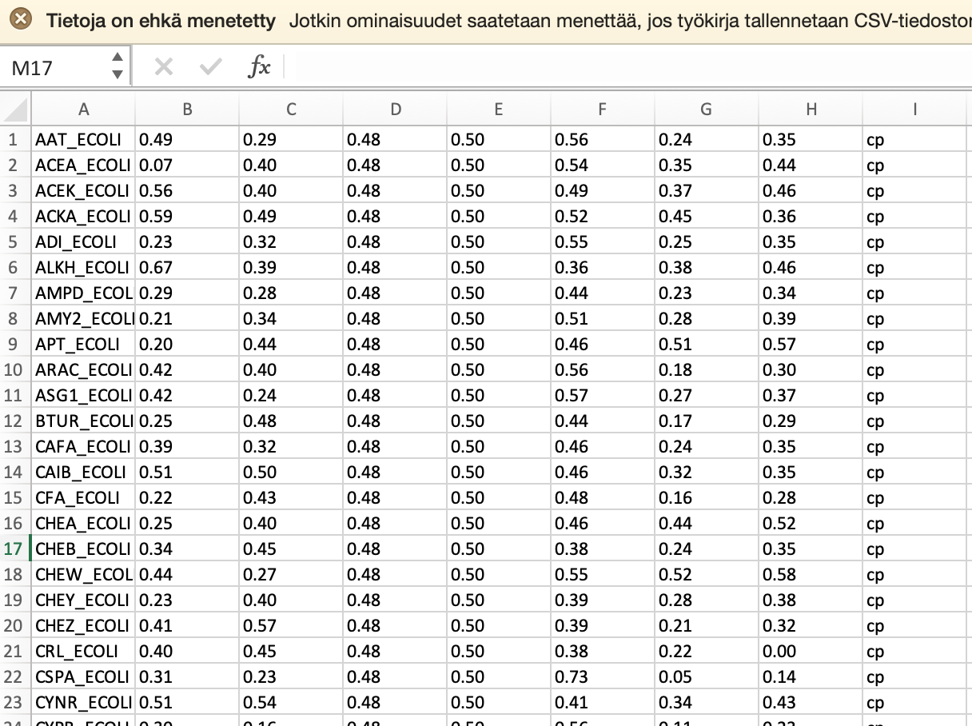
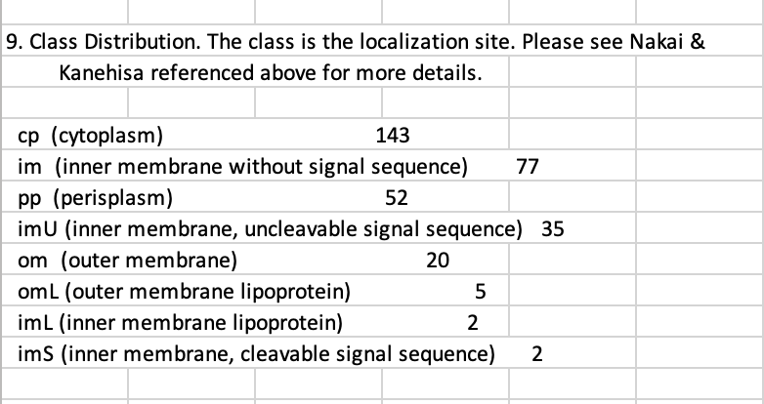
Task 2-2
I used ecoli dataset here:
https://archive.ics.uci.edu/ml/datasets/Ecoli

Slide 7
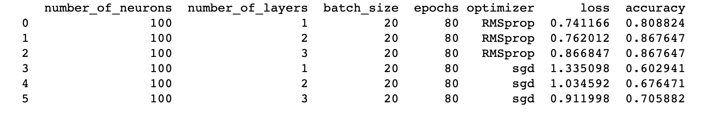
DNN implementation with Keras

Slide 8
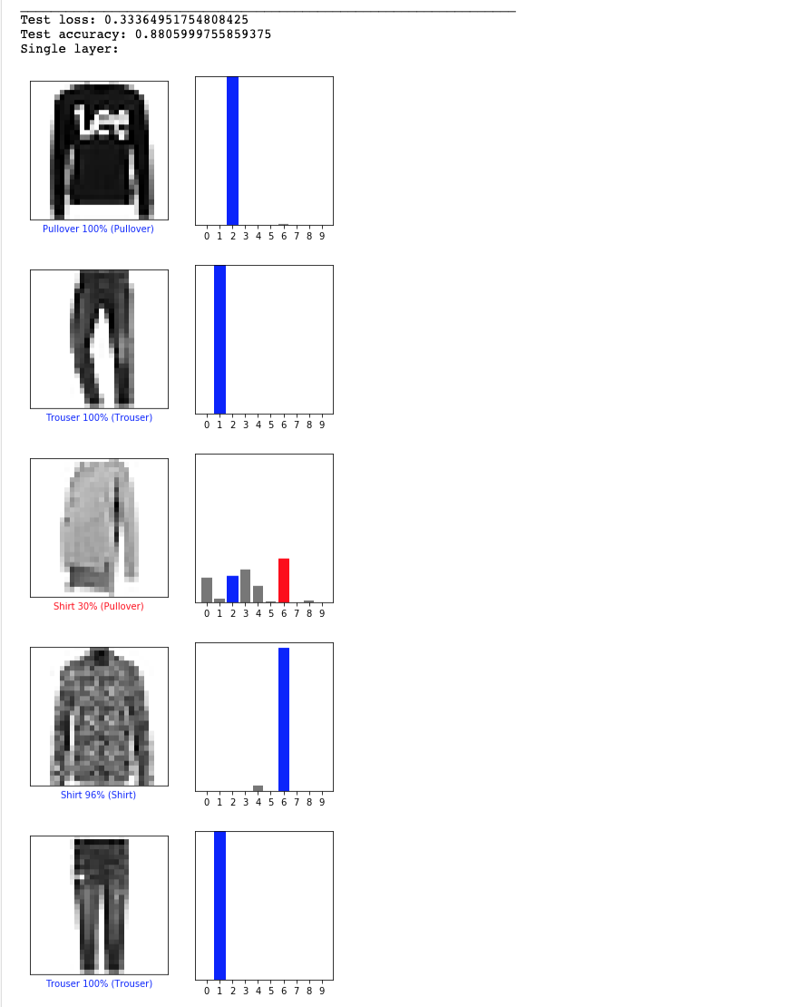
2-3
Single-layer classification with keras:

Slide 9
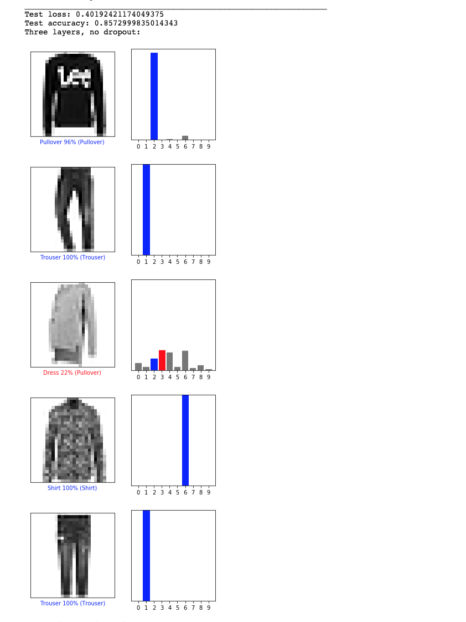
Three layers with
no dropouts

Slide 10
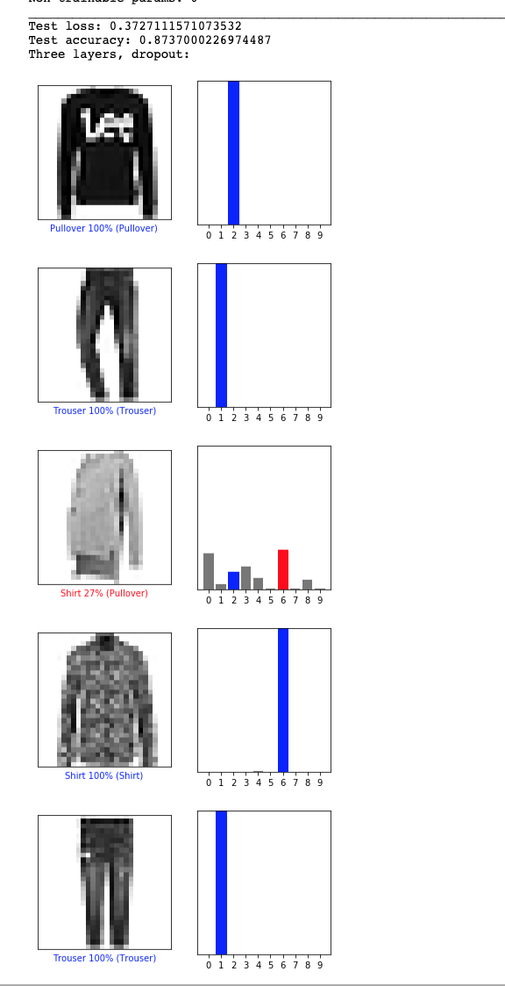
Three layers with
dropouts

Slide 11
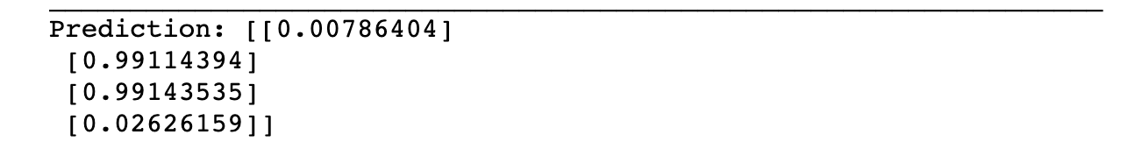
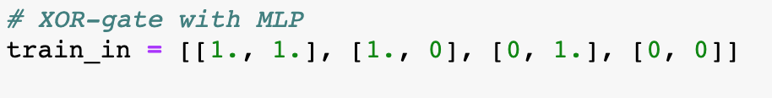
Task 2-4
xor-gate with keras:
For values:

