Slide 1

The Power Platform Governance
Microsoft Discover: Power Platform Club · 27. August 2020
Peter Hödl, Toni Pohl
www.atwork.at

Slide 2




What we do…
We get you in the cloud!
Microsoft
Cloud Solution Provider
Collaboration
Security & Governance
Consulting
Power Platform
Migrations
Apps
Development

Slide 3
What is IT governance?
“IT Governance is a process used to monitor and control key information technology capability decisions - in an attempt - to ensure the delivery of value to key stakeholders in an organization.”

Slide 4
Adoption & Change Management (ACM)
Business Continuity
Teams / Groups Governance
Information Lifecycle Mgmt & Protection
M365 Governance
SharePoint Governance
Stream Governance
(+ Live events)
Power Platform Governance
Identity & Access Governance
(+ Guests)

Slide 5
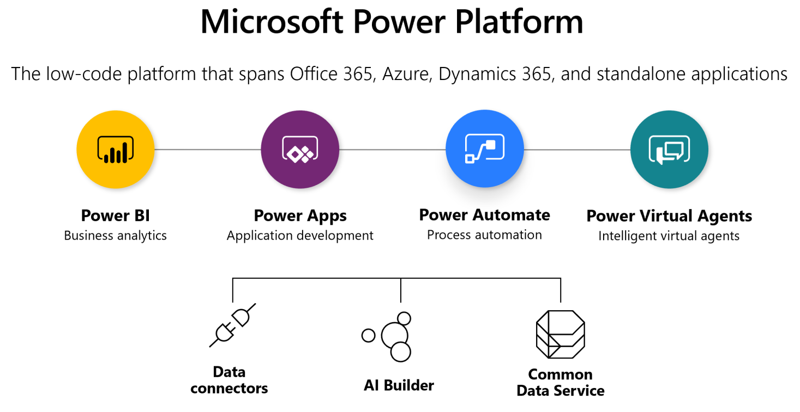

Slide 6
PPAC
The new admin portal
Notes:
aka.ms/ppac

Slide 7
Best Practices
Environments Strategy​
Policies for Connectors​
Activity Logs and Analytics​
Automatic Audit processes​
Makers Onboarding
Types of Environments
Dev / Test / Production Segregation
Data Allowed / Blocked
Standard / Premium
Outdated / Orphaned Flows and Apps
App Classification
Trainings & Templates
Usage Analysis

Slide 8
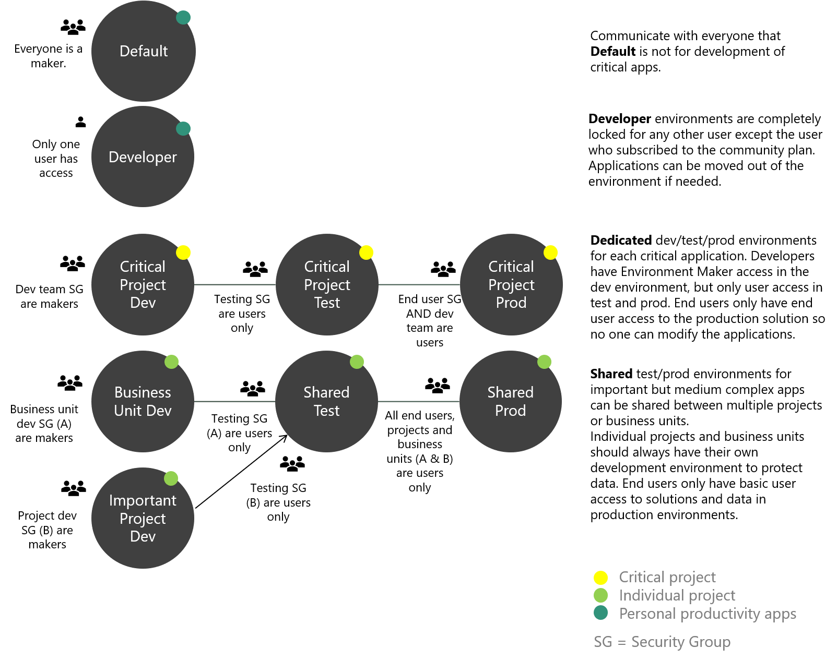
Example environment strategy diagram
https://powerapps.microsoft.com/de-de/blog/establishing-an-environment-strategy-for-microsoft-power-platform/

Slide 9
Managing environments and apps with PowerShell
Automation of the Power Platform

Slide 10
Install the Power Platform PowerShell modules
# PowerShell in this topic requires PowerShell version 5.x.
Install-Module -Name Microsoft.PowerApps.Administration.PowerShell
Install-Module -Name Microsoft.PowerApps.PowerShell -AllowClobber
# Get static analysis checks of solutions against a set of best practice rules
Install-Module Microsoft.PowerApps.Checker.PowerShell
# check the latest installed version
Get-InstalledModule -Name Microsoft.PowerApps.Administration.PowerShell, Microsoft.PowerApps.PowerShell

Slide 11
Sign-in
# Ask for credentials
Add-PowerAppsAccount
OR
# Alternatively: You can pass in credentials (avoiding opening a prompt)
# This works only without MFA.
$pass = ConvertTo-SecureString "password" -AsPlainText -Force
Add-PowerAppsAccount -Username foo@bar.com -Password $pass

Slide 12
Sign-in
# Ask for credentials
Add-PowerAppsAccount
OR
# Alternatively: You can pass in credentials (avoiding opening a prompt)
# This works only without MFA.
$pass = ConvertTo-SecureString "password" -AsPlainText -Force
Add-PowerAppsAccount -Username foo@bar.com -Password $pass

Slide 13
Sample to get the environment
# Get the environment
Get-AdminPowerAppEnvironment | ft
$environment = Get-AdminPowerAppEnvironment -Default
OR
$environment = Get-AdminPowerAppEnvironment -EnvironmentName 'a123…'
# $environmentid = $environment.Internal.id
# We need to extract the ID only from
# "/providers/Microsoft.BusinessAppPlatform/scopes/admin/environments/Default-<someid>"
$environmentid = $environment.Internal.id.split("/")[-1]
Write-Output "Environment ID: $environmentid"

Slide 14
Sample to get all apps in one enviroment
$apps = Get-AdminPowerApp | Where-Object {$_.EnvironmentName -eq $environmentid }
$apps | Format-Table -Property DisplayName, CreatedTime, EnvironmentName
$apps.count
# Get one specific app by AppName
$myapp = $apps | Where {$_.DisplayName -eq "DMyApp" }
$myapp.AppName

Slide 15
Modify app permissions
# Get the permissions for a specific app (prev. Get-AdminAppRoleAssignment)
Get-AdminPowerApp -AppName $myapp.AppName -EnvironmentName $environmentid `
| Get-AdminPowerAppRoleAssignment `
| Select PrincipalDisplayname, PrincipalObjectId, RoleType, AppName `
| ft
# Add a user. We need the UserID from Azure AD.
$userid = "c345…"
# Add permissions to an app = Share the app. # The user gets an email if -Notify $true (default)
Set-AdminPowerAppRoleAssignment -PrincipalType Group ` -PrincipalObjectId $userid -RoleName CanEdit ` -AppName $myapp.AppName -EnvironmentName $environmentid -Notify DoNotNotify

Slide 16
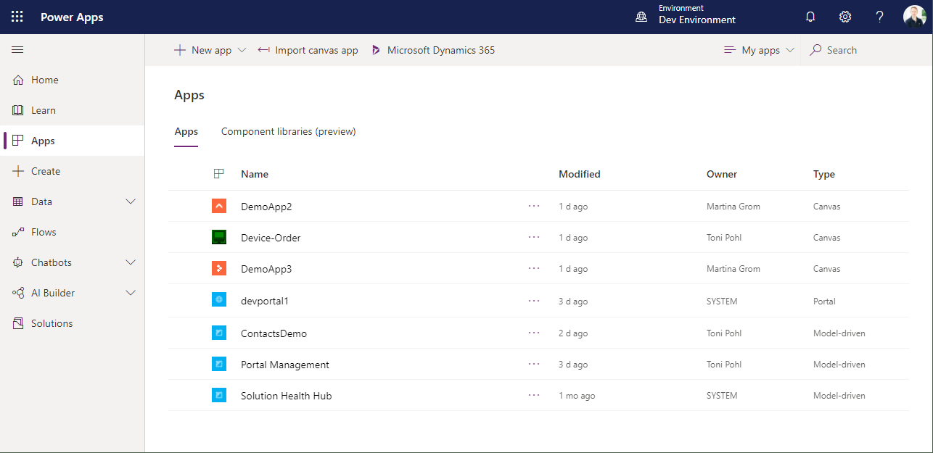

Slide 17
Change the owner of an app
# Change owner: Set-AdminPowerAppOwner (previously Set-AdminAppOwner)
Set-AdminPowerAppOwner -AppName $myapp.AppName ` -AppOwner $userid ` -EnvironmentName $environmentid

Slide 18
Center of Excellence (CoE)
Microsoft Add-On for governance of the Power Platform

Slide 19


CoE Architecture
Environment
Developer Compliance Center
CoE Admin Center
Power BI dashboard
Environment
Custom apps or dashboards
Environment
data
Environment
Flows
Power Apps
CDS
CoE process
Connectors
DLP Policies
flows
Archive unused apps & flows
Notifications (orphaned apps, etc)

Slide 20
CoE Demo
Components of the starter kit & Walkthrough

Slide 21

Offering
Phase 1: Analyse und Planung
Architektur, Lizenzierung und Security
Environments, Connectors, Common Data Services, Data Loss Prevention (DLP)
Detaillierter Plan für die Verwendung der Komponenten
Phase 2: Aufbau des CoE
Aufbau des Power Platform Center of Excellence (CoE)
Monitoring, Alerts und Deployment (DevOpps)
Übersicht über die bereits verwendeten Power Apps und Kontrolle über neu erstellte Lösungen
Phase 3: End User Adoption
Wissentransfer und Trainings der End User für Best Practices und Policies im Unternehmen
Workshops, Community Aufbau, Champions Programm
End User wissen über die sichere Verwendung der Power Platform Bescheid
Notes:
Phase 1: Analyse und Planung
Architektur, Lizenzierung und Security
Environments, Connectors, Common Data Services, Data Loss Prevention (DLP)
Detaillierter Plan für die Verwendung der Komponenten
Phase 2: Aufbau des CoE
Aufbau des Power Platform Center of Excellence (CoE)
Monitoring, Alerts und Deployment (DevOpps)
Übersicht über die bereits verwendeten Power Apps und Kontrolle über neu erstellte Lösungen
Phase 3: End User Adoption
Wissentransfer und Trainings der End User für Best Practices und Policies im Unternehmen
Workshops, Community Aufbau, Champions Programm
End User wissen über die sichere Verwendung der Power Platform Bescheid

Slide 22
Summary
Governance Tools for the Power Platform
Develop a governance plan & strategy
Admin Center
Manage with PowerShell
Center of Excellence

Slide 23
Call to action!
Contact us and see our M365 governance solutions
www.atwork.at
www.governancetoolkit365.com
https://github.com/tonipohl/PowerPlatformGovernance

