Slide 1
Week 7: Geometric Modeling - Parametric Representation of Synthetic Curves
Spring 2018, AUA
Zeid, I., Mastering CAD/CAM, Chapter 6

Slide 2
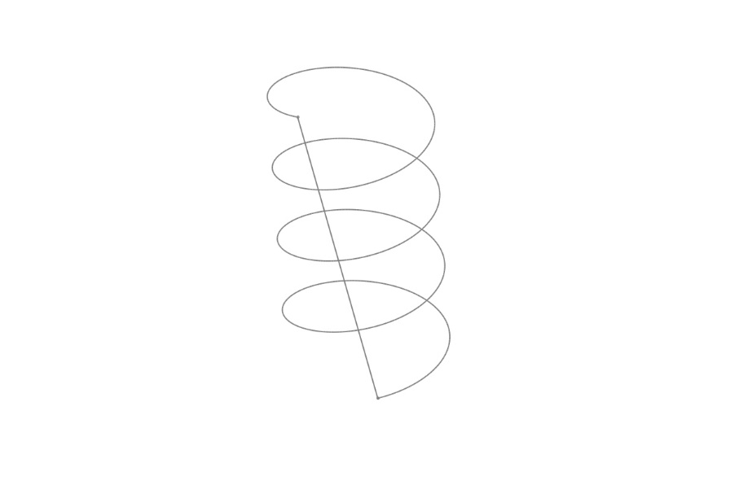
Planar vs. Space

Slide 3

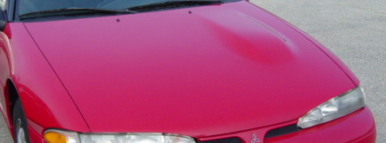
Analytic (known form) vs. Synthetic (free form)
We can create simplistic objects such as the forklift given below by using known equations.
Creating these curves by using known analytic curve equations is not reasonable all the time. Sometimes – impossible.

Slide 4
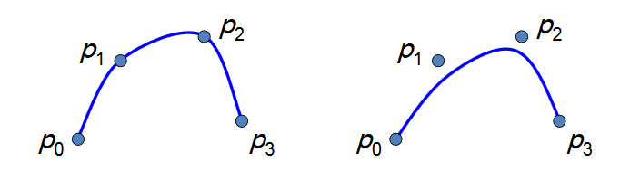
Interpolation vs. Approximation
The curve passing through given data (control) points - interpolation curve.
The curve not necessarily passing but controlled by data points - approximation curve

Slide 5
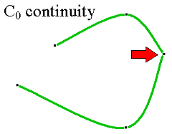
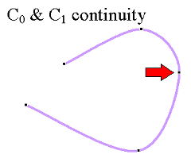
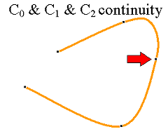
Continuity
The smoothness of the connection of two curves or surfaces at the connection points or edges.
C⁰: simple connection of two curves
C¹: the geometric slopes at the joint must be same
C²: curvature continuity that not only the gradients but also the center of curvature is the same
Notes:
For a plane curve C, the curvature at a given point P has a magnitude equal to the reciprocal of the radius of an osculating circle (a circle that "kisses" or closely touches the curve at the given point), and is a vector pointing in the direction of that circle's center.

Slide 6
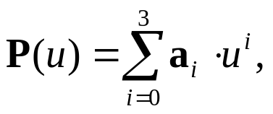

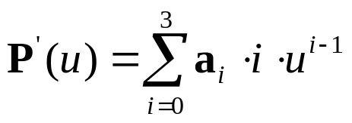

Cubic Curves
Parametric equation of a cubic spline segment:
where 0u 1
In an expanded vector form:
The tangent vector:
In an expanded vector form:

Slide 7
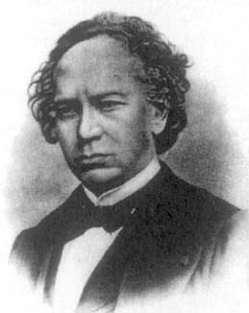
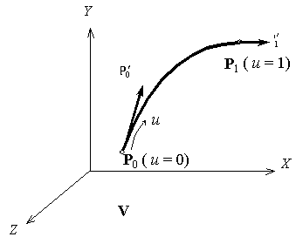
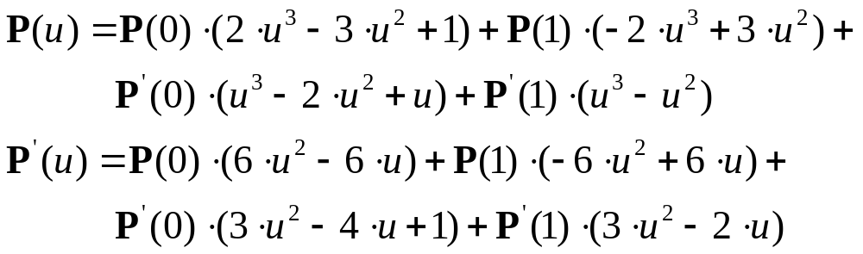
Hermite Cubic Splines
Hermite form of a general cubic spline is defined by positions and tangent vectors at two data points.
P’(1)
P’(0)
P(1) (u=1)
u
t
P(0) (u=0)
Charles Hermite
(1822 - 1901)
Applying the boundary conditions at u = 0 and u = 1 and performing the necessary substitutions,

Slide 8
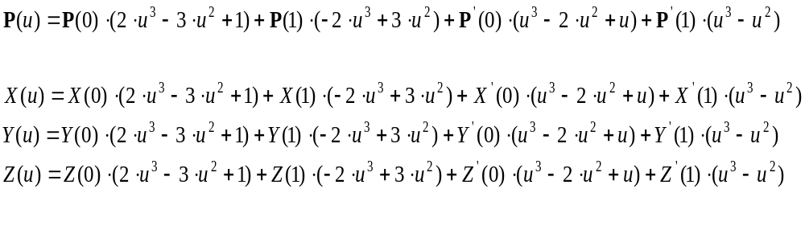
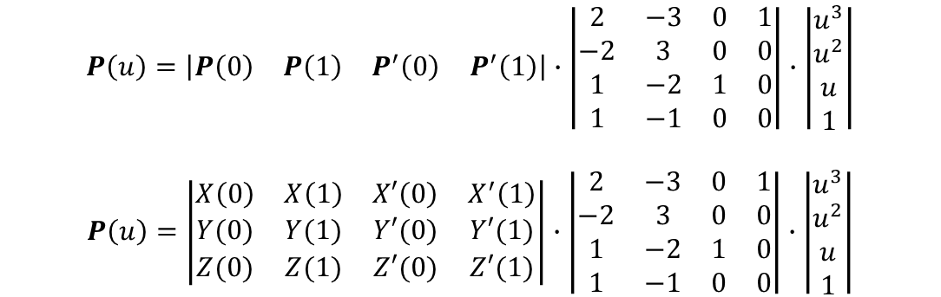
Hermite Cubic Splines
Vector
form
Scalar
form
Vector
form
Scalar
form

Slide 9
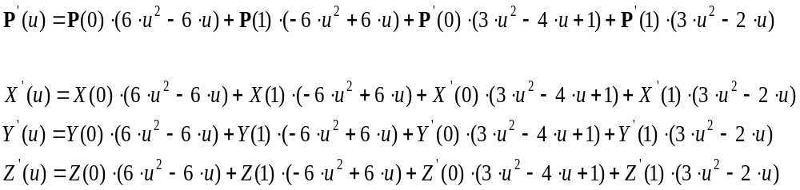
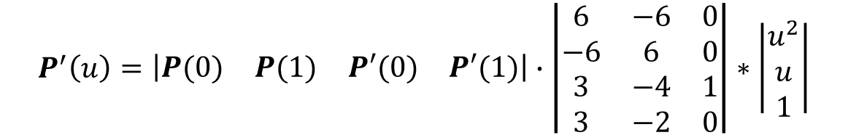
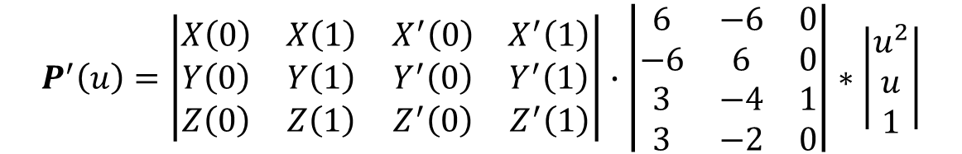
Hermite Cubic Spline – Tangent Vector
Vector
form
Scalar
form
Vector
form
Scalar
form

Slide 10
Hermite Cubic Splines - example
Y
The Hermite curve fits the points:
P₀ = [1,1]^{T},
P₁ = [3,5]^{T}
and the tangent vectors: P₀’ = [0,4]^{T},
P₁’ = [4,0]^{T}.
Calculate
the parametric mid-point of the curve,
the tangent vector on that point.
Sketch the curve on the grid
X

Slide 11
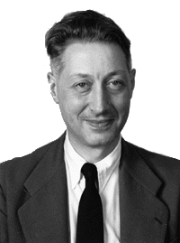
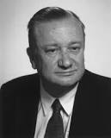
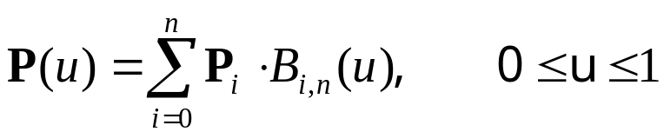

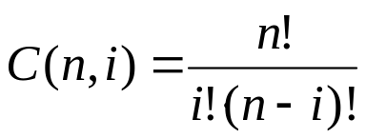
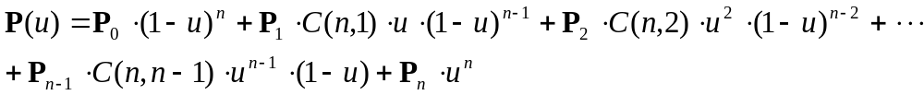
Bezier Curves - sl. 1
Parametric equation of Bezier curve
where P(u) is the position vector of a point on the curve, P_{i} are control points, and B_{i,n} are the Bernstein polynomials (blending functions for the curve).
and C(n,i) are the binomial coefficients:
In an expanded form:
Pierre Bezier
(1910-1999)
Renault
Paul de Casteljau
(1930)
Citroën

Slide 12
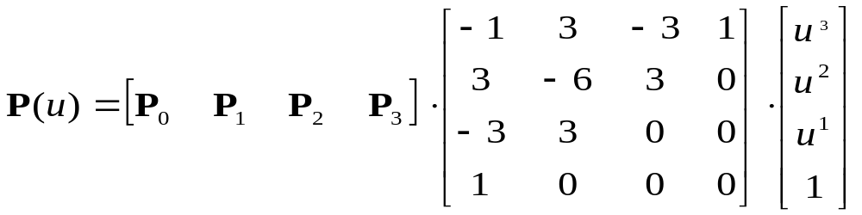
Bezier Curves - sl. 3
For n = 3:
Or, in matrix form:
Bezier geometric matrix
G_{B}
Bezier basis matrix
M_{B}

Slide 13
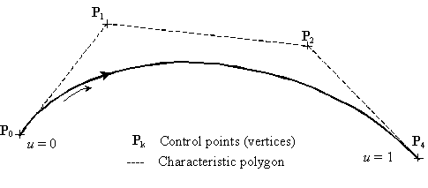
Bezier Curves - sl. 2
P₁
P₂
P₀
t=0
P_{k}
P₃
t=1
General Characteristics
The Bezier curve is defined by n+1 points
Only P₀ and P_{n+1} lie on the curve
The curve is tangent to the first and last polygon segments
The curve shape tends to follow the polygon shape.
Convex hull property.
The sum of B_{i,n} functions is always equal to unity.
Bezier vs. Hermite Cubic Spline
The Bezier curve is controlled by data points. No derivatives
The order is variable: n+1 points define n^{th} order curve . -> higher order continuity

Slide 14
Bezier Curves - sl. 5
Practice
The coordinates of 4 control points are given:
P₀ = [2,2]^{T}, P₁ = [2,3]^{T}, P₃ = [3,3]^{T}, P₄ = [3,2]^{T}
    Find the equation of the resulting Bezier curve,
    Find the points on the curve for u = 0, ¼, ½, ¾, 1,
    Sketch the curve.

Slide 15
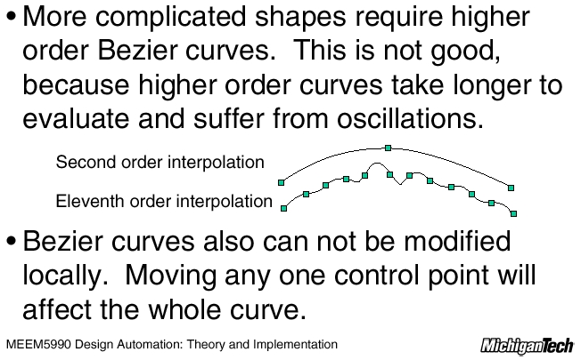
Bezier Curves - sl. 4

Slide 16
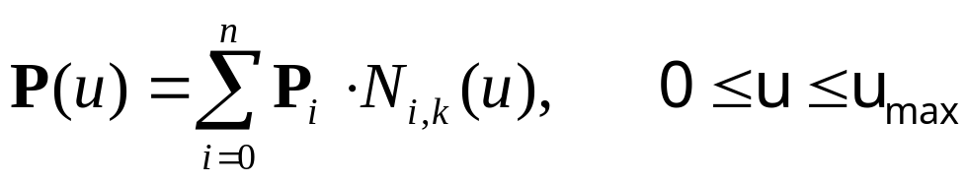
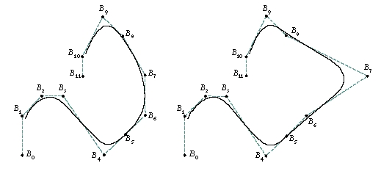
B-spline Curves - sl. 1
See: http://www.ibiblio.org/e-notes/Splines/Basis.htm
Powerful generalization of Bezier curves
local control
opportunity to add control points without increasing the degree of the curve
ability to interpolate or approximate data points
The B-spline curve defined by n+1 control points P_{i} consists of n – 2 curve segments and is given by:
where N_{i,k}(u) are the B-spline (blending or basis) functions. The parameter k controls the degree (k-1) of the B-spline curve.
Local control

Slide 17
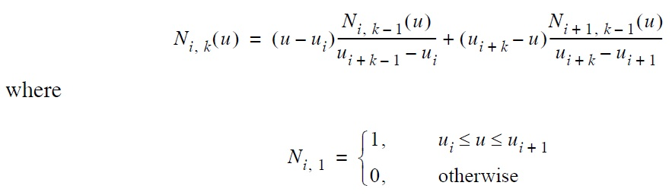
B-spline Curves - sl. 2
See: http://www.ibiblio.org/e-notes/Splines/Basis.htm
The B-spline curve defined by n+1 control points P_{i} consists of n – 2 curve segments and is given by:
where N_{i,k}(u) are the B-spline (blending or basis) functions. The parameter k controls the degree (k-1) of the B-spline curve.

Slide 18
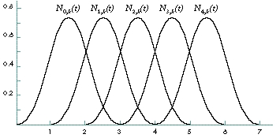
B-spline Curves - sl. 3
Basis Functions
The function N_{i,k} determines how strongly control point P_{i} influences the curve at t. Its value is a real number – 0.25, 0.5…

Slide 19
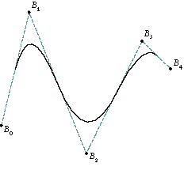
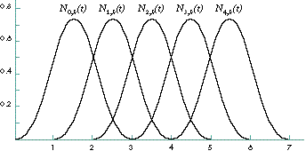
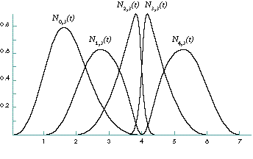
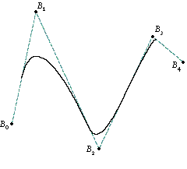
NURBS Curves - sl. 1
NURBS (Non-uniform Rational B-spline) curves are the generalization of uniform B-spline curves.

Slide 20
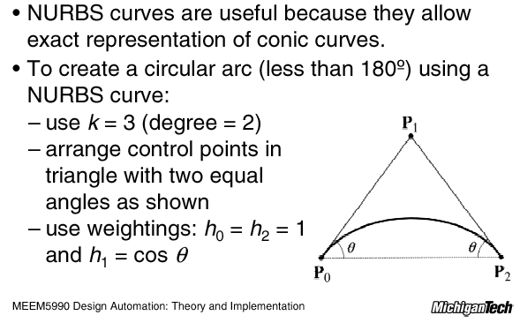
NURBS Curves - sl. 2

