Slide 1
Introduction
Condor Software Forum
OGF19

Slide 2
Outline
What do YOU want to talk about?
Proposed Agenda
  Introduction
  Condor-G
  APIs
  << BREAK >>
  Grid Job Router
  GCB
  Roadmap

Slide 3
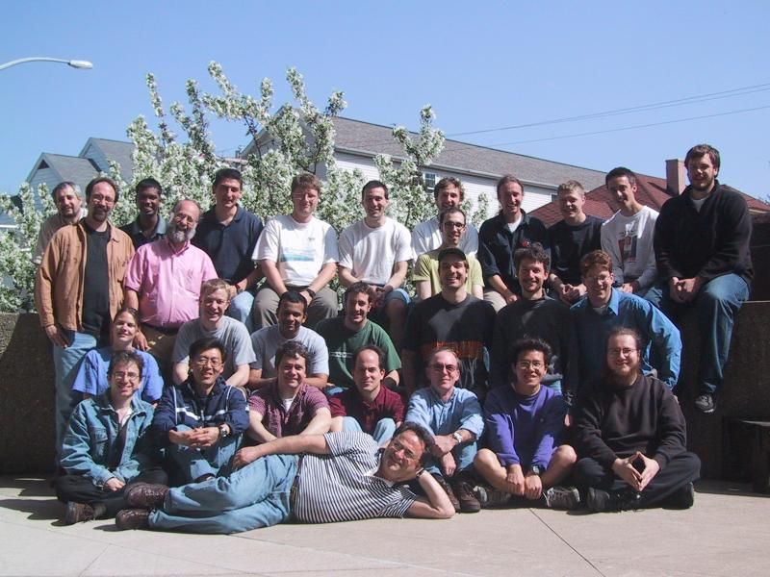
The Condor Project (Established ‘85)‏
Distributed High Throughput Computing research performed by a team of ~35 faculty, full time staff and students.

Slide 4
The Condor Project (Established ‘85)‏
Distributed High Throughput Computing research performed by a team of ~35 faculty, full time staff and students who:
  face software engineering challenges in a distributed UNIX/Linux/NT environment
  are involved in national and international grid collaborations,
  actively interact with academic and commercial users,
  maintain and support large distributed production environments,
  and educate and train students.
Funding – US Govt. (DoD, DoE, NASA, NSF, NIH),
AT&T, IBM, INTEL, Microsoft, UW-Madison, …

Slide 5
Main Threads of Activities
Distributed Computing Research – develop and evaluate new concepts, frameworks and technologies
The Open Science Grid (OSG) – build and operate a national distributed computing and storage infrastructure
Keep Condor “flight worthy” and support our users
The NSF Middleware Initiative (NMI) – develop, build and operate a national Build and Test facility
The Grid Laboratory Of Wisconsin (GLOW) – build, maintain and operate a distributed computing and storage infrastructure on the UW campus

Slide 6
A Multifaceted Project
Harnessing the power of clusters - opportunistic and/or dedicated (Condor)‏
Job management services for Grid applications (Condor-G, Stork)‏
Fabric management services for Grid resources (Condor, GlideIns, NeST)‏
Distributed I/O technology (Parrot, Kangaroo, NeST)‏
Job-flow management (DAGMan, Condor, Hawk)‏
Distributed monitoring and management (HawkEye)‏
Technology for Distributed Systems (ClassAD, MW)‏
Packaging and Integration (NMI, VDT)‏

Slide 7
Some software produced by the Condor Project
Condor System
ClassAd Library
DAGMan
GAHP
Hawkeye
GCB
MW
NeST
Stork
Parrot
Condor-G
And others… all as open source

Slide 8
What is Condor?
Condor converts collections of distributively owned workstations and dedicated clusters into a distributed high-throughput computing (HTC) facility.
Condor manages both resources (machines) and resource requests (jobs)‏
Condor has several unique mechanisms
  Transparent checkpoint/restart
  Transparent process migration
  I/O Redirection
  ClassAd Matchmaking Technology
  Grid Metacheduling

Slide 9
Condor can manage a large number of jobs
Managing a large number of jobs
  You specify the jobs in a file and submit them to Condor, which runs them all and keeps you notified on their progress
  Mechanisms to help you manage huge numbers of jobs (1000’s), all the data, etc.
  Condor can handle inter-job dependencies (DAGMan)‏
  Condor users can set job priorities
  Condor administrators can set user priorities

Slide 10
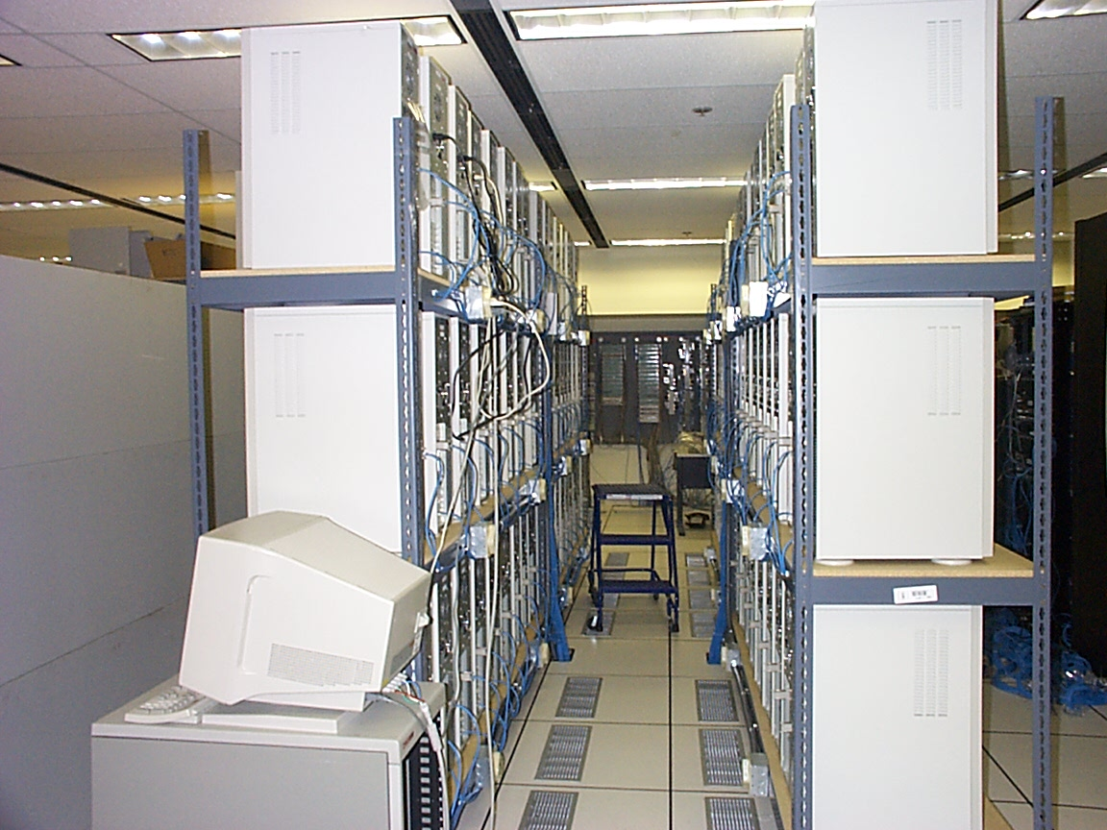
Condor can manage Dedicated Resources…
Dedicated Resources
  Compute Clusters
Grid Resources
Manage
  Node monitoring, scheduling
  Job launch, monitor & cleanup

Slide 11
…and Condor can manage non-dedicated resources
Non-dedicated resources examples:
  Desktop workstations in offices
  Workstations in student labs
Non-dedicated resources are often idle --- ~70% of the time!
Condor can effectively harness the otherwise wasted compute cycles from non-dedicated resources

Slide 12
Condor Classads
Capture and communicate attributes of objects (resources, work units, connections, claims, …)‏
Define policies/conditions/triggers via Boolean expressions
ClassAd Collections provide persistent storage
Facilitate matchmaking and gangmatching

Slide 13
Example: Job Polices w/ ClassAds
Do not remove if exits with a signal:
on_exit_remove = ExitBySignal == False
Place on hold if exits with nonzero status or ran for less than an hour:
on_exit_hold = ((ExitBySignal==False) && (ExitSignal != 0)) || ((ServerStartTime – JobStartDate) < 3600)‏
Place on hold if job has spent more than 50% of its time suspended:
periodic_hold = CumulativeSuspensionTime > (RemoteWallClockTime / 2.0)

Slide 14
Condor Job “Universes”
Vanilla - serial jobs
Standard – serial jobs with
  Transparent checkpoint/restart
  Remote System Calls
Java
PVM
Parallel (thanks to AIST and Best Systems)‏
Scheduler
Grid

Slide 15
Condor Job “Universes”, cont.
Scheduler
Grid

Slide 16
Scheduler Job example: DAGMan
Directed Acyclic Graph Manager
Often a job will have several logical steps that must be executed in order
DAGMan allows you to specify the dependencies between your Condor jobs, so it can manage them automatically for you.
(e.g., “Don’t run job “B” until job “A” has completed successfully.”)‏
Notes:
In the simplest case…

Slide 17
What is a DAG?
A DAG is the data structure used by DAGMan to represent these dependencies.
Each job is a “node” in the DAG
  Can have it’s own requirements
  Can be scheduled independently
Each node can have any number of “parent” or “child” nodes – as long as there are no loops!
Job A
Job B
Job C
Job D
Notes:
a DAG is the best data structure to represent a workflow of jobs with dependencies
children may not run until their parents have finished – this is why the graph is a directed graph … there’s a direction to the flow of work
In this example, called a “diamond” dag, job A must run first; when it finishes, jobs B and C can run together; when they are both finished, D can run; when D is finished the DAG is finished
Loops, where two jobs are both descended from one another, are prohibited because they would lead to deadlock – in a loop, neither node could run until the other finished, and so neither would start – this restriction is what makes the graph acyclic

Slide 18
Additional DAGMan Features
Provides other handy features for job management…
  nodes can have PRE & POST scripts
  failed nodes can be automatically re-tried a configurable number of times
  job submission can be “throttled”

Slide 19
Grid Universe
With Grid Universe, always specify a ‘gridtype’.
Allowed GridTypes
  GT2 (Globus Toolkit 2)‏
  GT3 (Globus Toolkit 3.2)‏
  GT4 (Globus Toolkit 3.9.5+)‏
  UNICORE
  Nordugrid
  PBS (OpenPBS, PBSPro – thanks to INFN)‏
  LSF (Platform LSF –thanks to INFN)‏
  CONDOR (thanks gLite!)‏
‘Condor-G’
‘Condor-C’

Slide 20
A Grid MetaScheduler
Grid Universe
+
ClassAd Matchmaking

Slide 21
COD
Computing On Demand

Slide 22
What Problem Does COD Solve?
Some people want to run interactive, yet compute-intensive applications
Jobs that take lots of compute power over a relatively short period of time
They want to use batch computing resources, but need them right away
Ideally, when they’re not in use, resources would go back to the batch system

Slide 23
COD is not just high-priority jobs
“Checkpoint to Swap Space”
  When a high-priority COD job appears, the lower-priority batch job is suspended
  The COD job can run right away, while the batch job is suspended
  Batch jobs (even those that can’t checkpoint) can resume instantly once there are no more active COD jobs

Slide 24
Stork – Data Placement Agent
Need for data placement on the Grid:
  Locate the data
  Send data to processing sites
  Share the results with other sites
  Allocate and de-allocate storage
  Clean-up everything
Do these reliably and efficiently
“Make data placement a first class citizen in the Grid.”

Slide 25
Stork
A scheduler for data placement activities in the Grid
What Condor is for computational jobs, Stork is for data placement
Stork understands the characteristics and semantics of data placement jobs.
Can make smart scheduling decisions, for reliable and efficient data placement.

Slide 26
Stork - The Concept
Allocate space for input & output data
Stage-in
Stage-in
Execute the Job
Stage-out
Execute the job
Release input space
Stage-out
Data Placement Jobs
Release output space
Computational Jobs

Slide 27
Stork - The Concept
Condor
Job
Queue
DaP A A.submit
DaP B B.submit
Job C C.submit
…..
Parent A child B
Parent B child C
Parent C child D, E
…..
DAG specification
C
DAGMan
Stork
Job
Queue
D
F
A
B
C
E
E

Slide 28
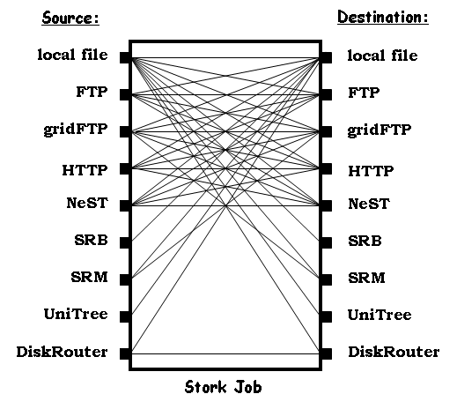
Stork - Support for Heterogeneity
Protocol translation using Stork memory buffer.

Slide 29
GCB – Generic Connection Broker
Build grids despite the reality of
  Firewalls
  Private Networks
  NATs

Slide 30
Condor Usage

Slide 31
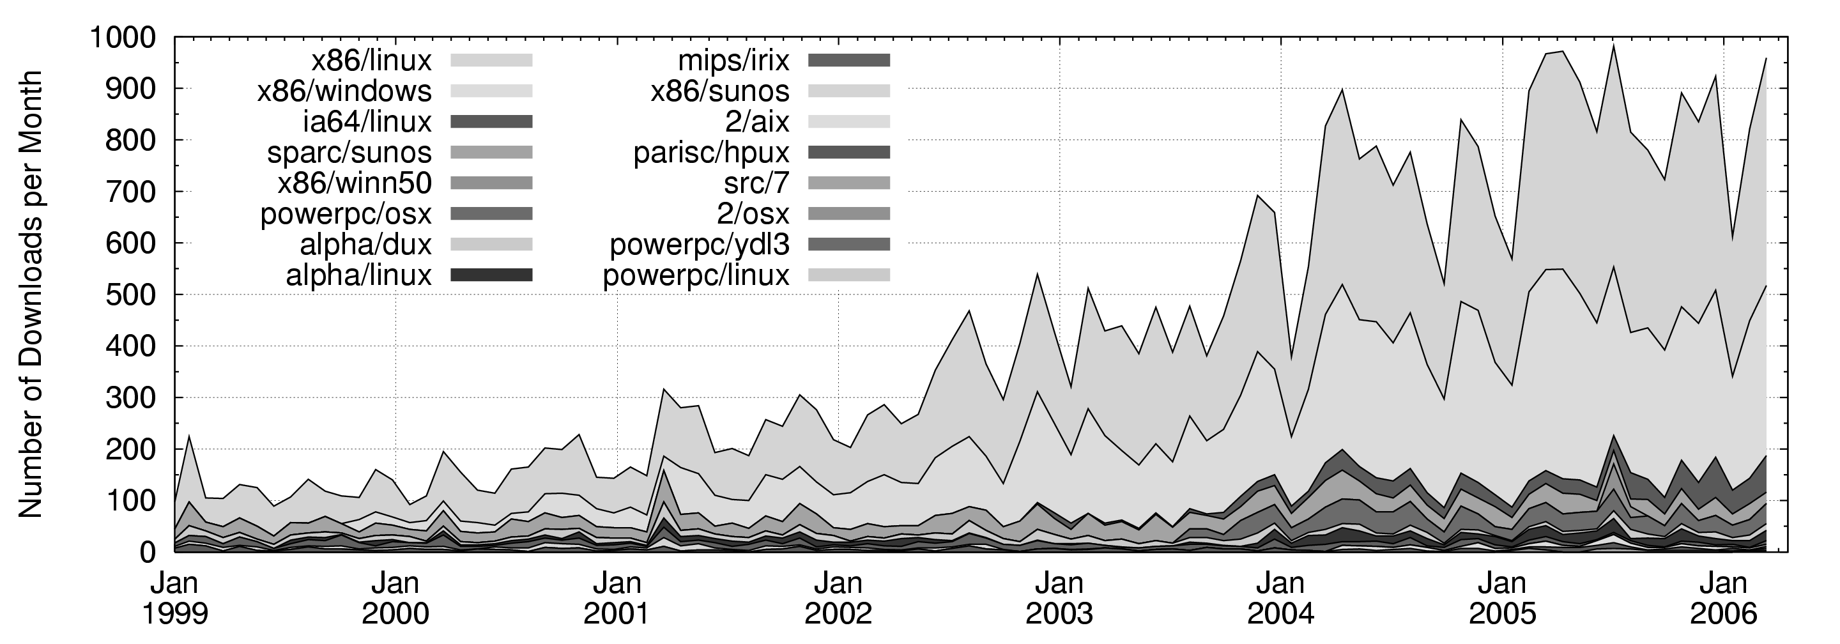
Downloads per month
900
600
X86/Linux
X86/Windows

Slide 32
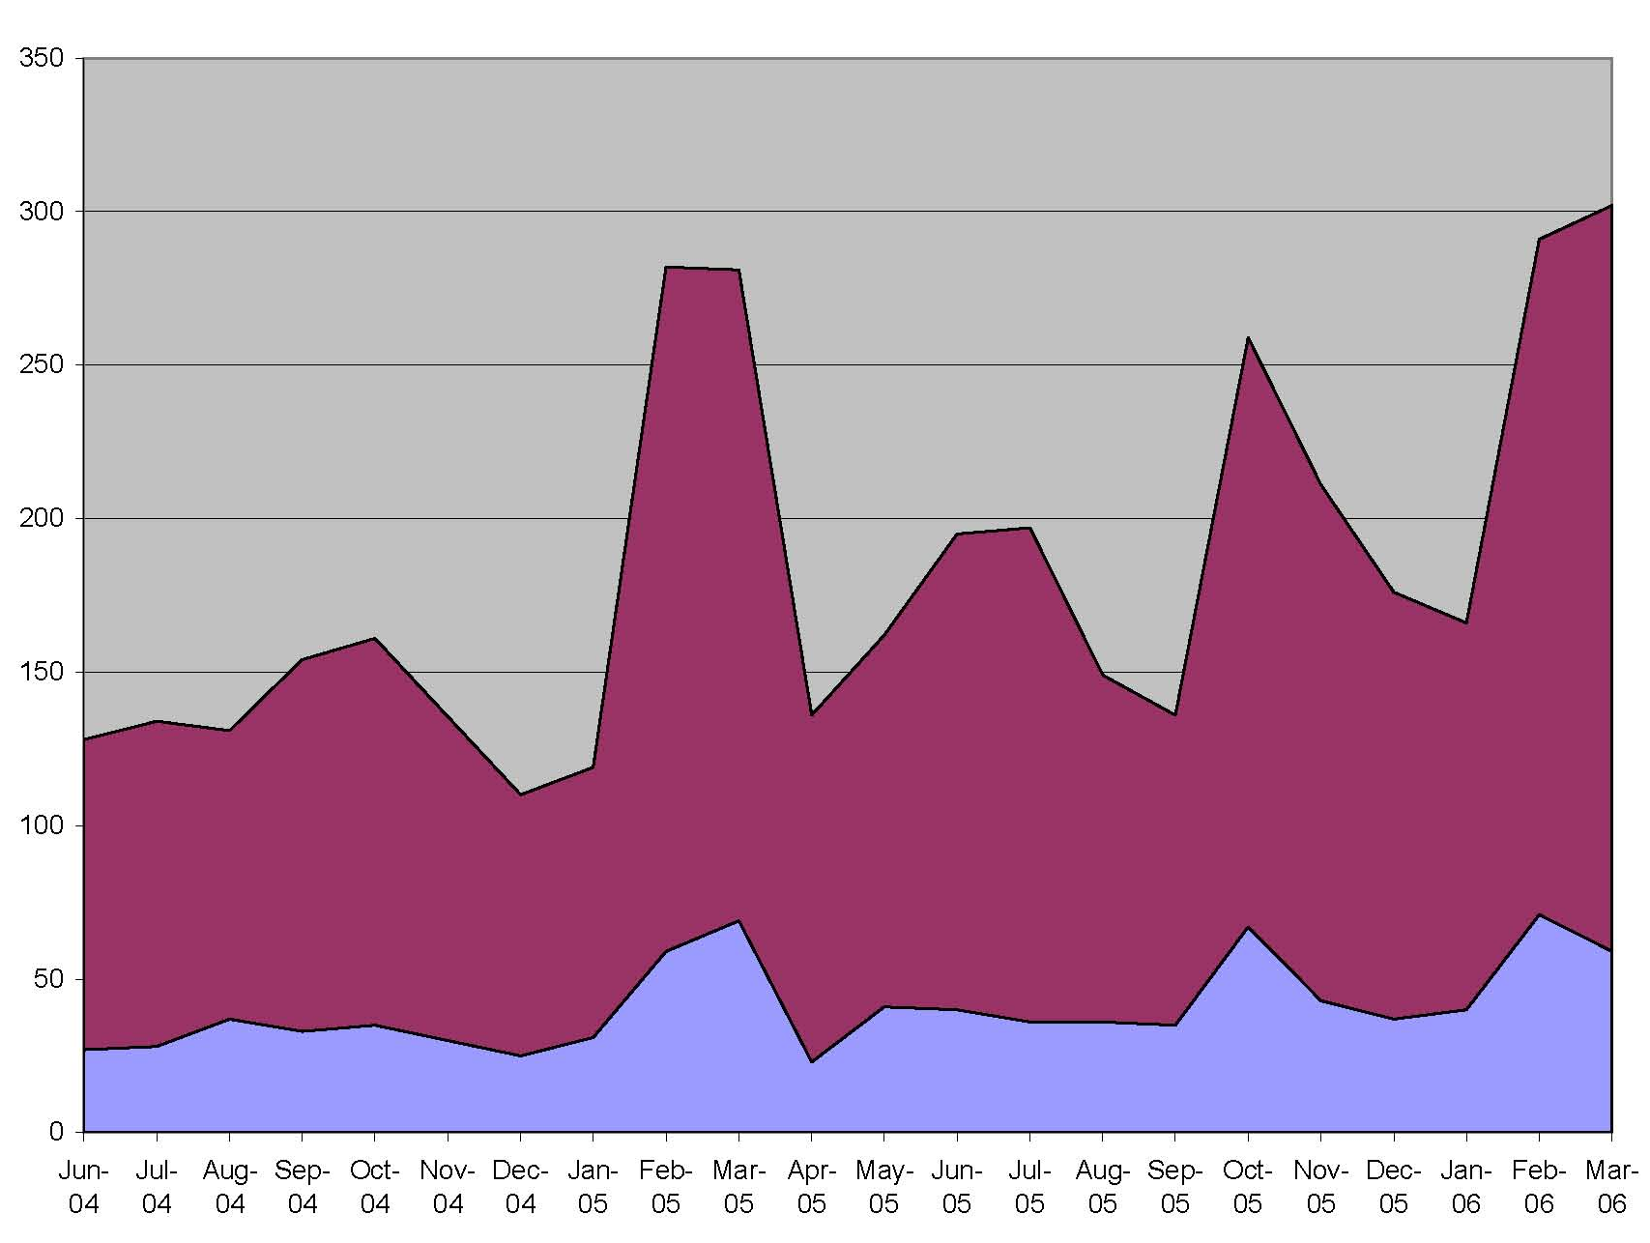
Condor-Users –Messages per month
Condor Team Contributions

Slide 33

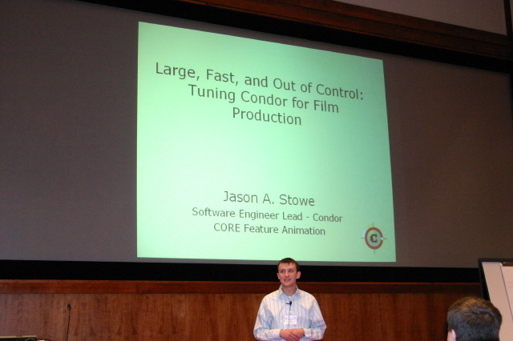
Notes:
me. Last year I was hear talking about tuning Condor for movie production. We ran 50+ million jobs to create a feature length animation…

Slide 34
Questions?

