Slide 1
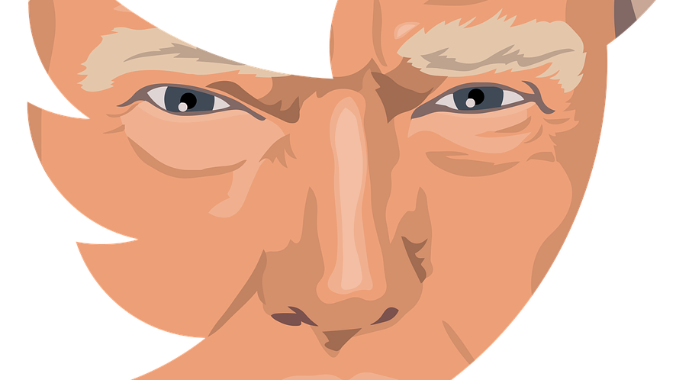
TrumpTweets.Project3
Prepared By:
Edward Doris
Hailu Sefera
Taiwo Onitiri

Slide 2
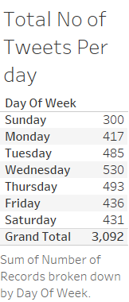

Slide 3
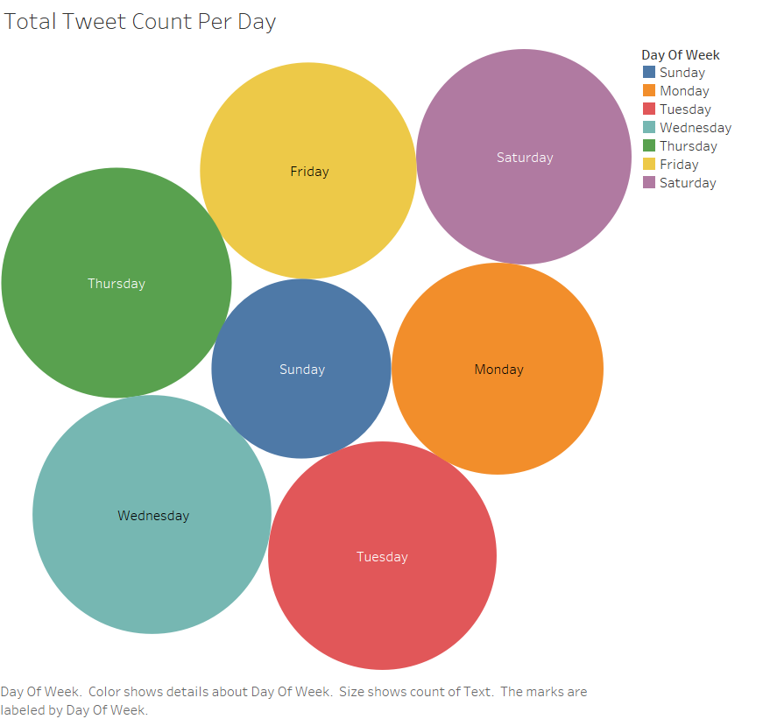

Slide 4
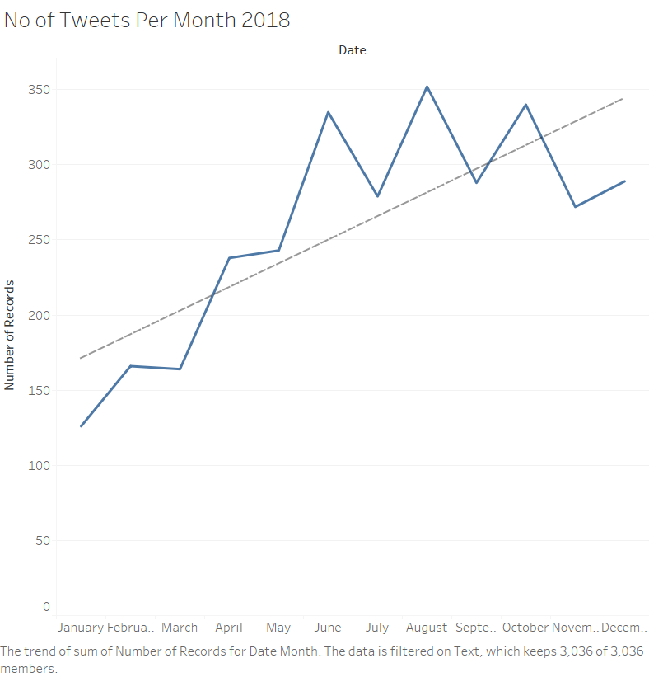

Slide 5
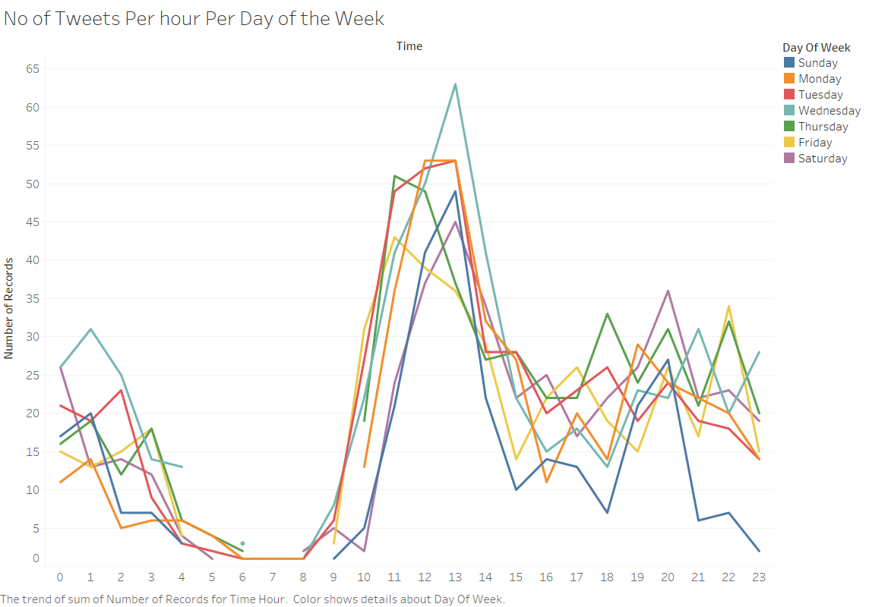

Slide 6
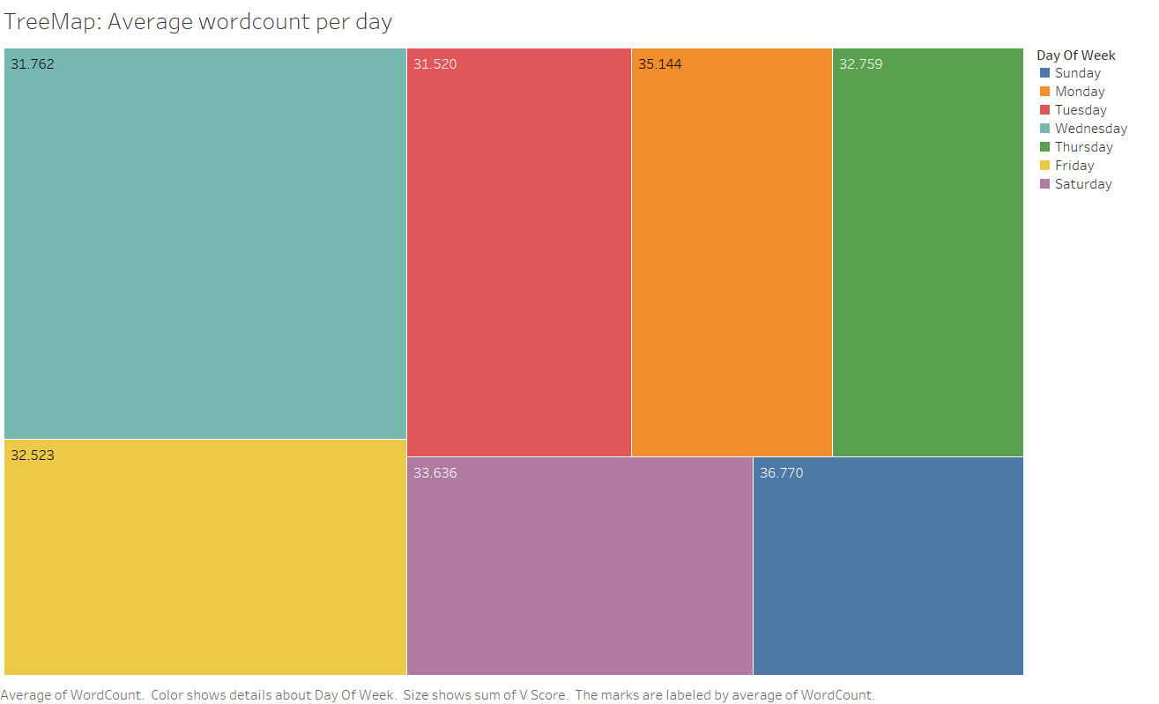

Slide 7
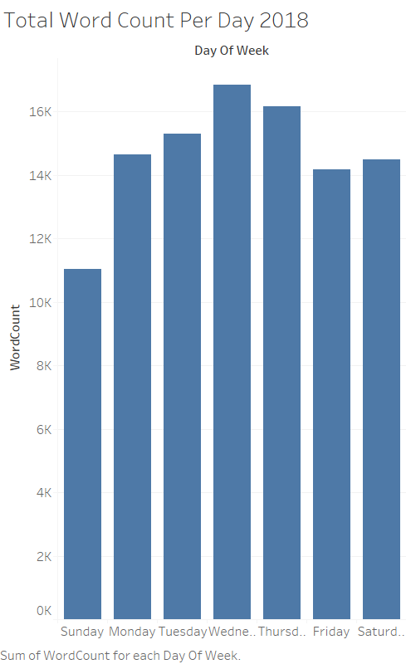

Slide 8
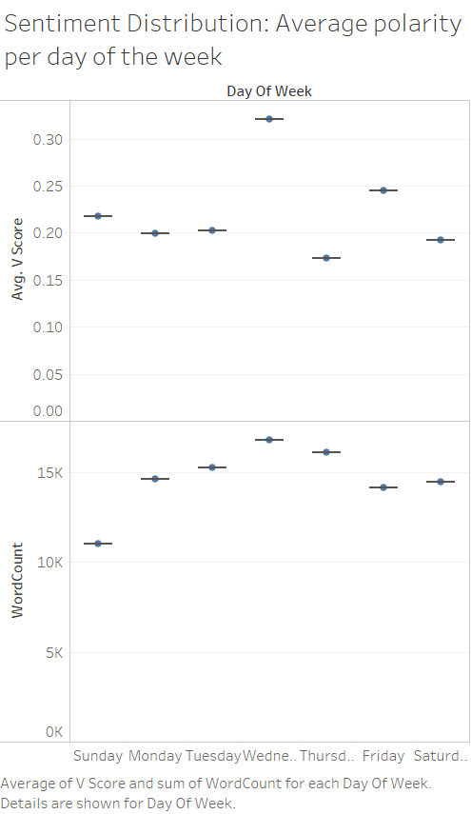

Slide 9
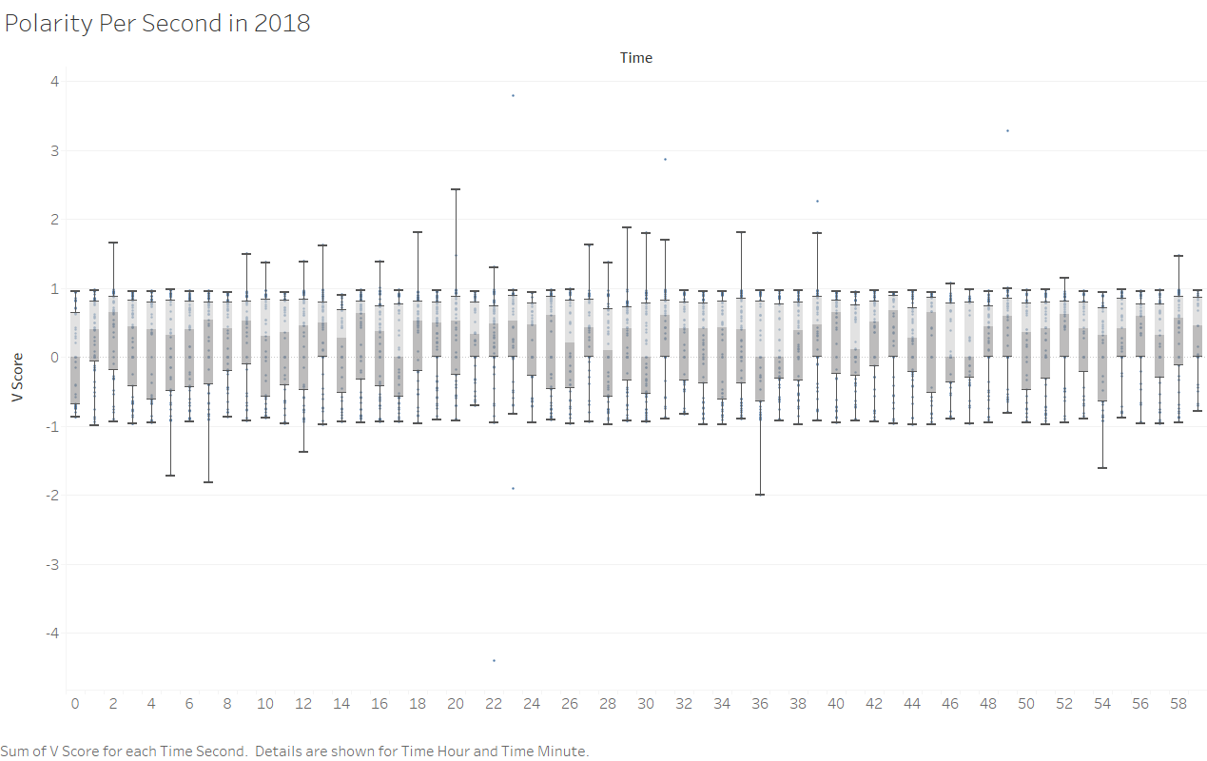

Slide 10


Slide 11
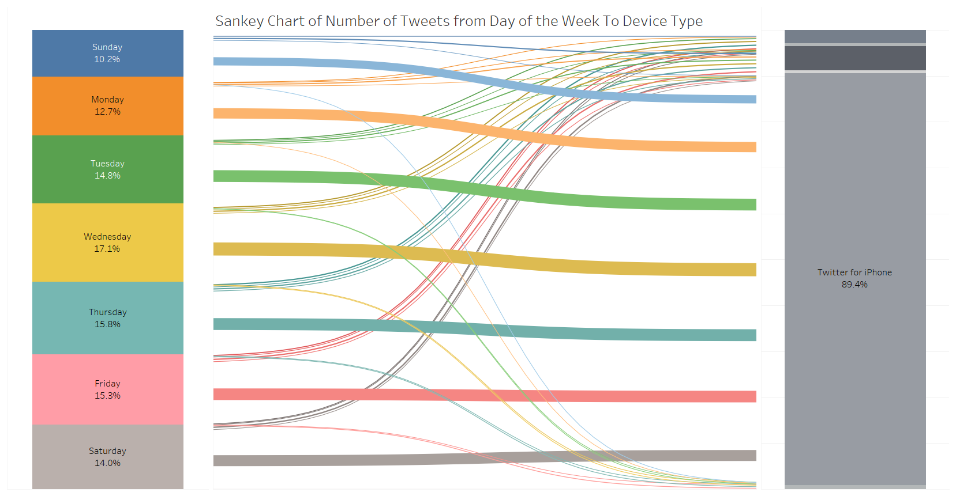

Slide 12
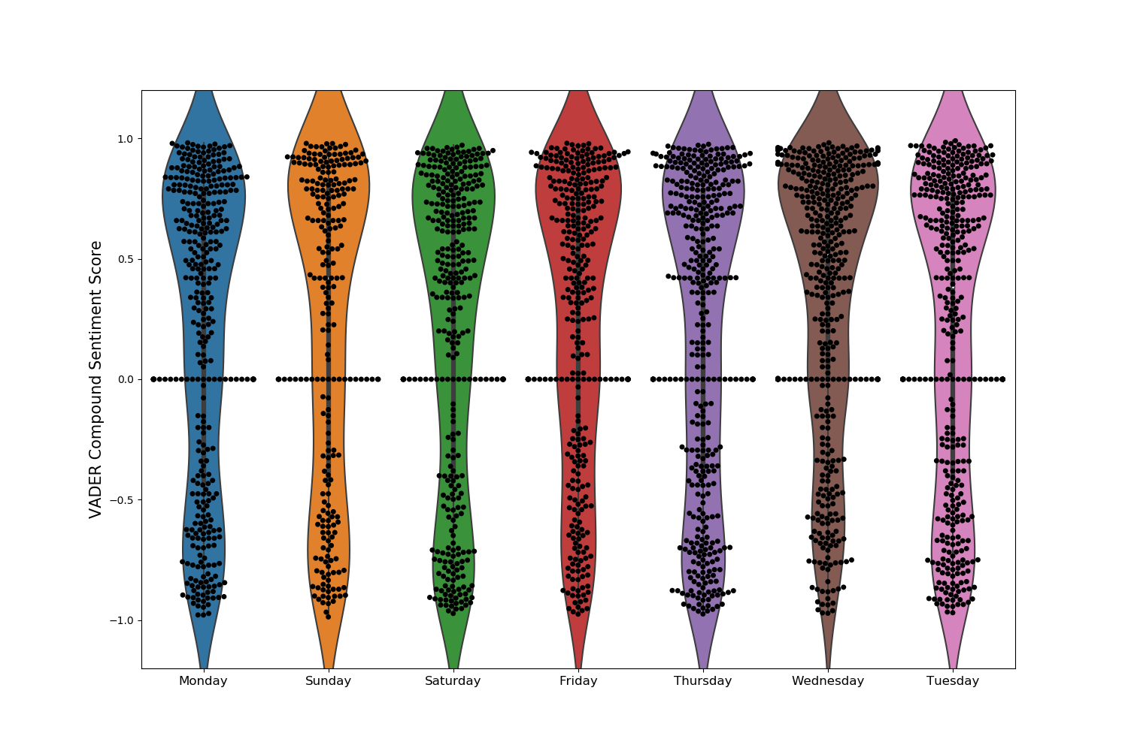
VADER Compound Sentiment Score ( Weekly - 2018)

Slide 13
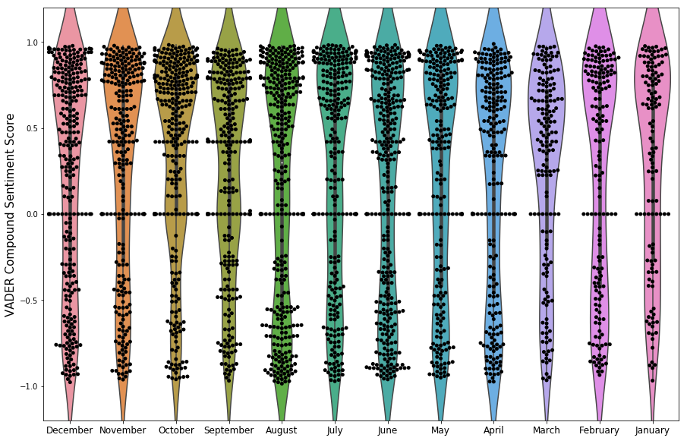
VADER Compound Sentiment Score ( Monthly-2018)

Slide 14
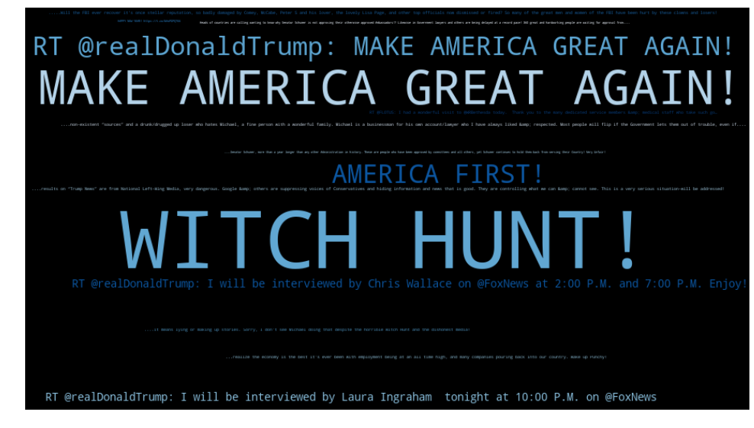
Word Cloud

Slide 15
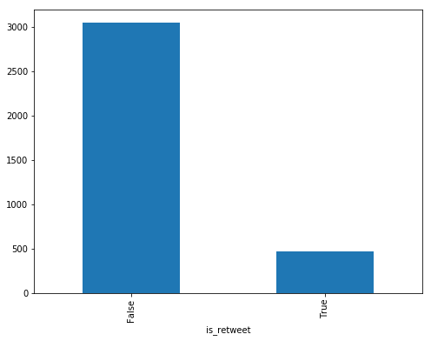
Re-tweet sentiment analysis

Slide 16
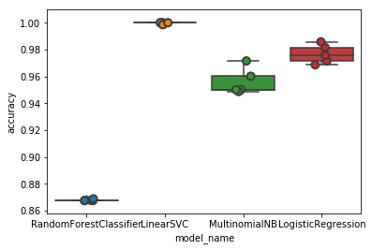
Model Analysis

Slide 17
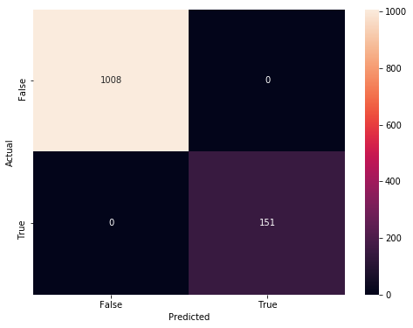
Confusion Matrix for the re-tweet

Slide 18

THANK YOU

