Slide 1



High-Quality Code:
Course Introduction
Course Program, Evaluation, Exams, Resources
Telerik Software Academy
Learning & Development
http://academy.telerik.com

Slide 2

Table of Contents
Next step in Telerik Software Academy
The High-Quality Code Course Program
The Trainers Team
Teamwork Project
Exams and Evaluation
  The Practical Exam
Recommended Books
Resources for the Course

Slide 3

High-Quality Code
The Next Module in the Software Academy (Programming Track)

Slide 4

Next Step in Telerik Software
High-Quality Code
  Continuation of OOP course
  Quality coding, unit testing, refactoring, software engineering, design patterns
  Lectures once a week
The course exam?
  Team work project
  Practical exam

Slide 5



High-Quality Code
Course Program
What Will Be Cover in the Course?

Slide 6
The Course Program
Course Overview.
Introduction to High-Quality Programming Code.
Code Formatting
Correctly Naming Identifiers in the Code (Classes, Properties, Methods, Parameters, Variables, etc.)
Code Documentation and Comments
Using Variables, Data, Expressions and Constants.
Using Control Structures, Conditional Statements and Loops
High-Quality Methods. Cohesion and Coupling.
High-Quality Classes and Class Hierarchies

Slide 7
The Course Program (2)
Defensive Programming and Exceptions.
Performance Tuning and Code Optimization
Unit Testing. Mocking. Test-Driven Development
Code Refactoring. Refactoring Patterns.
Effective Debugging: Tools and Techniques
Development Tools. IDEs. Change Management Systems. Code Analysis Tools. Automated Testing Tools. Automated Build Tools. Continuous Integration Tools. Team Collaboration Tools
Design Patterns: the Classical GoF Patterns

Slide 8

The Course Program (3)
Fundamentals of Software Engineering (Idea, Architecture, Design, Implementation, Testing, Deployment, Support). Development Methodologies. Scrum. Project Management
Exam Preparation
Teamwork Projects
Teamwork Public Defense
Practical Exam

Slide 9

The Trainers Team

Slide 10
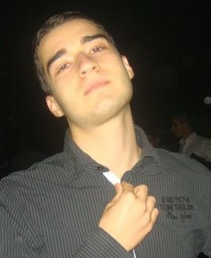
Trainers Team
Nikolay Kostov
  Team Lead, Senior Developer
  and Trainer @ Telerik Corp.
  Student at Sofia University
    Computer Science
  IT and Informatics competitions contestant
  Graduate from the second season of
  Telerik Software Academy
  Email: nikolay.kostov [at] telerik.com
  Blog: http://nikolay.it

Slide 11
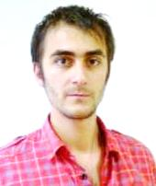
Trainers Team (2)
Doncho Minkov
  Senior Technical Trainer
  @ Telerik Software Academy
  Student in Sofia University
    Software Engineering
  Contestant in the Informatics competitions
  Graduate from the first season of
  Telerik Software Academy
  Email: doncho.minkov [at] telerik.com
  Blog: http://minkov.it

Slide 12
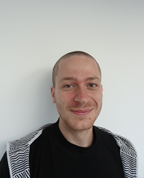
Trainers Team (3)
Ivaylo Kenov
  Junior Technical Trainer
  @ Telerik Software Academy
  Graduate from the fourth season
  of Telerik Software Academy
  Mathematical competitions contestant
  E-mail: ivaylo.kenov [at] telerik.com
  Champion in OOP and DSA

Slide 13




Evaluation
Code
Thank God There Are Bonuses!
Quality

Slide 14

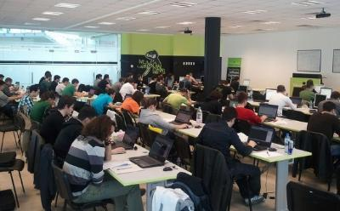
High-Quality Code – Evaluation
Evaluation components
  Practical exam – 60%
  Team work – 15%
  Homework – 10%
  Homework evaluation – 5%
  Attendance in class – 10%
Bonuses
  Forums activity – bonus up to 5%

Slide 15


Pass / Excellence / Fail Criteria
  Criteria for pass / pass with excellence / fail
    Pass with excellence
    Very high exam results
    or
    High total results
  Pass
    Average total results
  Fail
    Low total results or 0 at the exam

Slide 16
Homework Peer Reviews
Everyone will get feedback for their homework
Everyone will give feedback for few random homework submissions
  Students submit homework anonymously
    Please exclude your name from the submissions!
  For each homework submitted
    Students evaluate 3 random homeworks
    From the same topic, after the deadline
    Give written feedback, at least 200 characters
    Low-quality feedback → report for punishment

Slide 17
Teamwork Project
Teamwork project requirements
  Teams of 3-5 students (balanced random)
  Given a low-quality C# project
  Refactor the code
    Improve its quality and make it testable
  Write unit tests (with high coverage) + docs
  Use source control system
  Each team member should have commits during the whole assignment
  Public project defense

Slide 18

Practical Exam
You will be given a C# interface
  You need to implement it (write the code)
    According to the documentation
  Write unit tests
    High code coverage
    Catch all possible defects
Assessment
  Unit tests will be automatically checked
  Additional manual check

Slide 19



Use the Same Email!
Please use the same email address in:
  http://telerikacademy.com
  http://bgcoder.com
  http://forums.academy.telerik.com
Otherwise your score could be incorrectly calculated!

Slide 20

Recommended Books

Slide 21

The C# Textbook
The official textbook for the course
  “Introduction to Programming with C#”, Nakov S. and his team, 2010
  Freely downloadable from: www.introprogramming.info
The C# programming tracks follows the book
High-quality code → chapter 21

Slide 22
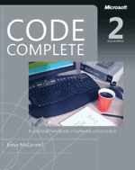


Recommended Books
Code Complete, 2nd Edition, Steve McConnell, ISBN 0735619670, http://www.cc2e.com
Refactoring: Improving the Design of Existing Code, Martin Fowler, Kent Beck, John Brant, William Opdyke, Don Roberts, ISBN 0201485672, http://martinfowler.com/
Test Driven Development: By Example, Kent Beck, ISBN 0321146530

Slide 23








Resources
What We Need in Addition to this Course Content?

Slide 24

Course Web Site & Forums
Register for the "Telerik Academy Forums":
  Discuss the course exercises with your colleagues
  Find solutions for the exercises
  Share source code / discuss ideas
The High-Quality Code official web site:
forums.academy.telerik.com/high-quality-code
http://academy.telerik.com/student-courses/programming/high-quality-code/

Slide 25
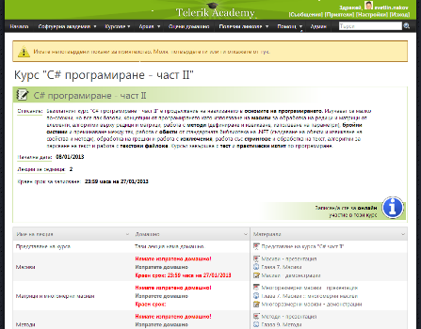
Telerik Integrated
Learning System (TILS)
The Telerik Integrated Learning System (TILS)
  www.telerikacademy.com
  Important resource for all students
  Homework submissions
  Homework peer reviews
  Presence cards with barcode
  Reports about your results
telerikacademy.com/Courses/Courses/Details/174

Slide 26


Required Software
Software needed for this course:
  Microsoft Windows (XP / Win7 / Win8)
  Microsoft Visual Studio 2012/2013 or Visual Studio Express 2012/2013 (free version of VS)
  .NET Framework 4.5 (included in Visual Studio)
  Visual Studio 2005, 2008 or 2010 is also OK

Slide 27

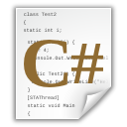



High-Quality Code:
Course Introduction
http://academy.telerik.com

Slide 28




Free Trainings @ Telerik Academy
C# Programming @ Telerik Academy
    csharpfundamentals.telerik.com
  Telerik Software Academy
    academy.telerik.com
  Telerik Academy @ Facebook
    facebook.com/TelerikAcademy
  Telerik Software Academy Forums
    forums.academy.telerik.com

