Slide 1
Heart-lung sound separation based on Self-attention mechanism
Tonmoy Kumar Roy
ID: 1705025

Slide 2
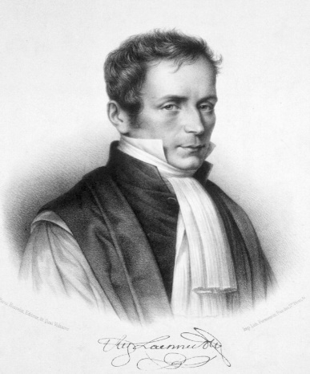
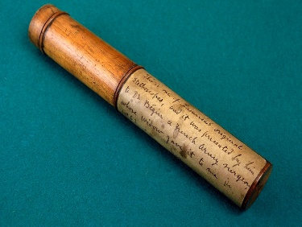
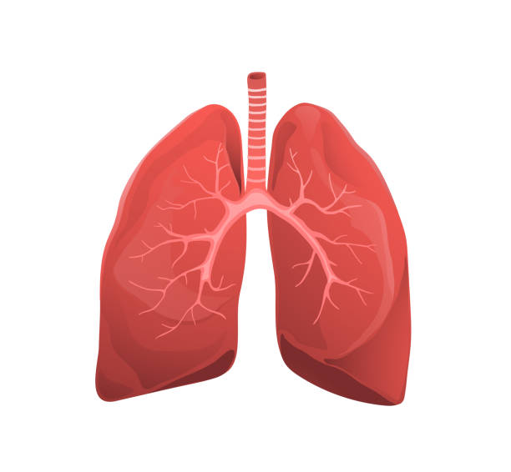
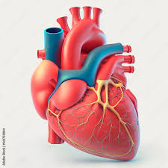
Introduction
René Laennec invented first Stethoscope in 1816.
Initially, focus on abnormalities in heart sound
Later on physicians began paying closer attention to lung sounds
Murmurs
Irregular rhythms
Other heart disease
Pneumonia
Bronchitis
Asthma

Slide 3
Benefits of heart-lung sound separation
Can Diff. Cardiovascular and Respiratory Conditions
Early Detection of Abnormalities
Targeted Treatment
Preventing Misdiagnosis
Monitoring Progression and Response to Treatment
Improving Patient Safety

Slide 4
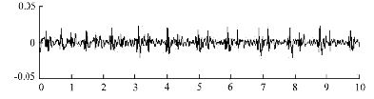


Task Illustration
Separation
Heart signal
Mixed signal
Lung signal

Slide 5
Literature Review
Title | Used Method | Remarks
Application of Adaptive Line Enhancer with LMS to Separate Heart Sound Signal from Lung Sound Signal at Real Time, by Krishnaswamy, et al., 2015 | Adaptive signal processing | Need Reference signal
Hybrid Nelder-Mead search based optimal Least Mean Square algorithms for heart and lung sound separation, by Ruban, et al., 2017 | Least Mean Square | Need Reference signal
Performance of Adaptive Noise Cancellation with Normalized Last-Mean-Square Based on the Signal-to-Noise Ratio of Lung and Heart Sound Separation, by Noman, et al., 2018 | Normalized Last-Mean-Square | Need Reference signal
Heart sounds separation from lung sounds using independent component analysis, by M Pourazad, et., 2005 | Independent component analysis | Can not apply to single-channel HLS separation
Parallel source separation system for heart and lung sounds, by A. J. Muñoz-Montoro et al., 2021 | Nonnegative matrix factorization | Fails when sound overlap time and frequency domain

Slide 6
Literature Review
Title | Used Method | Remarks
A non-negative matrix factorization approach based on spectro-temporal clustering to extract heart sounds, by F. J. Canadas-Quesada et al., 2017 | Nonnegative matrix factorization | Fails when sound overlap time and frequency domain
Blind Monaural Source Separation on Heart and Lung Sounds Based on Periodic-Coded Deep Autoencoder, by Tsai, et al., 2020 | PC-DAE | Assumed different periodicity between heart and respiration rate
Heart-lung sound separation by nonnegative matrix factorization and deep learning, by W. Wang et al., 2023 | Nonnegative matrix factorization, LSTM
Research on Heart and Lung Sound Separation Method Based on DAE-NMF-VMD, by W. sun et al., 2023 | Neural network, Nonnegative matrix factorization

Slide 7
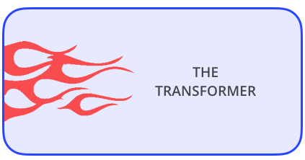
My proposed Self-attention method
Long-Term Dependencies
Attention Mechanism
Parallel Processing
Scalability
Better than RNN
Better performance

Slide 8
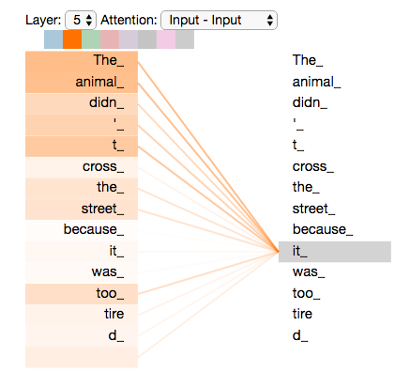
How Transformer Works?
If we try to translate the English text to another language
“The animal didn't cross the street because it was too tired”

Slide 9
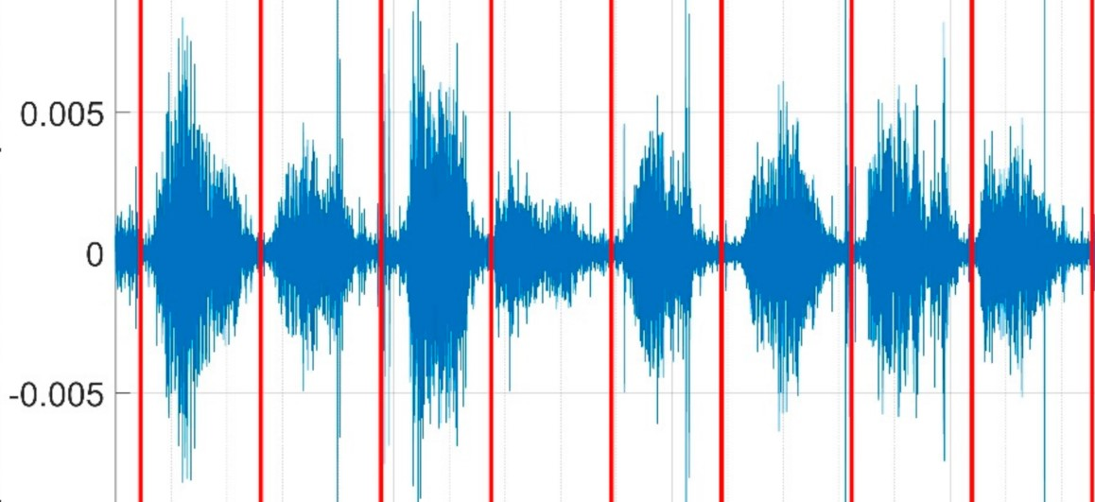
Transformer in Sound
1
2
3
4
5
5
6
7
8
1
2
3
4
5
5
6
7
8
1 | 2 | 3 | 4 | 5 | 6 | 7 | 8

Slide 10
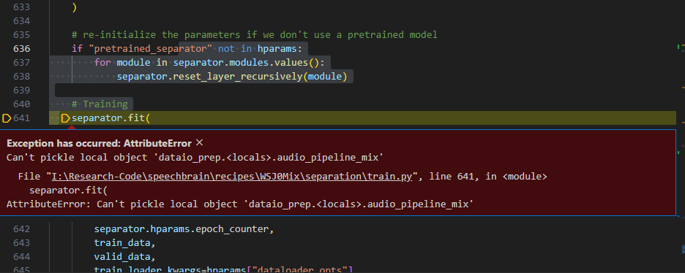
Progress
Try to train with Sepformer Model (Attention is All You Need in Speech Separation)

