Slide 1
MLSA INTERNSHIP
NAME : TONMOY MUKHERJEE
ROLL NO : 2200290120181
BRANCH : COMPUTER SCIENCE
YEAR : 3rd yr

Slide 2
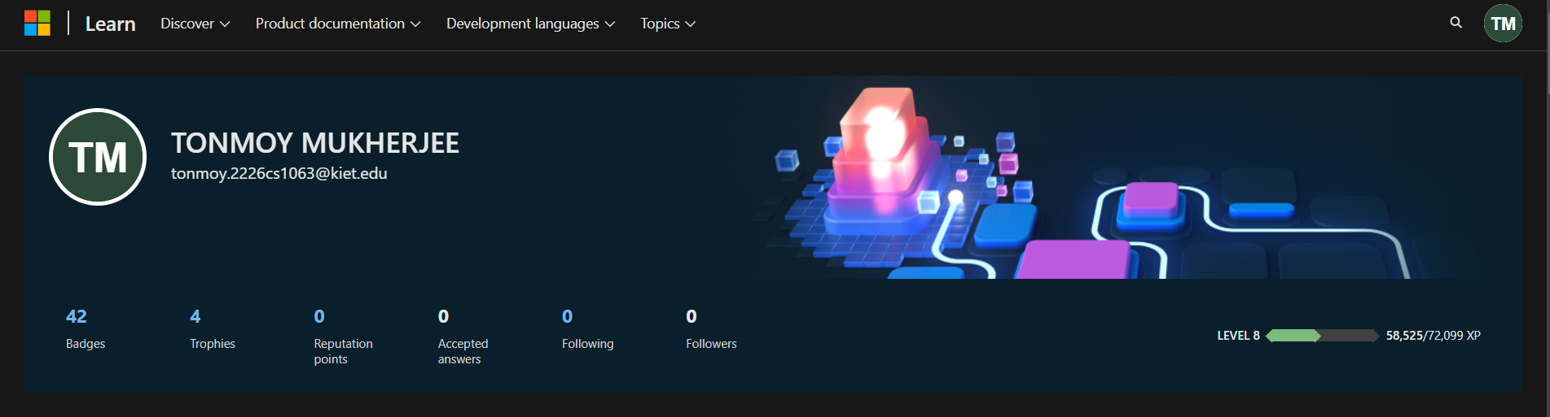
BADGES / TROPHIES

Slide 3
TO-DO-LIST
Objective: Build a simple, user-friendly app for managing daily tasks.
Description:
Allows users to add, delete, and organize tasks.
Real-time updates without page refresh.
Utilized JavaScript for event handling and interactive features.
Key Learnings:
Improved JavaScript skills in event-driven programming.
Gained experience in creating clean interfaces using HTML and CSS.

Slide 4
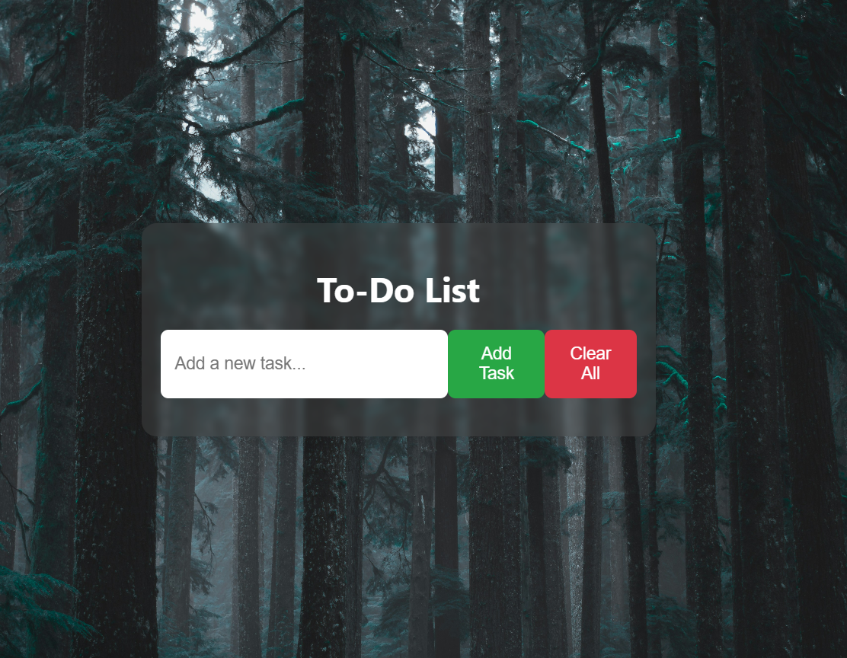
TO-DO-LIST

Slide 5
SIMPLE- CALCULATOR
Objective: Create a basic calculator for arithmetic operations.
Description:
Simple interface for performing addition, subtraction, multiplication, and division.
Real-time calculations without page reload.
Built with HTML, CSS, and JavaScript.
Key Learnings:
Strengthened JavaScript skills, especially for managing user input and real-time updates.
Practiced creating accessible and easy-to-use interfaces.

Slide 6
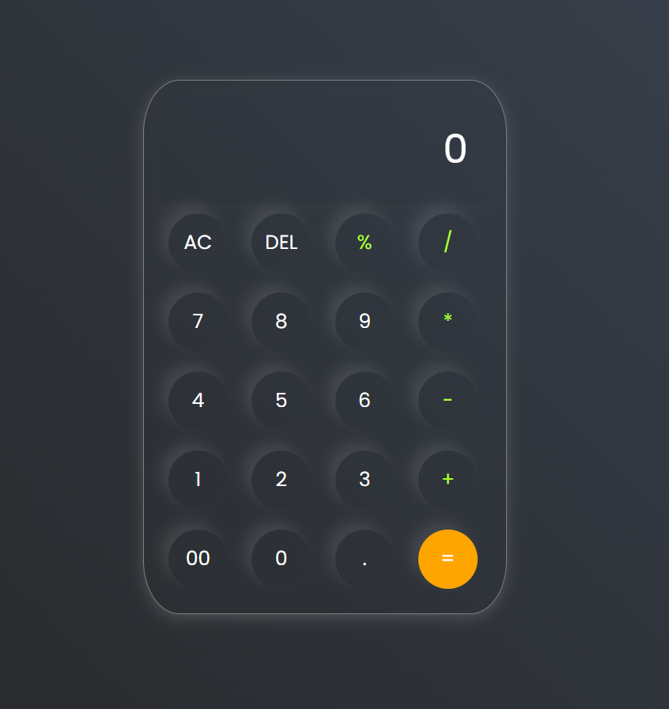
SIMPLE- CALCULATOR

Slide 7
Conclusion
Gained practical knowledge and hands-on experience in full-stack development.
Developed stronger problem-solving skills through real-world projects.
Built confidence in handling web development challenges by integrating various tools and technologies.

