Slide 1

DEPARTMENT OF COMPUTER SCIENCE Project Presentation (BCS 554) E Waste Facility Locator
Guide : Ms. Shivani(Assistant professor)
Project Members :
1.Sajal Mittal(2200290120141)
2.Sarvagya Pratap Singh(2200290120149)
3.Tonmoy Mukherjee(2200290120181) Group Id :PCS26-33
4.Utkarsh Pratap Singh(2200290120184) Project Id : SIH1392

Slide 2
Table of content
1.TITLE PAGE
2.PROBLEM STATEMENT
3.OBJECTIVES
4.TECHNOLOGY USED
5.LITERATURE SURVEY
6.SDGs
7.PROJECT SCREENSHOTS
8.PROJECT STATUS
9.RESEARCH PAPER STATUS
10.REFERENCES

Slide 3
Problem Statement
Website that tells you the location of the nearest e-waste collection and recycling facility. Offers educational pop-ups on the harmful components of your e-waste and their effects on the environment and human health if not disposed correctly. There could be an option to input the model of your old device and earn credit points relative to the amount of precious metals recovered from the device if disposed correctly.

Slide 4
Objectives
Locate Recycling Centers & Track Disposal: Help users find nearby e-waste recycling facilities and track their recycling efforts, showing environmental benefits.
Educational Content & PopUps: Inform users about harmful e-waste components, their impact, and provide guides on proper disposal methods.
Credit & Reward System: Allow users to earn points for recycling devices based on recoverable precious metals and introduce gamification to reward consistent efforts.
Device Condition & Resell Options: Let users assess their device’s condition to choose between repair, resale, donation, or recycling.
Global Awareness & Regulations: Highlight global e-waste trends, connect with certified recycling partners, and share government guidelines for proper disposal.

Slide 5
Technology Used
Frontend Technologies: Typescript, Next.js
Mapping and Geolocation: Leaflet.js/Mapbox
UI Frameworks: Tailwind CSS, framer- motion
Backend Technologies: Node.js(with Express) , MongoDB
APIs: RESTful APIs
Authentication and User Management: OAuth Authentication
Points and Rewards System: Custom trained Algorithm (Random Forest Model)

Slide 6
Literature Survey
Nnorom, I. C. & Osibanjo, O. (2008) focuses on the global state of e-waste management, particularly in developing nations like Nigeria. The paper highlights the hazards of improper e-waste disposal and proposes guidelines for better recycling practices, emphasizing the need for government intervention and public awareness campaigns[1].Manomivibul, P. (2009)evaluates the effectiveness of Extended Producer Responsibility (EPR) policies in managing e-waste across different countries. The study reviews case studies from Europe, Asia, and the U.S., showcasing how EPR incentivizes companies to design products with reduced environmental impact[2].Grant, K., Goldizen, F. C., Sly, P. D., et al. (2013) provides a systematic review of the health impacts of e-waste, particularly on children in low-income countries where informal recycling is common. The paper links e-waste exposure to respiratory issues, cognitive development problems, and chronic diseases[3].Widmer, R., Oswald-Krapf, H., Sinha-Khetriwal, D., et al. (2005) discusses the importance of e-waste recycling and emerging trends in the industry. The authors highlight key recycling technologies but note that implementation remains slow due to the lack of regulatory frameworks and public awareness[4].Kahhat, R. & Williams, E. (2012) examines e-waste policy frameworks across countries, comparing regulatory measures like EPR and take-back schemes. The paper finds that countries with well-developed regulations, such as the EU, have better e-waste management outcomes[5]

Slide 7
SDGs
SDG 3: Good Health and Well-being
E-waste has harmful chemicals. If not handled safely, it can make people sick. Proper management keeps people healthy.
SDG 11: Sustainable Cities and Communities
Managing e-waste properly makes cities cleaner and safer. It also reduces pollution in communities.
SDG 12: Responsible Consumption and Production
This goal is about using things wisely and reducing waste. E-waste fits here because it encourages recycling, reuse, and safe disposal of electronic items.
SDG 13: Climate Action
Burning or dumping e-waste adds harmful gases to the air. Managing e-waste properly helps fight climate change and protect the environment.

Slide 8
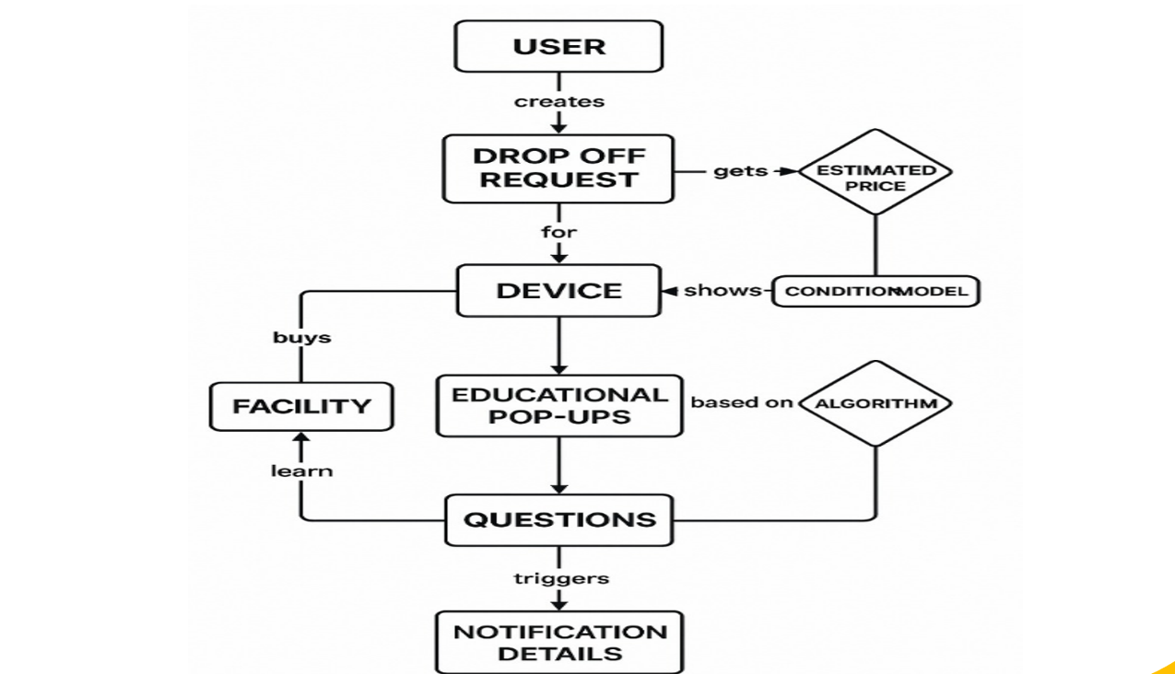
Diagrams
FLOW CHART

Slide 9
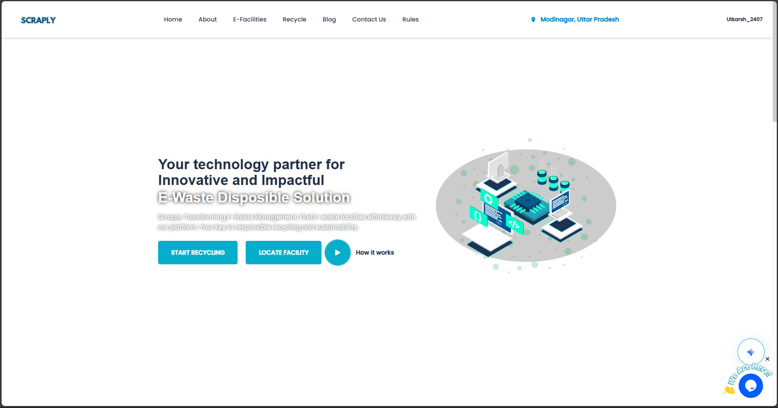
Project-Screenshots

Slide 10
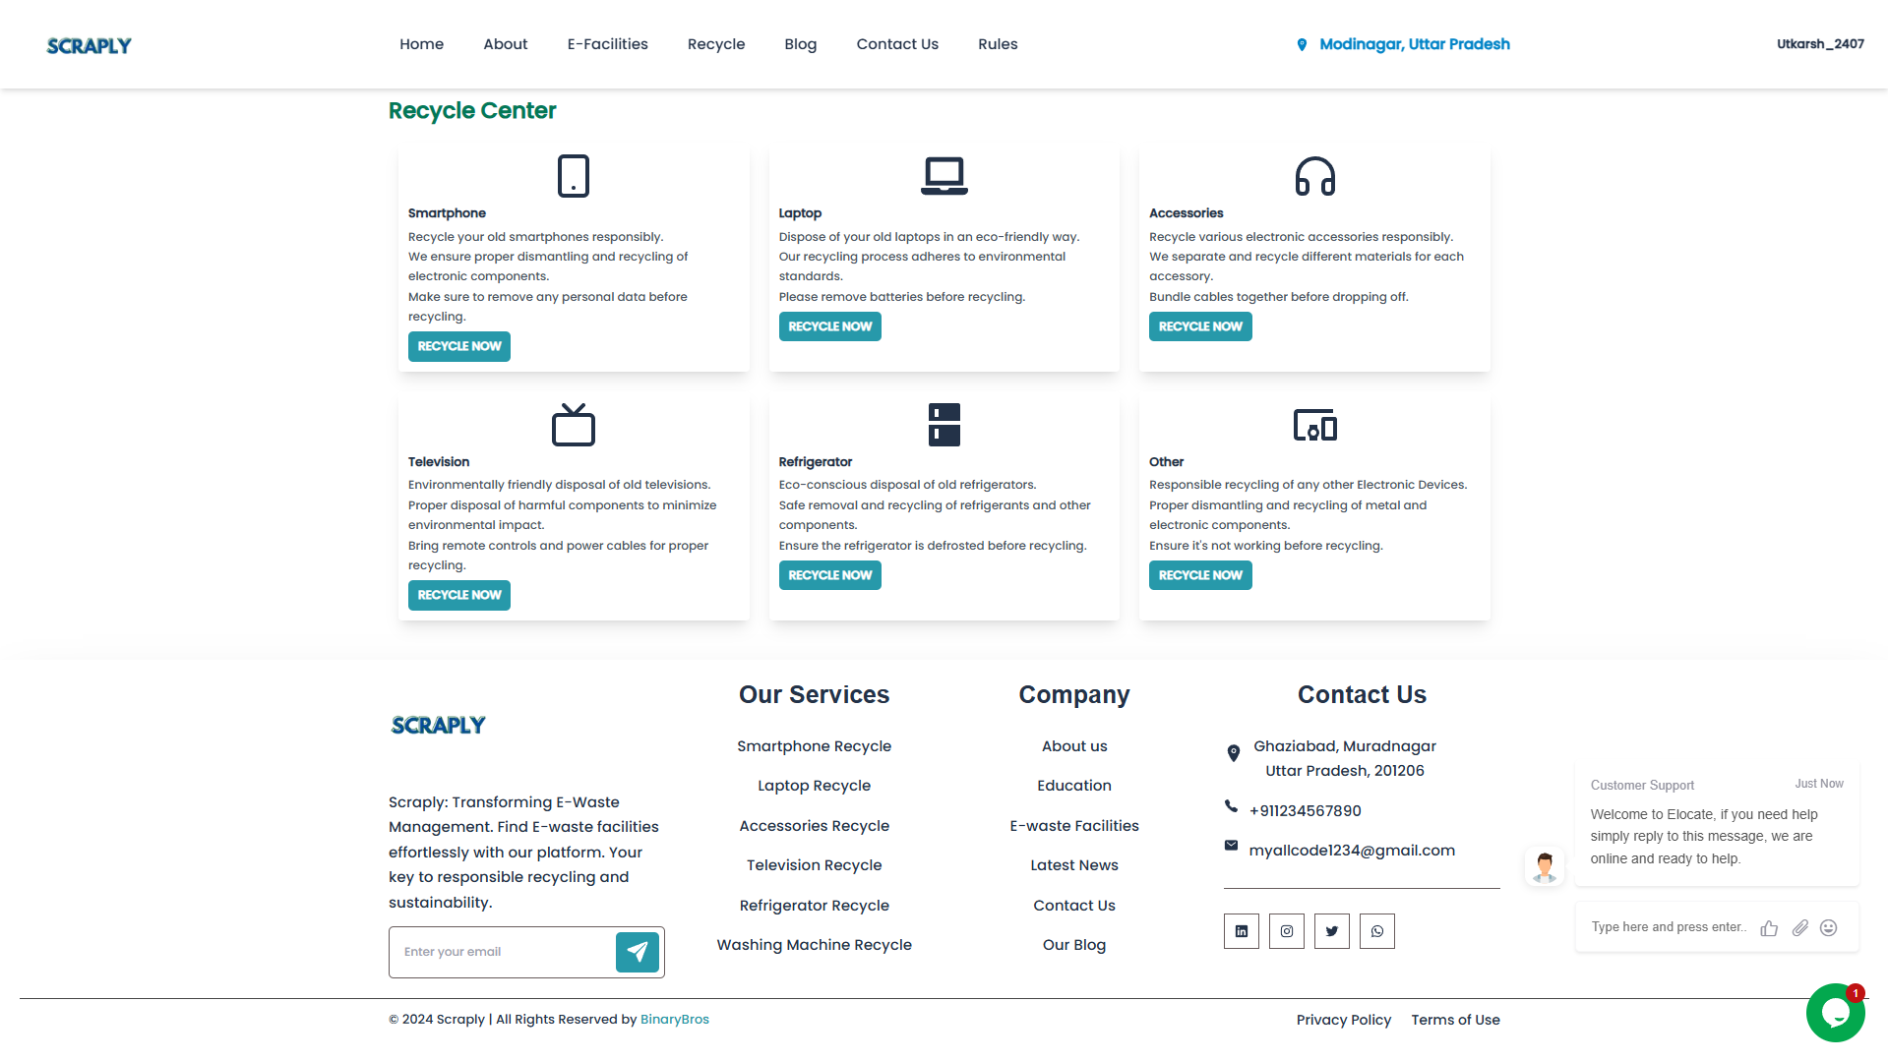
Project-Screenshots

Slide 11
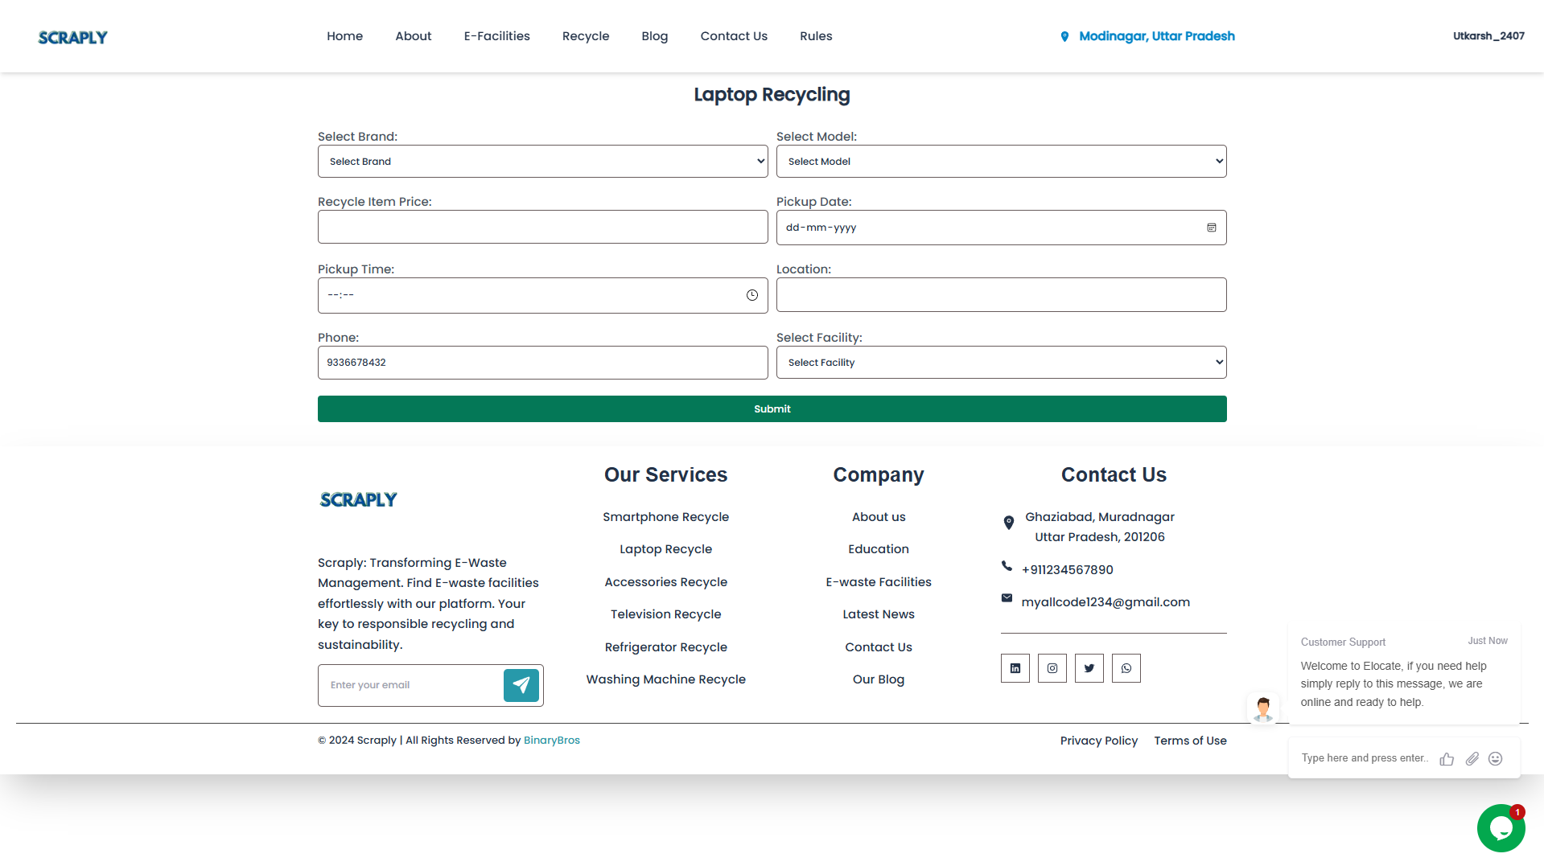
Project-Screenshots

Slide 12
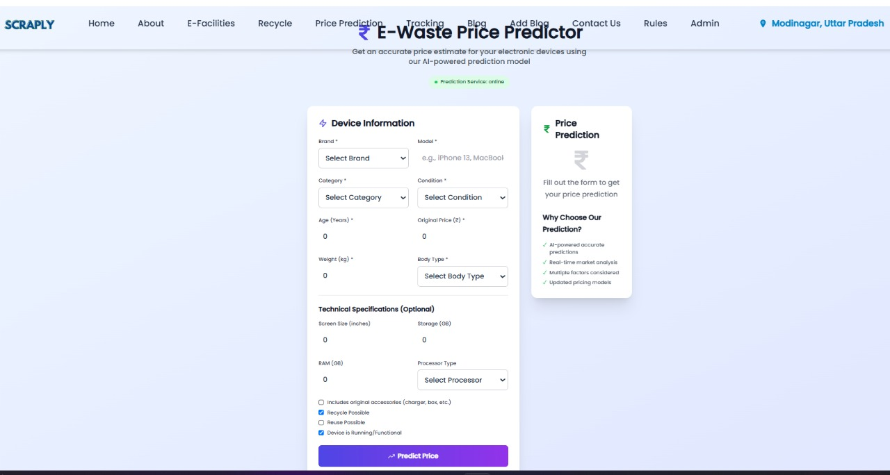
Project-Screenshots

Slide 13
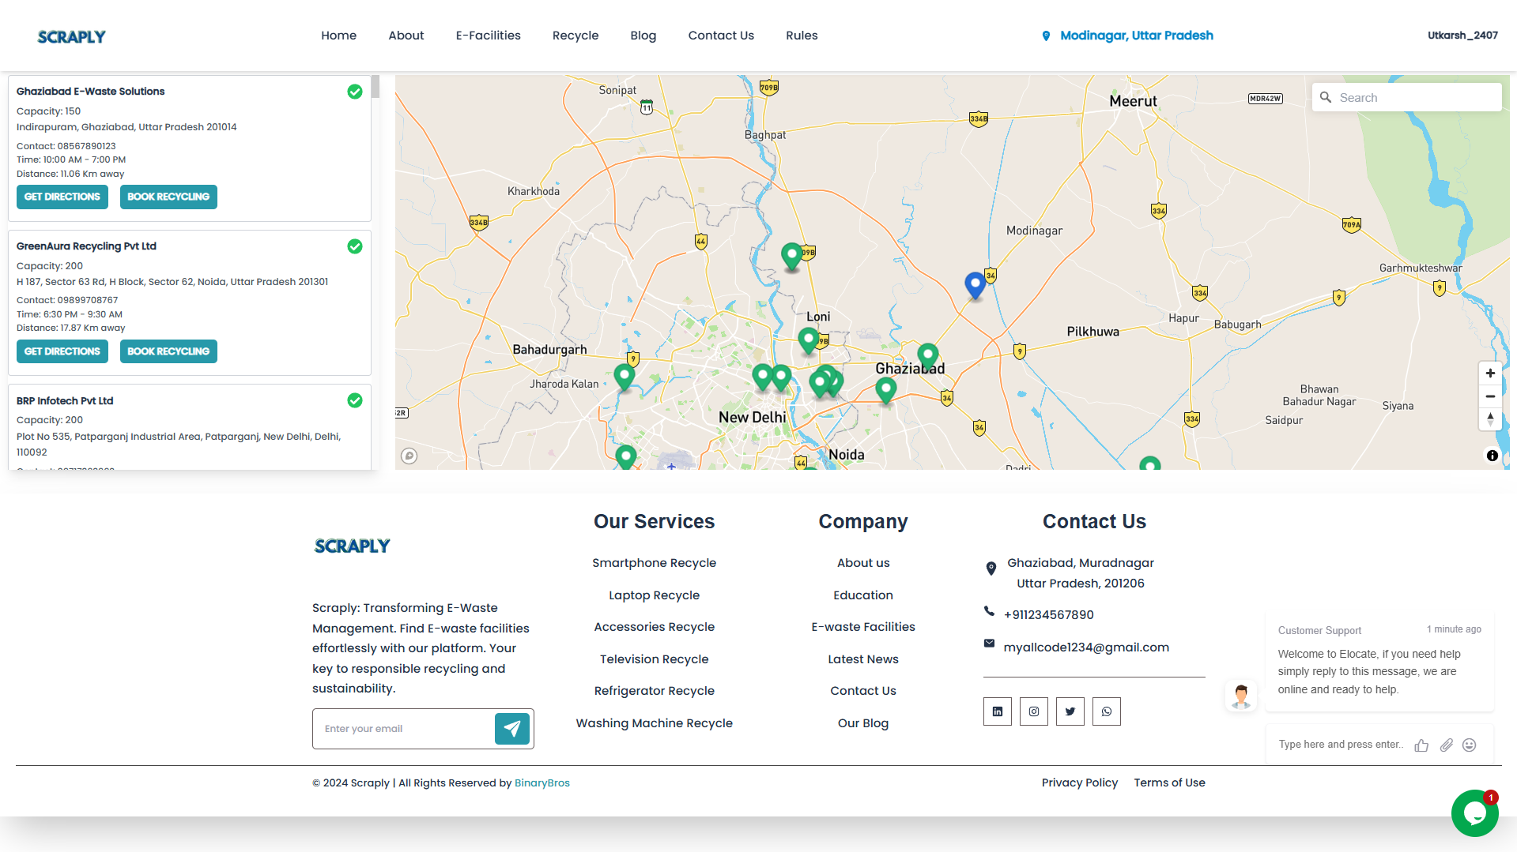
Project-Screenshots

Slide 14
Project Status
Project is completed
Patent Proof
Synopsis Created
Project PPT created
Research paper accepted
Research paper presented
Drive Link (PPT & Synopsis) :
https://drive.google.com/drive/folders/1w27Q5C_5vtwclSMiu6CsP3b-4FnHndOt?usp=drive_link

Slide 15
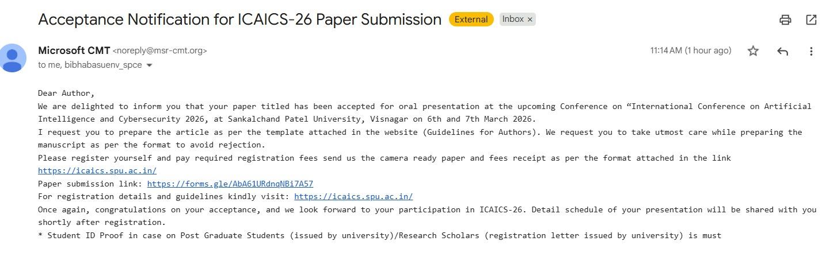
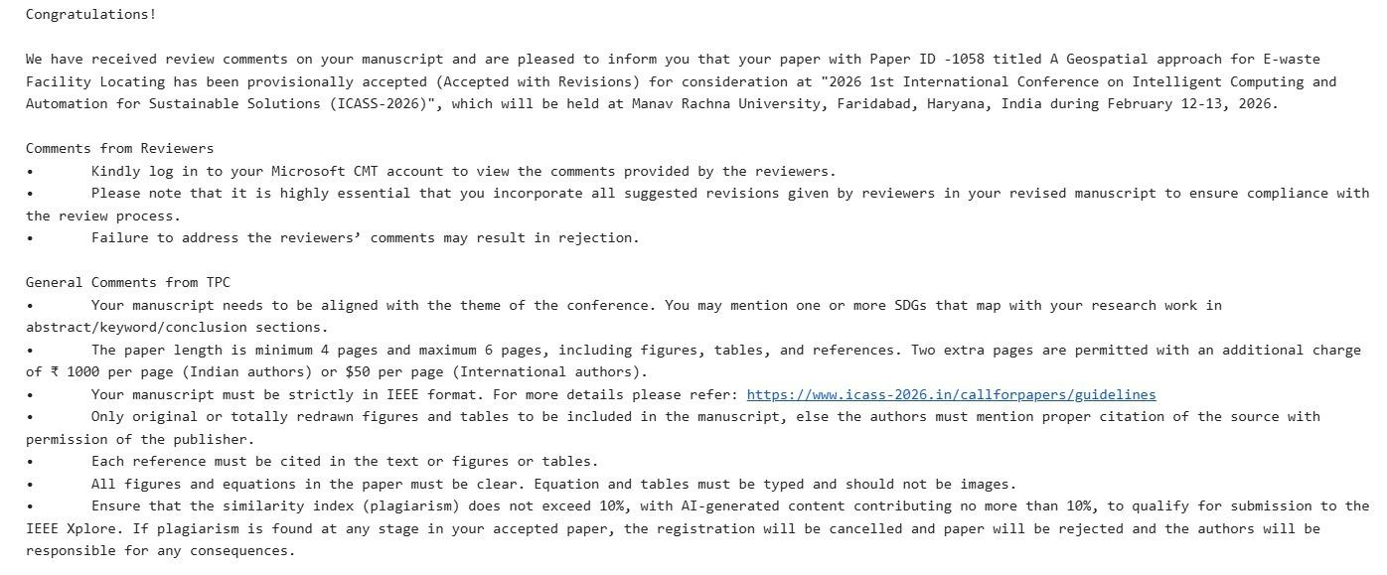
Research Paper Accepted Proof

Slide 16
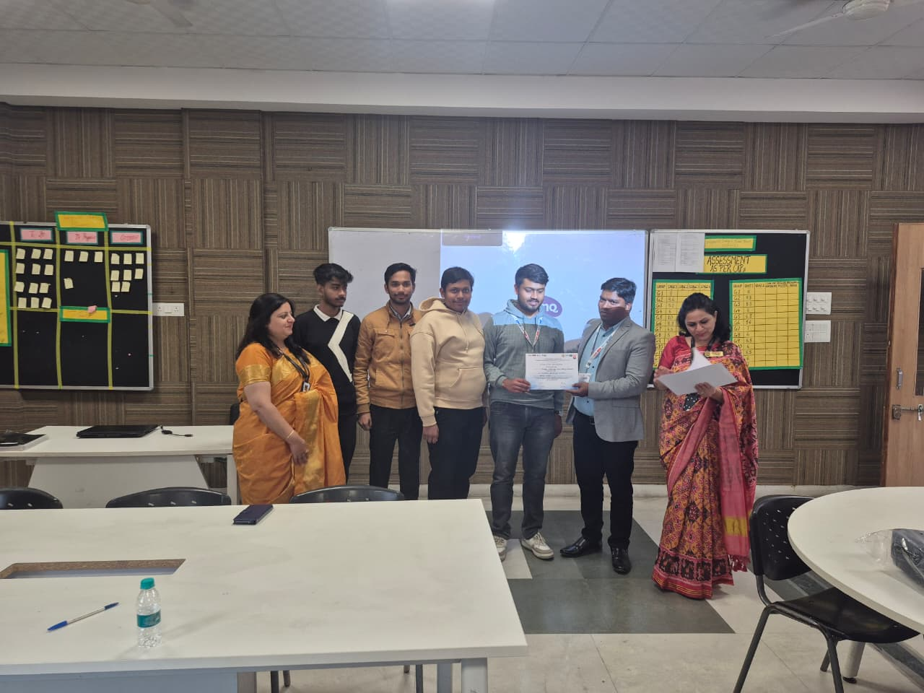
Paper Presented

Slide 17
Github- Links
tonmoy-cpu/Scraply-development
Utkarsh24072003
https://github.com/SarvagyaPratap
https://github.com/sajalmittal123

Slide 18
References
[1] I. C. Nnorom and O. Osibanjo, "Global E-waste Management Practices," Resources, Conservation and Recycling, vol. 52, no. 9, pp. 1170-1182, 2008.
[2] P. Manomivibul, "Extended Producer Responsibility (EPR) and Its Impact on E-Waste Recycling: A Global Perspective," Waste Management & Research, vol. 27, no. 5, pp. 454-463, 2009.
[3] K. Grant, F. C. Goldizen, P. D. Sly, et al., "Health Consequences of Exposure to E-Waste: A Systematic Review," The Lancet Global Health, vol. 1, no. 6, pp. e350-e361, 2013.
[4] R. Widmer, H. Oswald-Krapf, D. Sinha-Khetriwal, et al., "Recycling of E-waste: An Emerging Trend," Environmental Impact Assessment Review, vol. 25, no. 5, pp. 436-458, 2005.
[5] R. Kahhat and E. Williams, "Addressing the E-Waste Crisis: Policy Insights from a Cross-National Analysis," Environmental Science & Technology, vol. 46, no. 5, pp. 2715-2723, 2012.

Slide 19
Conclusion
The E-Waste Facility Locator is an essential tool for promoting responsible e-waste disposal by providing users with easy access to nearby recycling facilities, educational resources, and incentives for proper recycling. By raising awareness of the environmental and health risks of improper e-waste disposal and encouraging active participation through a rewards system, the platform empowers individuals to make informed decisions. With its user-friendly design and community engagement features, this platform contributes to a cleaner, healthier planet while fostering a culture of sustainability.

Slide 20
Thank You
-Team Lagaan

