Slide 1
CSCI 1301 Introduction to Computing and Programming
Summer 2015

Slide 2
Test 1 Review

Slide 3
Test Format
The test will consist of:
10-15 True/False
10-15 Multiple Choice
6-8 Short Answer
2 Writing Code Problems (small but complete programs to perform some task)
Short Answer can be anything from:
Code reading
Finding code errors
Expression evaluation
Testing your binary knowledge

Slide 4
Running Java Programs
Java does not directly compile to machine code. What does it do instead?
What is needed to run a Java byte code program on a given computer?
How does this make Java architecture neutral (able to run on many machines)?

Slide 5
Running Java Programs
Java does not directly compile to machine code. What does it do instead?
What is needed to run a Java byte code program on a given computer?
How does this make Java architecture neutral (able to run on many machines)?
Java programs are compiled into bytecode. To run the bytecode program, a computer must have a suitable Java virtual machine (an interpreter) installed. This translates the bytecode into the local machine code of the computer. Since Java virtual machines have been developed for many different types of computer, and each VM can run the same byte code, the byte code program is called architecture neutral.

Slide 6
Primitive Data Types
List the 8 primitive data types used in Java as well as the number of bytes used to store a value of each type.

Slide 7
Primitive Data Types
List the 8 primitive data types used in Java as well as the number of bytes used to store a value of each type.
boolean 1 byte
byte 1 byte
short 2 bytes
char 2 bytes
int 4 bytes
long 8 bytes
float 4 bytes
double 8 bytes

Slide 8
If s and t are both variables for primitive data types (e.g., int), what sorts of thing do the variables actually store? What about class types?

Slide 9
If s and t are both variables for primitive data types (e.g., int), what sorts of thing do the variables actually store? What about class types?
s and t would both hold binary representations of the values. E.g., If s is assigned the value 10, then it will hold a binary representation of 10.
The same is not true if s and t have been declared to be the type of a class (e.g., String). In that case, s and t each hold a reference to an object (that is, the memory location of the object).

Slide 10
If s and t are both String variables, how is using s == t different than s.equals(t)?

Slide 11
If s and t are both String variables, how is using s == t different than s.equals(t)?
s == t is true if and only if the strings for s and t are stored in the same memory location (that is, s and t hold the same references).
In contrast, s.equals(t) is true if and only if the strings for s and t are identical on a character by character basis.

Slide 12
If s and t are primitive data type variables, will the method s.equals(t) test for equality? Why or why not?

Slide 13
If s and t are primitive data type variables, will the method s.equals(t) test for equality? Why or why not?
This will cause a compiler error. If s is a primitive data type variable, then it has no methods defined for it. And so invoking s.equals(t) is syntactically incorrect.

Slide 14
Given that x is a variable of type float and has value 5.0, which of the below assignment statements is correct, and which will generate a compile time error?
int result = x;
double result = x;
int result = (short) x;
int result = (long) x;
int result = (byte)((double) x));

Slide 15
Given that x is a variable of type float and has value 5.0, which of the below assignment statements is correct, and which will generate a compile time error?
int result = x; //NO! Must explicitly cast as an int
double result = x; //OK. float values can be “promoted” to doubles.
int result = (short) x; //OK. Explicitly casting to a short
is OK. The short is then promoted
to an int.
int result = (long) x; //NO! A long will not fit into an
int variable.
int result = (byte)((double) x)); //OK. The float is cast to a
double, which is cast to a byte, which is promoted to an int.

Slide 16
Where the variables are defined as below, what will be the value and data type of each of the following? use decimal points to indicate floating point values (e.g., ‘1.0’ rather than ‘1’).
int i1 = 10, i2 = 5;
byte b = 5;
float f = 200.00F;
double d = 0.1;
b/i2 - i1 |  | f*d*d
((b*b) + (i2 * i2)) |  | b++
(int)f % b |  | d/i1
b * d |  | i2/i1
(int)(i1/f) |  | i1 + f
What is the data type of b * b?

Slide 17
Where the variables are defined as below, what will be the value and data type of each of the following? use decimal points to indicate floating point values (e.g., ‘1.0’ rather than ‘1’).
int i1 = 10, i2 = 5;
byte b = 5;
float f = 200.00F;
double d = 0.1;
b
b/i2 - i1 | -9 int | f*d*d | 2.0 double
((b*b) + (i2 * i2)) | 50 int | b++ | 6 byte
(int)f % b | 0 int | d/i1 | 0.01 double
b * d | 0.5 double | i2/i1 | 0 int
(int)(i1/f) | 0 int | i1 + f | 210.0 float
What is the data type of b * b? int

Slide 18
In the below table, p and q are both boolean variables, while sum and result are both float variables. For the values shown below, write the truth value of the corresponding expression.
In the first row, will the program actually evaluate the expression (sum <= result)? How about (q || !q) in row 3?
p | q | sum | result | Expression | value
true | true | 92.0 | 98.0 | (p && !q) && (sum <= result)
true | false | 92.0 | 98.0 | !((result – sum) >= 10) || p
false | true | 92.0 | 98.0 | (p && !p) || (q || !q)
false | false | 92.0 | 98.0 | ((int)sum / (int)result)> 0)

Slide 19
In the below table, p and q are both boolean variables, while sum and result are both float variables. For the values shown below, write the truth value of the corresponding expression.
In the first row, will the program actually evaluate the expression (sum <= result)? How about (q || !q) in row 3?
In row 1, since !q is false, the left hand side of the && is false. Because of short-circuit evaluation, the right hand side will not be evaluated.
In row 3, the left hand side of || evaluates to false. To determine the truth value of the whole expression, the right-hand side must be evaluated.
p | q | sum | result | Expression | value
true | true | 92.0 | 98.0 | (p && !q) && (sum <= result) | false
true | false | 92.0 | 98.0 | !((result – sum) >= 10) || p | true
false | true | 92.0 | 98.0 | (p && !p) || (q || !q) | true
false | false | 92.0 | 98.0 | ((int)sum / (int)result)> 0) | false

Slide 20
List the errors in the following program.
public Class MoreErrors
{
public void main()
(
//* A few Errors appear
in this program *//
int x1 = 1; x2 = 2; x3 = 3;
long lng = 10000.0
int sum = x1 + x2 + x3 + (int) lng;
System.out.println("the Sum of these three
integers is: " + x4);
)
}

Slide 21
Suppose that a user has input a digit from the set {0,1,2,3,4}, and this is stored in an int variable digit.
Write a switch statement to print out the written equivalent of the digit (e.g., "Four").
Include a case to handle when the user mistakenly inputs a number outside of this range.

Slide 22
switch(digit)
{
case 1: System.out.println("One"); break;
case 2: System.out.println("Two"); break;
case 3: System.out.println("Three"); break;
case 4: System.out.println("Four"); break;
default: System.out.println("Number Out of Range!");
}

Slide 23
Now rewrite the previous example using if…else statements instead of a switch statement.

Slide 24
if(digit == 1){
System.out.println("One");
}
else if(digit == 2){
System.out.println("Two");
}
else if(digit == 3){
System.out.println("Three");
}
else if(digit == 4){
System.out.println("Four");
}
else System.out.println("Number Out of Range!");

Slide 25
Practice #1
Write a program to read in three integers and determines the minimum value entered.
You may assume the three values are entered on a single line.
You may only use two int variables, min and temp.
Enter 3 integers.
Enter them all on one line.
> 9 2 3
Minimum is: 2

Slide 26
Practice #2
Now write a program to read in three integers and print them in order.
You may assume the values are entered on a single line.
You may use 4 int variables, min, middle, max, and temp.
Enter 3 integers.
Enter them all on one line.
> 42 7 30
7 30 42

Slide 27
Practice #3
Write a program which prompts the user to enter a day of the week, and then prints out the meal served that day.
If the user enters a value, print out “I DID NOT UNDERSTAND THAT. GOODBYE” and then exit the program.
Otherwise, print out the menu item for that day.
"Monday: Meatloaf“
"Tuesday: Papa John's"
"Wednesday: Red Beans and Rice"
"Thursday: Pasta“
"Friday: Fish"
"Saturday: Chicken“
"Sunday: Roast Beef"

Slide 28
Practice #3
How could we change the code to ignore the case of the input word?

Slide 29
Practice 4: Letter grades to numbers
Write a program to convert letter grades to numerical scores:
Use switch statements.
The user should be prompted to enter a letter grade.
If the input is not a valid letter grade, then the program should output an error message and exit.
What type of value can the controlling expression be?
What if we wanted to cover A+, A-, B+, …?
Could we use a switch statement?
Could we use the same type of controlling expression?
A: 4.0 D: 1.0
B: 3.0 F: 0.0
C: 2.0

Slide 30
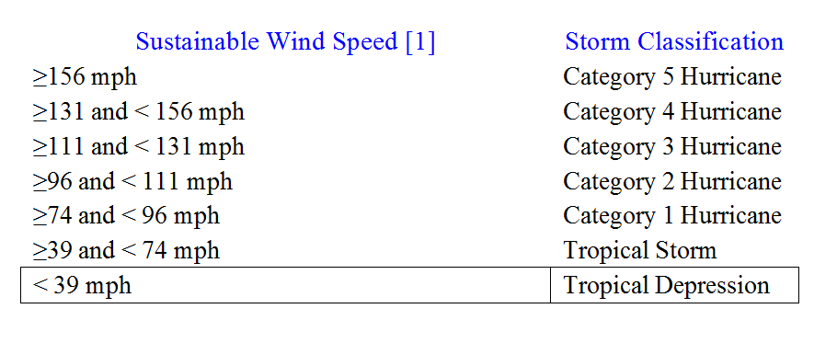
Practice 5: Storm Classification
Tropical storms are classified according to the speed of their sustainable winds as follows:
[1] Sustainable wind speed: average wind speed measured over a period of 1minute at 33 ft above the surface.
Write a class StormClassification to prompt the user for wind speed and outputs the correct category.

Slide 31
Practice 6
Let x be an int variable.
Write an if-else (or switch) statement to output “EVEN” if x is even and “ODD” if x is odd.
You may not use any variable assignments.

