Slide 1


Traffic Sign Recognition with CNN & Keras: A Deep Learning Approach
Team: 0_Confidence
Presentation Prepared By
Taki Tamim (2003002)
Tonmoy (2003027)
Md Abu Sufyan (2003085)

Slide 2
Introduction
🚗 Introduction
A crucial component of Autonomous Vehicles & ADAS.
Enhances road safety by automatically detecting & interpreting traffic signs.
🧠 Deep Learning Approach
Uses Convolutional Neural Networks (CNNs) & ResNet50.
Implemented with Keras for high accuracy.
🔧 Project Features
Real-time detection from webcam/phone cam/video.
Recognizes traffic signs using a trained model.
Provides voice output for detected signs.

Slide 3
Project Overview
GitHub
📂 Dataset:
German Traffic Sign Recognition Benchmark (GTSRB)
🔢 Classification:
43 different classes of traffic signs
🛠 Framework:
TensorFlow & Keras for model development
🧠 Approach:
CNN & ResNet50 for feature extraction & classification
🔊 Goal: Accurate & real-time traffic sign recognition with voice output!

Slide 4
Dataset Overview: GTSRB 🚦
50,000+ Images of diverse traffic signs
43 Sign Classes (e.g., Speed Limits, Stop, No Entry)
Real-World Challenges: 🌧 Weather Effects 👀 Occlusion 📐 Viewpoint Variations
Images in Various Sizes & Lighting Conditions
Data Split into: 🏋 Training Set 📊 Validation Set 🧑‍🏫 Test Set

Slide 5
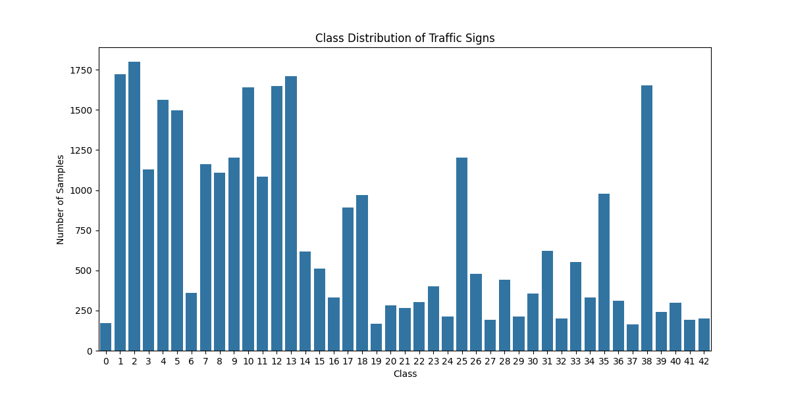
Exploratory Data Analysis
Class Distribution: 📊 Imbalanced representation across classes
Visualization: 🖼 Sample images from each class to understand variability
Data Insights: 🧠 Inform preprocessing decisions (e.g., balancing, augmentation)

Slide 6
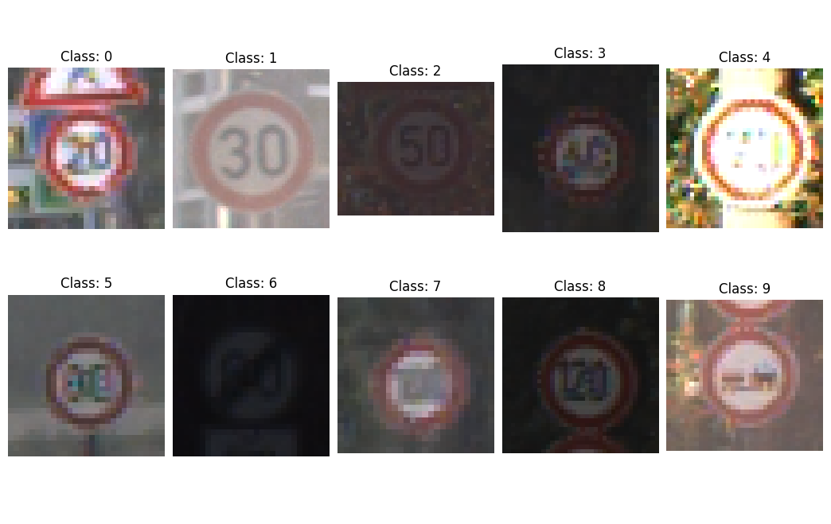
Sample Images Visualization 🖼️
Understanding Dataset Diversity: 🌟 Varied illumination, perspective, and quality
Challenges for Model Training: 🔍 Variability in image conditions creates difficulties for accurate classification
Key Insight: 🔧 Helps identify preprocessing and augmentation needs to improve model robustness

Slide 7
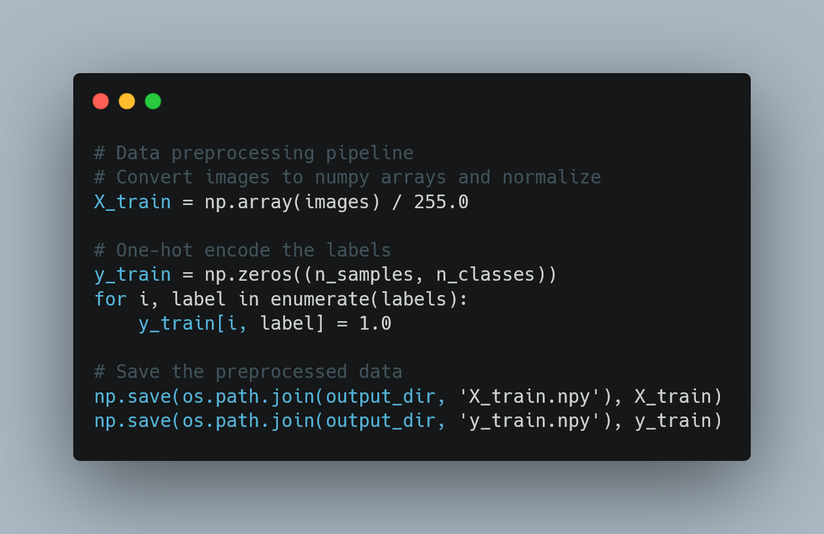
Data Preprocessing Strategy
Image Resizing: 🔄 All images resized to 30×30 pixels for uniform input
Normalization: 🌈 Pixel values scaled to [0, 1] range
Label Encoding: 🔢 One-hot encoding for multi-class classification
Train-Test Split: 📊 Data divided for training and evaluation
Data Augmentation (Optional): 🔄 To address class imbalance

Slide 8
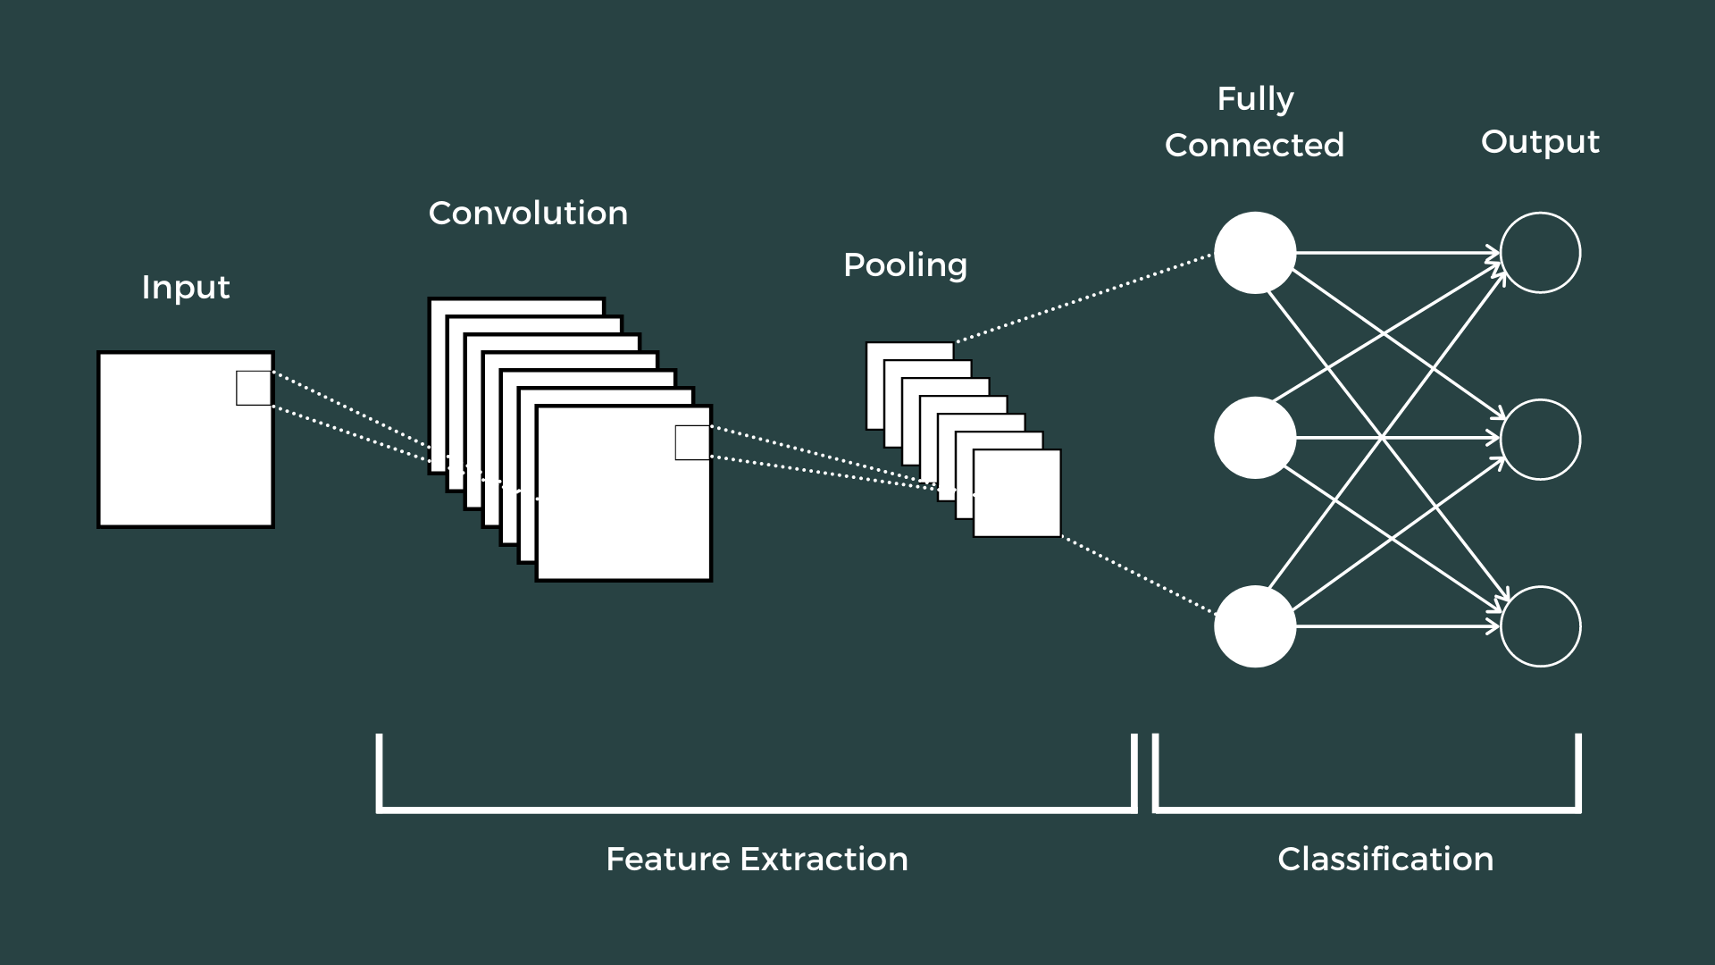
CNN Architecture Overview
CNN Architecture Overview 🧠
Convolutional Neural Networks (CNNs) are perfect for image classification.
Architecture Components:
Convolutional Layers: 🔍 Feature extraction from images
Pooling Layers: 📉 Dimensionality reduction for efficiency
Dropout Layers: 🚫 Regularization to prevent overfitting
Dense Layers: 🏷️ Final classification based on extracted features

Slide 9
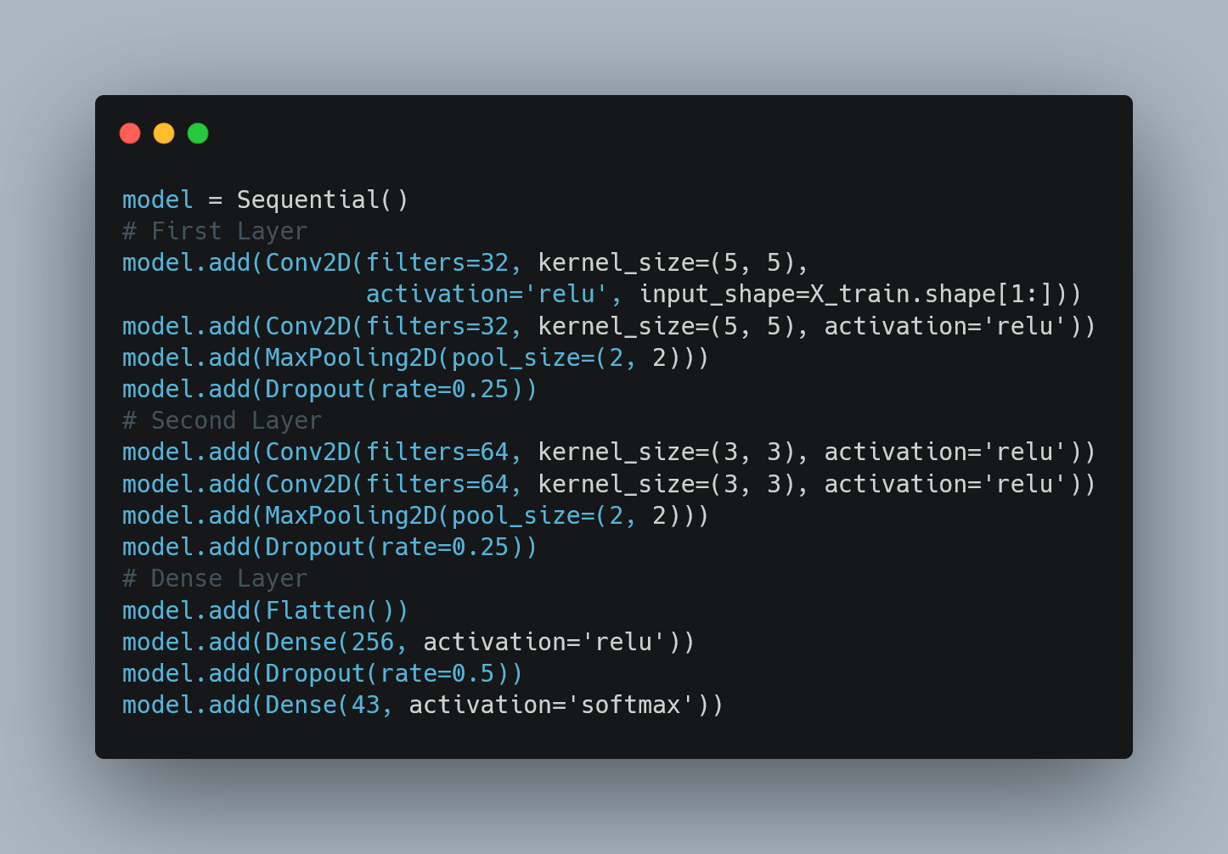
Model Architecture Implementation

Slide 10
Architectural Design Choices
Output Layer
43 neurons with Softmax activation for multi-class probability prediction.
Convolutional Layers
Two blocks with increasing filter sizes (32 → 64).
Smaller kernel sizes in deeper layers (5×5 → 3×3).
ReLU activation for introducing non-linearity.
Regularization Strategy
Dropout layers with varying rates:
0.25 in convolutional blocks.
0.5 in dense layers.
MaxPooling for spatial downsampling and parameter reduction.
Output Layer: 43 neurons with SoftMax activation for multi-class probabilities

Slide 11
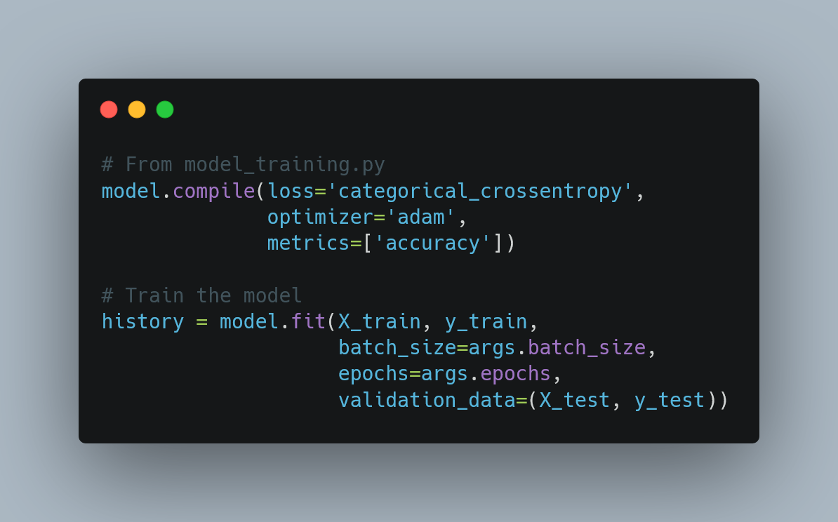
Model Training Configuration ⚙️
Model Training Configuration ⚙️
Loss Function: 🧮 Categorical Cross-Entropy (for multi-class classification)
Optimizer: ⚡ Adam (adaptive learning rate for faster convergence)
Metrics: 📊 Accuracy (to monitor model performance)
Batch Size: 🍽️ 64 (default)
Epochs: 🔄 20 (default, configurable via command line)

Slide 12
Model Training Workflow 🏋️‍♀️
Load Data: 📂 Load preprocessed data from NumPy arrays
Build Model: 🧑‍💻 Construct the CNN model architecture
Configure Training: ⚙️ Set up training parameters (loss function, optimizer, etc.)
Train with Validation: 🎯 Monitor training with validation data to prevent overfitting
Save Best Model: 💾 Store the best performing model and training history

Slide 13
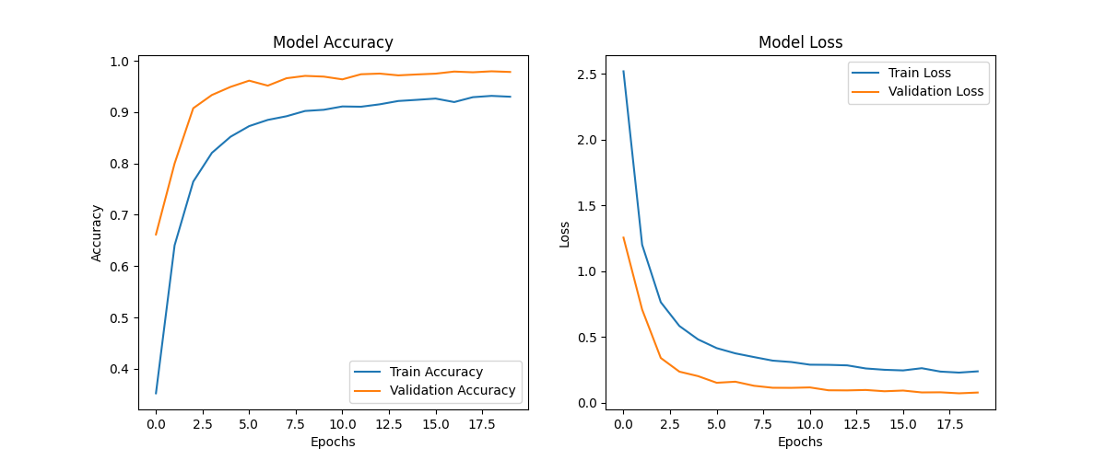
Model Evaluation Metrics 📊
Model Evaluation Metrics 📊
Loss: 📉 Measures how far predictions deviate from actual labels
Accuracy: ✅ Percentage of correctly classified signs
Training vs. Validation: 🔍 Monitors for overfitting by comparing training and validation performance
Confusion Matrix: ❌ (Not implemented, but a valuable addition) to evaluate true vs. predicted labels
Class-specific Performance: 📊 Analyzes accuracy per class to identify areas of improvement

Slide 14
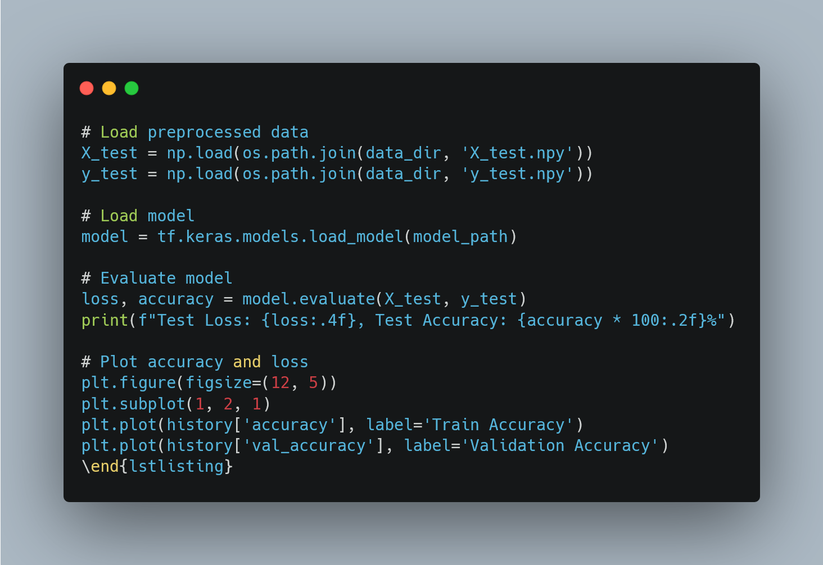
Evaluation Implementation
Convergence: 📊 Indicates if the model is learning effectively (i.e., loss decreases, accuracy increases).
Overfitting: ⚠️ Detects if there’s a gap between training and validation performance (training accuracy high, validation accuracy low).
Early Stopping Points: ⏸️ Identifies when improvement plateaus, helping decide when to stop training to avoid overfitting.

Slide 15
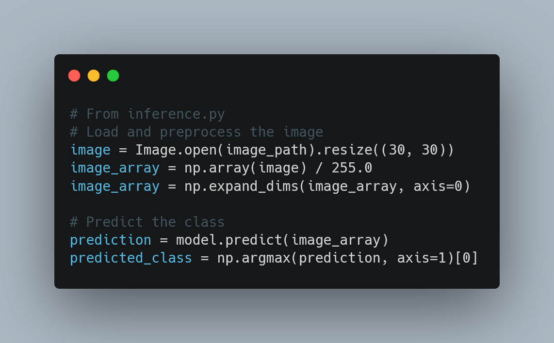
Inference Pipeline with Real-Time Features 🧑‍💻
Standalone Inference Module: 🔍 Tests single images for traffic sign recognition
Real-Time Features Added: 📷 Webcam, 🎥 Real-time video, 📱 Phone camera for real-time sign detection & identification
Consistent Preprocessing: 🔄 Applies the same preprocessing steps as during training for accurate results

Slide 16
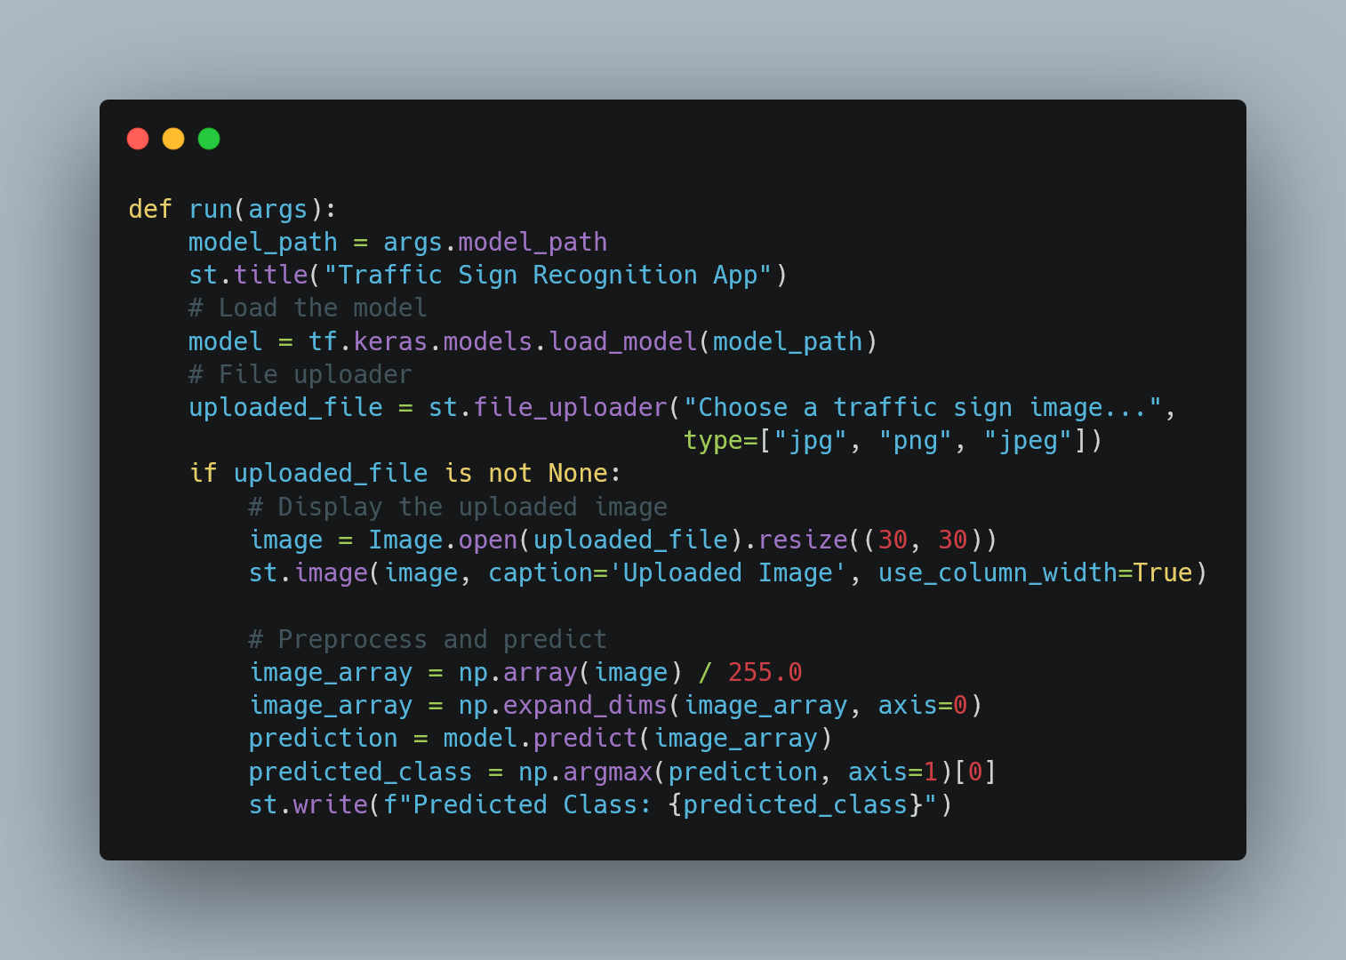
Streamlit Web Application

Slide 17
User Interface Features
Core Features:
Real-time sign recognition using webcam, phone camera, or video input.
Preprocessing and inference in real-time for accurate detection.
Immediate display of recognized signs with identified class labels.
User-friendly interface for seamless interaction.
Potential Enhancements:
Class descriptions instead of just numerical labels.
Confidence scores for predictions to indicate reliability.
Multiple prediction options to improve flexibility.
Enhanced frontend design for better user experience.

Slide 18
Complete Project Pipeline 🚀
Data Collection: 📂 Using the GTSRB dataset for traffic sign images
Exploratory Data Analysis (EDA): 🔍 Understanding data characteristics (e.g., class distribution, image variations)
Data Preprocessing: 🔄 Resizing, normalization, and label encoding for consistency
Model Development: 🧠 Designing CNN architecture with MobileNetV2 for efficient feature extraction
Model Training: ⚙️ Parameter optimization and validation to improve accuracy Model Evaluation: 📊 Performance assessment using metrics like accuracy, loss, and confusion matrix Inference: 🌐 Real-world testing with webcam, phone camera, and video inputs Application Development: 💻 Creating a user interface for easy interaction and real-time sign detection

Slide 19
Conclusion
Project Overview: 🚗 Traffic Sign Recognition using Deep Learning (CNN & MobileNetV2) 📊 GTSRB Dataset for classifying 43 different traffic signs in real-time
Key Features: 📷 Real-time detection via webcam, phone camera, and video inputs 🧠 Model Development: CNN architecture, MobileNetV2 for efficient feature extraction 🔄 Consistent Preprocessing: Resizing, normalization, and encoding for uniform input
Real-World Impact: 🛣️ Enhancing driver assistance systems and autonomous vehicles with robust traffic sign detection

Slide 20
Thank You 🙏
Thank You for your attention! 🌟 Any Questions? 🤔

