Slide 1
Microcontroller Assembly
Call Instructions and stack
By Anika-2003022

Slide 2
Call Instruction
Used to call a subroutine (A group of instructions need to be called
frequently)
In AVR, the instructions to call subroutine is as below:
CALL- long call
RCALL- Relative call
ICALL- Indirect call to Z
EICALL- Subroutine Return

Slide 3
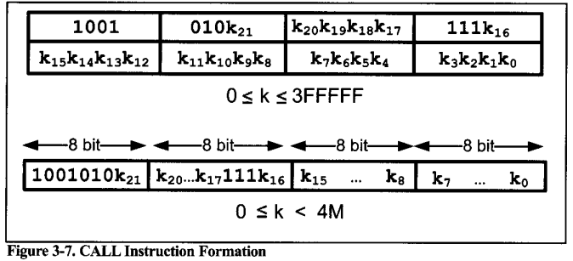
It is used to call subroutine
located anywhere within the
4M address space of 000000
to 3FFFFF
For Atmega 32 it is from
0000 to 3FFF

Slide 4
Stack
The stack operates on the Last In, First Out (LIFO))
The stack is a section of RAM used by the CPU to store information temporarily.
Information could be data or address.
Because there are only a limited number of registers we need to use portion of a RAM for storing extra data or address.

Slide 5
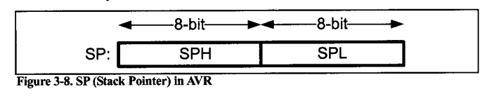
Stack Pointer in AVR
In I/O memory space, there are two registers:
1.SPL(the low byte of the SP)
2.SPH(the high byte of the SP)

Slide 6
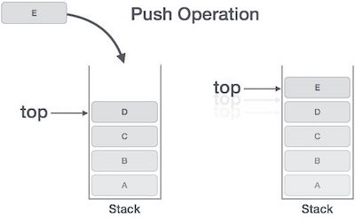
Pushing onto stack
The storing of CPU information
such as the program counter on
the stack is called a PUSH
To push a register onto the stack we
use the PUSH instruction:
This Photo by Unknown Author is licensed under CC BY-SA
PUSH R10 ;store r10 onto stack and decrement SP

Slide 7
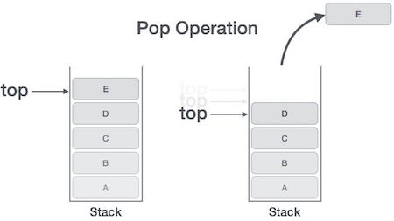
Popping from the stack
The loading of stack contents back
into a CPU register is called a POP
To retrieve a byte of a data back from
a stack we use the POP instruction:
This Photo by Unknown Author is licensed under CC BY-SA
POP R16 ;increment SP and then load the top of stack to R10

Slide 8
Initializing The Stack Pointer
To initialize the SP, load
The high byte of RAMEND into SPH and
The low byte of RAMEND into SPL.
; AVR Assembly Code to Initialize Stack Pointer LDI R16, HIGH(RAMEND) ; Load high byte of RAMEND into register R16 OUT SPH, R16 ; Set SPH to the high byte of RAMEND LDI R16, LOW(RAMEND) ; Load low byte of RAMEND into register R16 OUT SPL, R16 ; Set SPL to the low byte of RAMEND

Slide 9
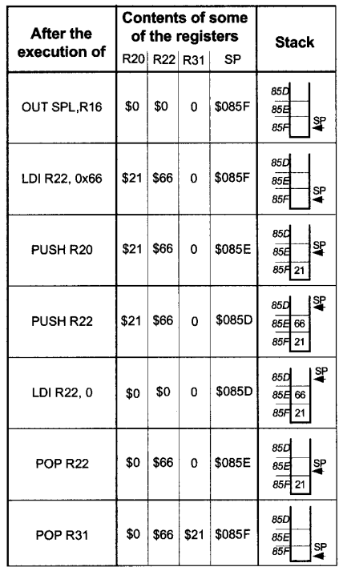
Example:
. INCLUDE "M32DEF. INC"
.ORG 0
LDI R16, HIGH (RAMEND)
OUT SPH, R16
LDI R16, LOW (RAMEND)
OUT SPL, R16
LDI R31,0
LDI R20, 0x21
LDI R22, 0x66
PUSH R20
PUSH R22
LDI R20,0
LDI R22,0
POP R22
POP R31

Slide 10
CALL & RET Instruction
1. CALL Instruction
Usage: Initiates a subroutine call, transferring
control to a specified subroutine.
Format: CALL Target_Subroutine_Address
Effect on Stack:
Pushes the return address onto the stack.
Updates the Stack Pointer (SP).
2. RET Instruction
Usage: Returns from a subroutine, resuming
execution from the saved return address.
Format: RET
Effect on Stack:
Pops the return address from the stack.
Updates the Stack Pointer (SP).
; Example Subroutine Call and Return Main: CALL MySubroutine ; Call subroutine ; Continue with the main program ... MySubroutine: ; Subroutine code here ... RET ; Return from subroutine

Slide 11
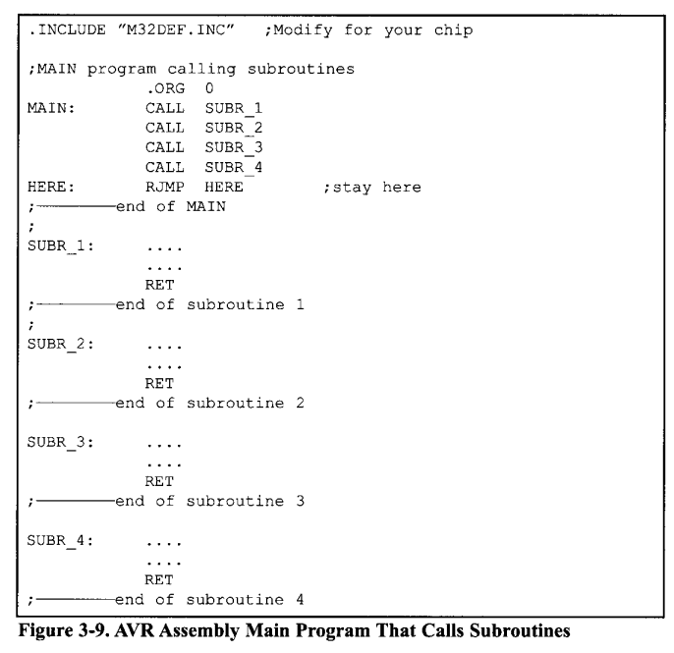
Calling many
subroutines
from the main
program

Slide 12
RCALL Instruction
RCALL is a 2-byte instruction.
Main: RCALL Near_Subroutine ; Relative call to a nearby subroutine ; Continue with the main program ... Near_Subroutine: ; Subroutine code here ... RET ; Return from subroutine
Uses 12 bits for the address
within the 2-byte instruction.
Target address range: -2048 to
+2047 words relative.
The target address for CALL can be anywhere within 4M address space of
the AVR whileThe target address of RCALL must be within a 4k range.

Slide 13
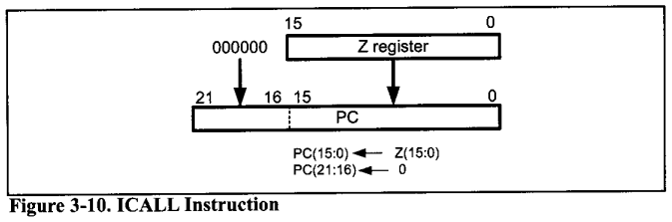
ICALL Instruction
Indirect call of a subroutine
pointed to by the Z pointer
(16bit) register .
Main: ; Load target address into Z register ldi ZH, high(Target_Subroutine) ldi ZL, low(Target_Subroutine) ; Indirect call using ICALL ICALL ; Continue with the main program ... Target_Subroutine: ; Subroutine code here ... RET ; Return from subroutine
‘ICALL’ doesn’t automatically
manage the stack for return
addresses.

Slide 14
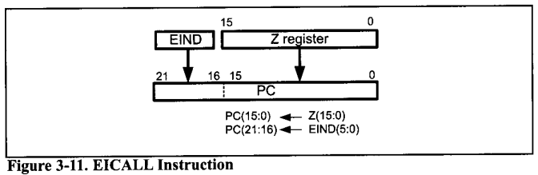
EICALL Instruction
Extended Indirect CALL
In the AVRs with more than
64k words of program memory,
the EICALL instruction is available.
The EICALL loads the Z register
into the lower 16 bits of the pc and
the EIND register into the upper 6
bits of the pc.

