Slide 1
Topic: Program Counter and Program ROM Space in Microcontroller
Prepared by Md. Al-zami ashraf - 2003024

Slide 2
Program Counter in Microcontroller
An important internal register.
Used to point to the address of the next instruction to be executed.
As CPU fetches the opcode from the program ROM, the program counter is incremented automatically to point to the next instruction.
The wider the program counter, more the memory locations a CPU can access. For example: 16-bit program counter has in total 2¹⁶= 64K locations
Minimum address: 0000 0000 0000 0000B= 0000H
Maximum address: 1111 1111 1111 1111B= FFFFH
Each memory location can carry 2 bytes.

Slide 3
Table: Microcontroller On-chip ROM Size and Address Space
 | On-chip Code ROM (Bytes) | Code Address Range (Hex) | ROM Organization
ATtiny25 | 2K | 00000-003FF | 1K*2 bytes
ATmega8 | 8K | 00000-00FFF | 4K*2 bytes
ATmega32 | 32K | 00000-03FFF | 16K*2 bytes
ATmega64 | 64K | 00000-07FFF | 32K*2 bytes
ATmega128 | 128K | 00000-0FFFF | 64K*2 bytes
ATmega256 | 256K | 00000-1FFFF | 128K*2 bytes

Slide 4
Where the microcontroller wakes up when it is powered up
In the case of the microcontroller(that is, all members regardless of the family and variation), the microcontroller wakes up at memory address 0000 when it is powered. By powering up it is meant that V_{CC} is applied to the RESET pin.
In other words, when the microcontroller is powered up, the program counter has the value of 0000 in it. This means that it expects the first opcode to be stored at ROM address $00000. For this reason, in the microcontroller system, the first must be burned into memory location $00000 of program ROM because this is where it looks for the first instruction when it is booted.

Slide 5
Placing code in program ROM
The list file of a sample program is examined and showed how the code is placed into the Flash ROM of the AVR chip. The opcode and the operand for each instruction are listed on the left side of the list file.
After the program is burned into ROM of an
AVR family member such as ATmega32 or
ATtiny11, the opcode and operand are placed
in ROM memory locations starting at 0000.
The list shows that address 0000 contains
E205, which is the opcode for moving a value
in R16, and the operand to be moved to R16.
Therefore, the instruction “LDI R16, 0X25” has a
machine code of “E205”, where E is the opcode
and 205 is the operand.
;AVR Assembly Language Program to Add Some Data
;store SUM in SRAM location 0x300
.EQU SUM = 0X300 ;SRAM loc $300 for SUM
.ORG 00 ;start at address 0
LDI R16, 0x25 ;R16= 0x25
LDI R17, $34 ;R17= 0x34
LDI R18, 0B00110001 ;R18= 0x31
ADD R16, R17 ;add R17 to R16
ADD R16, R18 ;add R18 to R16
LDI R17, 11 ;R17= 0x0B
ADD R16, R17 ;add R17 to R16
STS SUM, R16 ;save the SUM in loc $300
HERE: JMP HERE ;stay here forever

Slide 6
LDI Rd, k 16<=d<=31, 0<=K<=255
LDI Rd, k₁k₀ | LDI R16, 0x25
LDI R17, 0x34 | LDI R18, 0x31
1 1 1 0 | k k k k | d d d d | k k k k
E k₁ | D k₀
E 2 | 0 5
Figure 1: The machine code for instruction “LDI Rd, k” in binary
E 3 | 1 4
E 3 | 2 1
Figure 2: The machine code for instruction “LDI Rd, k” in Hex
ADD Rd, Rr 0<=d<=31, 0<=r<=31
ADD R16, R17 | ADD R16, R18
0 0 0 0 | 1 1 r d | d d d d | r r r r
0 F | 0 1
0 F | 0 2
Figure 3: The machine code for instruction “ADD Rd, Rd” in binary
Figure 4: The machine code for “ADD Rd, Rr” in Hex
Similarly, the machine code “E314” is located in ROM memory location 0001 and represents the opcode and the operands of the instruction “LDI R17, $34”. In the same way, machine code “E321” is located in memory location 0002 and represents the opcode and the operand for the instruction “LDI R18, 0b00110001”. The memory location 0003 has the machine code o 0F01, which is the opcode and the operands for the instruction “ADD R16, R17”. Similarly, the machine code “0F02” is located in memory location 0004 and represents the opcode and the operands for the instruction “ADD R16, R18”.

Slide 7
The memory location 0005 has the opcode and the operand for the “LDI R17, 11” instruction.
The memory location 0006 has the opcode and the operand for the “ADD R16, R17” instruction.
The opcode for instruction “STS SUM, R16” is located at address 00007 and its address 0x300 at address 00008.
The opcode for “JMP HERE” and its target address are located in locations 00009 and 0000A.
While all the instructions in this program are 2-byte instructions, the JMP and STS instructions are 4 byte instructions.

Slide 8
Executing a program instruction by instruction
When the AVR is powered up, the program counter has 00000 and starts to fetch the first instruction from location 00000 of the program ROM. In the case of the above program the first code is E205, which is the code for moving operand 0x25 to R16. upon executing the code, the CPU places the value of 25 in R16. Now one instruction is finished. Then program counter is incremented to point 00001, which contains code E324, the machine code for the instruction “LDI R17, 0x34”.
Upon executing the machine code E314, the value 0x34 is loaded to R17. Then the program counter is incremented to 0002.
ROM location 0002 has the machine code for instruction “LDI R18, 0x32”. This instruction is executed and now program counter= 0003.
This process goes on until all the instructions up to “ADD R16, R17” are fetched and executed.
Now PC= 0007 points to the next instruction, which is “STS SUM, R16”. When the instruction is executed, the content of R16 is stored into memory location 0x300. After the execution of this instruction, PC = 0009.
Now PC = 0009 points to the next instruction, which is “JMP HERE”. After the execution of this instruction, PC = 0009. This keeps the program in an infinite loop. The fact that the program counter points at the next instruction to be executed explains why some microprocessors (notably the x86) call the program counter the instruction pointer.

Slide 9
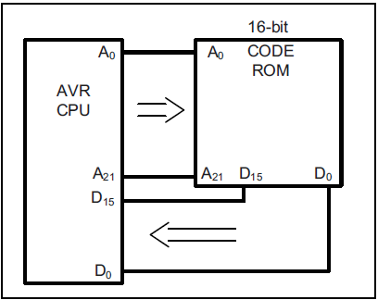
ROM width in the AVR
Each location of the address space holds two bytes (a word). If we have 16 address lines, this will give us 2¹⁶ locations, which is 64K of memory location with an address map of 0000–FFFFH. To bring in more information (code or data) into the CPU, AVR increased the width of the data bus to 16 bits. In other words, the AVR is word-addressable. In a sense, the data bus is like traffic lanes
on the highway where each lane is 8 bits wide. The more lanes, the more
information we can bring into the CPU for processing. For the AVR, the internal
data bus between the code ROM and the CPU is 16 bits wide, as shown in the
figure. Therefore, the 64K ROM space is shown as 32K × 16 using a 16-bit word
data size. The same rule applies to the entire program address space of AVR,
which is 8M, organized as 4M × 16.
Figure: Program ROM width for the AVR

Slide 10
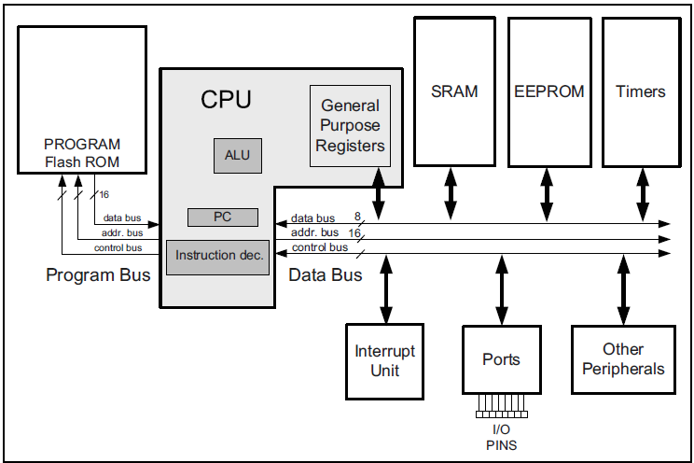
Harvard architecture in the AVR
Figure: Harvard Architecture in the AVR

Slide 11
Instruction size of the AVR
LDI instruction formation The LDI is a 2-byte (16-bit) instruction. Of the 16 bits, the first 4 bits are set aside for the opcode, the second and the fourth 4 bits are used for the value of 00 to $FF, and the third 4 bits present the destination register. This is shown below.
ADD instruction formation
The ADD is a 2-byte (16-bit) instruction. Of the 16 bits, the first 6 bits are set aside for the opcode, and the other 10 bits represent the source and the destination registers. This is shown below.
LDI Rd, K ;load register Rd with value K 16<=d<=31, 0<=K<=255
ADD Rd, Rr ;add Rd to Rr 0<=d<=31, 0<=r<=31
1 1 1 0 | K K K K | d d d d | K K K K
0 0 0 0 | 1 1 r d | d d d d | r r r r
STS instruction formation
The STS is a 4-byte (32-bit) instruction. Of the 32 bits, the first 16 bits are set aside for the opcode and the address of the source, and the other 16 bits are used for the address of the destination. This is shown below.
LDS instruction formation
The LDS is a 4-byte (32-bit) instruction. Of the 32 bits, the first 16 bits are set aside for the opcode and the destination register, and the other 16 bits are used for the address of the source memory location. This is shown below.
STS k, Rr ; store register Rr in memory location k 0<=r<=31, 0<=k<=65535
LDS Rd, k ;Load from memory location k to register Rd 0<=d<=31, 0<=k<=65535
1 0 0 1 | 0 0 1 r | r r r r | 0 0 0 0
k k k k | k k k k | k k k k | k k k k
1 0 0 1 | 0 0 0 d | d d d d | 0 0 0 0
k k k k | k k k k | k k k k | k k k k

Slide 12
Instruction size of the AVR
IN instruction formation
The IN is a 2-byte (16-bit) instruction. Of the 16 bits, the first 5 bits are set aside for the opcode, and the other 11 bits are used for the address of the source memory location, and destination register. This is shown below.
OUT instruction formation
The OUT is a 2-byte (16-bit) instruction. Of the 16 bits, the first 5 bits are set aside for the opcode, and the other 11 bits are used for the address of the source memory location and destination register. This is shown below.
IN Rd, A ;load from Address A of I/O memory into register Rd 0<=d<=31, 0<=A<=63
OUT A, Rr ;Store register Rr in I/O memory location A 0<=d<=31, 0<=A<=63
1 0 1 1 | 0 A A d | d d d d | A A A A
1 0 1 1 | 1 A A r | r r r r | A A A A
JMP instruction formation
The JMP is a 4-byte (32-bit) instruction. Of the 32 bits, only 10 bits are set aside for the opcode, and the rest (22 bits) are used for the target address of the JMP. This is shown below. The 22-bit address gives us 4M of address space; so, it can address all of the ROM space.
JMP k ;Jump to address k 0<=k<=4M
1 0 0 1 | 0 1 0 k | k k k k | 1 1 0 k
k k k k | k k k k | k k k k | k k k k

