Slide 1
Topic 2. Microcontroller Architecture & General-Purpose Registers in Microcontroller
Presented By,
Farzana Haider
Roll:2003026
Section: A
CSE 20

Slide 2
AVR uses Harvard Architecture.
There are separate buses for the separated code and the data memory.
The Program Bus provides access to the Program Flash ROM whereas the Data Bus brings data to the CPU.
This allows the AVR microcontroller to fetch instructions and data simultaneously, improving efficiency and performance in certain applications.

Slide 3
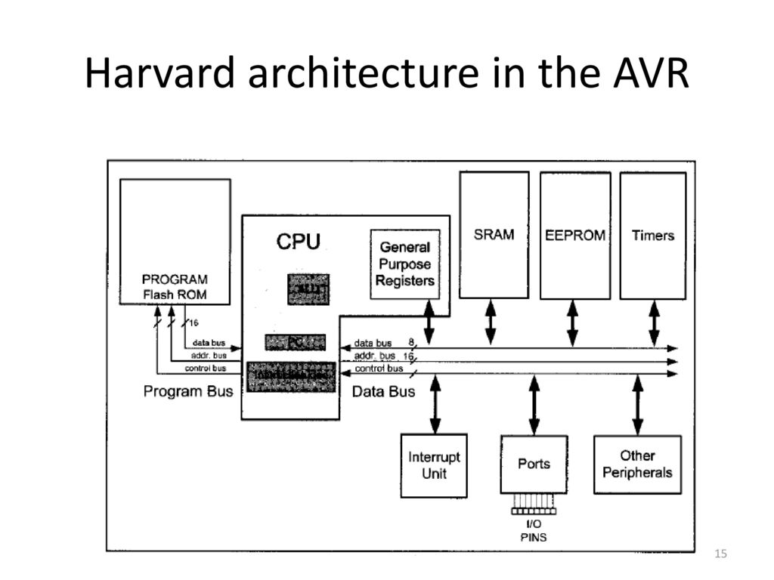
ALU
PC
Instruction Decoder

Slide 4
The General Purpose registers
In the CPU, registers are used to store information temporarily.
That information could be a byte of data to be processed or an address pointing to the data to be fetched.
In AVR there are 32 general purpose registers. They are R0 to R31 and are located in the lowest location of a memory address. All of these are 8 bits.
The 8 bits of a register
They can be used by all arithmetic and logic instruction.
R0
R1
R2
.
.
R14
R15
R16
R17
R18
.
.
R30
R31
D7 D6 D5 D4 D3 D2 D1 D0
MSB
LSB

Slide 5
example
To understand the use of general purpose registers, we will show it in the context of two simple instructions: LDI and ADD
LDI instruction:
The LDI instruction copies 8-bit data into the general purpose registers.
LDI Rd, K ;load Rd (destination) with immediate value K
;d must be between 16 and 31
K is an 8-bit value that can be 0-255 in decimal or 00 to FF in hex and Rd is R16 to R31.
The following instruction loads the R20 register with the value 0x25 (25 in hex)
LDI R20, 0x25 ; R20 = 0x25

Slide 6
Add instruction:
The ADD instruction has the following formal:
ADD Rd, Rr ; Add Rr to Rd and store the result to Rd
The add instruction tells the CPU to add the value of Rr to Rd and put the result into the Rd register.
To add two numbers such as 0x25 and 0x34, one can do the following:
LDI R16, 0x25
LDI R17, 0x34
ADD R16,R17
Executing above line results in R16 = 0x59 (0x25 + 0x34 = 0x59)

Slide 8
THANK YOU

